Slide 1
Tweet – word counter
CS220 parallel and high performance computing
Levon Avetisyan
Grigor Nalbandyan
Lilit Harutyunyan
Nelli Aghajanyan
Arsen Ignatosyan
Artyom Hakobyan

Slide 2
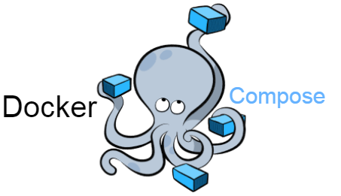




Work separation

Slide 4

Planning poker
Python
Linux Configuration
Presentation
Kafka
Github
Docker
Docker Compose
2
5
1
3
8
13

Slide 5
Twitter API
Producer
Consumer
Topic
Kafka Server
Zookeeper
Docker

Slide 6
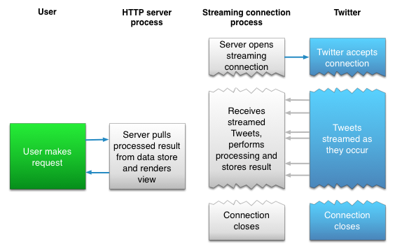
Twitter api
Authorization keys
Python Library
Streaming

Slide 7
Kafka
Distributed streaming platform
Publish, subscribe / store / process
Producer – publish a stream of records to kafka topic(s)
Consumer – subscribe to topic(s), process the stream of records

Slide 8
Docker / docker-compose
Kafka image
Docker Hub
YML file

Slide 9
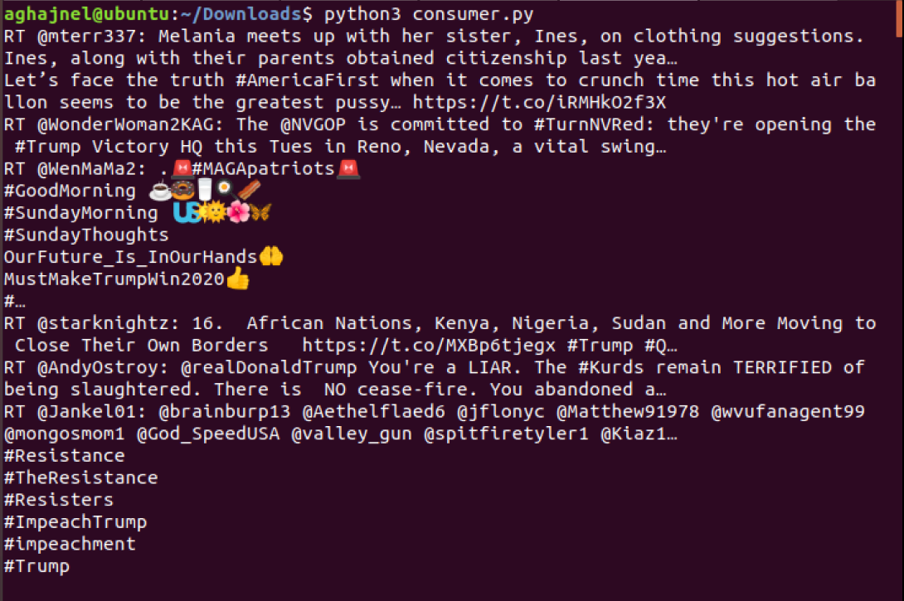

Slide 10
Challenges we faced

Slide 11

Future Possible Developments

Slide 12
Libraries and Documentation
Tweepy Library (Python)
Kafka (Python)
https://www.digitalocean.com/community/tutorials/docker-ubuntu-18-04-1-ru
https://hub.docker.com/
https://docs.docker.com/compose/install/
https://medium.com/big-data-engineering/hello-kafka-world-the-complete-guide-to-kafka-with-docker-and-python-f788e2588cfc
https://tecadmin.net/install-apache-kafka-ubuntu/?fbclid=IwAR1CLkLGLQnrKjVGHFSC5WT5FdNhqzoaFzmOjtIsbeBHRd0x3IYiZVvH6FY

