Slide 1
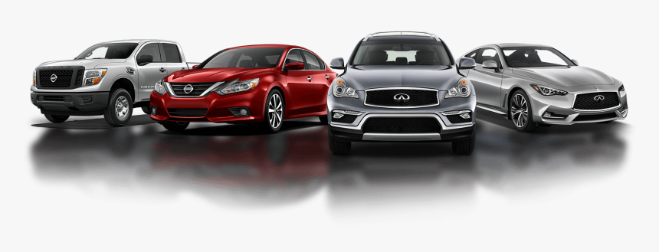
CARS MODELS

Slide 2
CONTENTS
Abstract
Introduction
Home Page Design
Explore Cars
Contact Us
Reviews
Conclusion
1
2
3
4
5
6
7

Slide 3
ABSTRACT
→Since the start of the twentieth century, the role of cars has become highly important, though controversial.
→ They are used throughout the world and have become the most popular mode of transport in many of the more developed countries.
In developing countries, the effects of the car on society are not as visible, however they are nonetheless significant.

Slide 4
INTRODUCTION
In this website here is the complete information of cars and from this cars models website we all can know what are the different types and what are the brands of cars.
Now a days cars are very important as we need the transport to go where ever you want.
→So this website is completely based on the popular brands of cars used now a days.

Slide 5
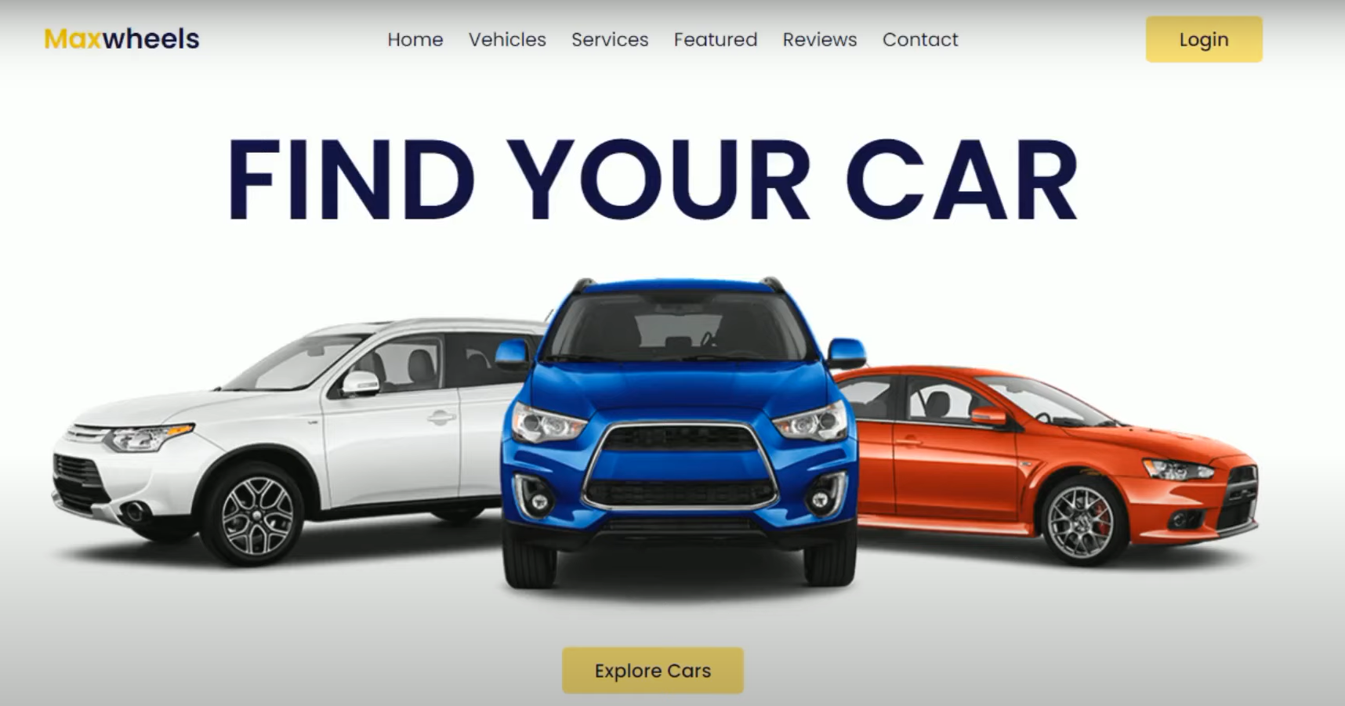
HOME PAGE DESIGN

Slide 6
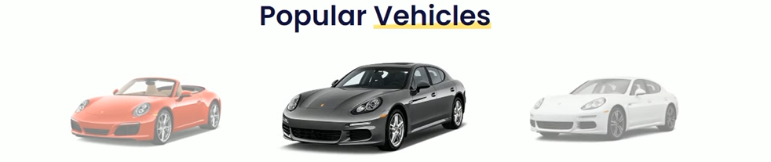
EXPLORE CARS

Slide 7

LAKIREDDY BALIREDDY COLLEGE OF ENGINEERING
PRESENTED BY:
Nelli Reshma
CSE Department
20761A05A8
UNDER THE GUIDANCE OF:
MS.K.DeviPriya(Sr.Asst Professor)

Slide 8

THANK YOU

