Slide 1
CI/CD
Cross Account / self-deployment
Nelli Lovchikova
29/04/2021

Slide 2
Motivation
Security Boundaries
Multiple environments for multiple purposes
Protect Personal Identifiable Information

Slide 3
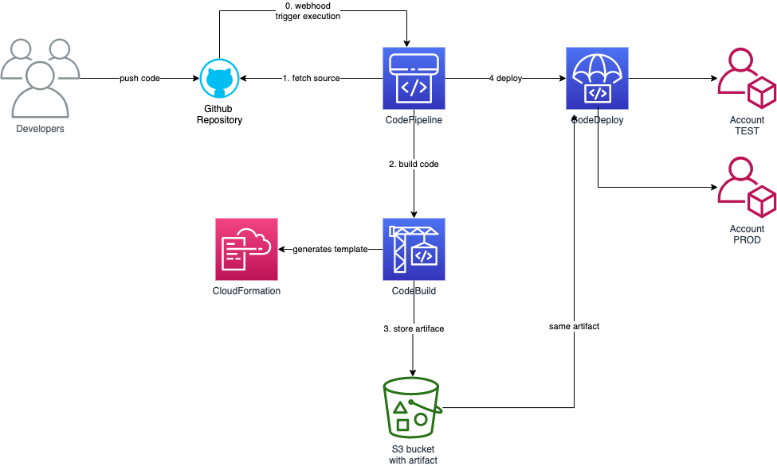
Architecture

Slide 4
Limitations
No context queries: context queries are not supported. That means that Vpc.fromLookup() and other functions like it will not work
Current approach is easy to build, however it is not very flexible.
It built by AWS team according with the best practices

Slide 5
Questions

