Slide 1
CI/CD
Cross Account / self-deployment
Nelli Lovchikova
17/06/2021
Notes:
I’m going to demonstrate CI/CD pipeline that builds a simple application and deploys it into different environment. It also updates self-mutating, meaning if I do a change it is going to update and restart itself.

Slide 2
Motivation
Security Boundaries
Multiple environments for multiple purposes
Protect Personal Identifiable Information
Notes:
Why do we have different environments or accounts? Accounts help to establish natural boundaries for security, access and billing. For example developers have full access to dev environment where they can experiment and innovate fast. However, for staging environment developers would have only readonly access so they cannot really temper with infrastructure and it remains prod like for better behavioural predictability. And nobody should have access to prod account, so developers not compromise living system and also do not have access to for example Personal Identifiable or Sensitive Information.

Slide 3
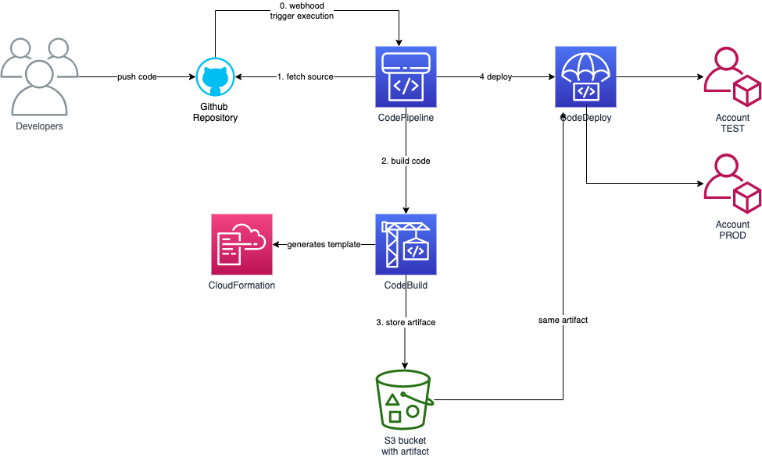
Architecture
Notes:
Here, hos it is going to work. Developers committing code, this action triggers Orcestrration service, codePipeline. That is going to grab a source from GitHub, then trigger CodeBuild. Codebuild is going to compile atrtifacts. In our case it is a cloudFromation templates, one for pileine itself and one for application a lambda code. The result of this operation is stored in S3 and linked to this particaul build. This is important part, because we are going to deploy the same build into different enviromens to achieve consistency. So after we have this build it is going to deploy itself and in case of changes the build process is going to restart, then we can start deployeing actual application, first it is going to be deployed in test account. Potentially we can add integration testing or manual approval. And the next it is going to deploy into prod account.
Let me show you around.

Slide 4
Limitations
No context queries: context queries are not supported. That means that Vpc.fromLookup() and other functions like it will not work
Current approach is easy to use.
It built by AWS team according with the best practices.

Slide 5
Questions

