Slide 1

SQL to SparkQL
Continue the Development of SQL to SPARQL translation on Jyphon
University of Texas
Database Management
Professor Cannata (Oracle Engineer)
Nelma Perera Rodriguez, Semur Nabiev, Marek Bejda

Slide 2

Building Instructions
ant clean
move dist to the trash
ant
ant
sudo dist/bin/jython >> conn = connectTo 'jdbc:oracle:thin:@129.152.144.84/PDB1.usuniversi01134.oraclecloud.internal' 'cs370_ontologies' 'orcl' 'rdf_mode' 'emp'; >> SQL on conn 'select * from emp'

Slide 3

How it is working?
After the SQL query is wrote, it is evaluated and send it to the SQL Server hosting the database,
In PyTuple.doRDF: if (statement instanceof Select), call SQLVisitor.getSelect
In SQLVisitor.getSelect, somehow gets to visit, which calls visitSelect_buildSPARQL
visitSelect_buildSPARQL returns the SPARQL statement to SQLVisitor.getSelect with the help of jsqlparser that convert SQL statements grammar to SPARQL grammar ( we don't need to write code to check for key words or parse the statement. That work is done by the jsqlparser)
SQLVisitor.getSelect returns the SPARQL to PyTuple
PyTuple.doRDF then calls runAndOutputTuples, which calls conn.executeQuery(ReLstmt) and the results from this are processed and stored in the results field of PyTuple

Slide 4
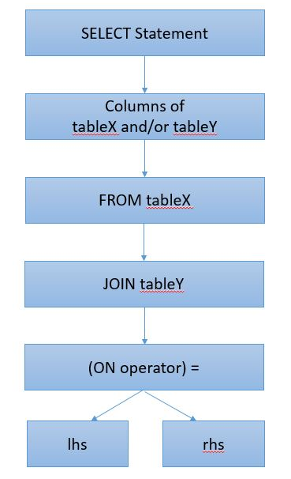
Actual Visitor Design Pattern

Slide 5
Example without subqueries
SQL:
SELECT * FROM emp;
SPARQL:
SELECT v1 "empno", v2 "deptno", v3 "comm", v4 "job", v5 "mgr", v6 "ename",
v7 "hiredate", v8 "sal", v9 "dept"
FROM TABLE(SEM_MATCH('SELECT * WHERE {
GRAPH { ?s1 rdf:type :emp }
OPTIONAL { ?s1 :empno ?v1 }
OPTIONAL { ?s1 :deptno ?v2 }
OPTIONAL { ?s1 :comm ?v3 }
OPTIONAL { ?s1 :job ?v4 }
OPTIONAL { ?s1 :mgr ?v5 }
OPTIONAL { ?s1 :ename ?v6 }
OPTIONAL { ?s1 :hiredate ?v7 }
OPTIONAL { ?s1 :sal ?v8 }
OPTIONAL { ?s1 :dept ?v9 } }

Slide 6
What we are going to add
Subqueries capability
(subselect implementation)
A SubSelect is the ability to nest a SELECT query inside SPARQL query pattern. The sub-select is evaluated and the results (a table) form part of the enclosing group, to be combined with other elements of the group.

Slide 7
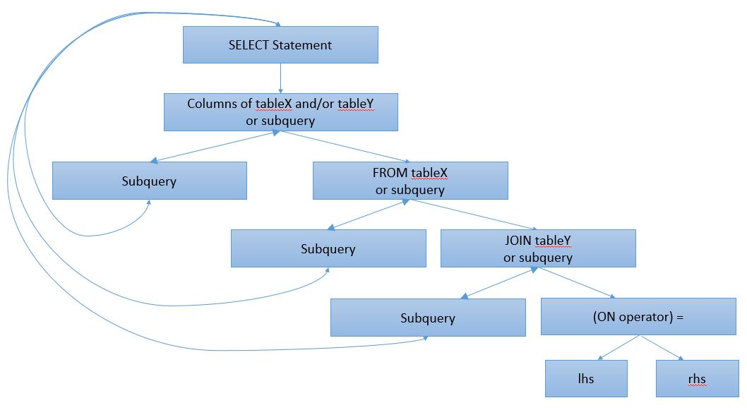
After Our Implementation Visitor Design Pattern

Slide 8
Example with subqueries (how it will look after our implementation)
SELECT * FROM (select empno, deptno, comm FROM emp);
SELECT (select empno, deptno, comm FROM emp), deptno FROM dept;

