Slide 1

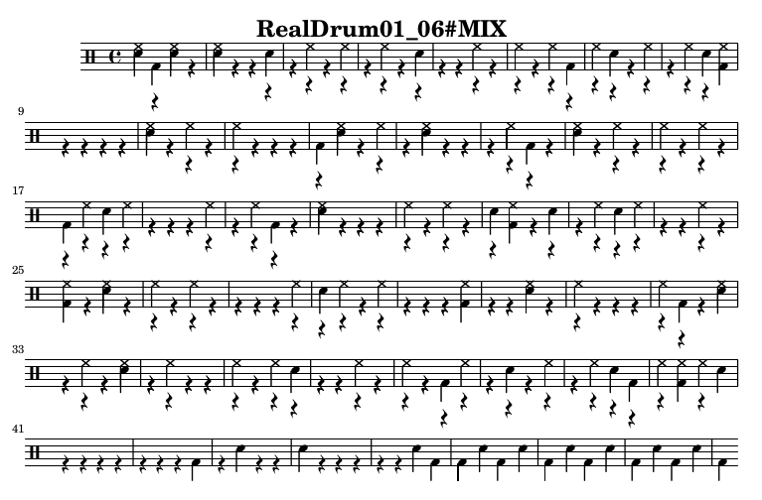
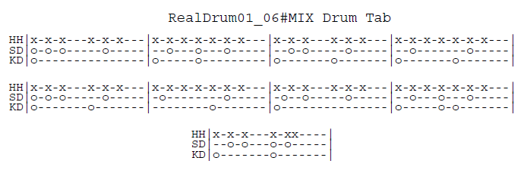
성균관대학교 소프트웨어대학
연구작품
머신러닝을 통한 드럼악보 추출
박동준, 홍주경
성균관대학교 소프트웨어대학
Extracting Drum Music Score by Machin Learning
Park Dong Jun, Hong Ju Kyung
Sungkyunkwan University College of Software
지도 교수: 윤희용 교수님
연구실명: 모바일 컴퓨팅 연구실
ⓔ
ⓔ
개요
실행 결과
Recently, drum, the most popular and important percussion instrument in modern music, is an instrument that many people want to learn. However, many people are suffering from difficulties of making drum scores. Moreover, many people feel that there are not enough materials about drum score, and also people found that making drum scores are labor-intensive work. Appeal for lack of materials to find or make music.
For those who are experiencing this difficulty, we want to create a product that extracts drum scores from voice files. The working principle of the work is as follows. First, from the voice file with drum sound, we classified each musical instruments’ sound signal and extracted the data set of drum sound by using MIR(Music Information Retrieval) Technology After that, by applying one of machine learning algorithm and multiclass classification method, categorize classified drum sound by 7 kinds. Finally, visualize the categorized data with the drum score.
ⓔ
<Figure 1> Result Drum Music Score
ⓔ
구현
First, user’s input files go to ADT module. If that files are invalid, this program prints error message and it ends. On the other hand, if the files are valid, ADT module learns drum sounds from its database and it prints result <filename>.txt file. Then, the function read_vis returns the printed result.
In this stage, we input our classified data sets which contains drum audio files’ segmented time data and classified drum types data into visualization.py code. In this code, we have 3 functions. First is read_vis(). This function receives the input file and saves segmented time data without overlapped data. Plus create a txt file with integrated classified drum data which sn, bd, hh, r symbols. Second is write_vis(). In this function we create a lilypond script based on the txt file created by read_vis(). Last, Produce_pdf() will compile .ly script file and create the pdf file for musical score of drum.
<Figure 2> Tab of Same Drum Music
<Figure 1> is a result drum music score of a music named ‘RealDrum01_06#MIX.wav’, and <Figure 2> is a real tab sheet of same music.
In this figures, we can guess its precision is about 70%.
ⓔ
결론
By advancing this graduation work, we have experienced many things that we cannot experience in general undergraduate courses.
First of all, with my team member, we got together in a place and made a lot of technical discussion. This made us to increase major knowledge and learn how to solve various problems.
Moreover, since this was the first time for us to do this big project, we systematically divided the project into parts and solved them step by step. This made us to solve problem fluently.
Finally, we used pair programming method to code our project. By using this method, we shared our major knowledge and anguished specific problem together. This made us to more concentrate on our work. Plus, we can also immediately proceed the code review and help to find each other’s errors.
ⓔ
개발 환경
OS | Ubuntu 16.04 LTS
Development Language | Python v3.5.2, v2.7.15
Used Library | Tensorflow LibROSA Scikit-learn Lilypond ADTLib

