Slide 1
PAPI QUANTUM
JustBuild: Quantum Computing Computation for Quantum Chemistry
11-07-2026

Slide 2

THE CLIENT
“At X Pharmaceutics Co., we're looking for ways to make drug discovery faster and less expensive. We face two major challenges: understanding complex molecular interactions and screening potential drug candidates to eliminate those unlikely to succeed.
We've heard the hype surrounding quantum computing, but we want to know: Could quantum computers solve either of our problems better than traditional computers?”

Slide 3
Question 1:
How can we use quantum computing to predict complex molecular interactions?
‘Classical’ methods:
2: Coupled Cluster Singles and Doubles (CCSD)
The gold standard of precision.
Really expensive.
Scales by n^7
1: Hartree-Fock (HF)
Cheap standard.
Not precise at all.
Used as initial approximation for larger pipelines.

Slide 4
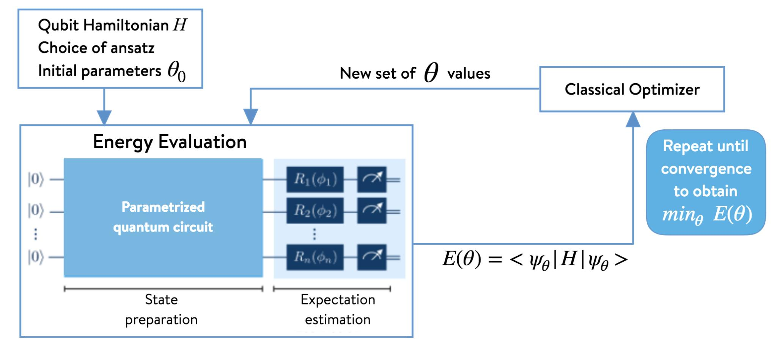
Our Goal:
Method:
Finding a quantum algorithm that has greater accuracy than the HF, but requires less computational power than the CCSD model.
The HF+VQE method is based on the principles of the molecular Hamiltonian.
The HF method uses the molecular geometry of the elements to construct an approximate electronic wavefunction and molecular Hamiltonian.
The Variational Quantum Eigensolver (VQE) uses this Hamiltonian to estimate the molecular energy and iteratively optimize the quantum state to find a lower-energy solution.

Slide 5

THE ALGORITHM
Variational Quantum Eigensolver, a Quantum algorithm from VQA family.
How does VQE work?
Using the same orbitals obtained by HF classical method, VQE models each electron on its quantum representation to find the minimum energy of a system. (The more stable)
Benefits
Pain points
The difference in time and cost between HF and CCSD is enormous, so every result on the middle would be great
It still needs classical approach to run the first part in order to get the required parameters to run de VQE

Slide 6

OUR MODELED SYSTEM:
Water in platinum (H2O + Pt)
-Used for H2 production, an important green fuel.
-Well studied.
-Small system.
-Pt is hard to simulate precisely.
If VQE can model this system with precision:
-We could simulate other kinds of catalysts.
-We could discover new processes without spending to much on computational resources.

Slide 7
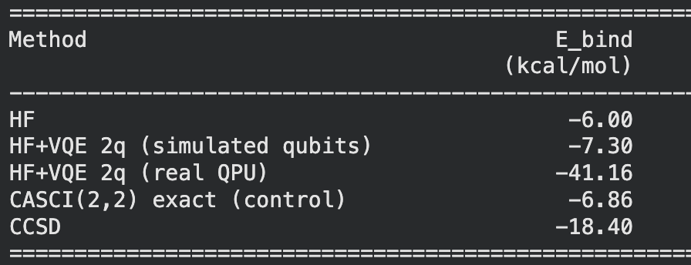
OUR RESULTS
Used QPU: Rigetti Cepheus 108Q
Provider: AWS via qBraid.
Used simulated QPU: QIR Simulated
Provider: qBraid
Fact #1
Fact #2
Fact #3
In one hand, time was mostly waiting times for real QPU (only 21 seconds of real calculation), in the other hand VQE also scales at n^7, so it would behave more like CCSD in terms of time than HF.
It is a bad approximation, but it is still a result. Bigger systems could not be calculated by classical methods. So far, with present precision, we can’t deliver a relevant result with QPU.
Real QPUs are unpractical for the amount of noise that cause on consecutive operations.
Also, credit consumption is so high, one single run spent all given credits from qBraid

Slide 8
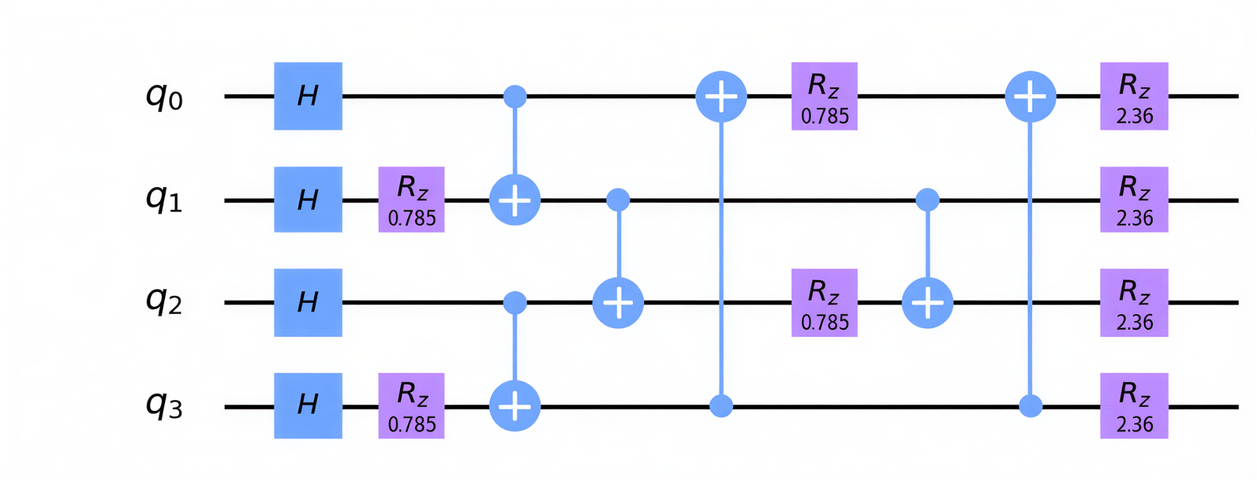
THE PROBLEM #2
Simple Constrained Optimization Problems may be better suited to Classical Computers.

Slide 9

Turning a Drug Portfolio into a Quantum Problem
Knapsack problem: Select drugs to maximize expected return without exceeding the testing budget.
QUBO formulation: Convert the budget constraint into a penalty within the objective function.
Cost Hamiltonian: Translate that mathematical objective into an energy function whose lowest-energy state represents the optimal portfolio.
QAOA: Use quantum gates and classical parameter optimization to increase the probability of measuring good portfolios.
Notes:
We are not necessarily simulating a physical knapsack Hamiltonian. We're deliberately constructing quantum operations that behave as though the qubits evolved under a Hamiltonian whose energies equal our optimization costs.
QUBO: Quadratic Unconstrained Binary Optimization
QAOA: Quantum Approximate Optimization Algorithm

Slide 10
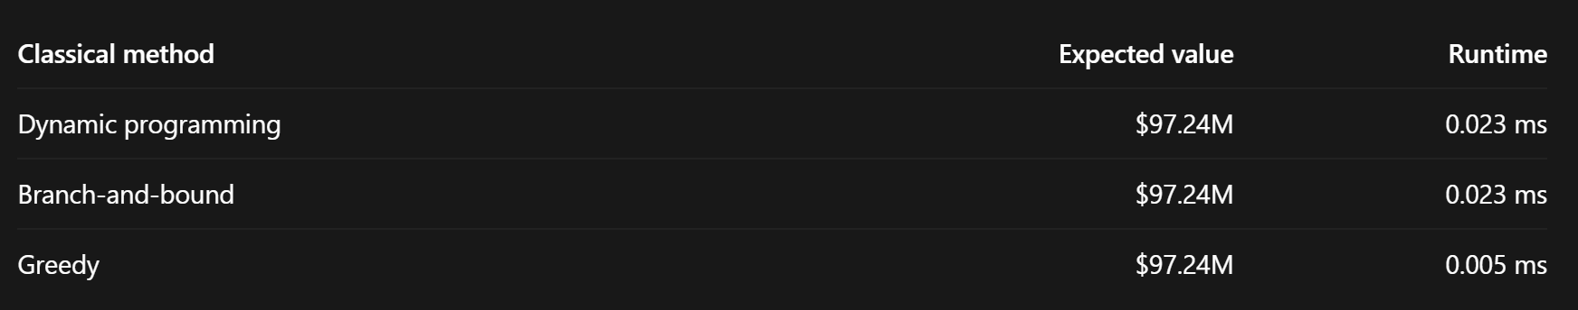
Classical Optimization: A Strong Baseline
Tested dynamic programming, branch-and-bound, and greedy selection.
All three found the optimal portfolio in our eight-drug baseline.
Dynamic programming guarantees an exact optimum in O(nB) time for integer costs and budget.
Very low runtimes, predictable behavior, and no quantum training or measurement overhead

Slide 11
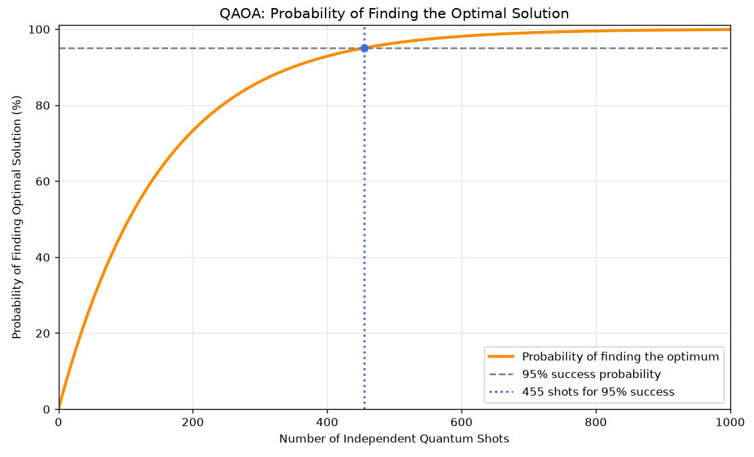
QAOA Introduces Computational Uncertainty
QAOA requires a classical optimization loop to select quantum circuit angles 𝜸 and 𝛽
The number of evaluations needed for good parameters is not known in advance.
Each quantum measurement gives a candidate portfolio—not necessarily the optimum.
The shots required for a high probability of success depend on an unknown, instance-dependent success rate.
Larger problems require more qubits and gates, with additional hardware noise and execution overhead.
Graph Goes Below: P(success) = 1 - (1 - 0.00657345)^n
N = number of shots

Slide 12
Conclusion
QPUs Usability for Quantum Chemistry:
Current noise makes recommending quantum computing over classical approaches currently difficult.
Efficiency advantages are negated by repeated computations needed for statistical adjustments.
Quantum chemistry calculations remain promising due to the increasing difficulty of obtaining analytical solutions for multiple-orbital Hamiltonians.
Better QPU performance and pricing is needed to continue favoring its usability.
Overall, we recommend investing into further research, but no current implementation.
Maximizing Expected Value Under Budget Constraints:
Strongly recommend classical algorithms over QAOA for this application.
Lower overhead: No quantum training or repeated measurements.
Guaranteed optimality: Dynamic programming finds the exact solution.
Predictable performance: Faster, simpler, and more reliable.
QAOA adds uncertainty: Success rates and training costs vary.
Parameter transfer: No demonstrated advantage over random initialization.

Slide 13

Say bye to
PapiQuantum

