Slide 1




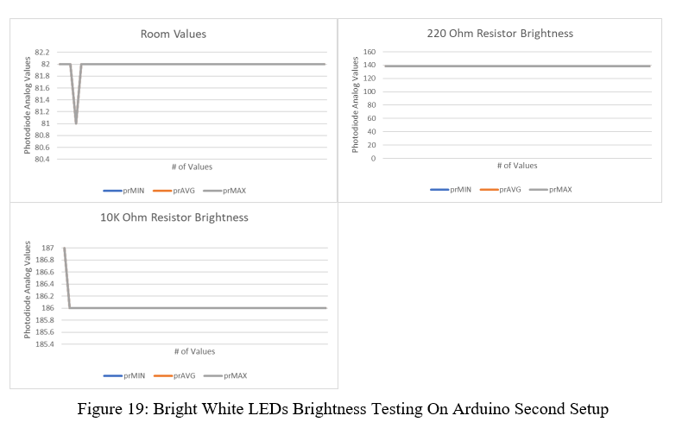
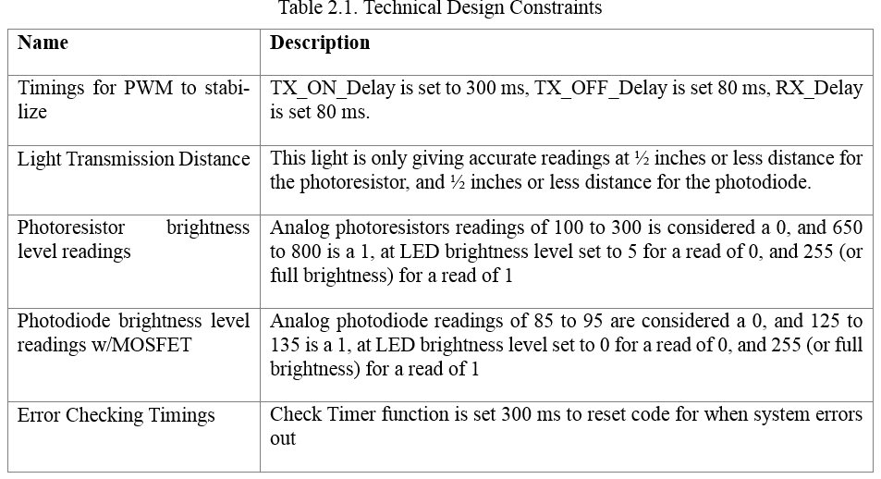
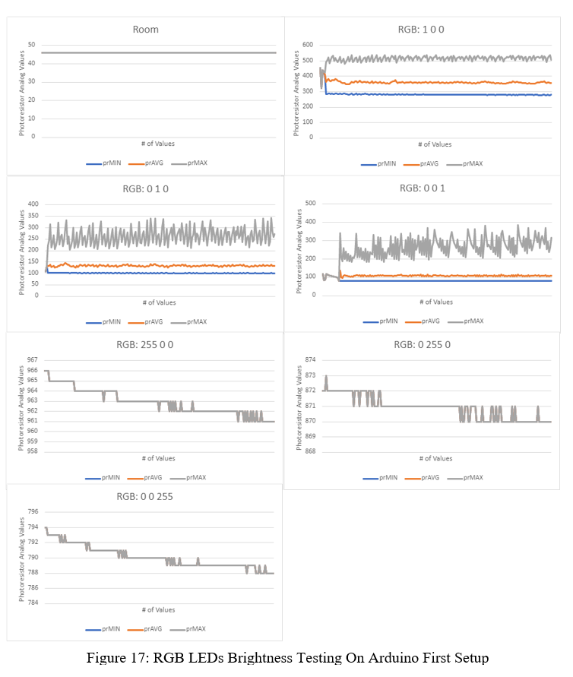
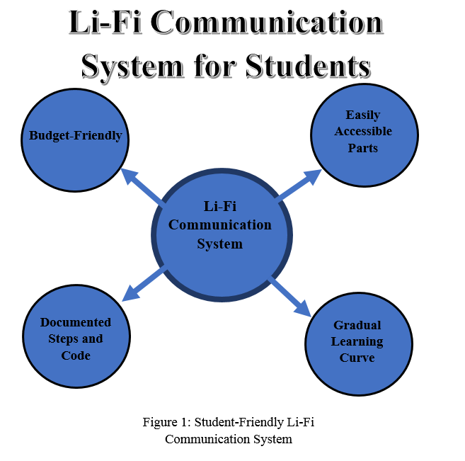
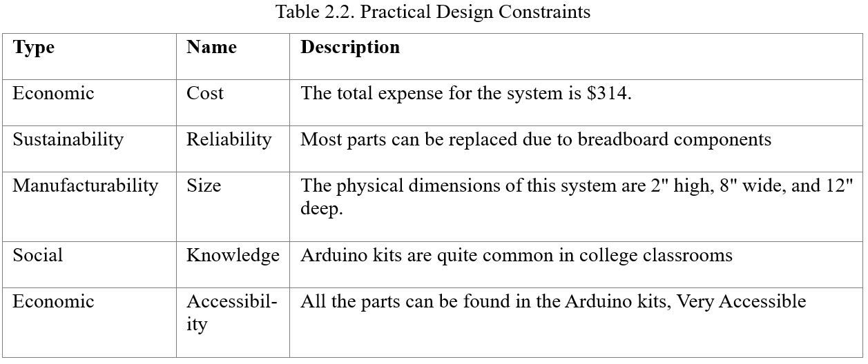
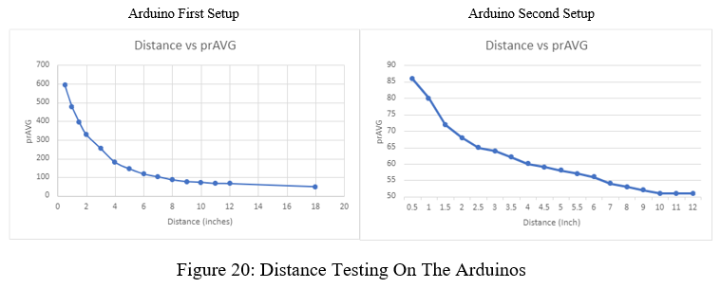
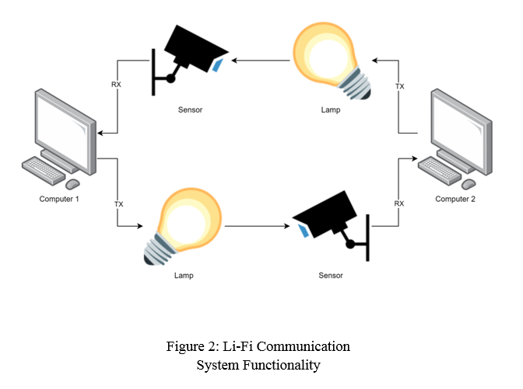
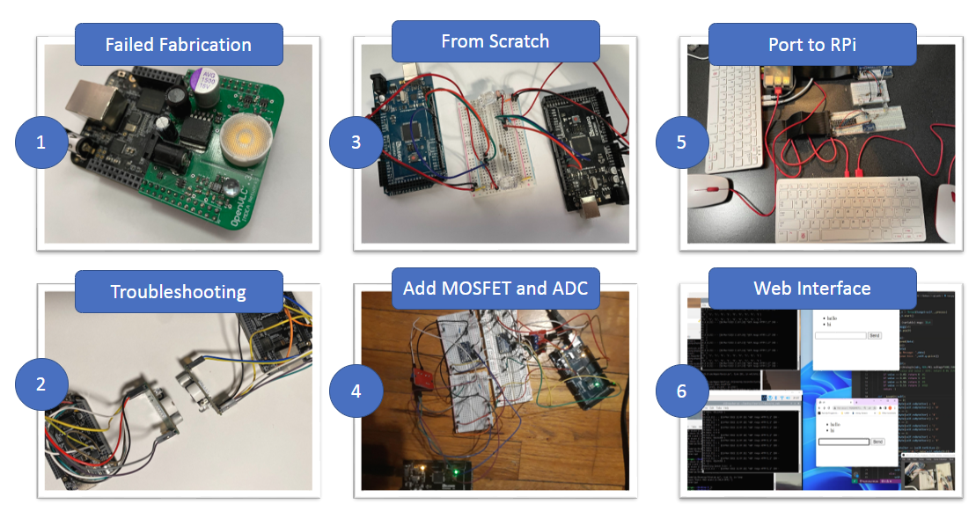
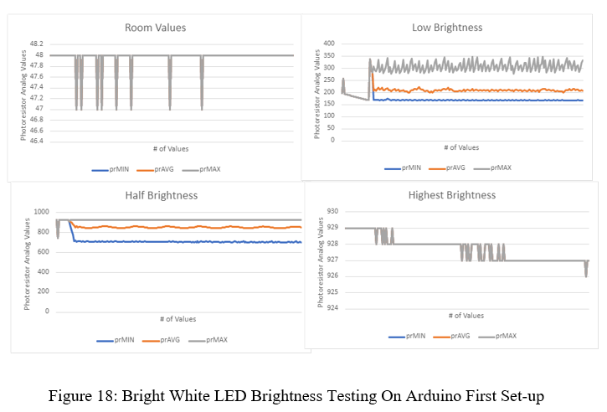
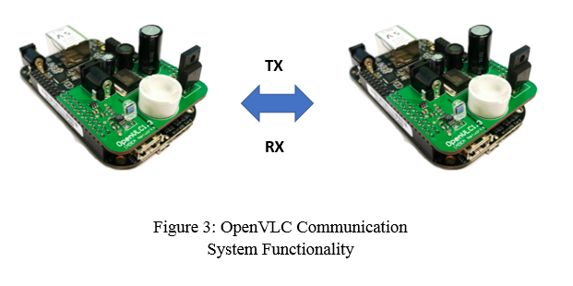
Li-Fi Communication System
By: Sacdiya Sayid, Greg Graham, Nelson Caberto
University of Missouri-Kansas City
Project Introduction
Design Constraints
Evaluation
Our project was to create a Li-Fi communication system after our failures to implement the OpenVLC system. Visible light communication is the ability to transmit data using the visible light spectrum, also referred to as Li-Fi or Light Fidelity. Our original project goal was to adapt the OpenVLC system and create our own set of demos. We were forced to create our own Li-Fi communication system after our attempts at recreating the OpenVLC system failed. We found that the OpenVLC system has a steep learning curve, and a lot of troubleshooting is needed to implement it successfully. We hope to create a system that is more friendly to those with limited knowledge. Our system is a great starting point for other students to familiarize themselves with Li-Fi and its functionalities.
This section covers what design constraints we have with our current set-up. The constraints are divided into two parts, technical and practical. Technical being testable restraints due to some hardware or software limitations. Practical constraints being qualitative restraints due to some limitations of scope, funding , and other various non-quantitative limitations in our project.
Brightness Testing:
We tested the RGB LEDs and the Bright Whites to determine which one was better to use for our purposes and decided in terms of brightness and signal stability, the Bright Whites were the better choice. We also tested the Bright White LEDs on our second set-up to see if there were any improvements from our first Arduino setup. We found major improvements in the stability of the light levels due to eliminating PWM by incorporating MOSFETs and parallel resistors. Our graphs for our brightness testing can be found below.
Distance Testing:
We tested distance using our Bright White LEDs to determine best transmission distance for our set-up. We tested on our first and second Arduino setups. We found that a distance of 1/2in or less was best for data transmission as it minimized data corruption and increased the rate of successful transmissions.
Design Approach
Summary And Future Work
Due to our design being foundational, we chose to build our system using very simple design techniques. We refamiliarized ourselves with the Arduinos and how to Blink LEDs and use photoresistors. We then built upon that by improving upon the functionalities of our code. We created several code versions, and each newer version of code has a new functionality implemented. We also went ahead and upgraded our components to circumvent issues we saw occurring while troubleshooting. We also ported our code over to Raspberry Pi and implemented many of the same functionalities.
Our design provides a foundation for other students looking to break into Li-Fi. We tried to use what we had readily available to us and cut down on costs. We made our design simple and easy to follow. The design process is documented so that others after us can understand and try to implement their own versions. Our design could be improved by increasing distance, integrating an RTC Module, defining more brightness levels to send more than one bit at a time. There’s much left to explore and improve upon in our design.
Acknowledgments
We wish to acknowledge Mostafizur Rahman, Wafi Danesh, Farid Nait-Abdesselam, and Hassan Ahmed of the University of Missouri Kansas City, Waleed Al-Shikhli, Ethan Kunz, Ethan Calfee, and Andrew Hauck of Honeywell for their continued support and feedback regarding this project. We also acknowledge Honeywell for its funding of this project, which enables this project to be developed.
Appendix
See GitHub for more details on product specifications and code.
https://github.com/nelson-caberto/OpenVLC.git

