Slide 1


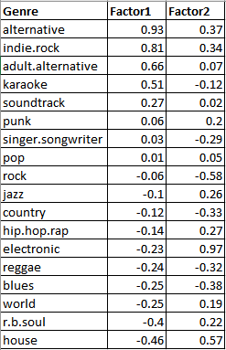
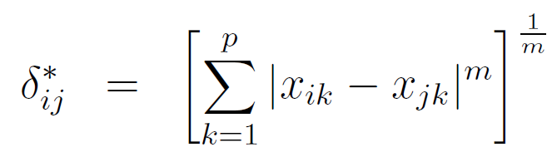
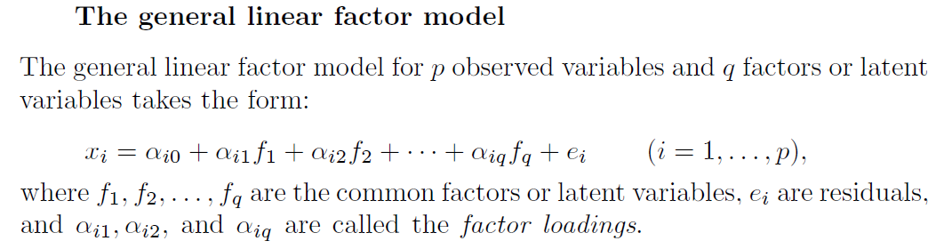
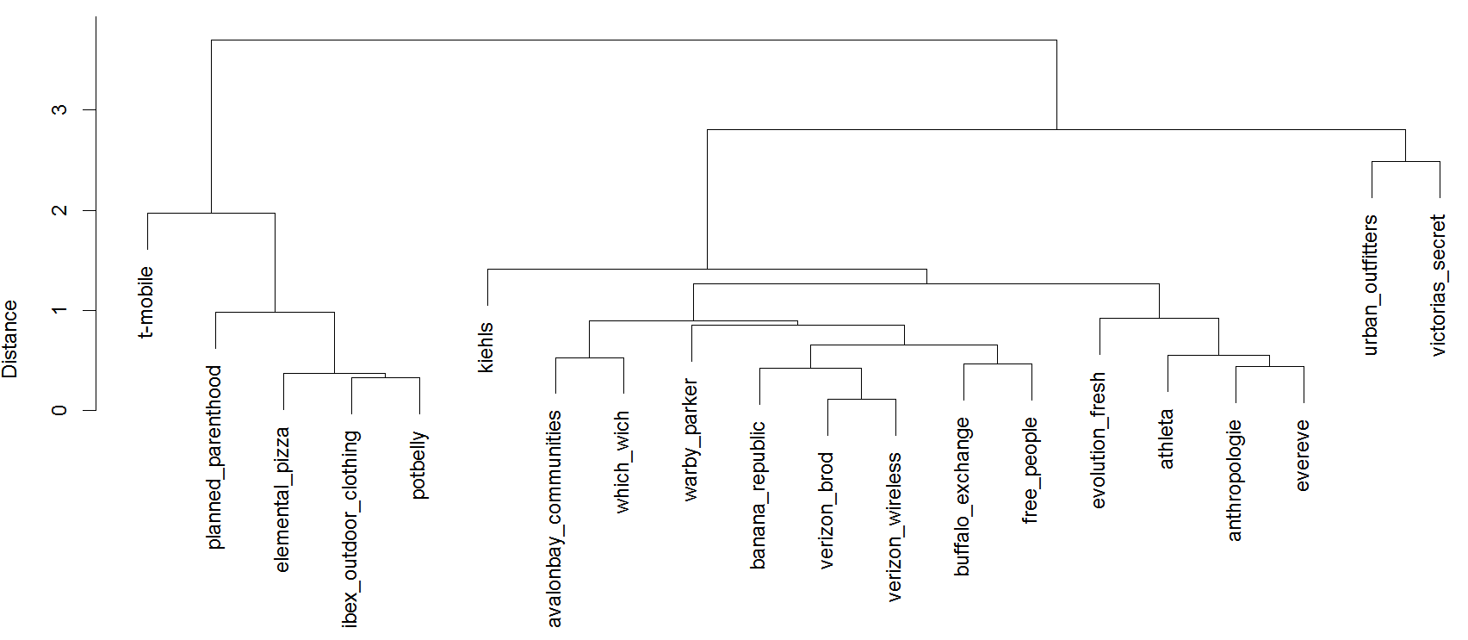
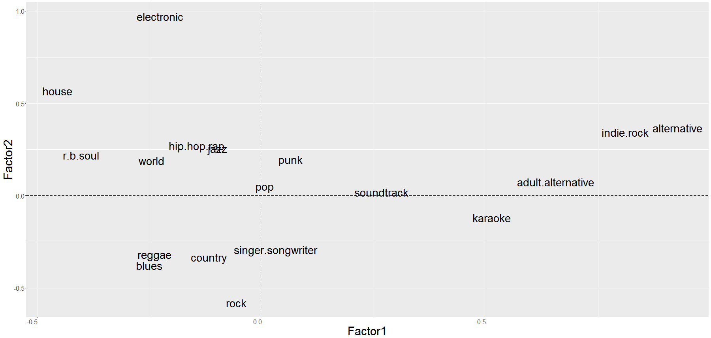
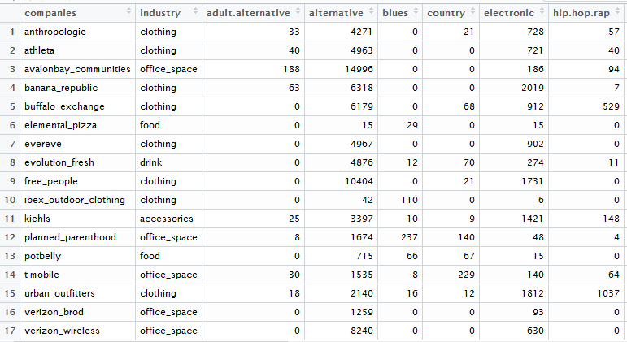
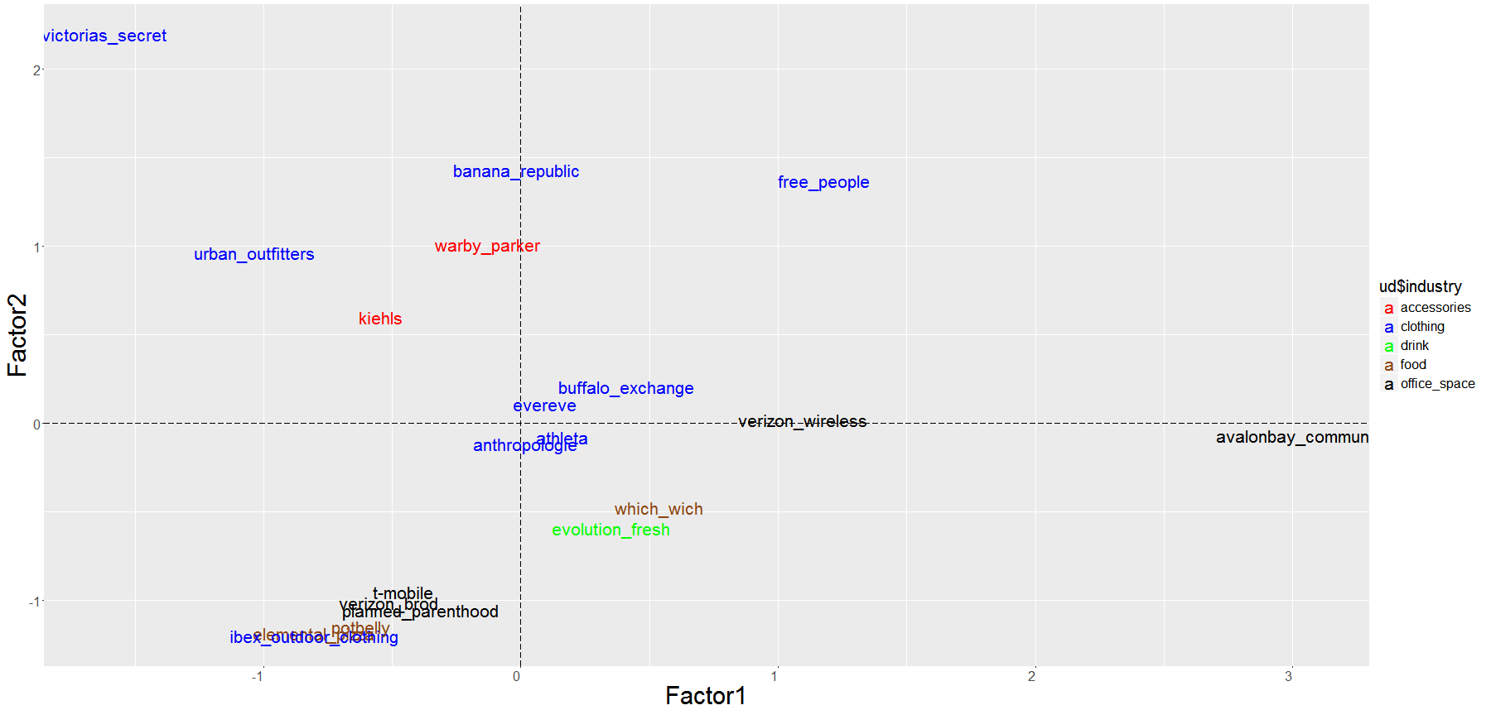
Can in-store ‘music experience’ be quantified and visualized?
A latent factor analysis of stores based on their music strategy
Nelson Dsouza, MS;
University of Washington, Information School
Abstract
Methodology for PCA and FA
Methodology for Cluster Analysis
The motivation for this project was to evaluate if something as subjective as in-store ‘music experience’ could be quantified and visualized. For the scope of this project, the data for stores from University District, Seattle was considered consisting of total count of the songs played by 20 stores under 18 music genres for one month. PCA was applied to the data and it was found that the first 2 Principal Components explained 90% variability in the data. Based on this, Factor Analysis was conducted for 2 factors. The Loadings and Scores were used to plot genres and stores respectively. Independently, the distances between each stores was computed and based on this, Cluster Analysis was conducted. These methods helped quantify & visualize in-store music and derive insights such as music branding and competitor analysis for the stores.
With 18 genre’s, PCA was perfect to overcome curse of Dimensionality.
On conducting PCA, it was found that the first 2 PCs could explain
90% of the variation in the data. This information was used to
perform Factor Analysis hypothesizing that there were 2 latent factors.
On performing the FA, we obtained latent factor loadings which
explained how the genre were related to each other. Based on this, the
scores for stores was obtained. The FA model was used:
The fit was assessed via p-value (0.148) and reconstructed correlation
matrix and it was found that the model fit the data really well!
Different datasets might not conform to the hypothesis of 2 latent factors. In such scenarios, it is still important to quantify and visualize our data. This was done using Cluster Analysis wherein the Euclidian distance between 20 stores was calculated after normalization:
used to calculate distance, where m=2, p = i = j = 20
The complete linkage method was used to construct the dendrogram as it maximized the distance between clusters and minimized the distance within clusters.
Table 2. Factor Loadings
Chart 3. Dendrogram of stores
“Music is the movement of sound to reach the soul for the education
of its virtue” - Plato.
Introduction & Data
Latent Factor Analysis Results
Most of us understand the power of music and its impact on those who listen to it, every day, consciously and unconsciously. But is it possible to measure how music influences different businesses and their brand’s identity? Is it possible to visualize this? To answer these question, relevant data is needed. The data was obtained through Playnetwork, a consumer engagement company that provides stores with music curation services. They work with the qualitative nature of music through human music curators who tap into a brand’s beliefs, design vision, aesthetics, and a range of other emotions to provide the perfect playlist.
This analysis focusses on only one area and selected time frame for its analysis, namely – the University District area in Seattle with the zip code of 98105 for July 2016. The key columns of the data were store name, industry, song name, song artist, genre, ISRC code and the cumulative count of the song played at the store. 18 genres out of 355 were selected, which accounted for 86% of unique company-song-artist combination from 21000 combinations. A pivot table was created to group genres by companies with the cells containing cumulative play count and is displayed in table 1.
Through the loadings and scores obtained via FA, we could plot genre and stores respectively for our data.
Chart 1. Genre’s based on 2 latent factors
Table 1. Snapshot of data
Applications
The results could be utilized in the following ways:
Company branding: With the results of this analysis, clients can now identify where their music concept lies and where the competitors’ music concept lies. For example, Victoria Secret plays unique music compared to other clothing companies. However, if Victoria’s Secret thinks it should get a little bit closer to its clothing industry fellows it now has a metric to achieve it.
Customer satisfaction: It is important to know if customer like the in-store music experience. Using the results from Factor Analysis, a store could plan 2 different music strategies for 2 months and do an A/B test to see which concept is more satisfactory based on customer feedback.
Store Categorization – The FA clusters as well as the Dendrogram help us to identify clusters of stores and categorize them on the basis of the music they play.
Chart 2. Stores based on 2 latent factors
Conclusions
It was found that high dimensional music data could be quantified and visualized in 2 dimensions via PCA while preserving most of the information. A 2 Factor Analysis fetched interesting results, both with respect to the genres as well as the stores. The graphs provide a ‘music map’ which is useful for music curation companies like Playnetwork as well as stores which use their service. The PCA/FA method may not be applicable to all datasets which is why a more robust analytical technique of Cluster Analysis can be used to create dendrogram even though some interpretability might be lost.
Contact
References
Nelson Dsouza
University of Washington
nelsonds@uw.edu ; (206) 992-9710
Bartholomew, David J. Analysis of Multivariate Social Science Data. Boca Raton: CRC Press, 2008.
Heading picture credits - http://kvhstudios.com/in-store-music-a-motivator/

