Slide 1
Python programming for scientists (Group 8) Dylan Nelson dnelson@uni-heidelberg.de

Slide 2
Programming
Computer programming is an essential skill.
The modern world is based on code, running on computers.
Programming means:
Conceptually understanding a problem.
Thinking of ways to tackle the problem.
Knowing the tools and how to use them.
Making code which is: correct, & fast enough to get the job done.
Writing code which is understandable by others.
Collaborating with colleagues and teams.
These days, scientific research and science means: reproducibility and open science. Python is the most important language for science.

Slide 3
Python is awesome
Python is a general-purpose programming language.
It is easy to learn. You can use Python for anything!
Machine Learning, Artificial Intelligence
Data Science, Data Analysis & Visualization, Math, Finance
Game Development
Web Development, Servers (Instagram!)
GUIs, Application Development
DevOps, Software Testing & Pipelines
Hardware Programming, Embedded Systems, Robotics
That’s a lot of buzzwords!
Python is an in-demand computer science skill. Both for academia and the “real world” (industry).

Slide 4
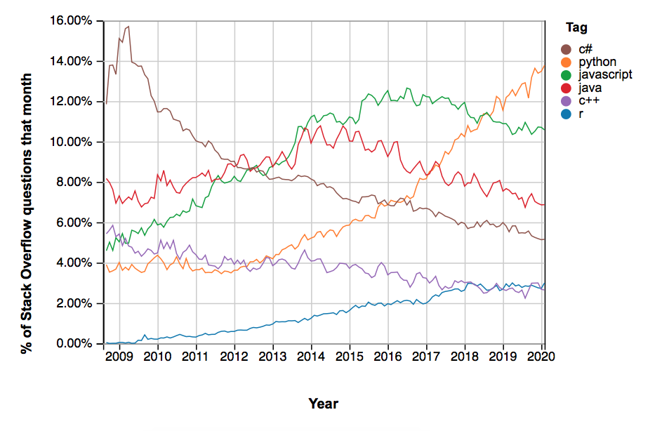
Python is awesome

Slide 5
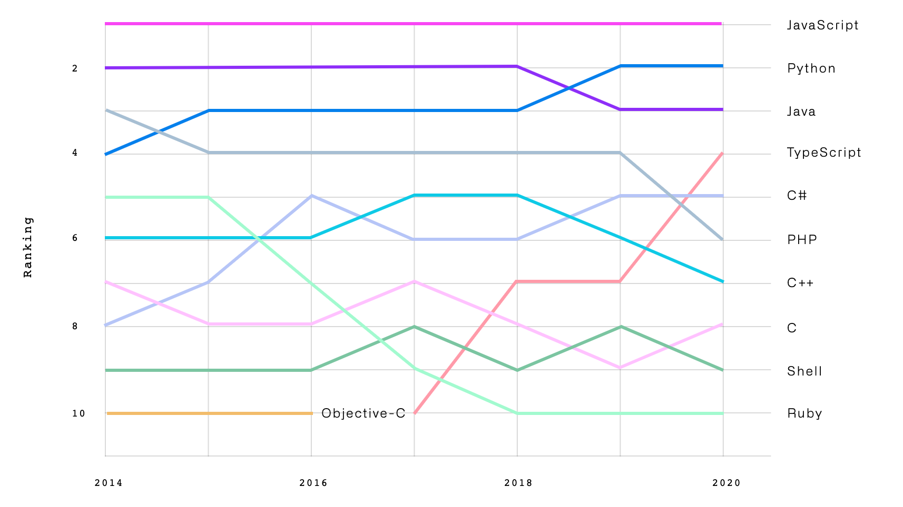
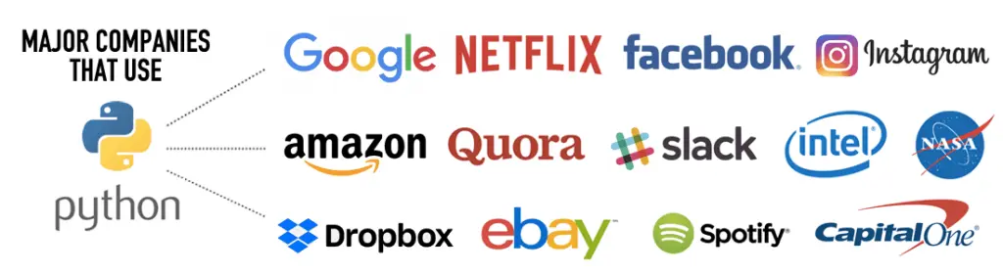
Python is awesome

Slide 6
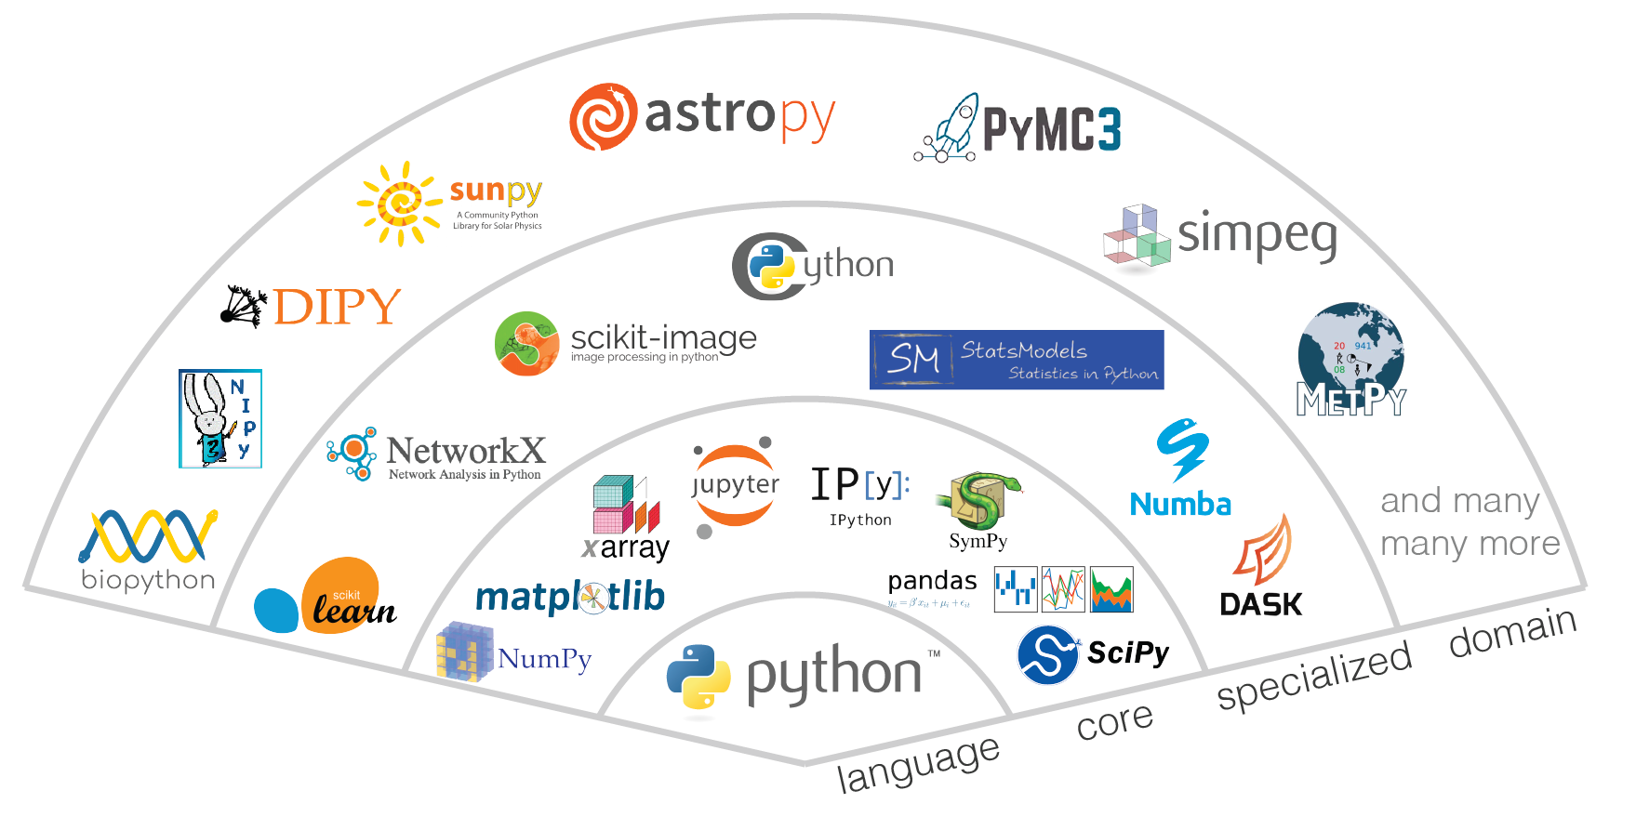


Python is awesome
The ecosystem.

Slide 7
Topics
Day 1
Getting started: IPython, scripts vs. Jupyter notebooks, JupyterLab
The python language
Variables, data structures
Control flow, functions
Day 2
I/O: reading and writing files
Remote data access via web APIs
Python modules
The python “standard library”
Day 3
numpy
Matplotlib – add 3d
Day 4
Classes, object-oriented programming, decorators - slower
Installing packages, error handling, debugging
Scipy: interpolation, integration, fitting
Day 5
Parallel programming: threading, multiprocessing (slower if possible)
Making it go fast: numba, C/C++ interfaces

Slide 8
Logistics
One week block course:
Mon – Fri
9:30am – 5pm
09:30 – 11:00 – lecture/exercises
11:00 – 11:15 – break
11:15 – 12:30 – lecture/exercises
12:30 – 14:00 – lunch break
14:00 – 17:00 – exercises/problems/homework
The course will be in English.
During the lectures there are many small exercises mixed in: you won’t be just listening, but also working.
At the end of the lecture notes each day, there is one exercise problem, and one challenge problem. These are optional (answers do not need to be submitted), but highly recommended. We will work on these in the afternoons.

Slide 9
Homework & grade
Please attend all the morning lectures.
I would expect that you attend afternoons (14-17h) until you’ve finished, or tried, the exercise problems of each day, and can then take off.
Can also use this time to simply finish the homework problem sets.
3 problem sets
All 3 problem sets must be submitted to pass the course.
An average grade of 60% is required (i.e. need to do most, but not all, parts).
Submit via email.
Due date: Friday October 7 @17h (one week after the end of the block course).
Problem set solutions:
Submit as python scripts (.py) or Jupyter notebooks.
Should be clean, documented, explained, understandable. Remove unused code.
Should run without errors.
Keep in mind: there is never a unique solution to a problem, so your approach is likely different than others.
Ok to work together, but everyone must submit their own answers!

Slide 10
Getting set up
You can use your own laptop if you wish, or a computer in the CIP Pool.
Regardless, I suggest everyone use the JupyterLab service of KIP:
https://jupyter2.kip.uni-heidelberg.de
You must log in with your student ID and password.
This lets you run Python remotely on the server, no need to configure things.
If you want to run Python on your own laptop instead, that’s ok, but I can’t help.
Once you connect, you can download all the course materials by running the following command (in a terminal, in the KIP Lab):
git clone https://github.com/nelson-group/pycourse.git
All the course materials are available at:
www.github.com/nelson-group/pycourse
including the lectures, the problem sets, and all the associated data files.

