Slide 1

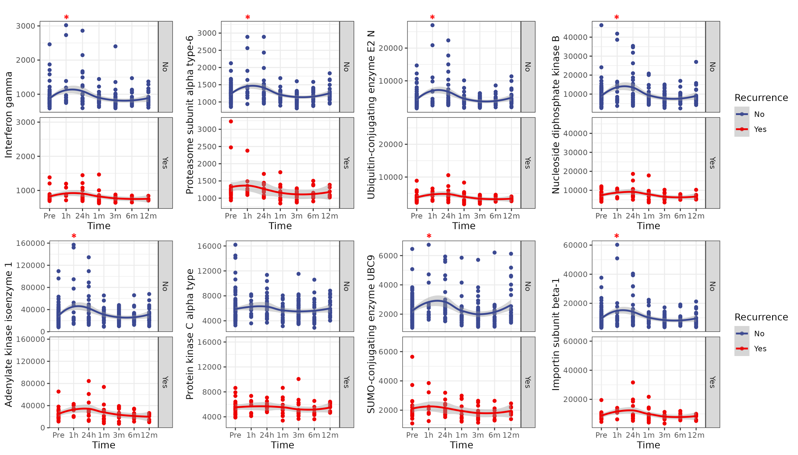
Low risk
High risk
Recurrence

