Slide 1
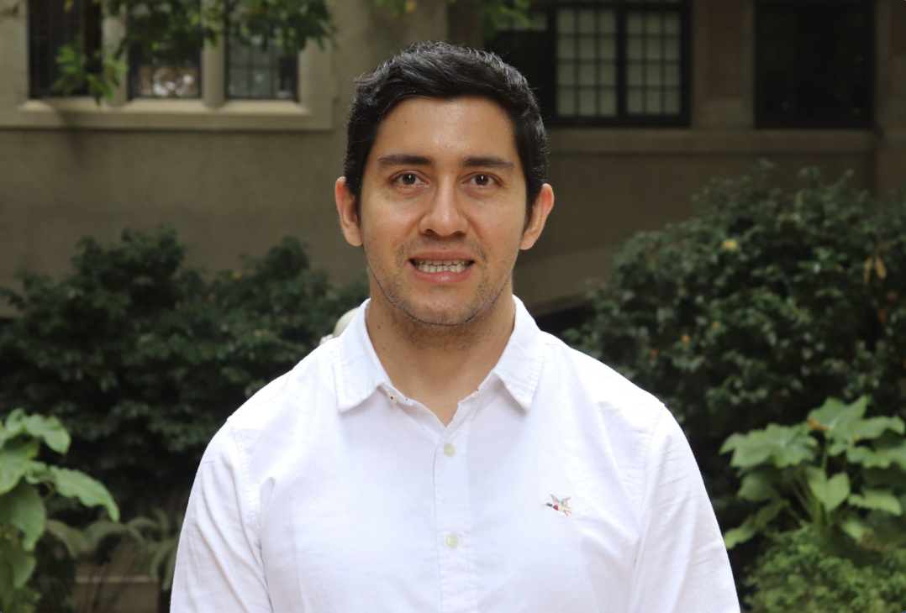

Computational Photography
Dr. Nelson Díaz
Departamento de Ingeniería Informática
Universidad Técnica Federico Santa María, campus Valparaíso, Chile
nelson.diazd@usm.cl
Academic website https://nelson-diaz.com/

Slide 2
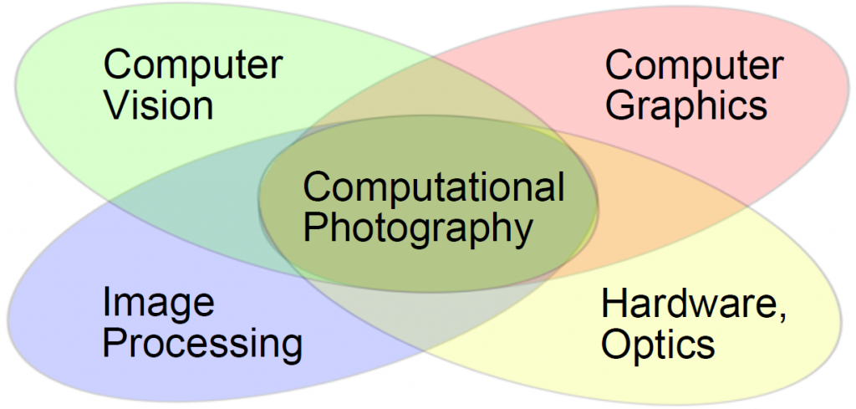
Computational Photography
Areas:
Computer Science
Electrical Engineering and Electronics
Maths
Physics (optics)
2

Slide 3
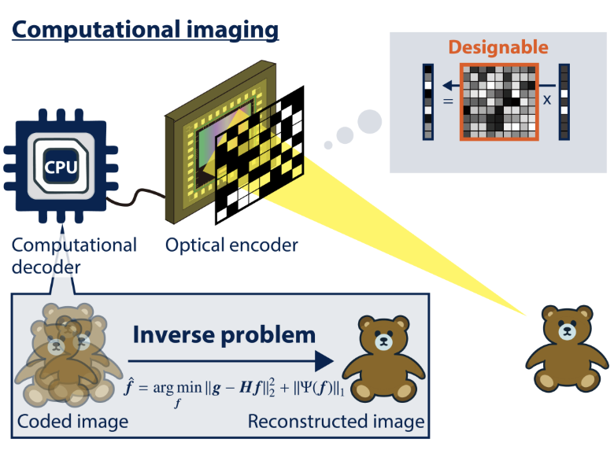
Computational Photography
Goal:
To capture and recover singal in many dimensions
To design
Hardward
Software--algorithm to solve the inverse problem--
3

Slide 4
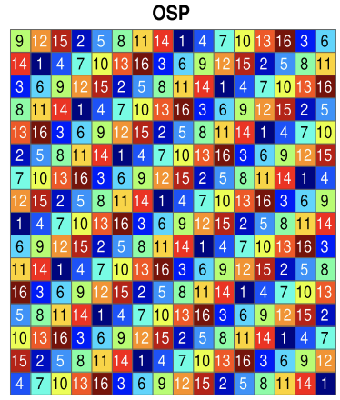
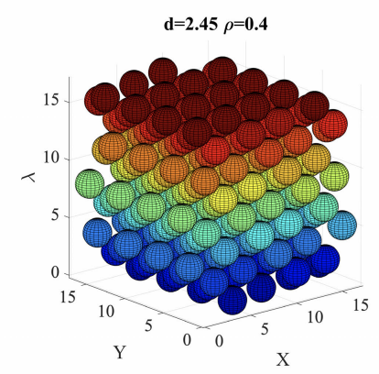
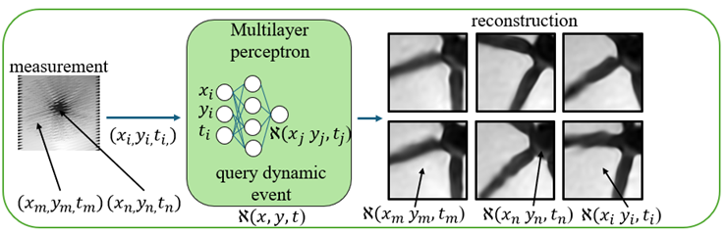
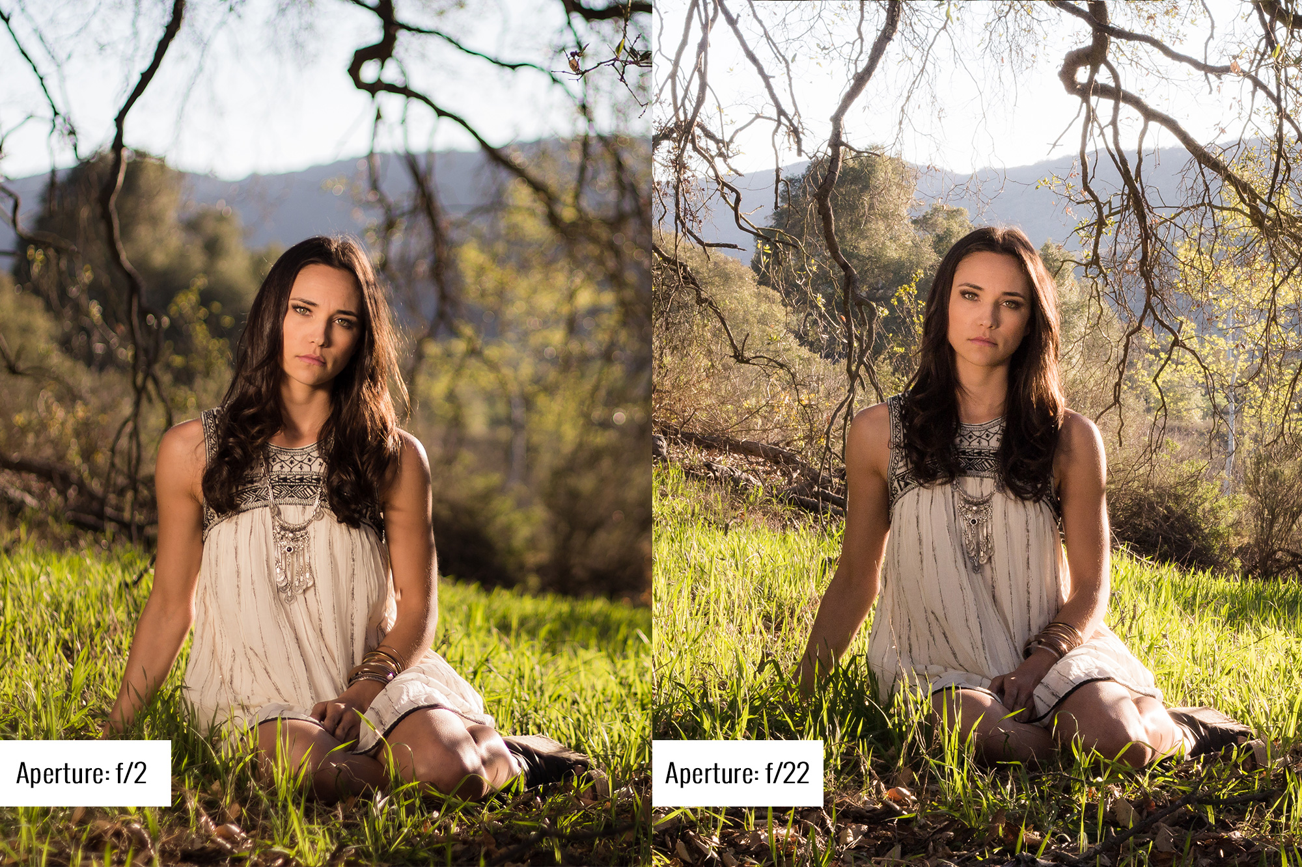
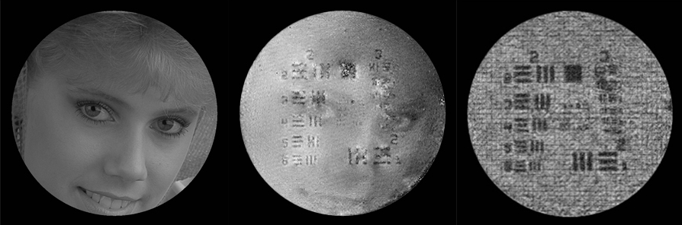
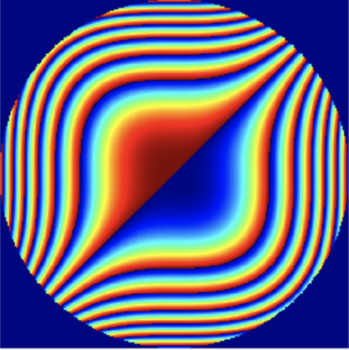
Computational Photography: Applications
It can be applied to different signals
It use compressive measurements
To solve an inverse problem
Multispectral
Video
GT phase
Recovered phase
Recovered Amplitude
A woman
1995
Cubic Phase
Depth
4

Slide 5
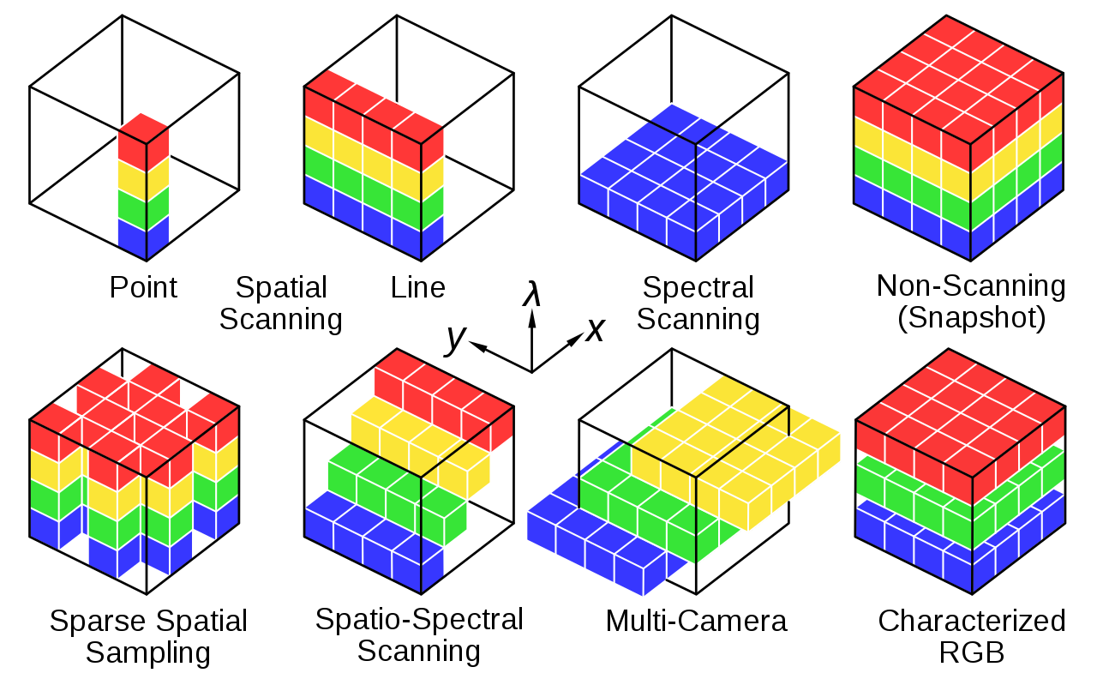
Traditional Approaches to Capture Multispectral Images

Slide 6
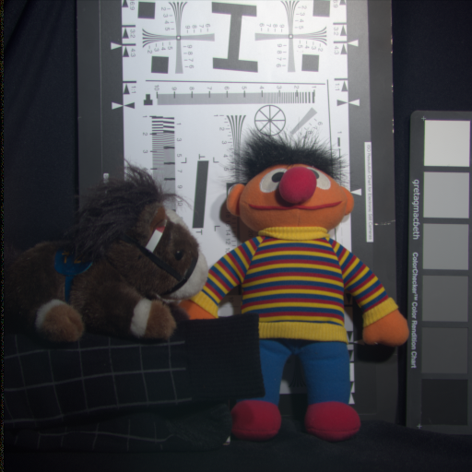
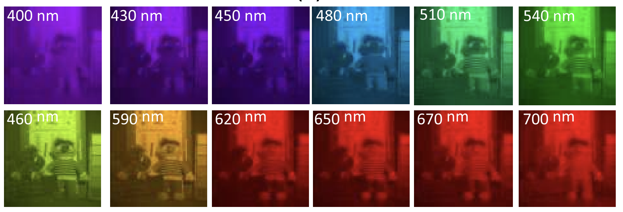
Spectral Images
RGB image
Spectral Images in the visible spectrum from 400 nm to 700 nm

Slide 7
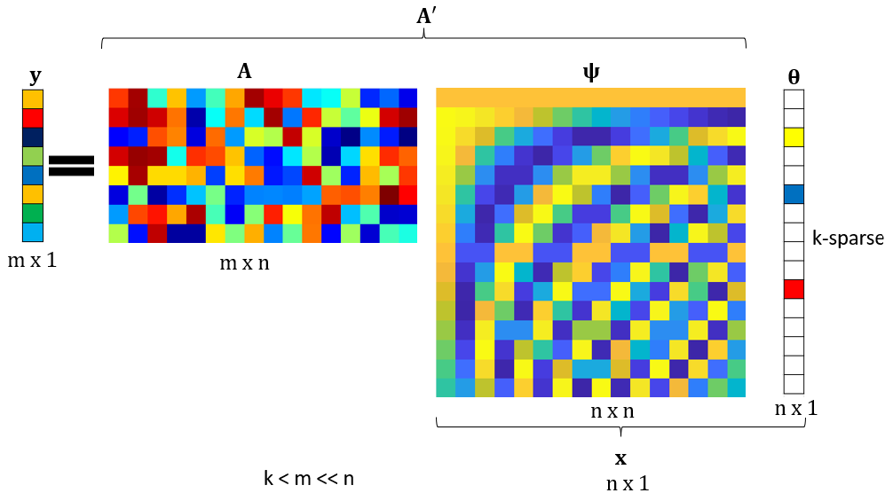
Compressive Sensing
What type of Signal?
Spectral Images
Video
Phase
MRI, ultrasound
Text
Sound
Any
The goal is to recover the sparse signal $θ$ from the measurement $y$
This is an ill-posed problem

Slide 8
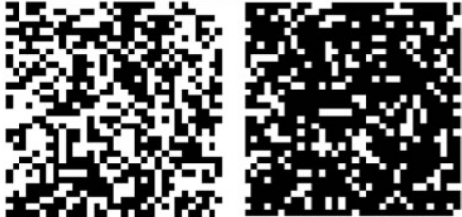

Compresive spectral Imaging
Hardware:
Sensing
Underdeterminated system of equations
Software:
Recovery

Slide 9
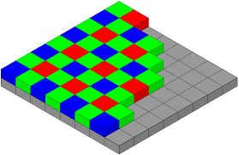
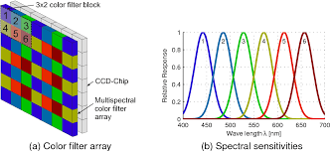
Multispectral Filter Array
Bayer filter
Multispectral Filter Array
The recovered signal is multispectral datacube

Slide 10
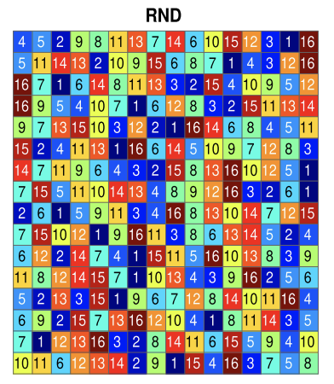
Random vs Sphere Packing

Slide 11
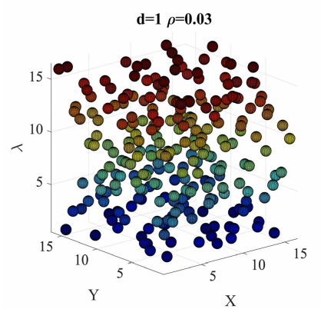
Sphere Packing

Slide 12
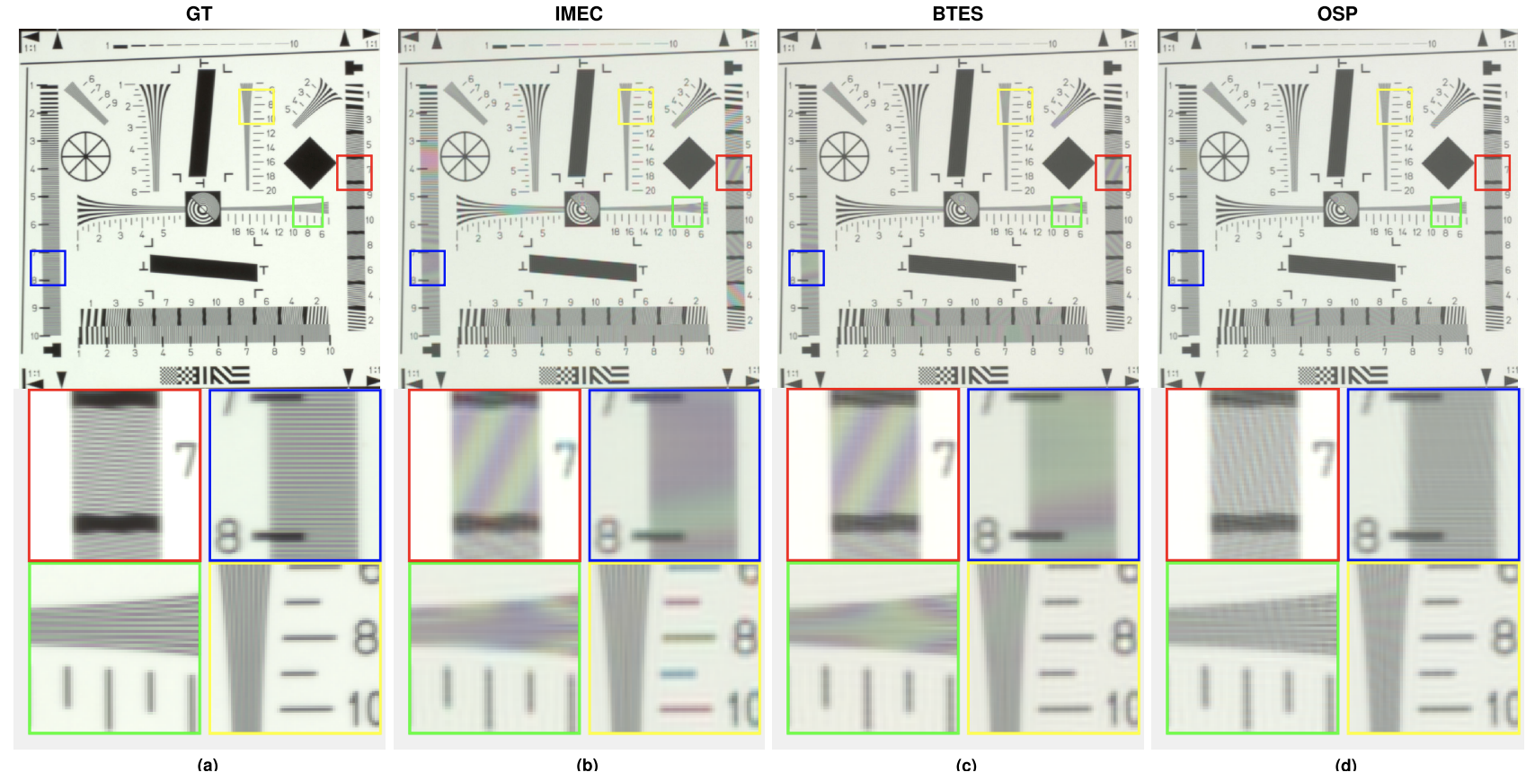
Reconstruction Results using MSFA
N. Diaz, A. Alvarado, P. Meza, F. Guzmán and E. Vera, "Multispectral Filter Array Design by Optimal Sphere Packing," in IEEE Transactions on Image Processing, vol. 32, pp. 3634-3649, 2023

Slide 13
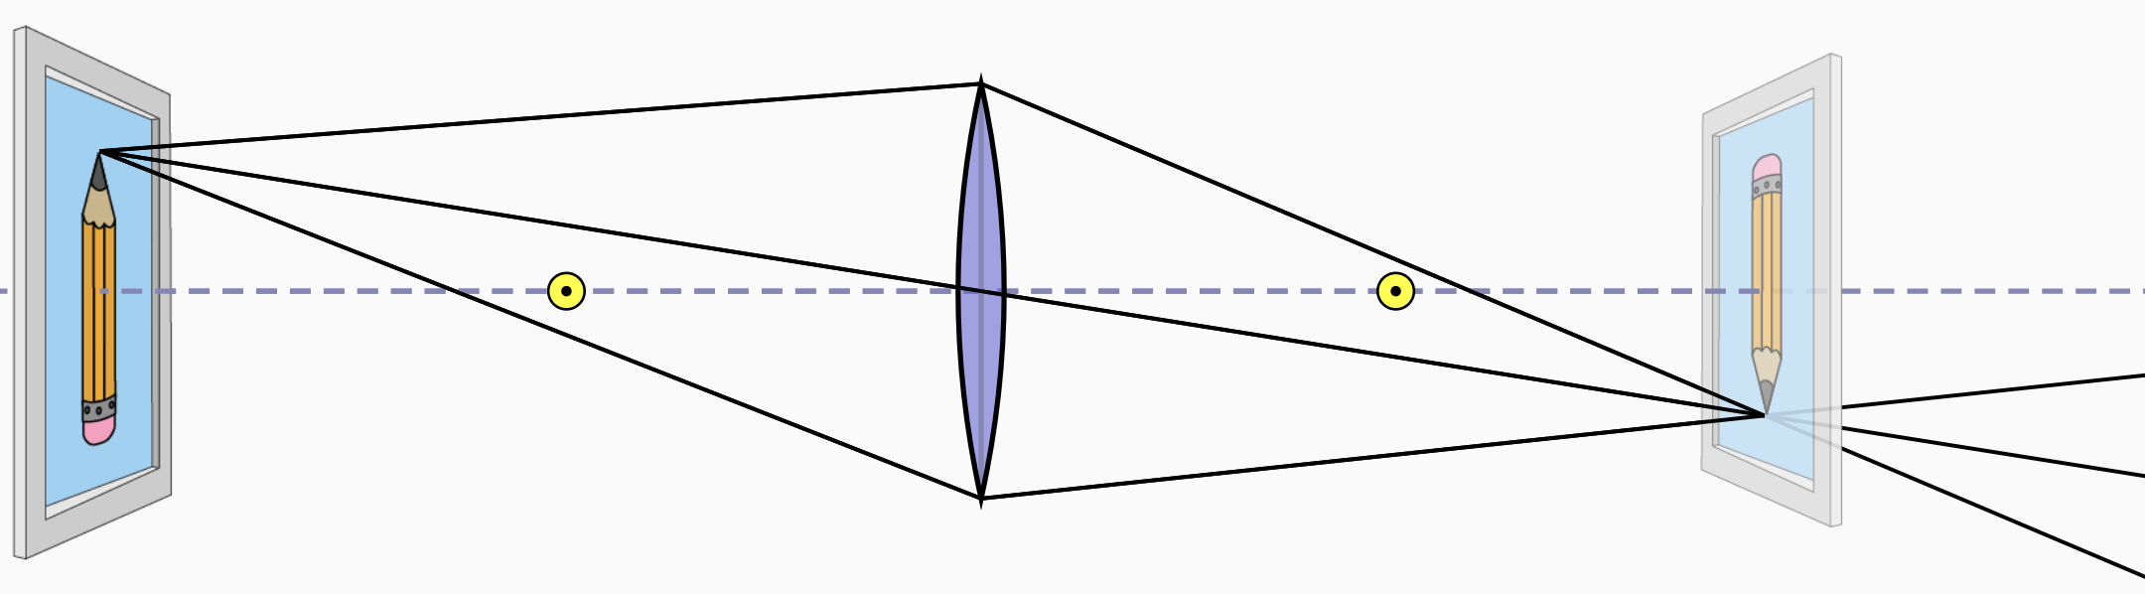
Imaging
13

Slide 14
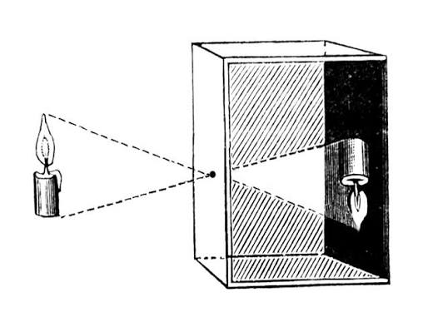
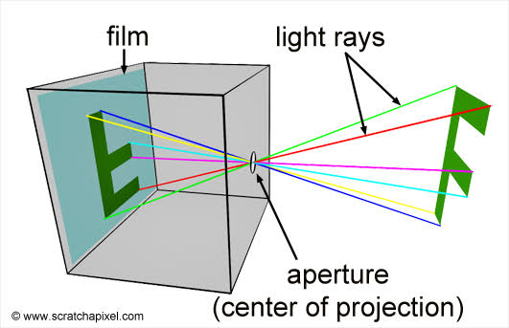
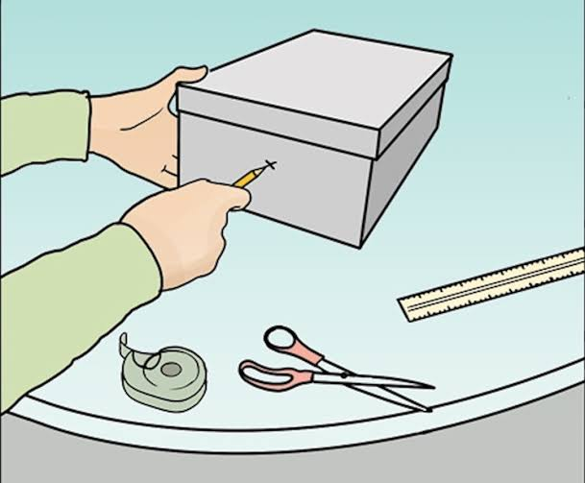
Pinhole Camera
14

