Slide 1
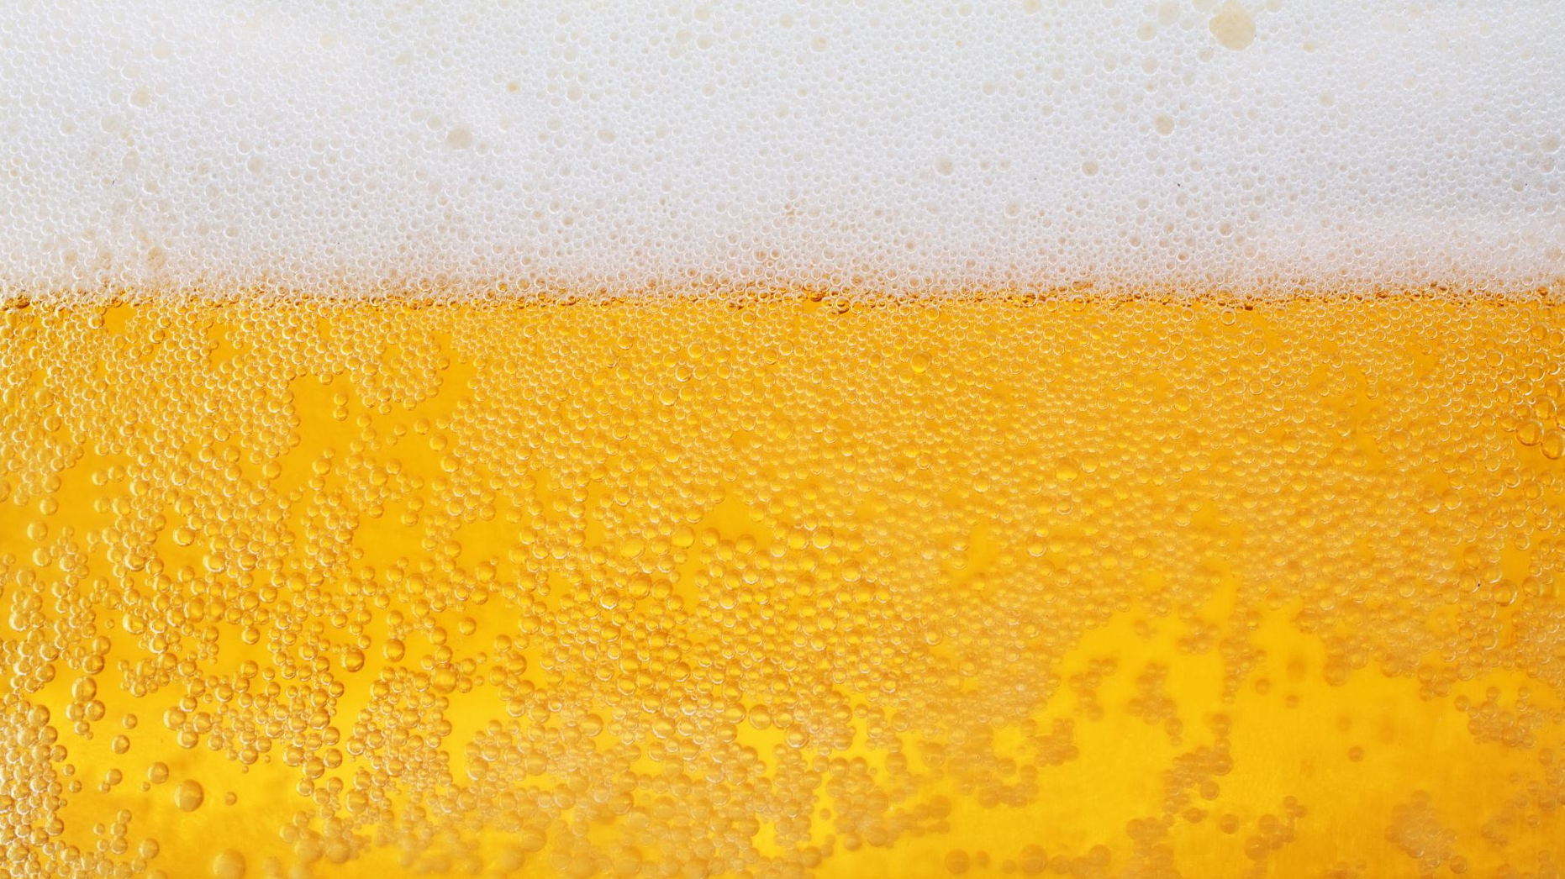
Trends in US Craft Breweries and Beer
Lauren Nelson | Alan Abadzic | Robert Derner

Slide 2
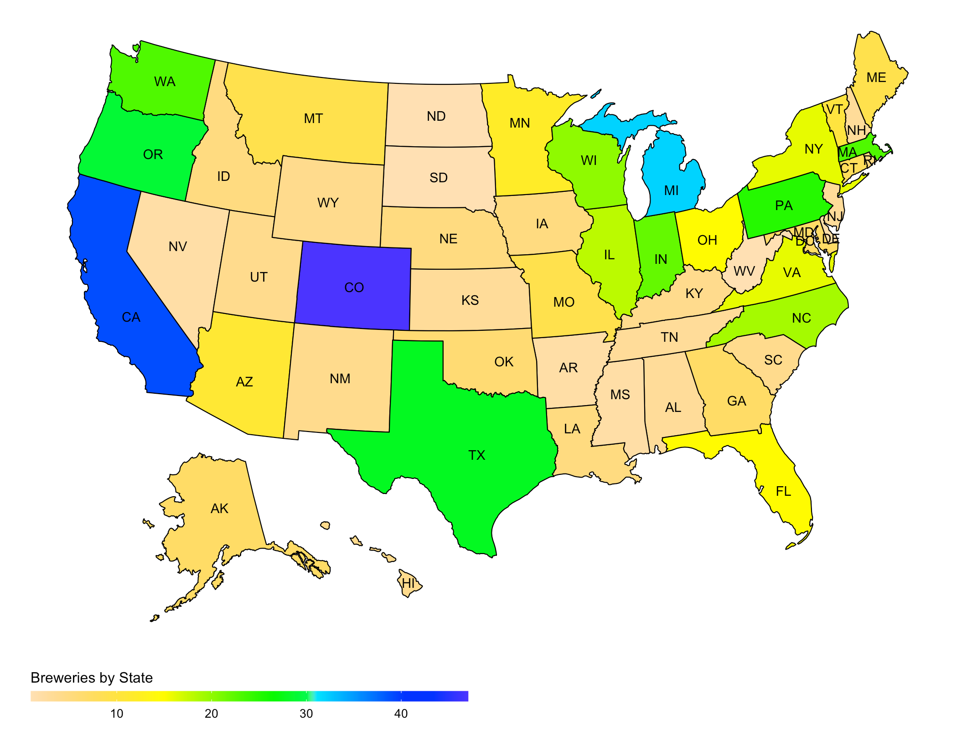
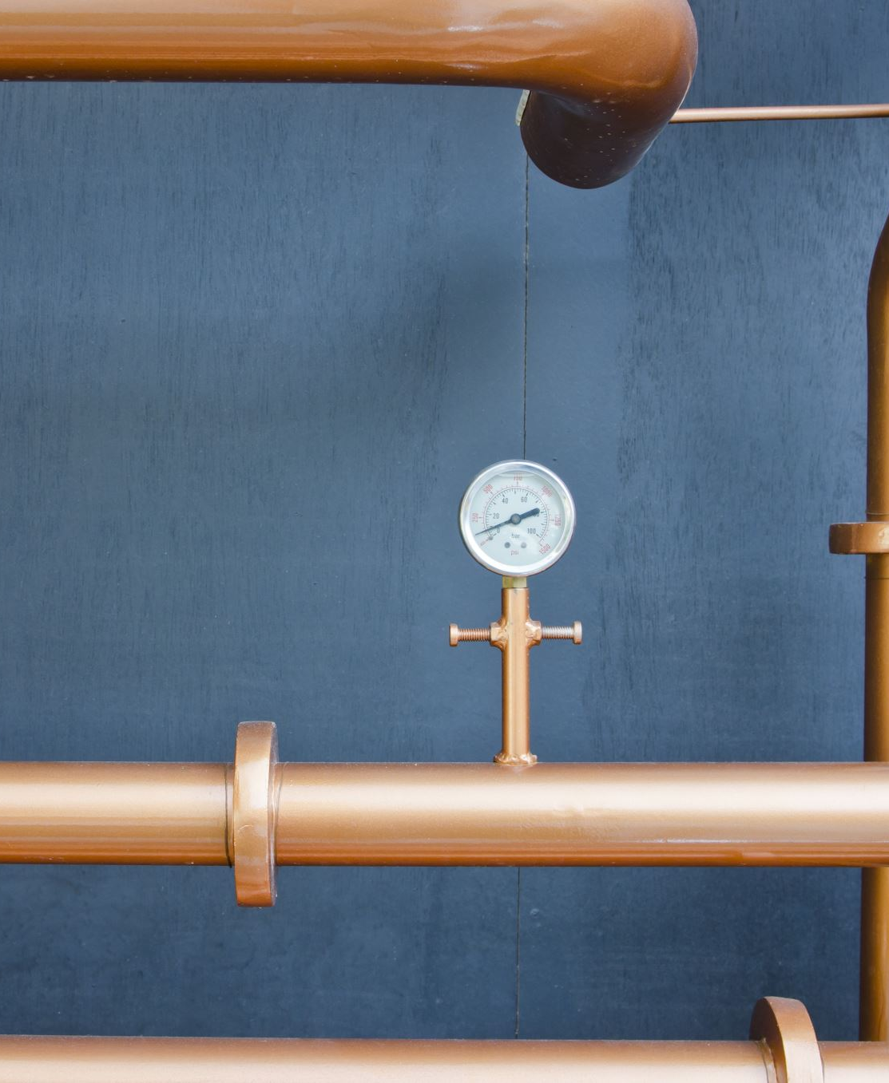
Breweries by State

Slide 3
Bonus Insights
City | Number of Breweries
Portland, OR | 17
Boulder, CO | 9
Chicago, IL | 9
Seattle, WA | 9
Austin, TX | 8
Denver, CO | 8
Cities with Highest Number of Breweries

Slide 4
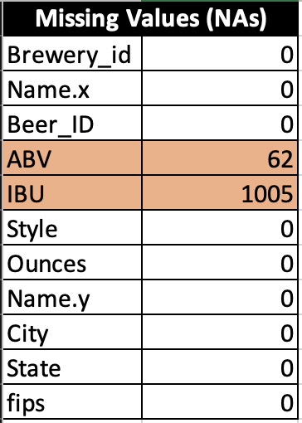
Notes on Missing Data Values
Two Datasets, "Beers.csv" and "Breweries.csv" were joined to create a Full Dataset for analysis and insight
Only ABV and IBU are missing Data Values
Important to note: IBU is missing values in around 42% of the 2,410 total rows of data
**Predictions based upon IBU data specifically, may be skewed
**Data used for analysis provided by client

Slide 5
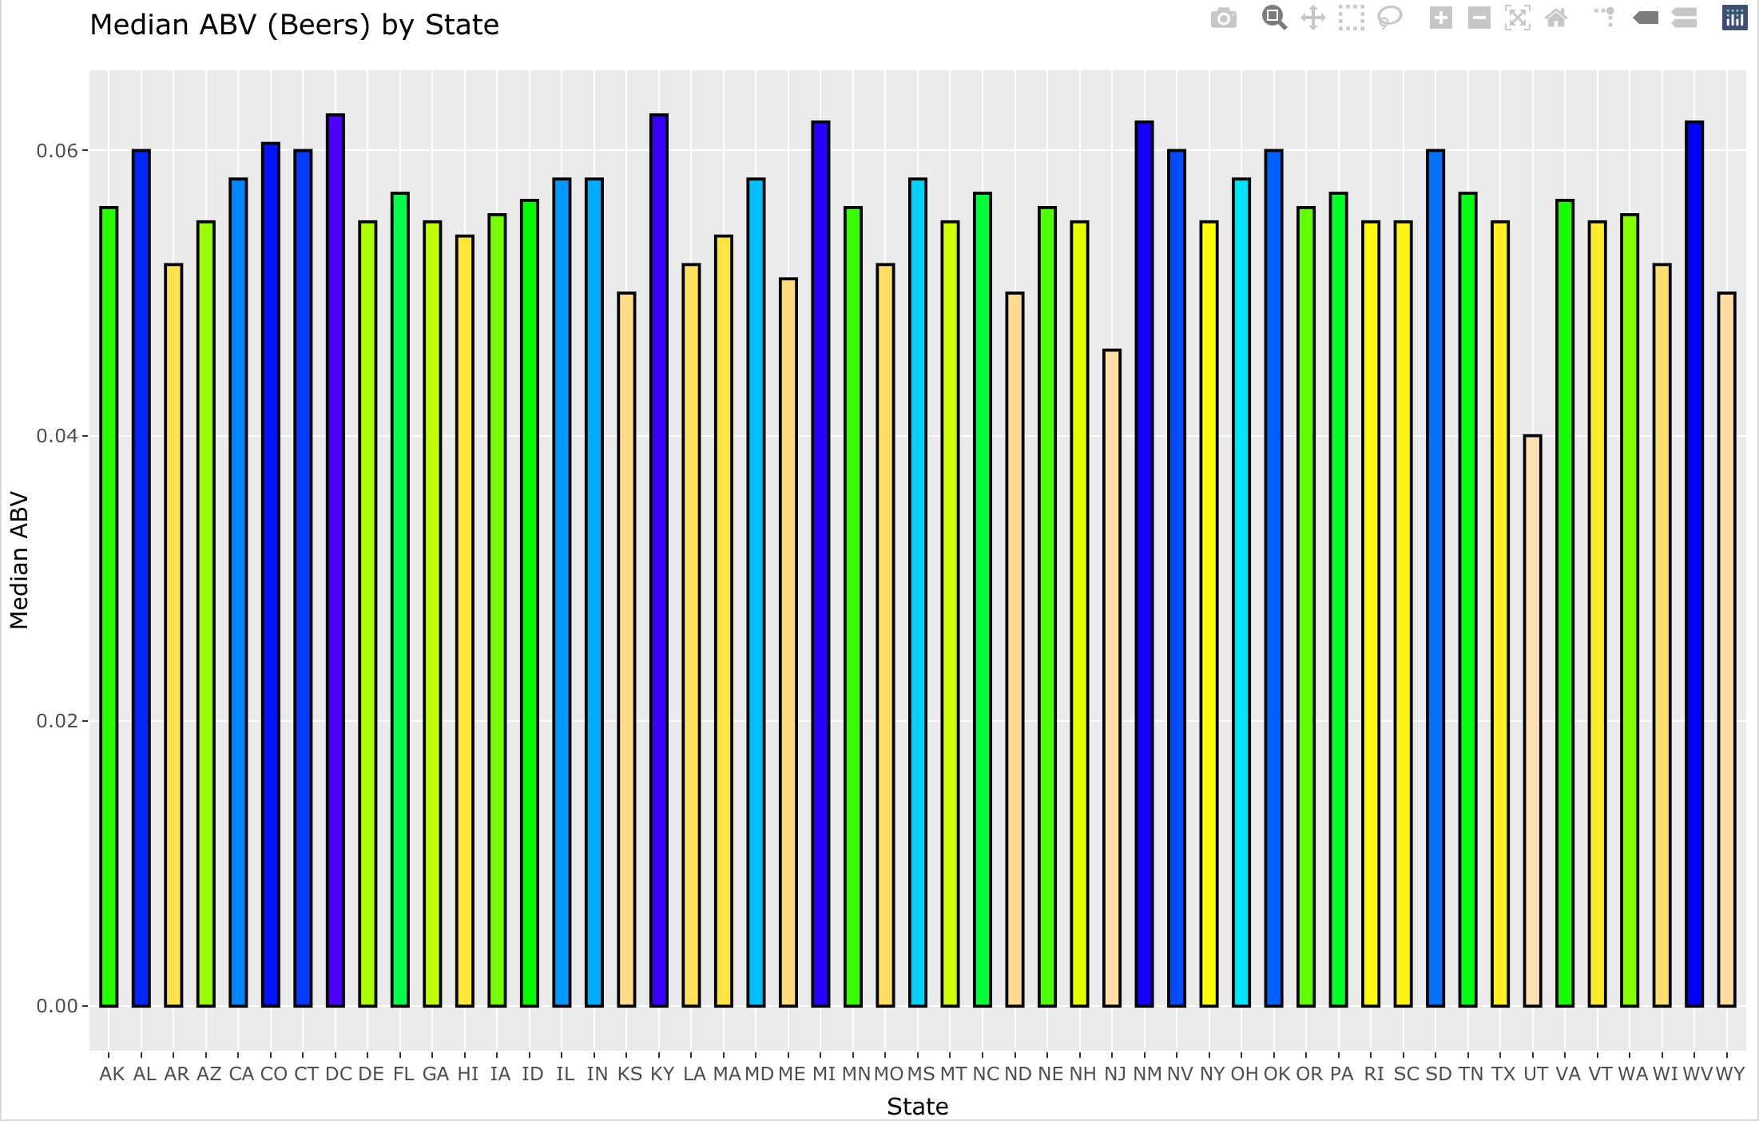
Median ABV (Beers) by State
Notes:
Comment about the ABV....Feel fre to delete

Slide 6
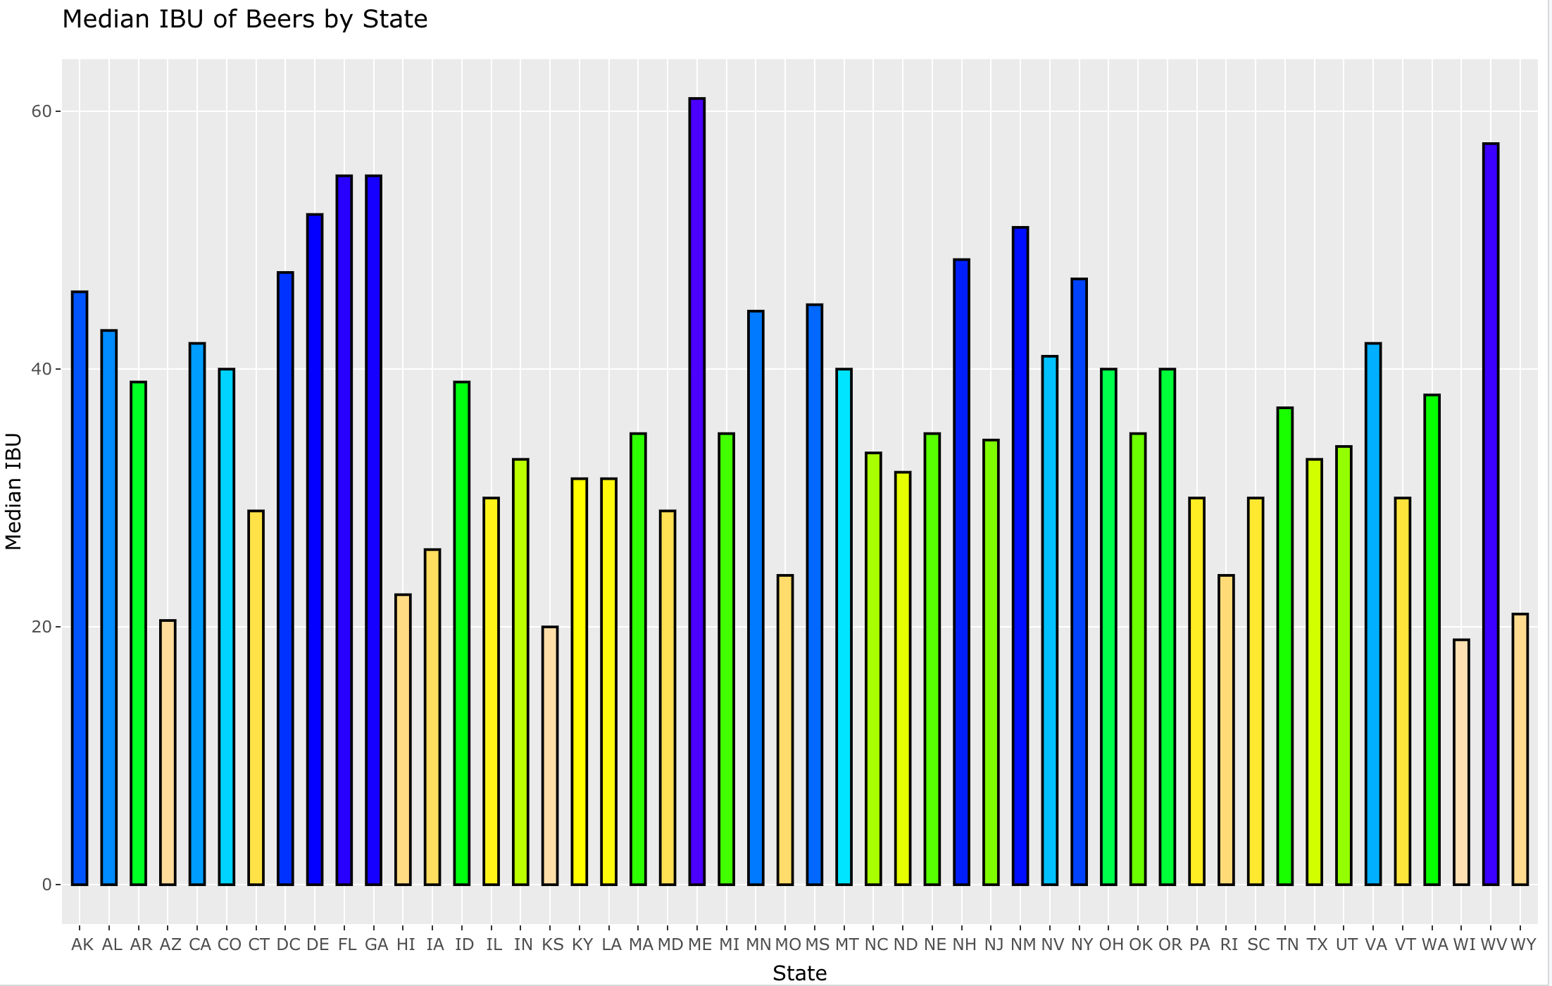
Bitterness Comparison by State
Notes:
Comment about the ABV....Feel fre to delete

Slide 7
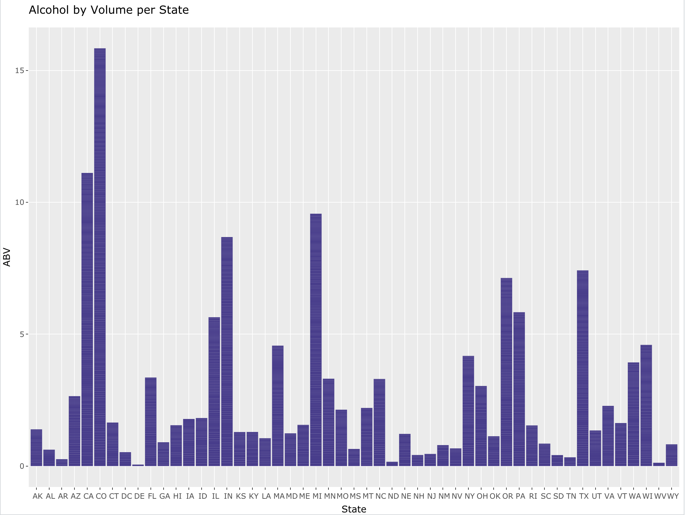
Alcohol by Volume per U.S. State

Slide 8
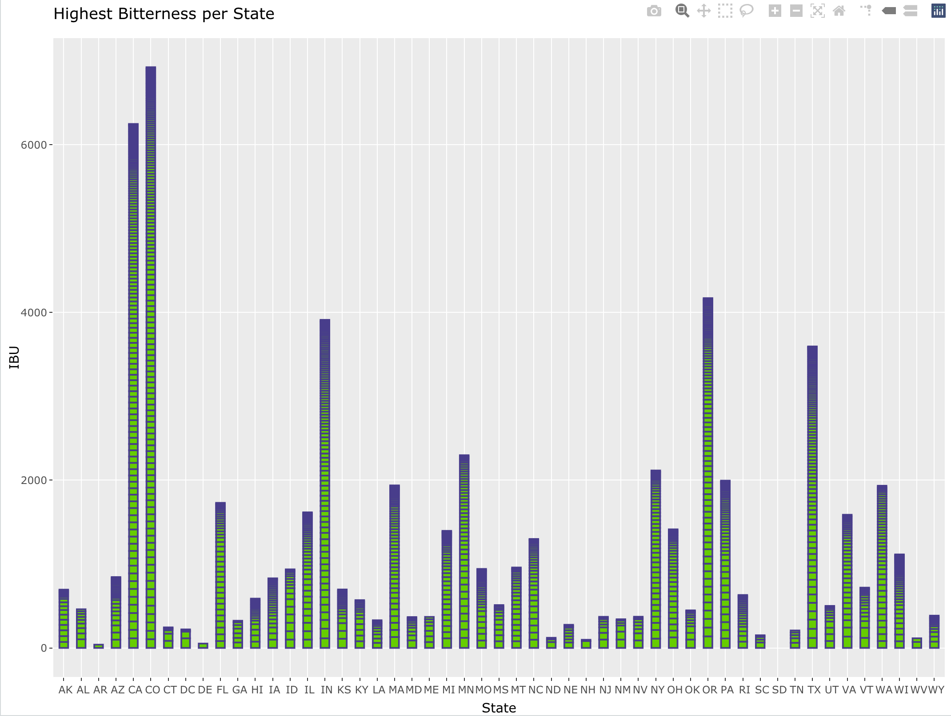
Highest Bitterness per U.S. State

Slide 9
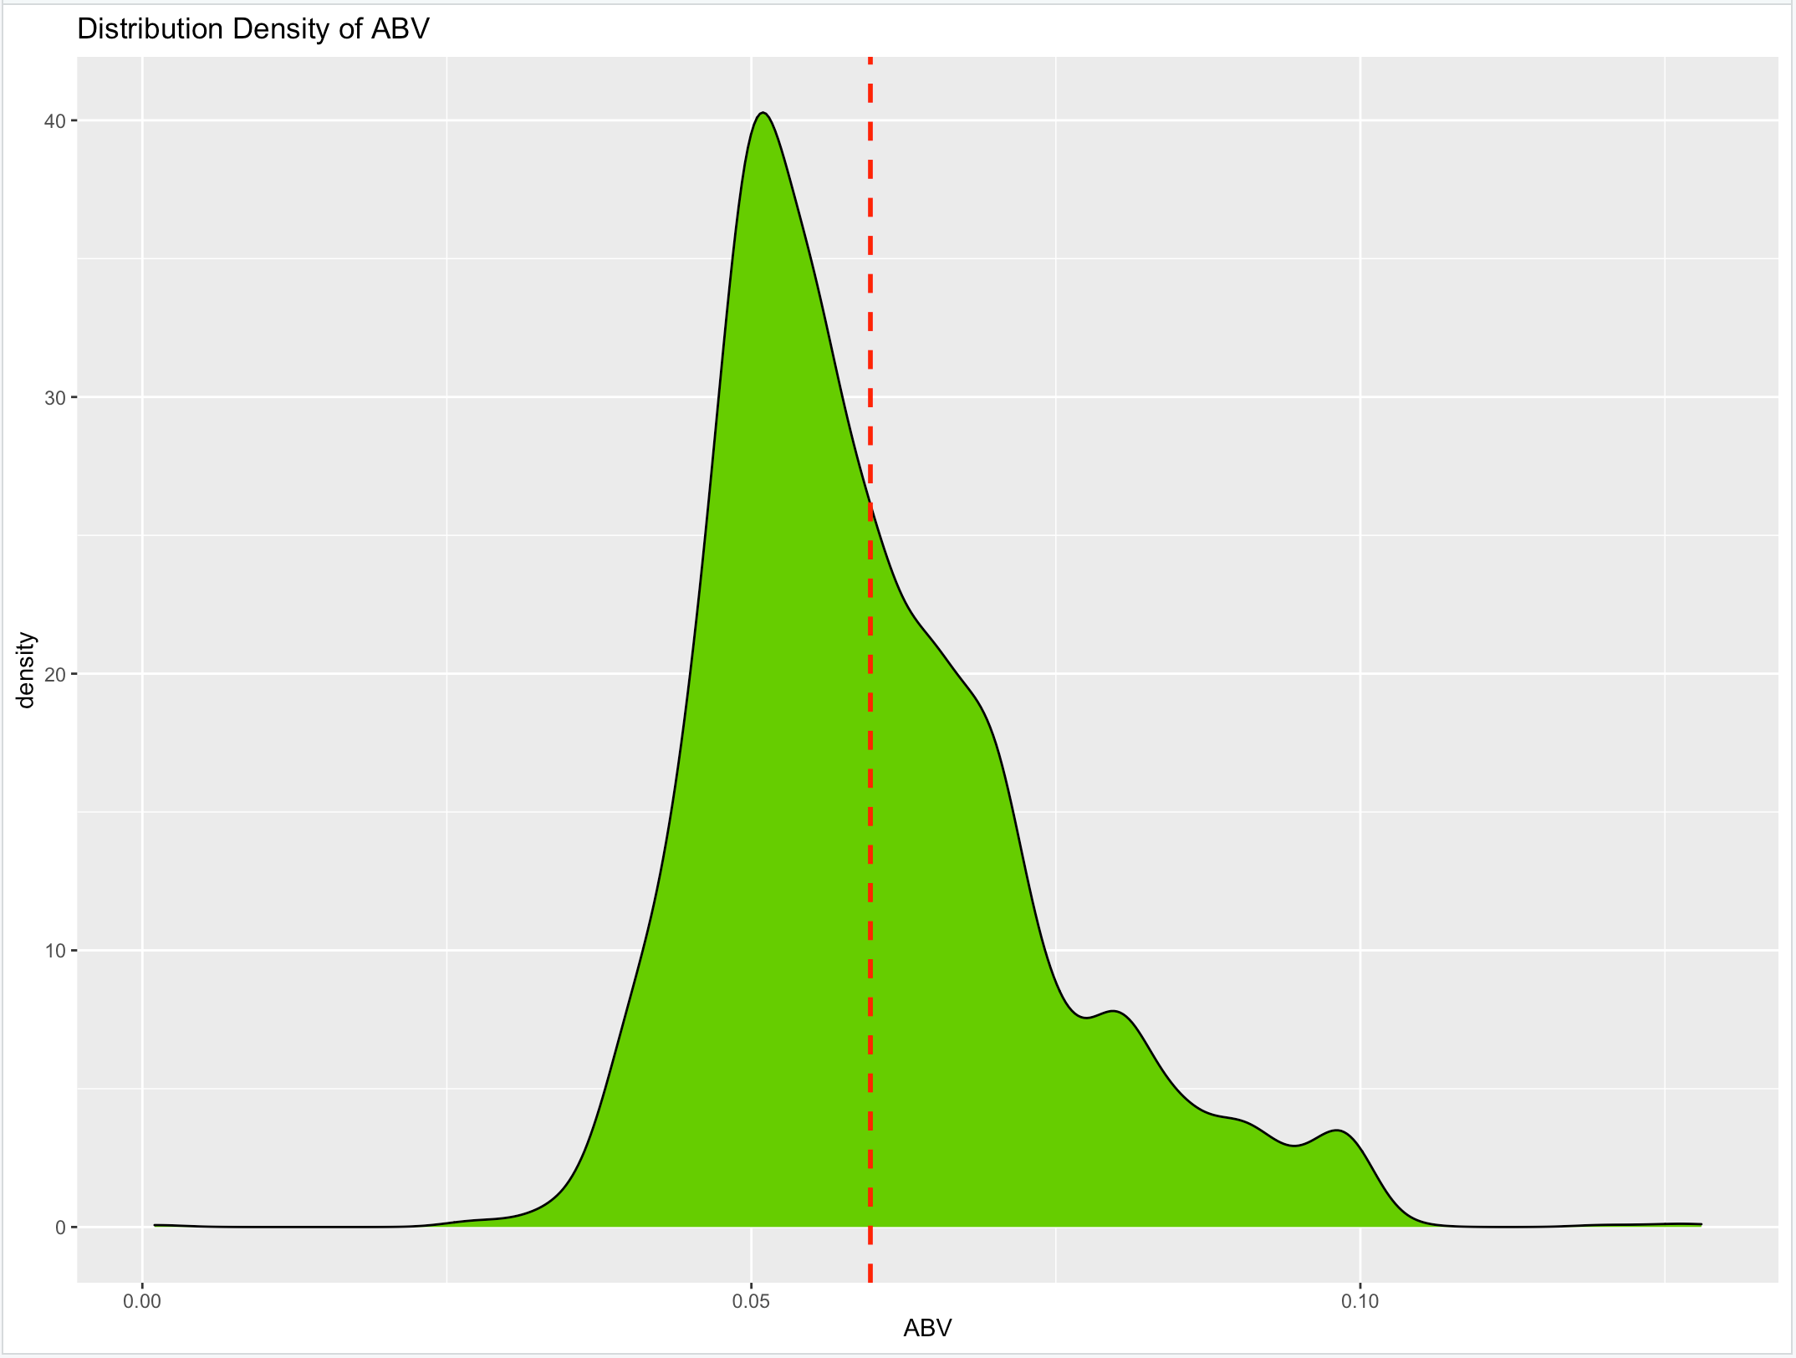
Summary Distribution
Min | 1st Quartile | Median | Mean | 3rd Quartile | Max | NA's
0.00100 | 0.05000 | 0.05600 | 0.05977 | 0.06700 | 0.12800 | 62
Notes:
Summary(Beer_Merge$ABV)
Beer_Merge %>%
ggplot(aes(x = ABV)) + geom_density(binwidth = .5, colour="black",fill="blue") +
geom_vline(aes(xintercept=mean(ABV, na.rm=T)),
color = "red", linetype = "dashed", size = 1) +
ggtitle("Distribution Density of ABV")
Very few nulls out of 2410 observations
The data can be interrupted that the distribution is skewed but definably leans towards the center with more values falling left of mean.

Slide 10
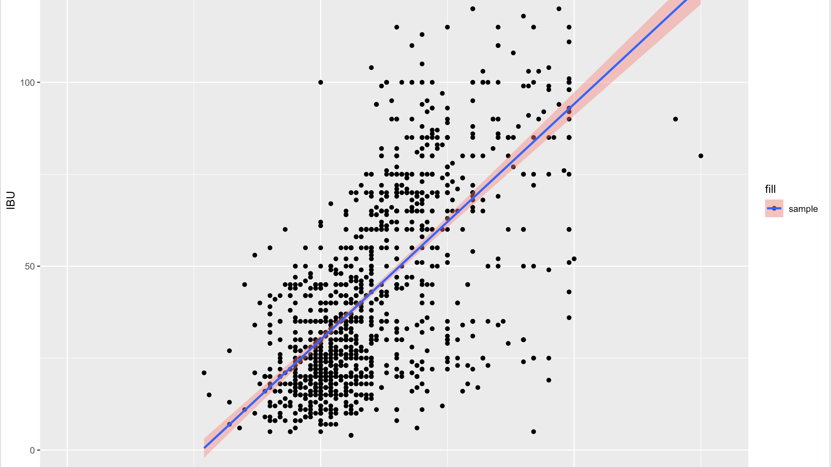
Bitterness & ABV
Notes:
Beer_Merge %>%
ggplot(aes(x = ABV, y = IBU)) + geom_point() + geom_smooth(method = lm) + ggtitle("Bitterness by ABV")
Even with a sample of 1005 beers out of 2410 observations in total of IBU, we can conclude that a p value of 2.2e-16 we can say, we should reject the null hypothesis given an intercept of 0, which is further proved by the confidence interval being .64 to .69 at alpha of .05 or 95%.
There appears to be a strong relationship with a r-squared correlation of .6706 squared = .45.
It's a fair to state that when the ABV or IBU is increased the other shall also increase.

Slide 11
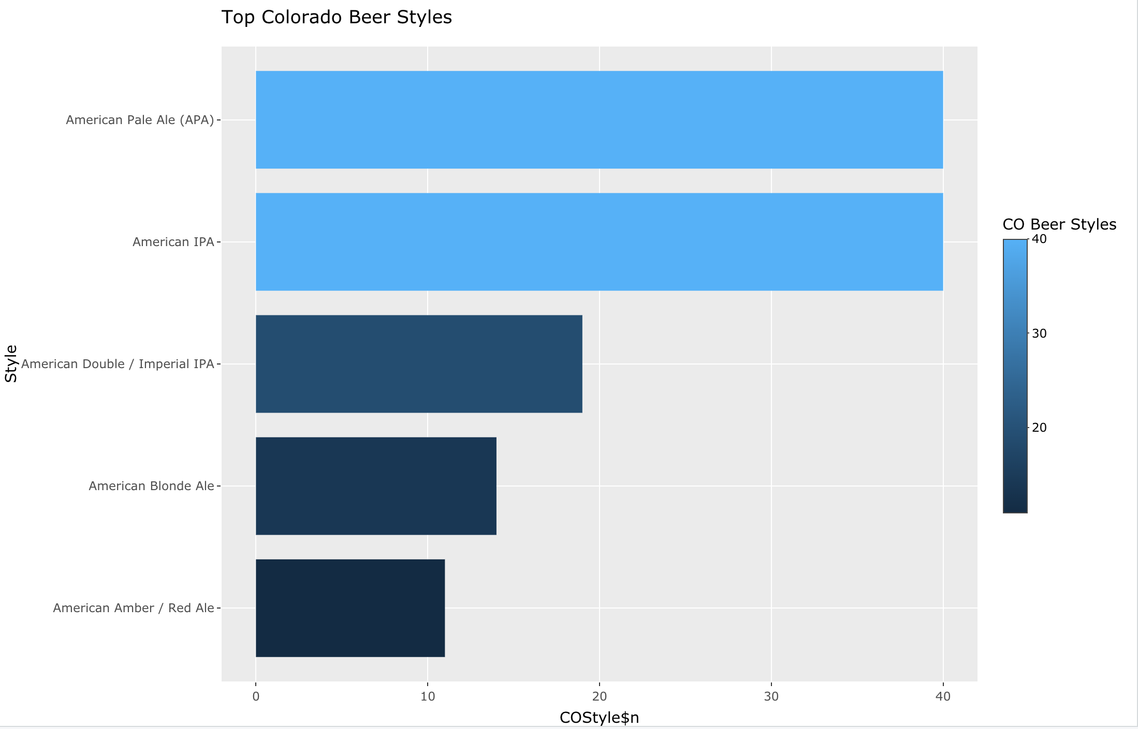
Bonus Insights

Slide 12
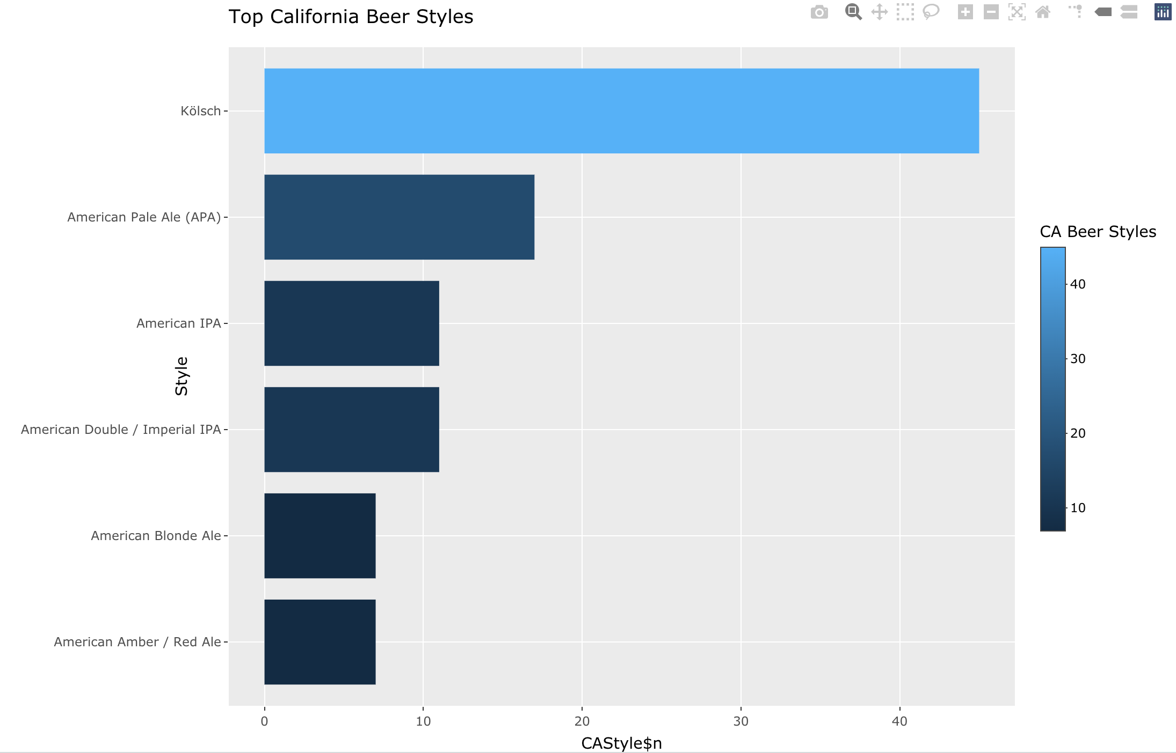
Bonus Insights

Slide 13
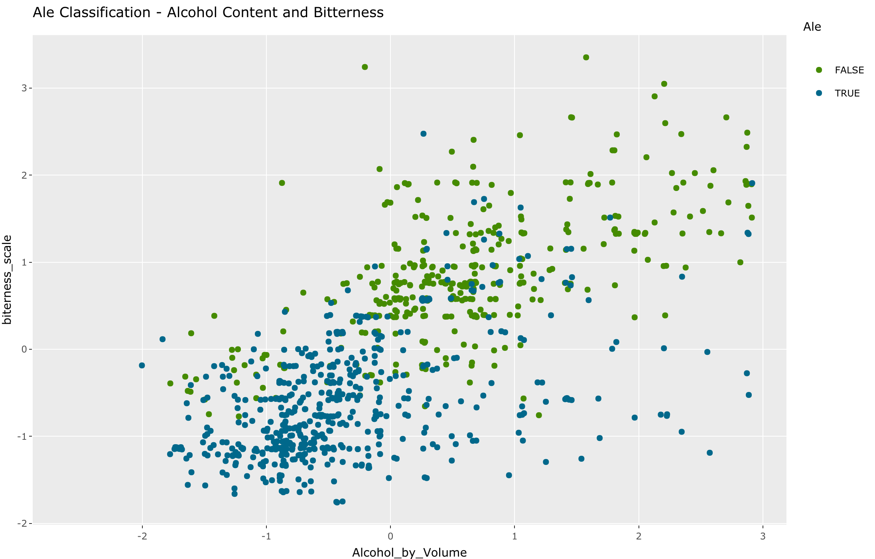
Classifying Ale based upon Alcohol Content and Bitterness

Slide 14
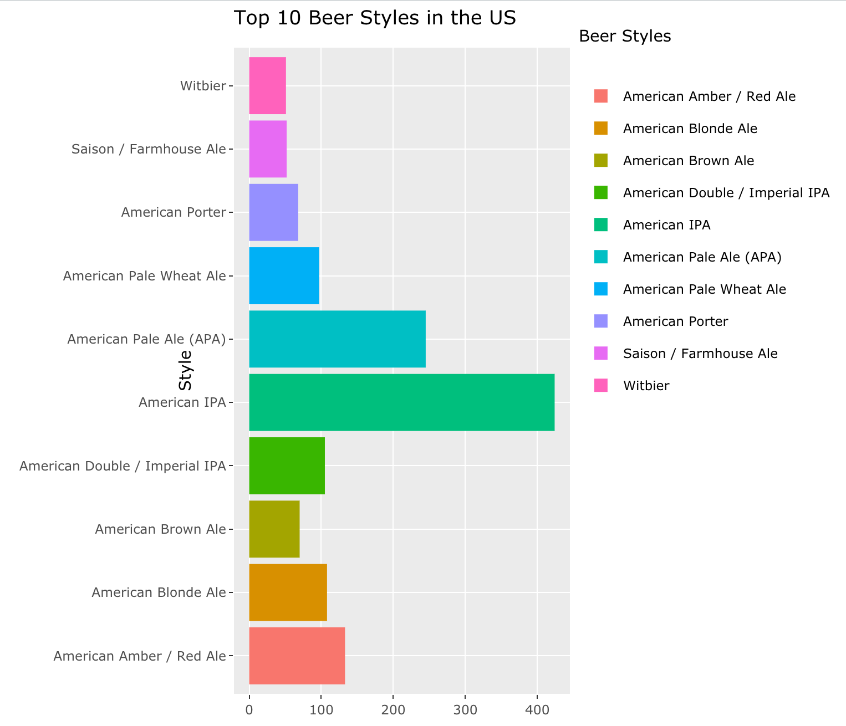
Bonus Insights

