Slide 1
Shopify Inc. (SHOP)
Investment Committee Presentation
Neutral / Accumulate on pullbacks — exceptional company, valuation still requires proof that 20%+ growth and margin expansion persist
Reference price
Model DCF value
Implied downside
Market cap / EV
$103
$96
-6.5%
$134B / $128B
Koyfin / model
model.xlsx DCF!B107
model.xlsx DCF!B109
Koyfin / model
Prepared from SHOP initial coverage report, thesis tracker and DCF model | 2026-05-23

Slide 2
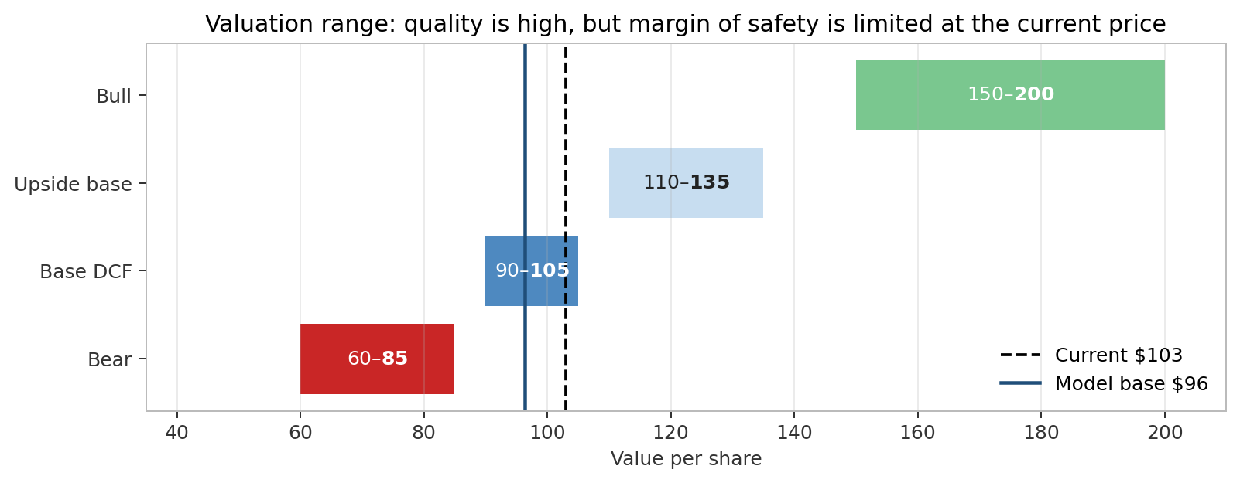
IC recommendation: own the work, wait for either a better entry or proof of reacceleration
Recommendation
Base DCF
Upside setup
Main concern
Neutral
~$96/share
$110–150+
Valuation
Accumulate on pullbacks below ~$90 or after proof high-20s growth is a floor
9.5% WACC; 3.5% terminal g; 22% terminal FCF margin
Requires lower WACC, higher growth duration, or AI/B2B upside
8.3x NTM EV/sales and ~44x NTM EV/EBITDA
Business quality is not the debate: Shopify is scaled, founder-led, asset-light and deeply embedded in merchant workflows.
Fundamentals remain strong: Q1 revenue +34%, GMV +35%, FY2025 FCF $2.0B and net cash balance sheet.
But the current multiple still prices in sustained 20%+ revenue growth and FCF margin expansion.
IC action: keep active coverage; add only on price weakness or evidence that growth/margins are tracking above base case.
Source: report.md; valuation_framework.md; model.xlsx DCF!B107/B109; outputs.json
2

Slide 3
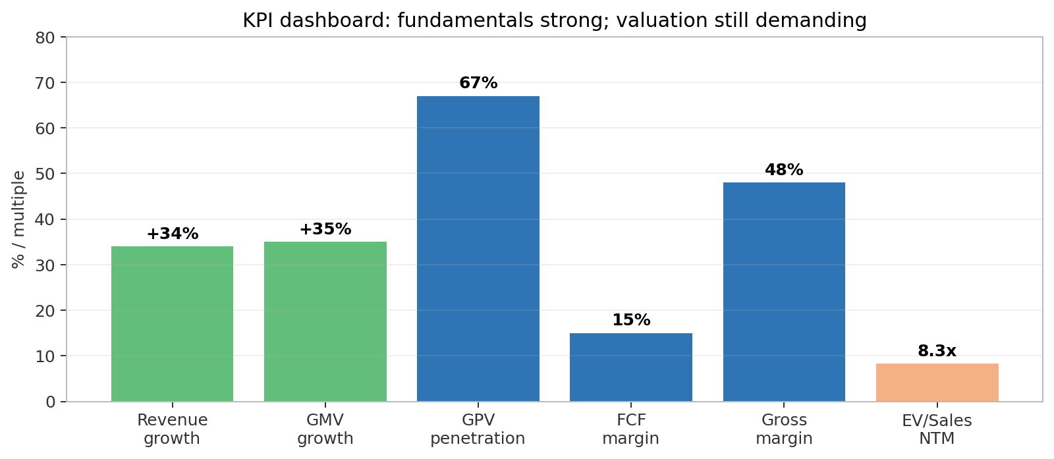
Company snapshot: Shopify is a scaled commerce infrastructure platform, not just SMB store software
FY2025 GMV
FY2025 Revenue
FY2025 FCF
Net cash
Insider ownership
$378B
$11.6B
$2.0B
~$5.6B
~6%
Q1 2026 GMV crossed $100B
+30% YoY
17% margin
Minimal debt
Founder alignment
Two revenue engines: high-margin Subscription Solutions plus GMV-linked Merchant Solutions.
Merchant Solutions is now ~76% of revenue and is the key monetization flywheel through Payments, Shop Pay, Capital, Shipping, Tax, Markets and POS.
Core strategic pivot: from online storefront software to operating system for independent commerce across online, offline, B2B, international and AI channels.
Source: Koyfin extraction summary; report.md; thesis_tracker.md
3

Slide 4
Business model: subscription locks in the merchant; Merchant Solutions monetizes merchant success
More merchants
More surfaces Online / POS / B2B / AI
More buyer conversion Shop Pay / Catalog
More GMV
More Merchant Solutions attach
Revenue stream | Q1 2026 revenue | Gross margin profile | Strategic role
Subscription Solutions | $750M / ~24% of revenue | ~80% | Merchant acquisition, platform control, Plus/enterprise
Merchant Solutions | $2.42B / ~76% of revenue | ~39% | GMV-linked monetization and retention flywheel
Source: report.md business model section; web_business_strategy.md; Koyfin summary
4

Slide 5
Thesis pillars: five things must stay true for SHOP to compound through the multiple
Pillar | Evidence today | KPI / breakpoint
Commerce OS | FY2025 GMV $378B; Q1 GMV $100.7B; broad app ecosystem | GMV growth; breakpoint <15% for 2+ quarters
Merchant Solutions flywheel | Merchant Solutions 76% of revenue; GPV penetration 67% | GPV penetration; breakpoint stalls <67%
Upmarket / B2B / international | Plus ~34% MRR; B2B +80–96%; international +mid-30s | Plus mix, B2B GMV, enterprise wins
FCF durability | FY2025 FCF $2.0B; Q1 FCF margin 15% | FCF margin; breakpoint <12%
AI option | UCP, Sidekick, Catalog, agentic storefronts | AI-referred GMV / monetization
IC framing: thesis is intact today, but valuation requires the KPIs to remain strong through the next 2–4 quarters.
Source: thesis_tracker.md
5

Slide 6
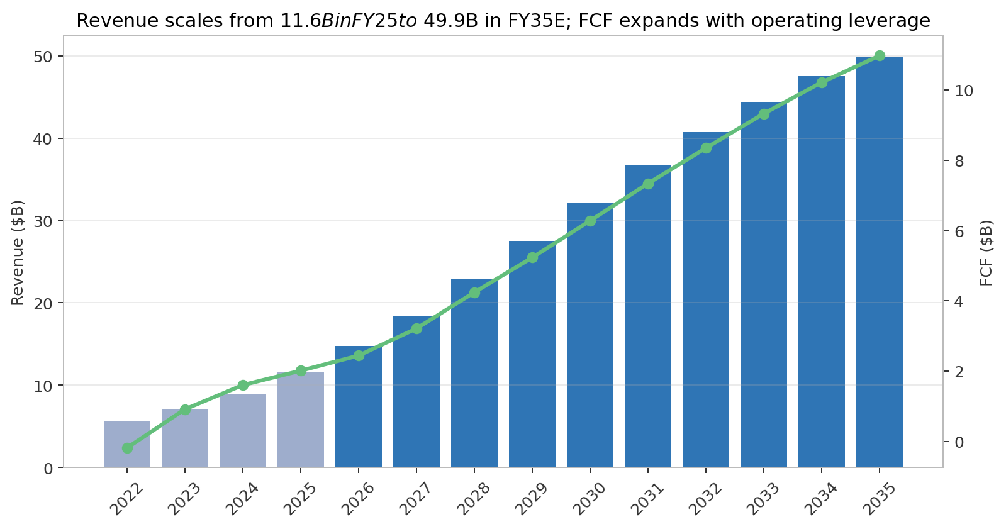
Financial model: consensus supports 20%+ growth through FY2028; DCF assumes gradual fade and FCF margin expansion
Metric | FY2025 | FY2028E | FY2035E
Revenue | $11.6B | $22.9B | $49.9B
Growth | 30% | 25% | 5%
FCF margin | 17.4% | 18.5% | 22.0%
FCF | $2.0B | $4.2B | $11.0B
Base case uses Koyfin consensus for FY2026–FY2028.
Long-run value depends on whether Shopify can keep growth elevated while expanding FCF margin despite Merchant Solutions mix pressure.
SBC remains an economic cost; buyback helps but does not eliminate dilution risk.
Source: model.xlsx DCF tab; valuation_framework.md; report.md financial analysis
6

Slide 7
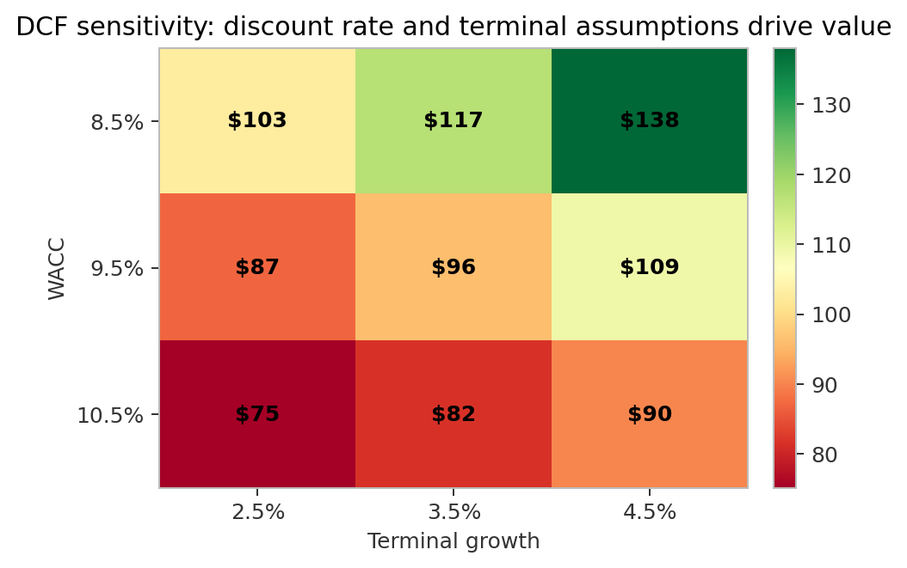
Valuation: model base is below current price; upside requires either duration, margin or discount-rate upside
DCF bridge | Value
PV explicit FCF | $39.7B
PV terminal value | $80.0B
Enterprise value | $119.6B
+ Net cash | $5.6B
Equity value | $125.2B
Implied value / share | $96.30
Model base: $96.30/share vs current $103.00, or -6.5% implied downside.
Base assumptions: 9.5% WACC, 3.5% terminal growth, 22% terminal FCF margin.
Practical decision range: <$85 attractive if fundamentals intact; >$135 requires bull-case execution.
Sensitivity remains large: small changes in WACC / terminal growth can move fair value by >$25/share.
This is why IC should focus on evidence of growth duration and margin trajectory, not just one-point DCF.
Source: model.xlsx DCF!B100:B109; outputs.json; valuation_framework.md
7

Slide 8
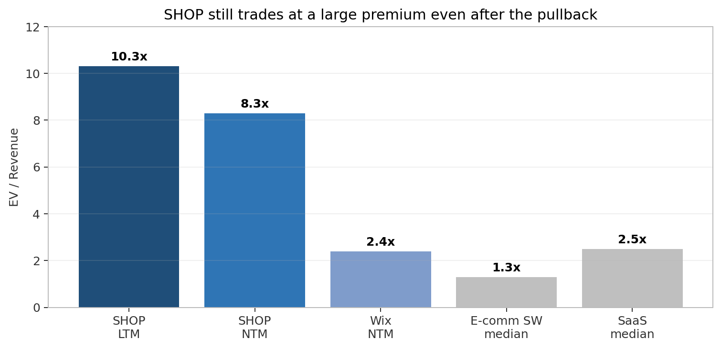
Multiple sanity check: SHOP deserves a premium, but the premium is still the key risk
Multiple | SHOP current
EV/Sales LTM | 10.3x
EV/Sales NTM | 8.3x
EV/EBITDA NTM | 44.4x
P/E NTM | 54.5x
Street avg target | $151
SHOP is not directly comparable to small commerce SaaS: scale, growth, GMV, payments and ecosystem justify a premium.
But multiple compression remains the main downside if Q2 guide proves to be the start of a deceleration cycle.
Upside to $130–150 requires sustained premium sales multiple or confidence FY2028 EBITDA/FCF is too low.
Source: Koyfin multiples; valuation_framework.md comps section; model.xlsx Comps tab
8

Slide 9
Competitive position: Shopify wins on merchant alignment, ecosystem breadth and unified commerce
Competitor set | Where they compete | SHOP counter-positioning
Amazon / marketplaces | Demand capture and fulfillment | Shopify preserves merchant brand, customer data and channel independence
WooCommerce / Wix / Squarespace | SMB storefront creation | Shopify has deeper commerce stack, payments, apps and scaling path
BigCommerce | Mid-market / B2B, no transaction fees | Shopify has larger ecosystem, Shop Pay and broader Merchant Solutions
Adobe / Salesforce / custom | Complex enterprise commerce | Shopify offers faster implementation and lower TCO, but must prove high-end complexity
Stripe / PayPal / Adyen / Block | Payments / POS economics | Shopify embeds payments in merchant OS; dependence and take-rate risk remain
Moat source: ecosystem + switching costs + aligned incentives; Shopify does not compete with merchants.
Main competitive risk: AI agents and platform walled gardens could shift demand/checkout away from merchant storefronts.
Monitoring: enterprise wins, GPV penetration, payment take rate, AI checkout economics.
Source: report.md competitive landscape; web_competition_market.md; thesis_tracker.md
9

Slide 10
Catalysts: next 6–12 months should clarify whether deceleration fears are overdone
Catalyst | Window | Bull signal | Bear signal
Q2 2026 earnings | Early Aug 2026 | Revenue > guide; GMV resilient; FCF mid/high teens | In-line on lower growth; weak Q3 guide
AI / agentic disclosures | 2026–2027 | AI-referred GMV disclosed; Shopify captures checkout/payment | Traffic without monetization; agents bypass storefront
Payments penetration | Quarterly | GPV penetration toward 70–75% | Stalls at 67%; take-rate compression
B2B / enterprise | Quarterly | More global brand wins; B2B remains >50% growth | B2B slows; Adobe/Salesforce defend enterprise
Buyback execution | 2026 | Share count stable/down; disciplined price | Buybacks fail to offset SBC dilution
Sezzle / regulation | H2 2026+ | Case contained | Forced interoperability / payments scrutiny
Source: thesis_tracker.md catalysts table
10

Slide 11
Risks and kill criteria: the thesis breaks if growth slows before margins scale
Risk | Why it matters | Watch item / kill criterion
Growth deceleration | Premium multiple requires long growth duration | Revenue <20% or GMV <18% for multiple quarters
Merchant Solutions margin pressure | Lower-margin mix can cap FCF expansion | Gross margin <45% or transaction losses rising
AI disintermediation | Could bypass storefront / checkout economics | AI traffic grows but Shopify monetization absent
Competition | Pressure across SMB, enterprise, POS and payments | Enterprise wins slow; GPV penetration stalls
Regulation / antitrust / BNPL | Can impair payments economics | Sezzle case expands or forced payment interoperability
SBC dilution | FCF per share matters more than FCF dollars | SBC >5% revenue and buyback insufficient
Position sizing should reflect asymmetric valuation risk: downside is mostly multiple compression, not balance sheet stress.
Source: thesis_tracker.md risks table; report.md risks section
11

Slide 12
IC decision: keep on active watch; require either price discipline or KPI confirmation
Decision
Entry rule
Upgrade rule
Do not initiate full-size position today
Add below ~$90
Buy on proof
Valuation does not provide enough margin of safety at ~$103
Assuming GMV / revenue / FCF KPIs remain intact
Q2/Q3 show high-20s growth floor + FCF durability
What we like: founder-led, dominant independent commerce OS, GMV-linked monetization, net cash, FCF-positive, multiple growth vectors.
What holds us back: base DCF below current price, premium multiple, margin mix pressure, AI outcome uncertain.
What to do now: maintain coverage, update after Q2 earnings, track KPI dashboard and valuation bands.
Source: Investment conclusion from report.md; model.xlsx; thesis_tracker.md
12

