Slide 1

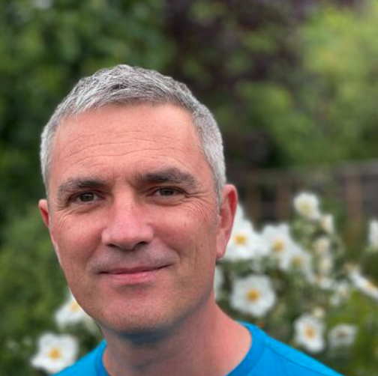
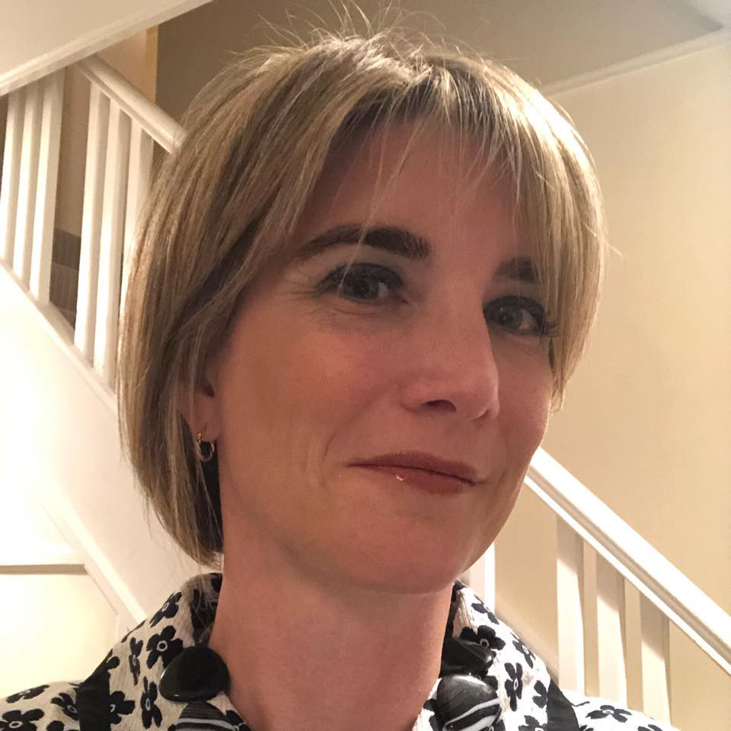
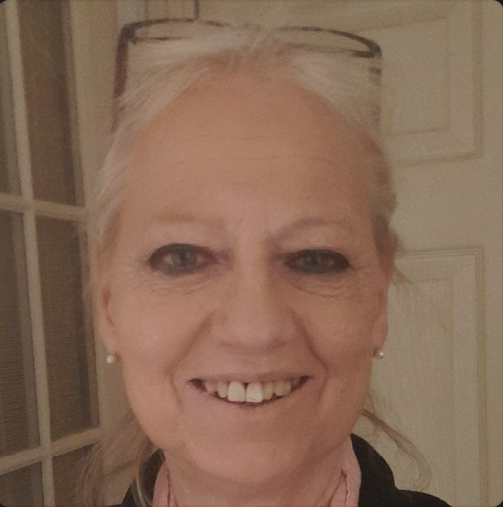
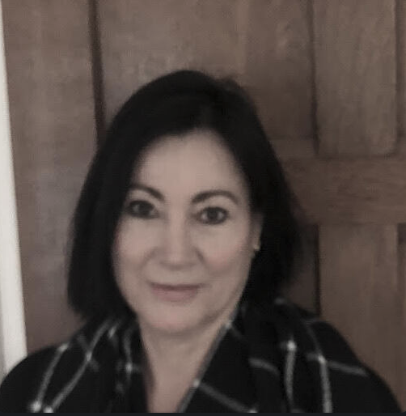
Meet The Team
https://eat-the-week.herokuapp.com/
Ben
Brom
Claire
Jane
Shirley

Slide 2
Our “Makers” Journey
to Eat The Week
https://eat-the-week.herokuapp.com/
Opportunity & Commitment
Pre-course
Admission Test
Self Driven Development
Weekly & Weekend
Challenges and Projects
Forever Changing/Challenging
Ruby to React
Australia, Poland, France, Ireland and UK
Peer Groups
Being Comfortable with the Uncomfortable
Notes:
End with Your Week, Well Fed

Slide 3

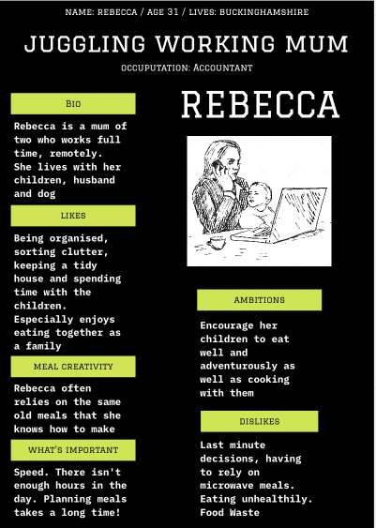
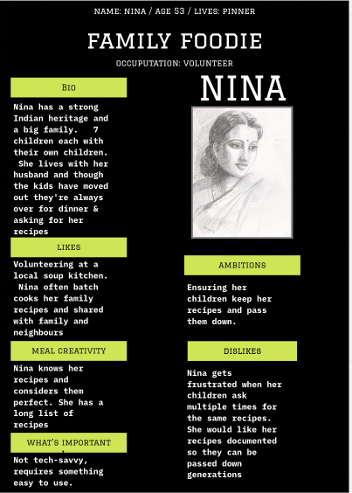
Why Eat The Week?
https://eat-the-week.herokuapp.com/
Notes:
Talk through personas, what problem are we trying to solve, who wants this, why do they want it?
Introducing Rebecca:
Definitely not based on anyone I know, or anyone on this call
Juggling working Mum of two
Lives with children husband & dog
Wants organisation, tidy house and time with the kids incl mealtimes
Relies on recipes she knows
Time is precious, planning meals takes time!
Introducing Nina
Family Foodie
Strong Indian heritage, big family with 7 kids and many grandchildren
Kids always over & want her recipes
Often batch cooks for family and friends
Frustrated at family asking for the same recipes
Wants her many recipes passed down
Not tech-savvy, needs something easy to use and pass them down

Slide 4
What is it?
https://eat-the-week.herokuapp.com/
Food website
Upload recipes
Create a weekly planner
Order products on the plan
Notes:
End with Your Week, Well Fed

Slide 5

Demo
https://eat-the-week.herokuapp.com/
Notes:
Demo:
Logon
My recipes, some pre-loaded
Let’s add
Allows photo upload
Edit
Let’s add to Sunday
Can view recipes and print them, Nina would find this useful
Let’s order this weeks food
Let’s remove it
So what about someone like Rebecca…she may want some inspiration to mix up what she feeds her kids
She can search for other recipes, using this page which calls an API and allows you to view other recipes
This is a little page about out team
And you can logout

Slide 6
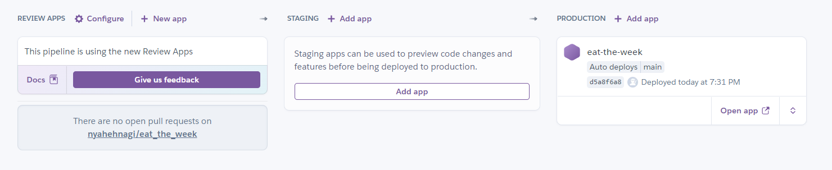
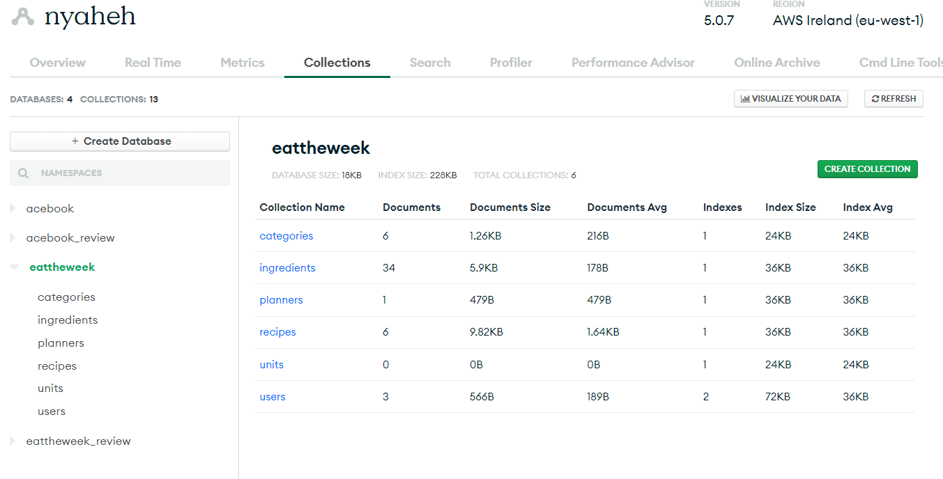
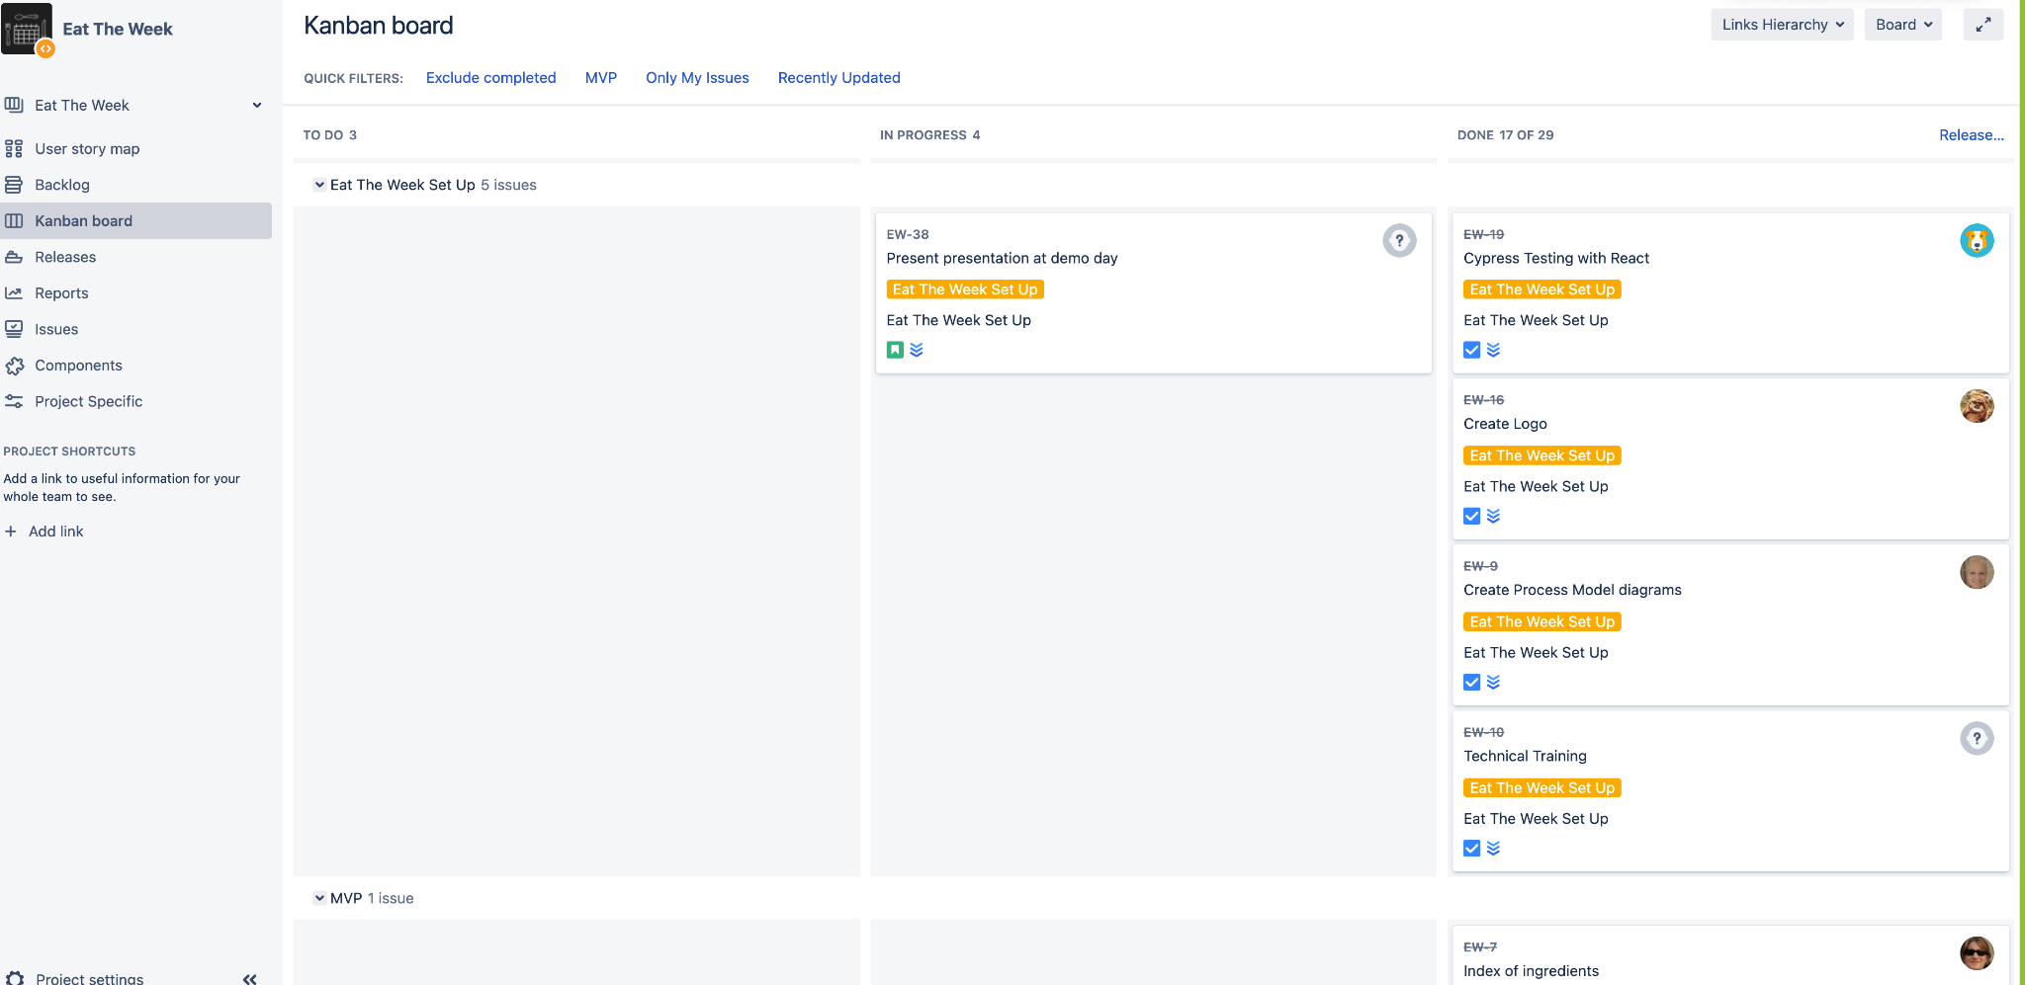
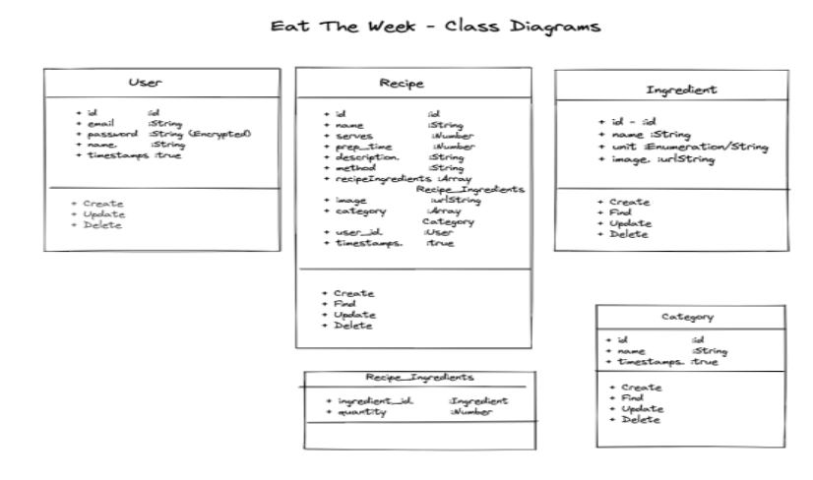
Tech & Process
https://eat-the-week.herokuapp.com/
Responsive React application based on the MERN stack
Automated deployment (via Github/Heroku integration)
Cloud hosted database (Atlas) and website (Heroku)
Full RESTful backend API with token authentication
Unit (Jest) and Integration testing (Cypress)
Class, domain modelling and screen mocks
Followed an agile process
Daily stand ups
Retros and show and tells
Pair and single programming
Notes:
Transcript.
Thank you Claire for the excellent demo, great to see the app again :-)
My name is Bromley and I am going to talk to you about the tech and the process we used to deliver the app
The over arching premise of the project was as a learning experience for the team. we wanted to choose tech that would be of interest to all of us
And we also wanted to make sure that what we were doing would be relevant to our future work at JL
on that basis we decided to run with the MERN stack, so building with a React front end and a back end of Express, Node and MongoDB - this was done with an MVC style of design
We’d already had exposure to the back end tech throughout the course, however React to us was totally new,
One of the great things about the course is that it gave us the skills and confidence to pick up a new language from scratch - in this case React
As with JL and Waitrose which uses GCP and AWS we decided to put our work into the cloud and used Atlas for the DB and Heroku for the app. This gave us the benefit of integrating our remote git repo on Github to heroku which enabled us to review a pull request and then after merging have our changes automatically move up to production. So a little bit of CI/CD there.
We developed a full restful API backend for the features we wanted to deliver and this included built in security using token authentication
to mirror how we work at JL we made use of Jest and Cypress for our unit and integration tests. Admittedly we did not do as much testing as we would have liked, the application was changing so quickly we were getting bogged down in amending tests and not delivering features, so we decided to get the features out and test retrospectively.
In terms of look, feel and responsiveness we used a mix of Bootstrap and custom css, so the site looks pretty good on mobile and the web.. This was primarily in the interests of time.
In terms of how we delivered our project we used Agile processes
We did modelling up front with class and domain models along with some screen mocks and personas that Ben spoke about
We had daily stand ups using our Kanban on Jira, thank you Claire for setting that up :-) to talk about the work we had done and what the day ahead would look like
We ran with 2 day sprints with a retro to talk about what went well, what didn't go so well and what we could do differently
And we also had regular show and tells, as noted at the beginning, the over arching premise of the project was to learn, so the show and tells were to share knowledge and highlight cool stuff that we had worked on.
Finally, we mixed it up with pair and solo programming, this was to work with different styles of working and it worked really well for us.
So, that’s the tech and how we delivered, and I’ll now hand you over to Shirley who will talk to you about what went well and our opportunities

Slide 7
Food Heaven and Food Hell
https://eat-the-week.herokuapp.com/
Bespoke
React
Team
Testing
React
Time
Notes:
Start with hell
Testing - initial setup took time, integrating with our code. Meant we started without some tests. Learn for future
React - Unique style, hard to learn and implement
Time - We’ve all worked v long hours and put everything we have into it to get to where we are and put pressure on us and families
Heaven: Perfect way to wrap up
Bespoke
Logo
Though used Bootstrap also lots of our own styling
Hooks, Reacts unique style!
Social Media
React - for what we said for Hell, that in itself is why then producing a website like this feels like a massive achievement
Team:
What better way to end
Great team
Gone above and beyond
As with any group working as intensely we had our moments, but we leave with just one broken elbow and one detached retina
But seriously
Hope all agree, I’ll leave with 4 friends for life, alghough the same could be said of the rest of the cohort

Slide 8

Thank You
https://eat-the-week.herokuapp.com/
Find us on:
twitter.com/eattheweek
facebook.com/eattheweekuk
instagram.com/eattheweek

