Slide 1


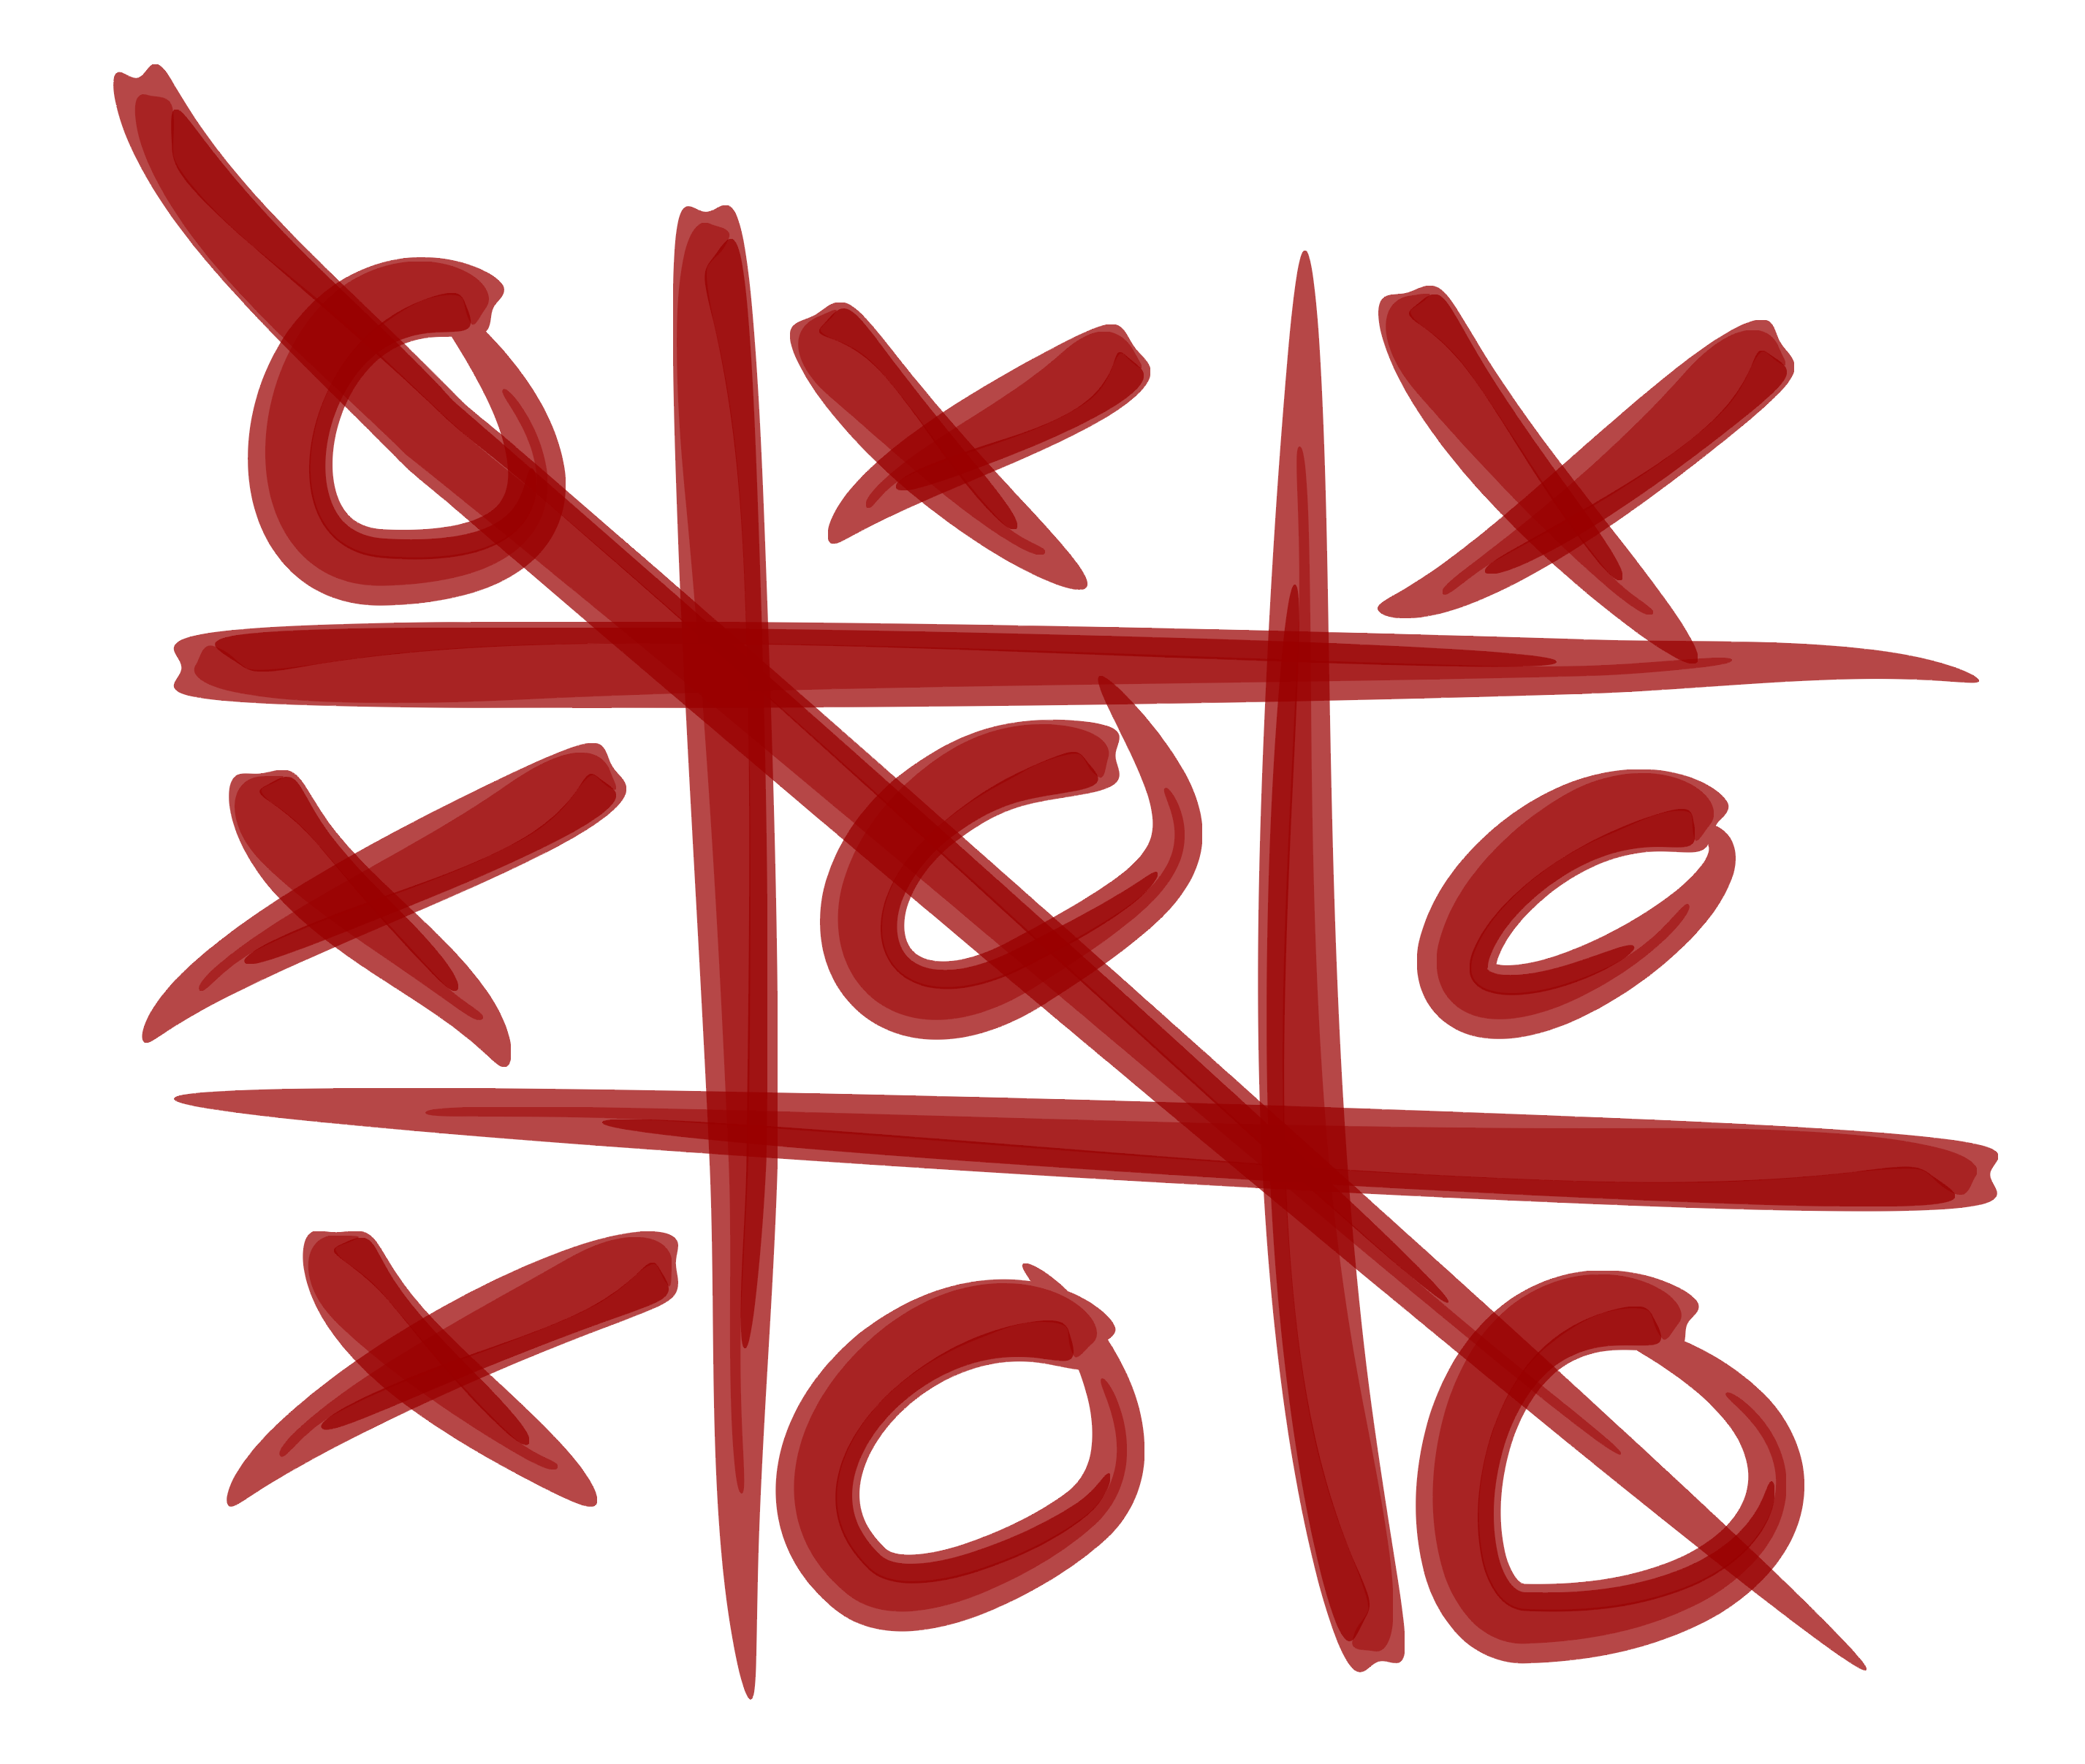
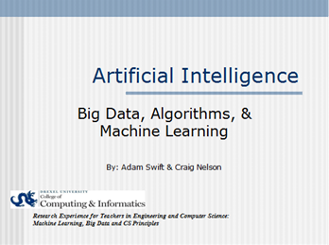
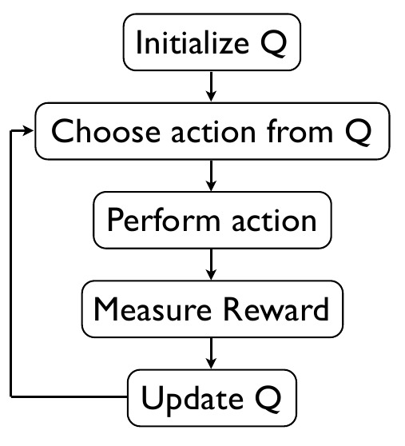
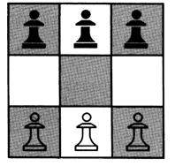

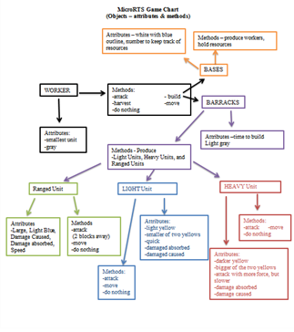

ARTIFICIAL INTELLIGENCE
CRAIG NELSON & ADAM SWIFT Faculty Advisor: SANTIAGO ONTANON
Overview
Activities
Course Materials
Artificial Intelligence
How can one create AI’s that effectively play real time, deterministic video games? In order to better understand this question, microRTS, a real time strategy game, was developed. MicroRTS implements a variety of hard coded AI’s which can be played against and evaluated to determine the AI’s prowess as a game player. This research demonstrates the limitations of hard coded AI and transitions into the need for Machine Learning or Intelligent AI.
Creating an Algorithm Activity – Tic-Tac-Toe (cs4fun)
CS Principles Big Ideas: Big Data, Algorithms & Machine Learning
Artificial Intelligence PPT
Explaining Q-Learning
Handouts and Questions for use during PPT, Activities, and Demos
Hands-on demos as reinforcement of material in PPT
Easy to use package for microRTS including installation instructions (Eclipse & NetBeans)
Tutorial File (video and hard copy) for understanding and playing microRTS
Plans/Tutorials for AI Projects using Finch Robots, Lego Mindstorm, and E-Textiles
Hexapawn Demo w/Machine Learning – Reward Activity (cs4fun)
microRTS
Minimalist Real-Time Strategy Game designed for AI Research
Play microRTS to understand AI
In game analysis questions
Describe algorithms to roam, attack and build units on playing grid
Deciphering the Code Activity
Project Objectives
Understand the game play and functionality of microRTS
Develop lesson plans to introduce students to AI while using microRTS as an engagement tool
Develop materials to demonstrate AI and machine learning through hands-on activities
Use microRTS to facilitate student understanding of concepts learned in their programming class and begin to possibly delve into coding their own AI
Discuss Open Source Coding and the need for documentation when others are contributing to their code
Future Work
Expansion in regards to the use of Robots and E-Textiles during the AI Unit
Lego Mindstorm, Finch Robots, &
E-Textiles!
Programming One’s Own AI in microRTS
Understanding Objects in microRTS
- A review of Object Oriented Programming
Acknowledgements
REThink@Drexel
Research Experiences for Teachers in Engineering and Computer Science:
Machine Learning, Big Data and CS Principles
This material is based upon work supported by the National Science Foundation under Grant No. CNS-1301171.
Any opinions, findings, and conclusions or recommendations expressed in this material are those of the author(s) and do not necessarily reflect the views of the National Science Foundation.

