Slide 1
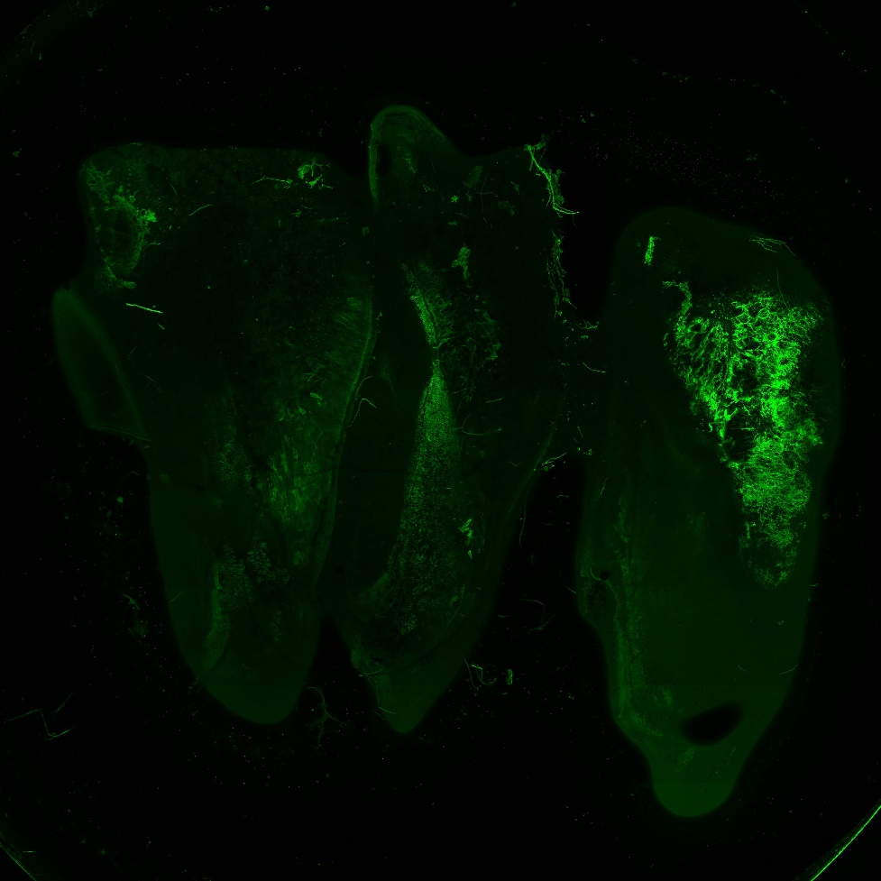
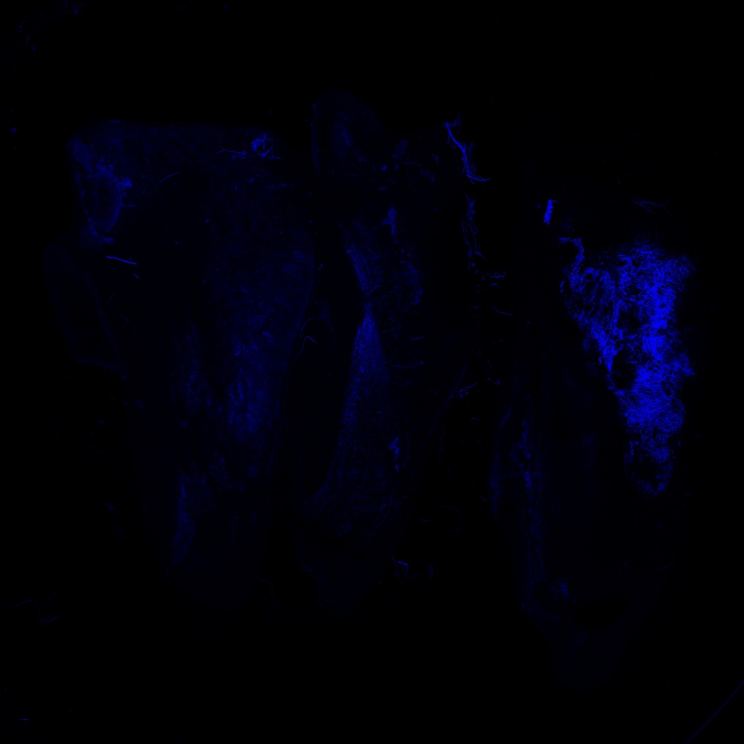
Fluorescent Confocal Microscopy
With Calcofluor
MS SXS Inoc
H
M
M
H
M
M

Slide 2

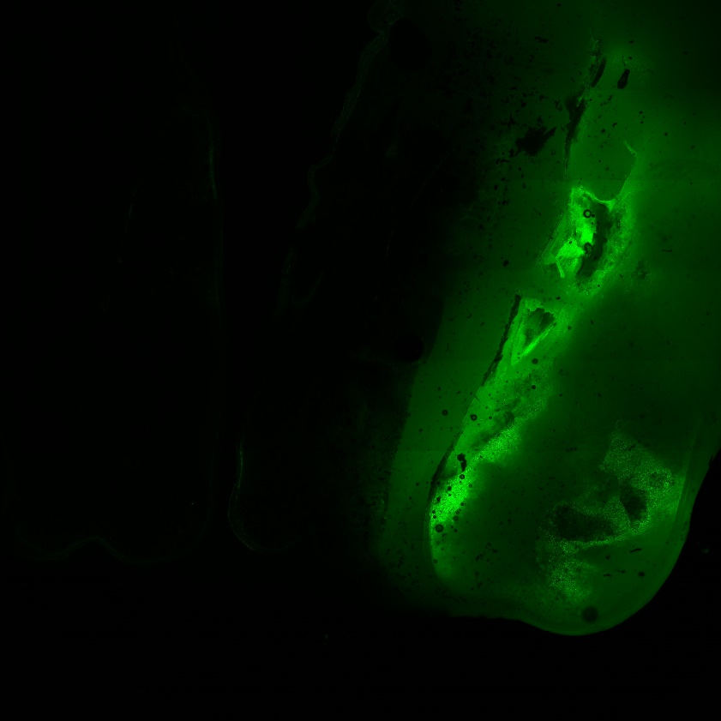
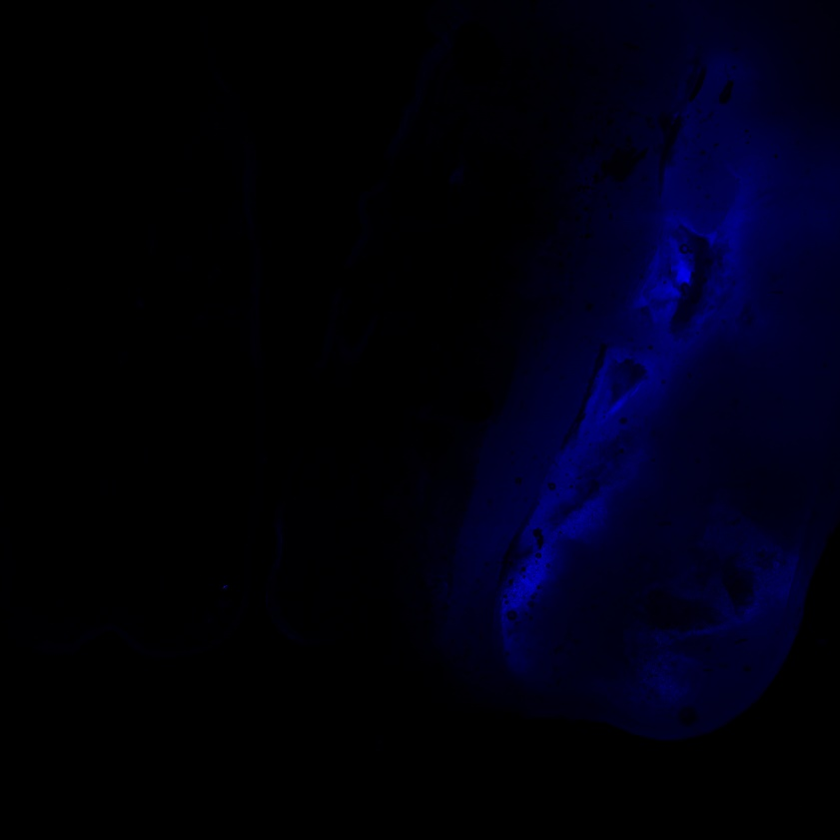
Fluorescent Confocal Microscopy
No Calcofluor
Texas 024
M
H
H
M
H
H
M
H
H

