Slide 1
Amazing Talker 金牌🏅講師
無所不能 - Omnipotent
May-9, 2025

Slide 2
General Product Business Process
Collect Market Requirement
Design Product
Material/Component Searching
Sample Run
Engineering Validation Test
Design Validation Test
Process Validation Test
Mass Production Test

Slide 3
General Product Factory Process
(IQC) Incoming Material/Parts Quality Control
Assembly Process
Testing Process
Packing Process
OQC Process (Sampling)
Shipping Process
After Sales

Slide 4
IQC – Incoming Quality Control Criteria
Purpose: Ensure raw materials and parts meet required specifications before entering production.
Common IQC Items in Bag Manufacturing:
  Fabrics & Materials: Check GSM (gram per square meter), colour matching, durability, water resistance.
  Zippers & Buckles: Verify brand, smoothness, tensile strength.
  Threads: Ensure strength, material (e.g., polyester, nylon), and colour matching.
  Liners & Foams: Check thickness, elasticity, and adhesion quality.
  Labels/Tags: Correct logo, placement accuracy, and spelling.
Inspection Tools/Fixtures:
  Fabric thickness gauge
  Colour swatches (Pantone book)
  Tensile testing machine for straps/zippers
  Caliper or micrometer

Slide 5
Assembly Process
Steps:
  Material Cutting: Using die cutting machines or laser cutters to shape fabric pieces.
  Printing/Embroidery: Applying logos or designs on panels.
  Sewing: Stitching panels using industrial sewing machines.
  Component Attachment: Add zippers, buckles, straps, lining.
  Shaping/Forming: Heat press or molds to ensure structure.
Tools/Fixtures Used:
  Industrial sewing machines (flat-bed, cylinder-bed, bar-tack)
  Heat press machines
  Cutting dies and cutting tables
  Riveting tools
  Templates and jigs for alignment

Slide 6
Testing Process – Test Items & Criteria
In-Line & Final QC Checks:
  Visual Inspection: Seams, threads, cleanliness, logo position.
  Functionality Test:
    Zipper smoothness test (open/close cycles)
    Buckle/snaps durability test
    Strap pull test (simulate load-bearing)
  Dimension Check: Bag size, pocket placement
  Load Testing: Typically 2-3x designed load for 24-48 hrs hanging test
  Water Resistance Test: For outdoor/travel bags
Tools/Fixtures Used:
  Pull test machine (tensile strength)
  Zipper cycling tester
  Measurement tape and templates
  Water spray tester (if water-resistant bags)

Slide 7
Packing Requirements
Steps:
  Dust Cleaning: Air gun or lint rollers to remove debris.
  Folding: Fold based on guidelines (to avoid wrinkle/crease in logos).
  Stuffing: Add paper or foam to maintain shape.
  Packaging:
    Poly bag (PE/PP) or non-woven bags
    Desiccant packets (if needed)
    Box packaging with barcode/labels
  Carton Labelling:
    Product name, colour, quantity, and batch number.
Fixtures/Tools Used:
  Folding templates
  Heat sealing machine for polybags
  Barcode label printer
  Packaging jig/board for uniform packing

Slide 8
OQC (Sampling) & Shipping
OQC Checks:
  Random sampling (AQL standards)
  Re-check key points from previous stages
  Drop test after final packing (simulate shipping conditions)
Shipping Process:
  Load packed cartons to pallets
  Stretch wrapping
  Loading to containers with shipping marks

Slide 9
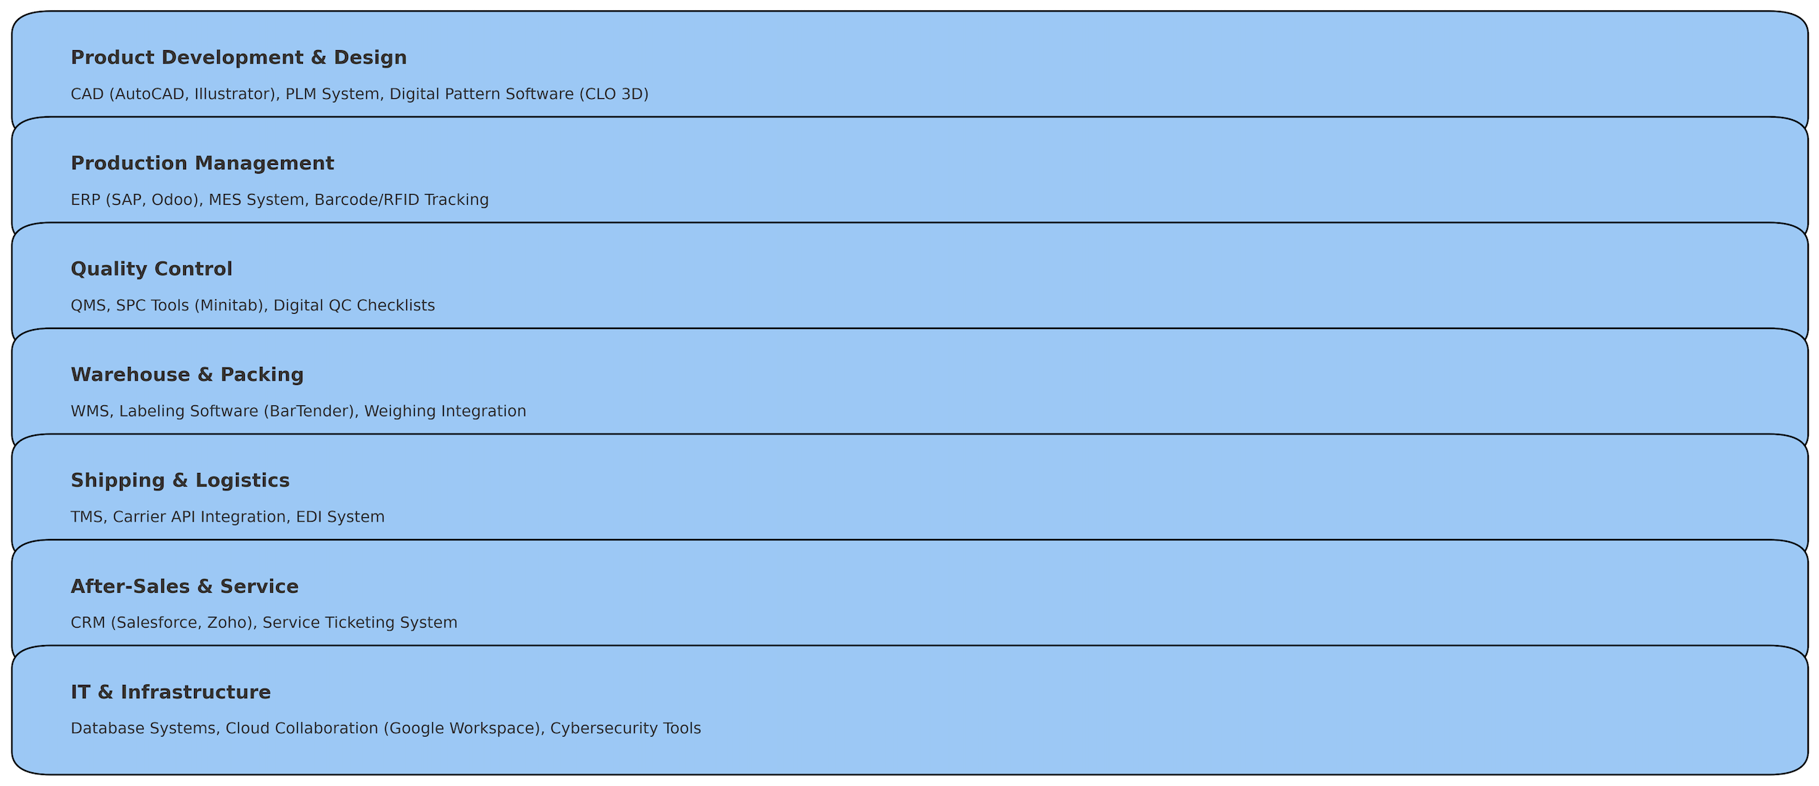
Software Systems in Bags Manufacturing Factory

