Slide 1
UML for Object-Oriented Programming

Slide 2
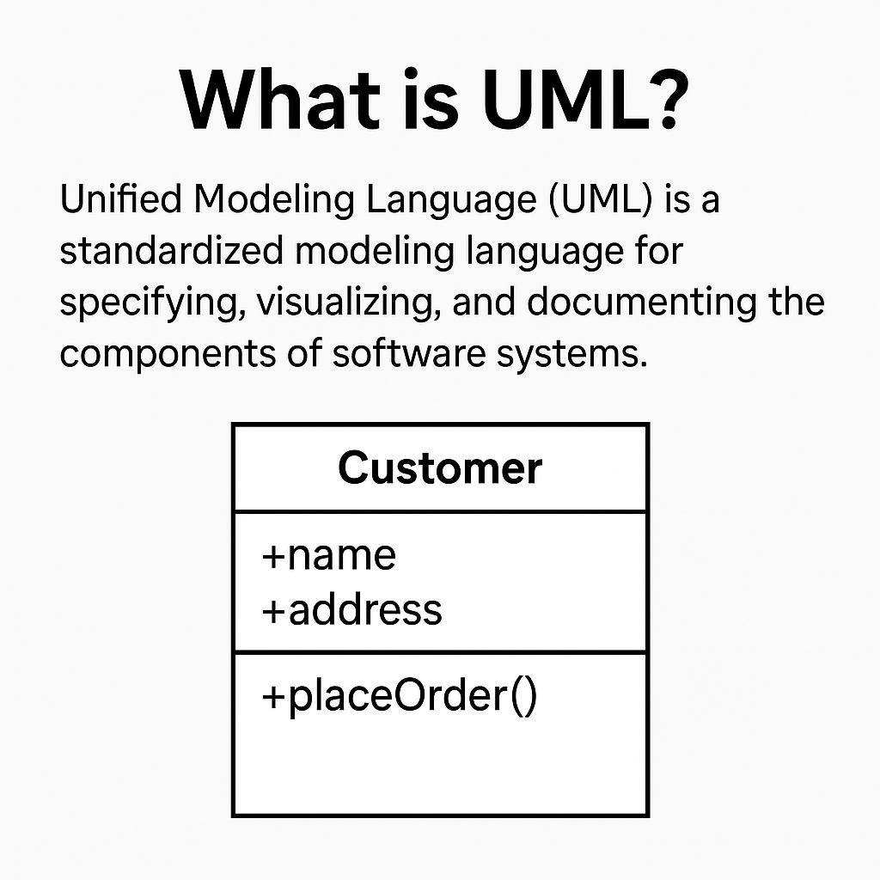
What is UML?
Unified Modeling Language (UML) is a standard visual language.
Used to describe, design, and document software systems.
Helps communicate structure and behavior of object-oriented systems.

Slide 3
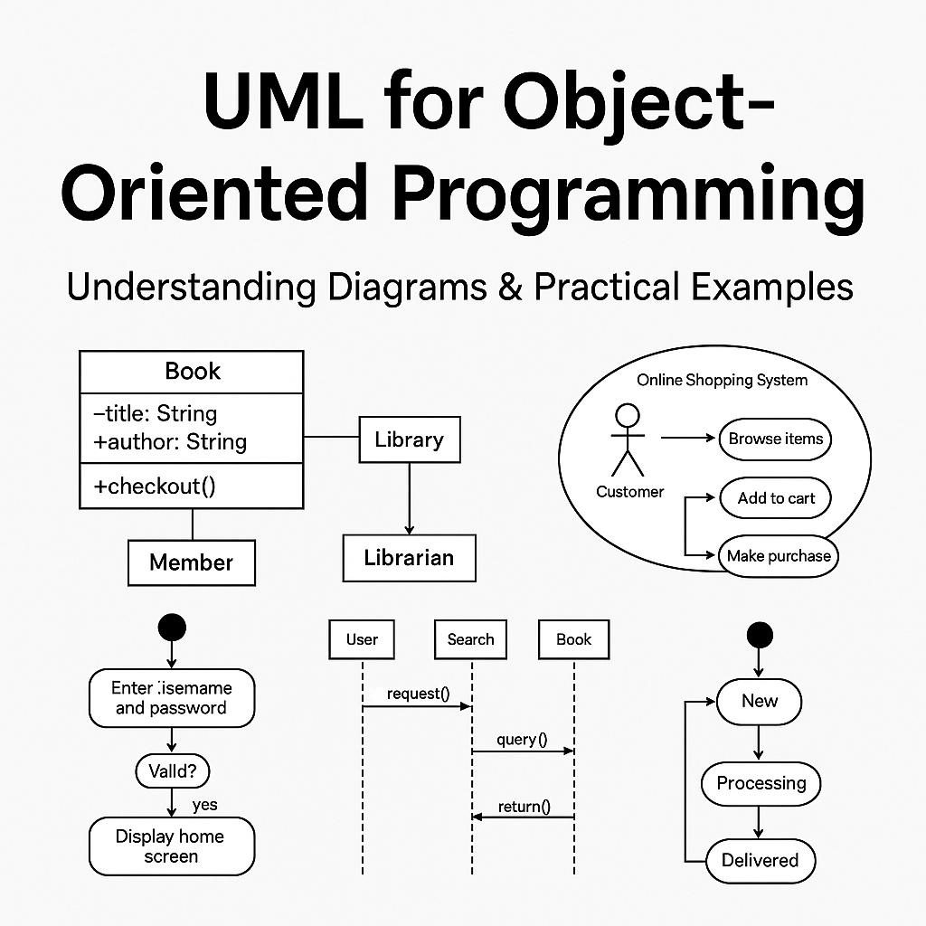
Importance of UML in OOP
Bridges the gap between concept and code.
Clarifies system requirements early in development.
Supports team collaboration and planning.
Essential for system architecture documentation.

Slide 4
UML Diagram Types Overview
Structural: Class, Object, Component, Deployment diagrams.
Behavioral: Use Case, Sequence, Activity, State diagrams.
Represent both static and dynamic system views.

Slide 5
Class Diagram (Example 1)
Shows classes, attributes, methods, and relationships.
Models the static structure of a system.
Example: Library system with Book, Member, Librarian classes.

Slide 6
Sequence Diagram (Example 2)
Illustrates object interactions over time.
Depicts message exchanges and lifelines.
Example: Book borrowing process in a library.

Slide 7
Use Case Diagram (Example 3)
Shows user (actor) interactions with the system.
Identifies functional requirements from user perspective.
Example: Online shopping use cases like Browse, Checkout.

Slide 8
Activity Diagram (Example 4)
Models workflows and decision logic.
Describes dynamic processes and control flows.
Example: Login process steps in an application.

Slide 9
State Diagram (Example 5)
Shows object state changes in response to events.
Represents lifecycle and transitions.
Example: Order states—New, Processing, Shipped, Delivered.

Slide 10
Summary of UML Benefits
Improves design clarity and planning.
Facilitates maintenance and documentation.
Enables standardization and scalable architecture.
Supports team collaboration.

Slide 11
Thank you for your attention!

