Slide 1
Amazing Talker Tutor
Nelson Lai
May-12, 2025

Slide 2
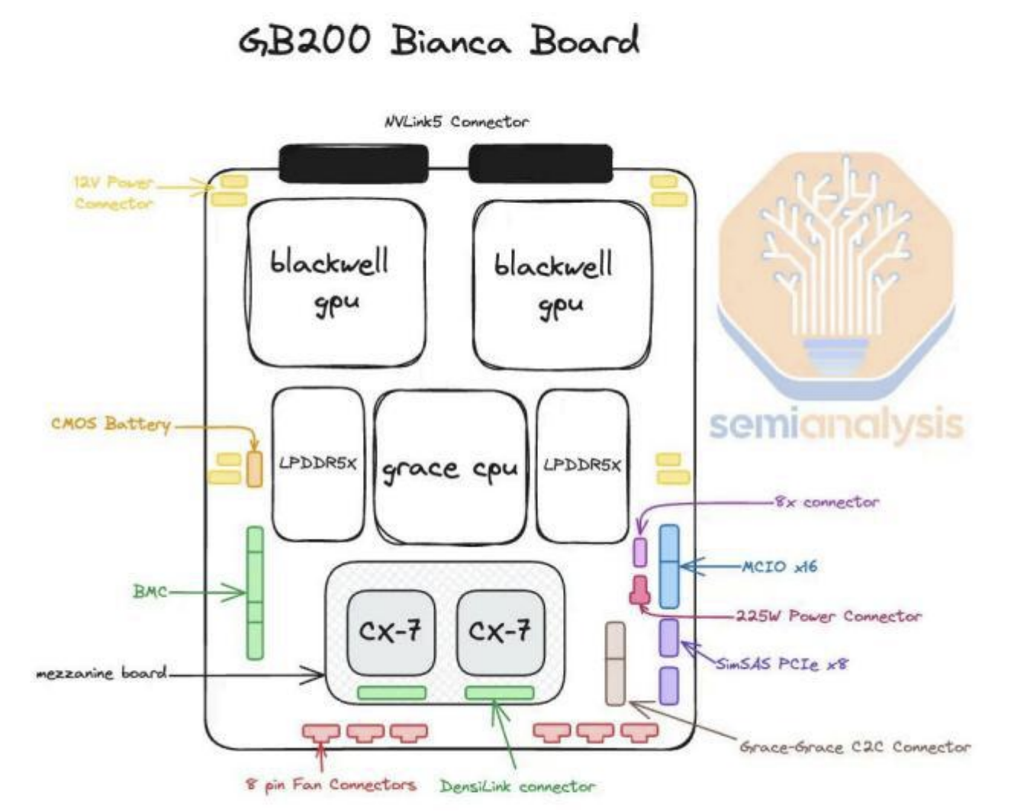

Slide 3
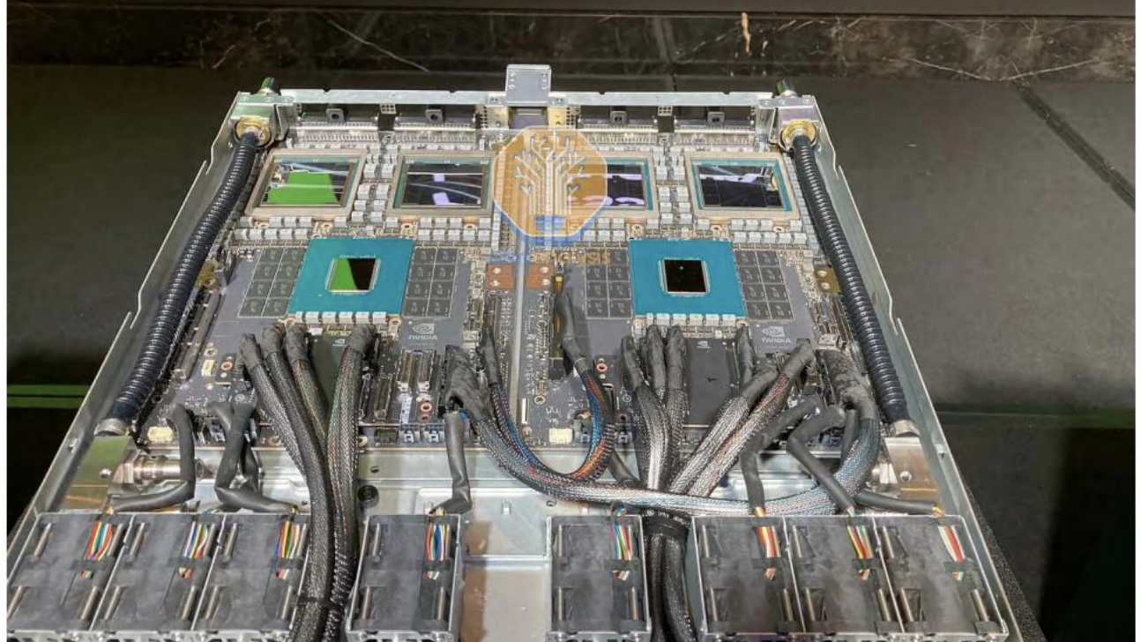

Slide 4
BMC
A baseboard management controller (BMC) is a small, specialized processor used for remote monitoring and management of a host system.

Slide 5
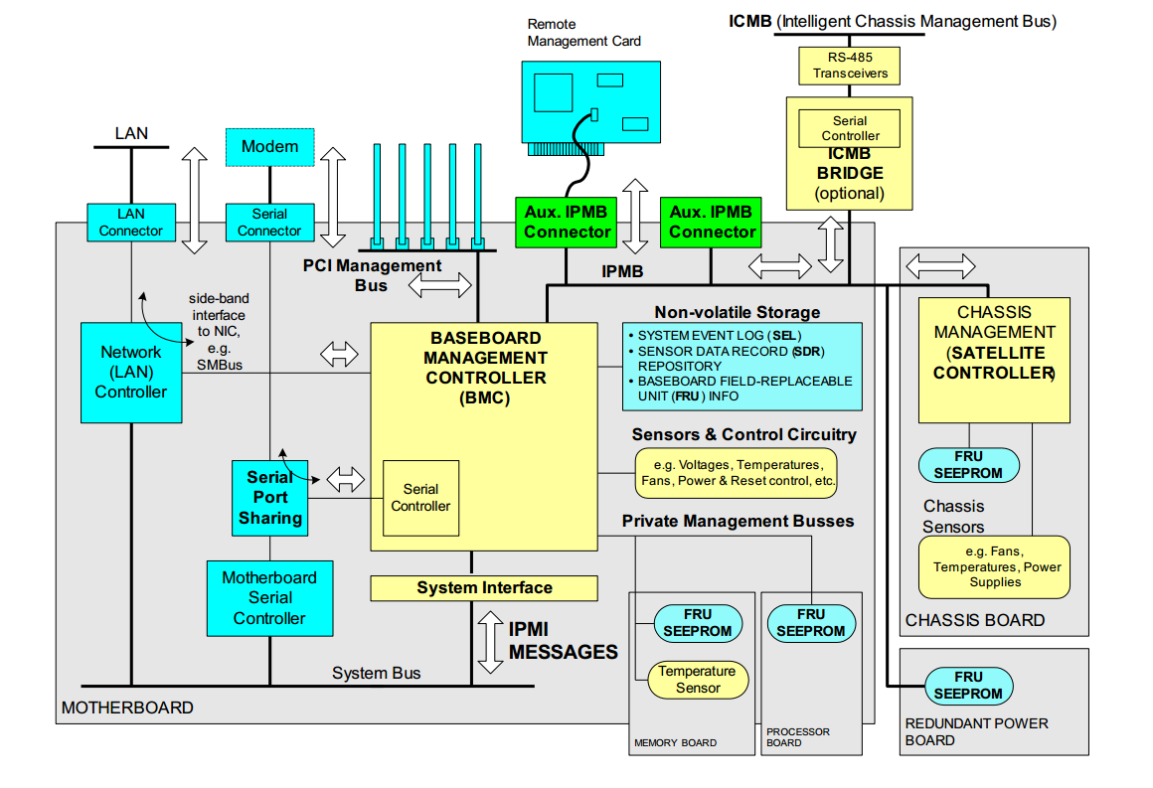

Slide 6
