Slide 1
Amazing Talker Tutor
Nelson Lai
May-12, 2025

Slide 2
FULL STACK DEVELOPMENT
全端開發

Slide 3
Introduction
簡介
What is full stack development
什麼是全端 (Full Stack) 開發
Full Stack Technologies
全端開發的技術
Advantages of full stack development
全端開發的特點及優勢

Slide 4
全端開發 – 簡介
FULL STACK DEVELOPMENT - INTRODUCTION
Full stack development is the process of designing, creating, testing, and deploying a complete web application from start to finish.
全端開發是從頭到尾設計，創建，測試以及部署完整網頁或是行動應用程式的過程
Full stack development is a term used to describe a software engineer or developer who works with both the front and back end of a website or application
全端開發是用來描述一位同時負責網站或應用程式前端與後端的軟體工程師或開發人員的術語。
A full-stack developer is comfortable working with front-end and back-end technologies that power a website or application
全端開發人員能夠熟練地使用驅動網站／行動應用程式的前端與後端技術。
It involves working with various technologies and tools, including front-end web/mobile development, back-end development, and database development.
它涉及使用各種技術與工具，包括前端的網頁／行動開發、後端的商業邏輯以及資料庫開發。

Slide 5
什麼是全端開發
WHAT IS FULL STACK DEVELOPMENT
Full Stack Development
Front end
Web
Mobile
HTML
CSS
Android - Kotlin
React.JS
Vite.JS (TypeScript)
JavaScript
iOS - Swift
Back end
RESTFul APIs
Django/Flask - Python
Database – MySQL
MongoDB
Node.js – JavaScript
/ TypeScript
3rd Parties Resources

Slide 6
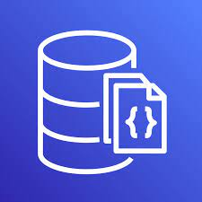

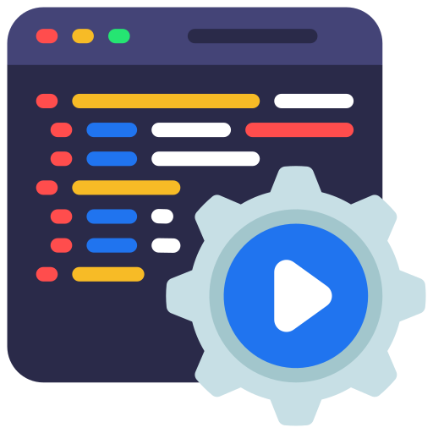
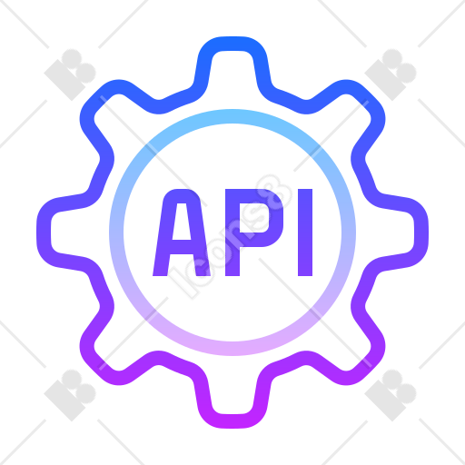


全端開發 – 資料流動圖
FULL STACK DEVELOPMENT – INFORMATION FLOW
數據庫
Database
後端
Back End
前端
Front End
第三方資源
3rd Parties Resources

Slide 7
全端開發技術
FULL STACK TECHNOLOGIES
Front End Technologies / 前端技術
Web Development / 網頁開發
HTML
iOS Development / iOS 開發
CSS
JavaScript
Swift - XCode
Android Development
Kotlin - Android Studio
Back End Frameworks and Libraries 前端開發框架及資源
ReactJS (TypeScript)
Bootstrap + template
Tailwind + TypeScript

Slide 8
全端開發技術
FULL STACK TECHNOLOGIES
Front End Technologies / 前端技術
Python, PHP, Java, React.JS + TypeScript
Back End Frameworks and Libraries 前端開發框架及資源
Django/Flask - Python
Node.JS
Maven
常用的數據庫 / Popular Databases
MySQL, MariaDB, Microsoft SQL, MongoDB

Slide 9
理解全端開發的優勢
ADVANTAGES OF FULL STACK DEVELOPMENT
Complete ownership and understanding of project.
對專案的完全擁有權與深入理解
Saves both project time and cost and enhances productivity.
節省專案時間與成本，並提升生產力
Faster bug fixing due to the knowledge of complete system.
由於對整個系統的了解，使得錯誤修復更迅速
Better division of work amongst team members.
團隊成員之間更有效的工作分工

