Slide 1
Recipe Data Workflow
Allrecipes JSON
Parse JSON data into Hive
Staging Step - Process Text Data
Load data into HDFS. (OK)
This data will be in a structured table format. (Not OK)
We are interested in the Recipe and Ingredient data.
Done in Apache PySpark??
Analytics
Convert data into graph format. Which software to use?

Slide 2
Recipe Data Workflow
Allrecipes JSON
Parse JSON data into Hive
Staging Step - Process Text Data
Load data into HDFS. (OK)
This data will be in a structured table format. (Not OK)
We are interested in the Recipe and Ingredient data.
Done in Apache PySpark??
FLUME?
Configure Channels into Hive

Slide 3
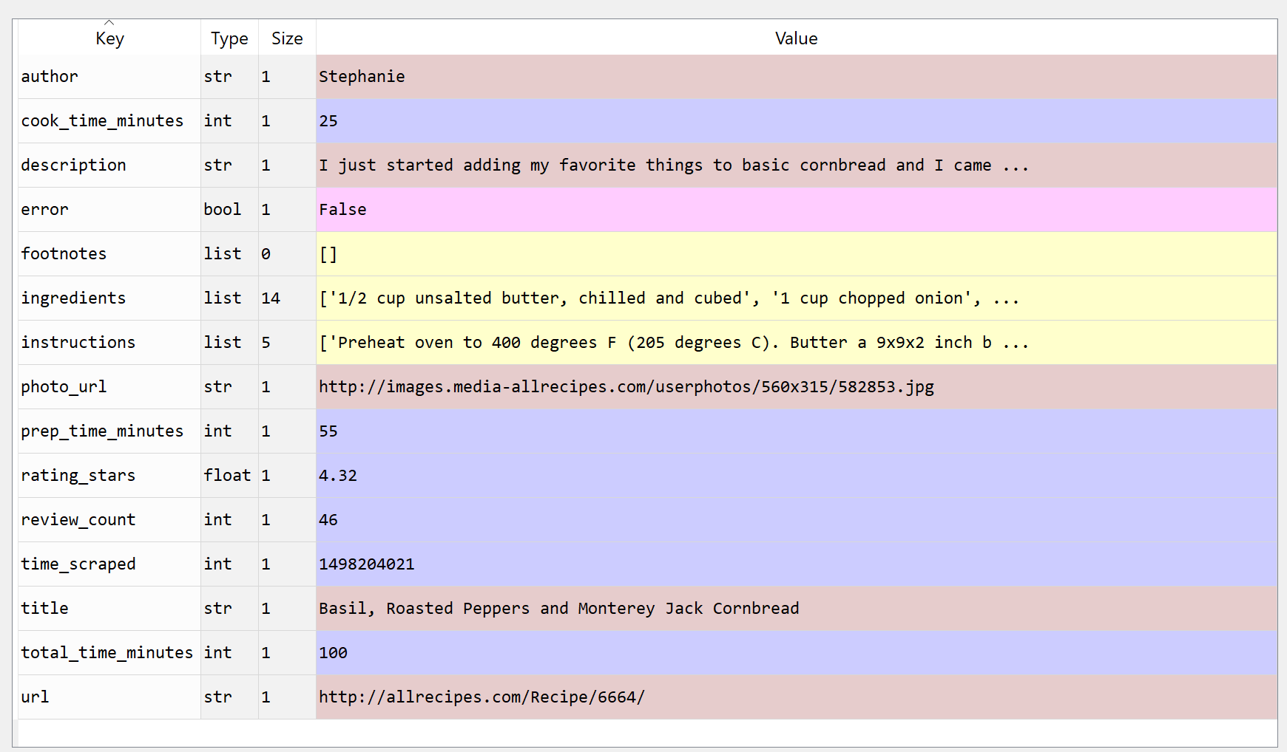

Slide 4
To do list:
Convert current python to pyspark and test.
Improve current text analytic code.

