Slide 1
A Customizable Machine Learning Pipeline
Nelson R. Manohar

Slide 2
What is a Pipeline?
A Data Flow
  IN: data rows (e.g, Xt)
  OUT: data rows (e.g, Yp)
A Sequence of Steps
  some required
  some optional
Customizable sequence
Customizable steps
Planned: each step can be done via a pub/sub compute-node
DATA
READ
DATA
TRANSFORMS
FEATURE
SELECTION
ENSEMBLE
TRAIN
ENSEMBLE
PREDICT

Slide 3
What is a Step?
data transformation function
  data in: some features X, Y
  data out: some features X', Y', findings
some steps mandatory, some optional
steps can be implemented:
  currently, in python, scikit, pandas
  planned, invoking steps implemented in bash, awk, R, java, MR

Slide 4
Predictive Pipeline
Feat. Engineering
  Overfitting Reduction
  Feature Generation
  Feature Selection
  Feature Decorrelation
  Feature Analytics
Data Handling
  Cleaning: NAs, Cuts, Factors
  Scaling/Centering
  Encoding
  Partitioning
  Augmentations
  Reductions
  Subsampling

Slide 5
Pipeline Setup
DATASET
SETUP
User specified:
  Dataset Spec
    ID, X, Y, co-Y, Nas, sep
  Pipeline Config
    steps, options
  Ensemble/Classifiers
    clfs, options, cv
  Feature Generator Hook
    user-specified pre-processing for custom features
PIPELINE
CONFIGURATION
CLASSIFIER
CONFIGURATION
CUSTOM
FEATURE
GENERATORS

Slide 6
Dataset Load/Read
User/System Choice:
  Fit-all in memory (default)
  Incremental reader (by features)
  Preselected features readers
  Chunk reader (in development)
  Streaming reader (planned)
DATA
READER
DATA
X[M,N], Y[M]
DEFAULT
DATA
READER
INCREMENTAL
DATA
READER
FEATURE
SELECTED
DATA
READER

Slide 7
Data Encoding
Numerical encoders
  Stabilize/condition numerical range
  autonomously applied
Categorical encoders,
  statistical profiles of factors/categories
  stabilize/condition numerical range
FEATURE
ENCODERS
CATEGORICAL
ENCODER
NUMERICAL
ENCODERS
CODES
ENCODER
FREQUENCIES
ENCODER
NUMERICAL
RANGE CUTS
ENCODER
COUNT
ENCODER
NUMERICAL
Z-VALUES
ENCODER
NUMERICAL
PRECISION
ENCODER

Slide 8
User-Gen'd Features
Dataset augmentation hook allows
  User-implemented features to be generated from existing dataset features
    Examples: indicator variables, statistical profiles, td-idf of name fields, timedate parsing, additions, conditionals, etc.
  Features subsequently stabilized/conditioned
USER
SPECIFIED
DATA
AUGMENTATION
CUSTOM
INDICATOR
FEATURE
GENERATED
CUSTOM
TIMEDATE
FEATURE
GENERATED
CUSTOM
TERM_FREQS
FEATURE
GENERATED
DATA
X[M,P], Y[M]

Slide 9
Feature Reduction
Chisq Feature Significance
  features numerically conditioned/stabilized
  selects: All, top K, statistically significant, or any above threshold N
  returns: ranked features
AUTONOMOUS
FEATURE
REDUCTION
NO VARIANCE
FEATURE
REMOVER
CHI TEST
FEATURE
SELECTION
DATA
PROJECTION
AUGMENTATION

Slide 10
Feature Decorrelation
Transitive closure of features
  keeps best rank feature given rank ordering by feature importance
  autonomous exploration of extent and degree
  for discarded features can
    generate replacement projection
    decorrelated replacement features
DECORRELATION
REDUCTION
TRANSITIVE
CLOSURE
MINSET
DATA
PROJECTION
AUGMENTATION

Slide 11
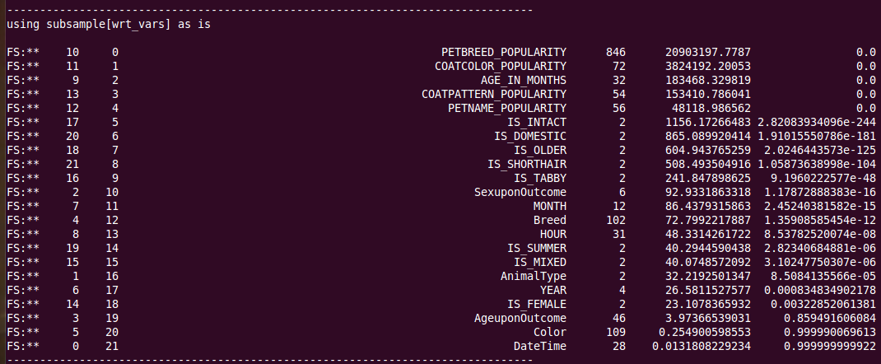
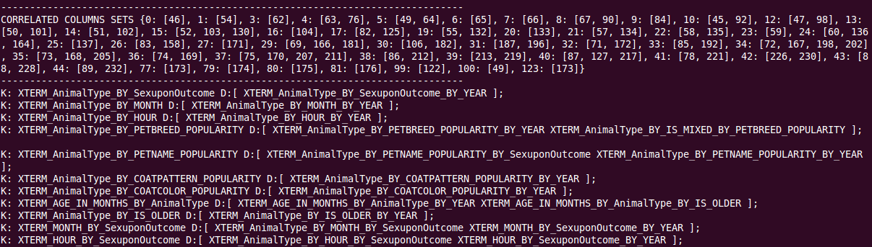
Output

Slide 12
FG: Projections
Feature Projections generate features from features
  Linear Discriminant of X features wrt Y
  Independent Signal Components of X features wrt Y
  Principal components of X features
  Attempts to generate a pre-specified 0, 1, or upto N other features from N features
  Features are automatically stabilized/condition
DATA
PROJECTION
AUGMENTATION
PCA
PROJECTION
ICA
PROJECTION
LDA
PROJECTION

Slide 13
FG: Factor Levels
Autonomously exploration
Identifies factors and factor interactions with high levels of significance wrt to target variable Y
Combinatorial exploration pruned via
  random subsampling of factors,
  pre-validation heuristics
  feature selection ranking
  timeout
AUTONOMOUS
FACTOR_LEVEL
EXPLORER
FACTOR
EXPLORER
FACTOR
INTERACTION
EXPLORER

Slide 14
FG: Interaction Effects
Marginals
  Explores feature interactions
  conditional statistical profiles (groupby)
  Autonomously explored
  Autonomously selected
  Selected wrt target variable Y
AUTONOMOUS
FEATURE
INTERACTION
EXPLORER
MARGINAL
EXPLORER
QUADRATIC
EFFECTS
EXPLORER
CUBIC EFFECTS
EXPLORER

Slide 15
Data Augm/Reduction: Centroids
Per-class random subsampling
  Representative sampled
  centroid (numerical)
  medoid (categorical) for subsamples
Used to
  artificially augment dataset or
  reduce dataset by deletion of the samples assoc. with a centroid
CENTROID
CLUSTER
AUGMENTATION
PER CLASS
CENTROID
AUGMENTATION
PER CLASS
MEDOID
AUGMENTATION

Slide 16
Dataset Partitioning
Dataset partitioned into
  Training set, dev set, cv set, and test set
  Balancing of class sizes done wrt user-specified policies (percentage, augmentation, subsampling, etc)
  Dev set used to fine-tune ensemble classifier parameters
DATA
DATA
DATA
SPLIT
PER_CLASS
DATA
BALANCER
PER_CLASS
DATA
AUGMENTER
PER_CLASS
DATA
TRIMMER
TRAINSET,
DEVSET, CVSET,
TESTSET
SPLITTER

Slide 17
Overfitting Control: Step Fitter
Autonomous exploration via step-fitter of ranked features by importance
  Forward stepper
  Back stepper
  Combo stepper
  Maximum timeout
  Warm-start (fix code) Gradient Boosting Classifier used to reduce training time and reduce overfitting
AUTONOMOUS
OVER FITTING
CONTROL
PREDICTIVE
IMPORTANCE
FEATURE
REDUCTION
STEP FITTER
MODEL
REDUCTION
FORWARD
STEP FITTER
BACKWARD
STEP FITTER
DATA

Slide 18
Ensemble Training
DATA
MODEL
WRITER
TRAINING
WRT
TRAINING SET
CLASSIFIER
FITTING
INCREMENTAL
EMSEMBLE
FITTER
GRID
PARAMETER
AND VALIDATION
CLASSIFIER
ARRAY
CLASSIFIER
PREDICTION
CLASSIFIER
PROB
FINE-TUNING/
CALIBRATION
ENSEMBLE
PREDICTION

Slide 19
Ensembles
Atop intra-classifier ensembles
  Variants of same classifier allowed
  Multiclass and Binary classifiers allowed
  Ensemble classifiers allowed (such as Random Trees, Bagging, Boosting, etc)
  Generative and discriminative classifiers can be mixed
Weighted Voting ensemble (deprecated)
Weighted Probability ensemble
  Computes weighted average of selected predictors
  Balances/conditioning classifier probabilities to 0.5
Trained Probability Predictor ensemble
  Trains meta classifier using predictions of ensemble classifiers
  Predicts using meta classifier

Slide 20
Ensemble DevSet Optimization
PARAMETER
OPTIMIZATION
WRT
DEV SET
INCREMENTAL
EMSEMBLE
UPDATER
CLASSIFIER
ARRAY
CLASSIFIER
PREDICTION
CLASSIFIER
PROB
FINE TUNING
VALIDATION
INCREMENTAL
ENSEMBLE
PREDICTION
DATA

Slide 21
Ensemble Cross Validation
DATA
PARAMETER
OPTIMIZATION
WRT
CV SET
INCREMENTAL
EMSEMBLE
UPDATER
CLASSIFIER
ARRAY
CLASSIFIER
PREDICTION
INCREMENTAL
ENSEMBLE
PREDICTION

Slide 22
Ensemble: TestSet Prediction
OPTIMIZED PARAMS
PREDICTION
WRT
TEST SET
INCREMENTAL
EMSEMBLE
UPDATER
CLASSIFIER
ARRAY
CLASSIFIER
PREDICTION
INCREMENTAL
ENSEMBLE
PREDICTION
DATA
YP

Slide 23
Classification Performance
 | Classification | MxN | Classifiers | LogLoss Accuracy
Santander | Binary | 130Kx300 | RF, DT, GB
BNP | Binary | 150Kx130 | ET, GB
Titanic | Binary | 1Kx11
Shelter | Multiclass
S.F. Crime
Avito
Digits

Slide 24
Future Work
Configuration
  Graphical “jobflow” style pipeline specification
MR/Cluster
  Steps to map reduce
  Steps to n-cores or n-nodes
Dashboard:
  Per step: pipeline stats
  Per step: data quality
  Per step: predictive increase

Slide 25
Non-Native Step
Via Pipeline Fork & Join
  OUT: X, Y, f(), params
  Bash fork f() process
  Bash waits f() completion
  F() generates X*, Y*, res
  Pipeline reads X*, Y*, res
  Pipeline resumes execution
PIPELINE
FORK
EXTERNAL
STEP
PIPELINE
JOIN

Slide 26
MR-1
MR implementation of certain pipeline steps
  Already envisioned for subsequent implementation
  Based on both simple (training and offline predictions) as well as streaming MR (classifier updates and production/online predictions)
Clustering:
  Currently, using representative-sample-KNN (centroids from subsamples)
  Later:
    chunks sent to reducers which generate local representative samples/local centroids
    then combiners produce clustering of local centroids to generate global centroids

Slide 27
MR-2
Encoders
  Currently, encoder transforms learned on either training set or global dataset
  Later,
    Preliminary job selected chunks based on some criteria such as timestamp, id ordering, random subsampling
    Chunks sent to first MR job reducers produce local/chunk statistical profiles for feature
    MR combiners take local/chunk profiles and learn/yield global dataset transform
    Second MR job applies learned transform to dataset chunks

Slide 28
MR-3
Feature Selection/Decorrelation:
  Currently, learned from subsampled slice of dataset
    Planned, learned from multiple subsampled dataset slices
  Later
    Dataset chunks to MR reducers which produce chunk feature importances
    combiners take chunk feature importances and learn/yield global/dataset feature importances

Slide 29
MR-4
Classifiers:
  Currently, ensemble, boosting, voting, and bagging classifiers (RT, DT, GB, etc)
    trained using Random Patches and/or Random Spaces
  Later,
    First MR job produces local classifier
    Combiners generate/grow ensemble classifier into pseudo-global classifier (see above Random Subspaces)
    Second MR job's reducer job applies learner global ensemble classifier to data
    Second MR job's combiner produces ordered predictions and stats

