Slide 1
Stock Replenishment Assistant
Nelson Portela · Ironhack · September 2026
Notes:
Good morning. My final project is a chatbot that helps footwear store managers find out what stock they can pull from the central warehouse, and turns that answer into a printable picking list.

Slide 2
What? Why?
I wanted to build something I would actually use, not a dataset exercise.
Work flow:
Export the stock file, tidy the data, compare store against warehouse. Every time.
Sizes missing on the shelf, while the same size sat in the warehouse.
Checking took long enough that nobody checked often.
No easy way to know what had already been sent somewhere else.
Notes:
I chose this because I lived it. Every one of these bullets is something I did by hand, week after week. The routine was the worst part: the same export, the same tidying, the same comparison, over and over.

Slide 3
Objectives
Do the work automatically, instead of by hand.
Answer stock questions by talking to it.
Find the sizes a store is missing.
Create a picking list ready to print.
The idea: take a picture of the stock at a given moment, and let the system do the comparison.
Notes:
Three goals. Everything in the project serves one of these.

Slide 4
Dataset
A real stock snapshot from a footwear retailer, one row per brand, reference, size and location.
RAW FILE
128,075
rows
16
columns
41
locations
all
product families
AFTER CLEANING
23,279
rows
12
columns
7
locations (HQ + 6 stores)
1
footwear only
Notes:
Real data, so it is anonymised and stays out of the repo. The raw file is much bigger than what I actually use — most of it is other product families and stores outside the scope I chose.

Slide 5
Cleaning the Data
Kept warehouses 1 (HQ), 2 (stores) and 5 (outlets) because is the warehouses with more units.
Footwear only. The family column had 181 different labels, all folded into one.
Negative quantities set to 0 — 4,206 rows
Brand names unified: the same brand appeared under more than one label.
# portuguese decimal comma, and negatives treated as 0
df_work['QUANTITY'] = df_work['QUANTITY'].astype(str).str.replace(',', '.').astype(float)
df_work['QUANTITY'] = df_work['QUANTITY'].clip(lower=0)
df_work['BRAND'] = df_work['BRAND'].replace({
'Fila apparel_acc': 'Fila', 'Merrell Aces': 'Merrell Foot',
'Munich Sports': 'Munich',
})
Notes:
The negative quantities were the interesting one. My first instinct was to drop those rows, but they represent transfers in progress, so treating them as zero is the conservative choice: it never overstates what is available.

Slide 6
Choosing the Scope
The raw file covers 41 locations. Most hold very little stock, and 13 held under 100 units.
I kept the 6 highest-volume stores, plus HQ as the stock source.
Brands that exist only at HQ and in none of those stores were dropped — nothing to replenish.
# scope: the 6 selected stores, keeping HQ as the stock source
SELECTED_STORES = ['5-52', '5-53', '5-50', '2-8', '5-51', '2-41']
df_work = df_work[df_work['STORE_ID'].isin(SELECTED_STORES + ['1-HQ'])]
# drop brands that exist only at HQ and in no selected store
relevant_brands = df_work[df_work['STORE_ID'] != '1-HQ']['BRAND'].unique()
df_work = df_work[df_work['BRAND'].isin(relevant_brands)]
Notes:
A scope decision, not a data problem. Six stores is enough to prove the logic works, and the code has nothing store-specific in it, so adding the rest is a change to one list.

Slide 7
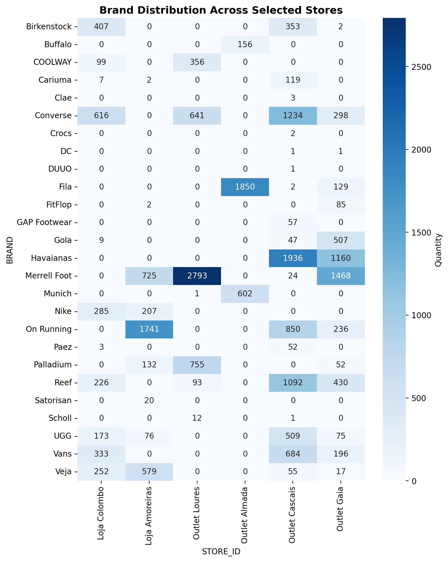
Every Store Is Different
Brands are not spread evenly. Each store carries its own mix, and most of the grid is zero.
Merrell Foot: 2,793 units in Outlet Loures, none in Loja Colombo.
Havaianas exists only in Cascais and Gaia.
Fila sits almost entirely in Outlet Almada.
This is why replenishment only looks at references a store already carries: sending a brand a store does not sell is not replenishment.
Notes:
This chart is the one that shaped the logic. Look at how much of it is zero. Each store has its own assortment, so a general "send this store everything HQ has" would be useless. The rule I built follows directly from what this shows.

Slide 8
The Size Problem
Sizes arrived in eight different formats in the same column. Comparing a store to HQ is impossible until they share one scale.
# 41,5 -> 41.5 comma decimals
# 39-40 -> 39.5 range, averaged
# 3940 -> 39.5 range without separator
# 135 -> 13.5 three-digit half-size code
# 5Y -> 5.0 US kids sizing, number kept
# UNI -> NaN no numeric equivalent
Kids US sizes keep their number and are never compared against EU sizes, because the logic always works inside a single reference.
75 rows (0.3%) use letter sizes and are excluded from size comparisons.
Notes:
This was the hardest cleaning problem. A 6 in kids US sizing and a 6 in EU sizing are completely different shoes. The reason it is safe is that the replenishment logic never compares sizes across references.

Slide 9
How it works
Notes:
Now the part that matters — the architecture.

Slide 10
Architecture
The language model reads the question and decides which function to call. It never produces a stock figure itself.
user question
|
v
LLM (routing only, no data)
|
v
Python query function -> dataset -> real numbers
Every number on screen comes from pandas, not from the model.
Notes:
This is the single most important design decision in the project. The model is a router. If it hallucinated a quantity, a store would ship the wrong shoes.

Slide 11
Function Calling
Each function is described to the model as a tool. The model picks one and fills in the arguments.
{
'name': 'find_replenishable_sizes',
'description': 'Find sizes the central warehouse has in stock but a store
does not, for references the store already carries.',
'parameters': {
'store_input': {'type': 'string'}, # required
'brand_input': {'type': 'string'}, # optional
'reference_input': {'type': 'string'}, # optional
'units_per_size': {'type': 'integer'}, # optional
},
}
"Which Nike sizes are missing in Loja Colombo?" -> store_input='Loja Colombo', brand_input='Nike'
Notes:
The description is the whole trick. The model matches the user question against these descriptions to pick the right tool.

Slide 12
The Query Functions
find_replenishable_sizes — sizes HQ has and a store does not
generate_replenishment_document — printable picking list; commits the stock
find_reference — where a reference exists, by prefix, with quantities per size
get_quantity — stock totals by store and/or brand
find_model_by_type — where a brand exists, grouped by HQ / store / outlet
export_stock — full store stock as an Excel size grid
All of them take the cleaned dataframe as the first argument — no hidden state, so Streamlit can cache the data.
Notes:
Six functions. They live in src/replenishment.py so the notebook and the app share the same code instead of keeping two copies that drift apart.

Slide 13
Replenishment Logic
For each reference the store already carries, compare its sizes against what HQ holds.
# reference/size pairs the store already has covered
store_sizes = set(map(tuple, store_data.loc[
store_data['QUANTITY'] > 0, ['REFERENCE', 'SIZE_NUMERIC']].values))
already_in_store = pd.Series(
[(r, s) in store_sizes for r, s in
zip(hq_stock['REFERENCE'], hq_stock['SIZE_NUMERIC'])],
index=hq_stock.index)
missing = hq_stock[(hq_stock['HQ_AVAILABLE'] > 0) & (~already_in_store)]
Only references the store already carries — otherwise "replenish this store" would return the entire HQ catalogue.
Notes:
The scope rule is the important part. This is size-gap replenishment, not new assortment. Without it a general request returns thousands of useless lines.

Slide 14
Session Allocation
Replenish store A, then store B. Store B must not be offered stock already committed to store A.
# discount stock already committed to earlier documents in this session
hq_stock['HQ_AVAILABLE'] = [
int(q - allocated.get((r, s), 0))
for r, s, q in zip(hq_stock['REFERENCE'],
hq_stock['SIZE'],
hq_stock['QUANTITY'])
]
Querying never commits anything. Stock leaves HQ only when a document is generated.
Nothing is written back to the dataset — the record lives in the Streamlit session.
Notes:
I deliberately kept this out of the database. A stateless design was easier to defend and the deadline did not allow a persistence layer. Querying is free; only generating a document commits.

Slide 15
The Picking Document
The output is an Excel file built for someone walking the warehouse floor with it.
REPLENISHMENT — LOJA COLOMBO
Brand: Nike | Lines: 72 | Total units: 72 | 06/09/2026 15:42
BRAND REFERENCE DESCRIPTION ITEM_TYPE SIZE QTY PICKED
Nike DD8959-103 WMNS AIR FORCE 1 '07 MULHER 5.5 1 __
Nike DD8959-103 WMNS AIR FORCE 1 '07 MULHER 8.5 1 __
Nike FV6603-101D WMNS NIKE P-6000 MTLC MULHER 37.5 1 __
Sorted alphabetically for physical picking, header repeated on every printed page, and an empty column to tick off each line.
HQ availability is deliberately left out — the picker only needs to know what to take.
Notes:
Small detail that matters: the person picking does not need to know HQ has 107 pairs. They need to know they are taking one. Showing both invites mistakes.

Slide 16
Demo
http://localhost:8501
Notes:
DEMO SCRIPT:
1. "Where is reference DH2920?" — shows the text answer
2. "Which Nike sizes are missing in Loja Colombo?" — shows the table
3. Set units per size to 1, generate the document, open it
4. Ask the same question again — the committed sizes are gone
Reset session allocations before starting.

Slide 17
Design Decisions
The LLM routes, it does not calculate. Function calling maps intent to deterministic Python.
Querying is not committing. Managers explore freely; stock is only allocated on generate.
Chat plus a confirmation form. Asking is natural language; deciding how many units is a form field.
Functions extracted to a module. The notebook and the app share one implementation, not two copies.
Notes:
If you remember one slide, this is it. Every one of these was a decision with an alternative I rejected for a reason.

Slide 18
What It Does Not Do
It finds which sizes are missing, not how many units a store needs — that requires sales history the dataset does not have.
Allocation resets when the app closes. There is no database.
Letter sizes (UNI, S, M) are excluded from size comparisons, though still counted in totals.
Reference typos involving transposed characters are not detected.
Notes:
I would rather tell you these than have you find them. Each one was a scope decision, not an oversight.

Slide 19
Future
Cover every location and every product type, not just footwear in six stores.
Add sales files, so the system can predict how many units and which references are worth sending.
Allow store-to-store transfers: a size sitting dead in one store may be selling in another.
Accept stock files from any date
Notes:
The second one is the real product. Everything here finds size gaps; with sales data it starts deciding quantities, and that is where the value is. The last two come from the same idea: stock should move sideways, not only from HQ down.

Slide 20
Thank you
github.com/nelsonp55/stock-replenishment-assistant
Questions?
Notes:
Questions.

