Slide 1
tidypollute
https://nelsonroque.github.io/tidypollute/index.html

Slide 2
Functions
Datasets
get_epa_airdata_analyte_codes()
us_states
download_stack_epa_airdata()
epa_superfund_npl_sites
scrape_epa_airdata_zip_links()
epa_airdata_monitoring_sites
get_epa_airdata()
epa_airdata_links / epa_airdata_links_archive
get_atmotube_data()

Slide 3
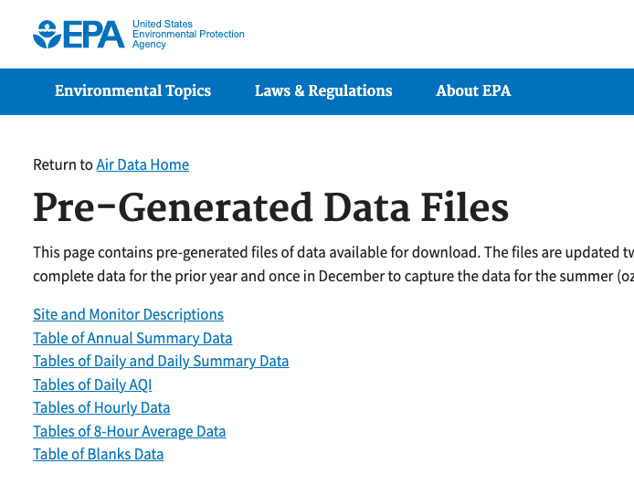
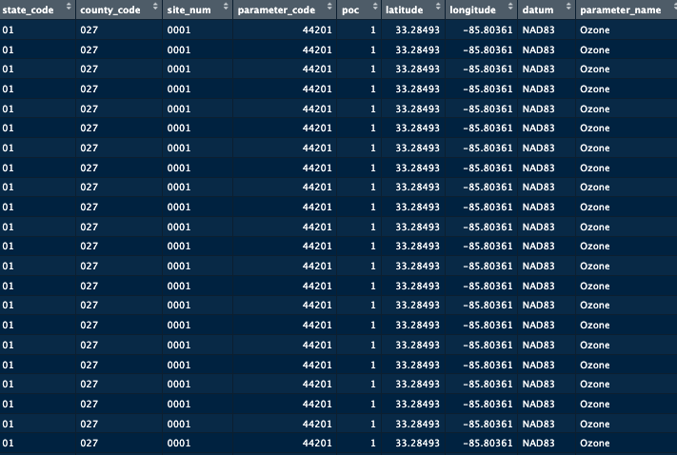
A
B
scrape_epa_airdata_zip_links()
get_epa_airdata()
This function scrapes the EPA AirData website for downloadable ZIP file links, extracts relevant metadata from filenames (such as year, unit of analysis, and analyte), and returns a tidy tibble with structured information.
This function downloads and stacks EPA AirData flat files for air quality data for specified parameters. Includes progress tracking.

