Slide 1
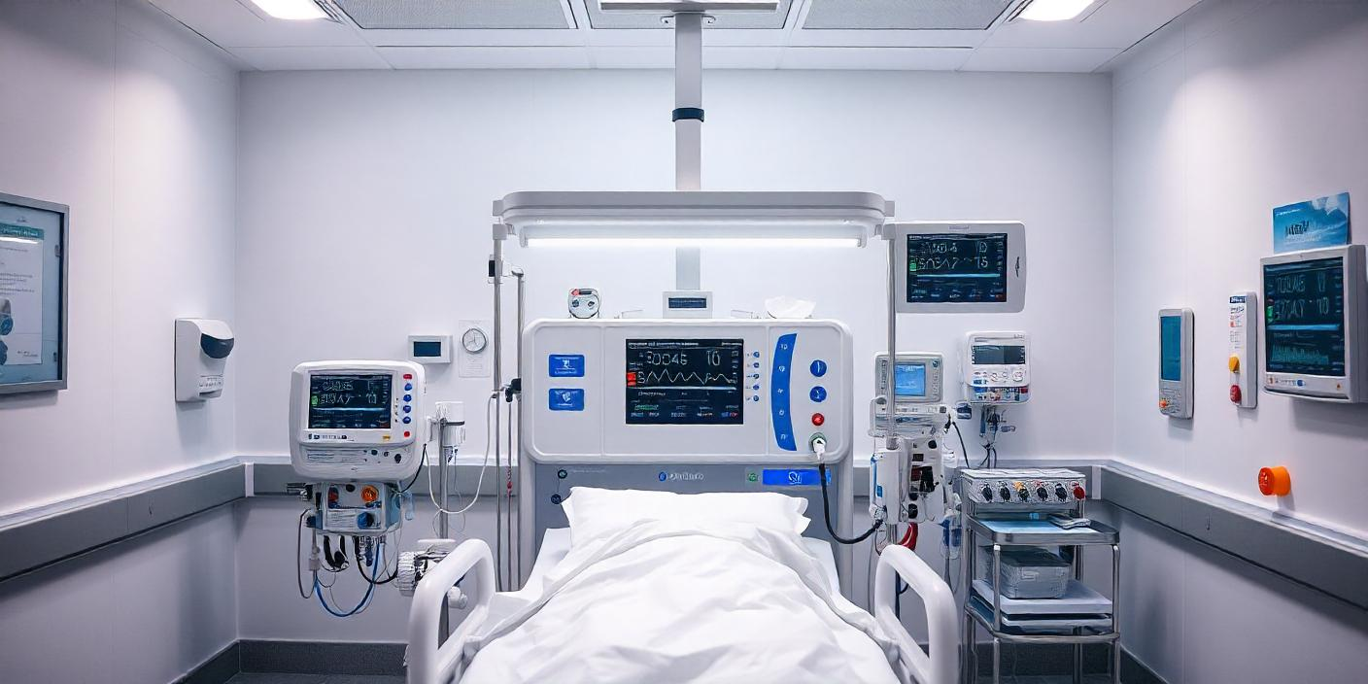

Dialysis Registry
Report
2022 - 2023
Nigerian Association
Of Nephrology

Slide 2

Prof. Ikechi
Okpechi
African
Renal
Registry
Prof. Chinwuba
Ijoma
Prof. Oluseyi Adejumo
Prof. Razeen
Davids
Registry
Committee
Executives & Members
Dr. Udeme-Abasi
Nelson
Prof Ume Okafor
Drs Mamven Manmak,
Bala Waziri, Stephen
Oguntola, Ugochi Onu
Dr Habib Galadanci
Acknowledgements
All dialysis centres
that submitted data.

Slide 3

Dialysis Overview | 2022-2023
● Sokoto
No State data
● Katsina
6,658
NW
● Jigawa
Geopolitical
boundaries
● Kano
● Borno
● Kebbi
Patients
NE
5,574
1,084
● Niger
NC
● FCT
● Plateau
● Kwara
83.7%
CKD
16.3%
AKI
● Nasarawa
● Oyo
● Osun
● Ekiti
● Kogi
49
6
SW
● Ondo
● Enugu
●
Geopolitical zones
● Lagos
SE
● Ebonyi
Collaborating centers
● Delta
● Imo
● Cross River
● Abia
Patient density
16
SS
● Rivers
● Akwa Ibom
pmp reported (Under-reporting, lack of access)

Slide 4
Patient and Facility Distribution | Zone & Category of Facility
Number of Patients by Zone and Category of Facility
Number of Facility by Zone & Category
0
400
800
1200
1600
0
15
NC
888
NC
4
833
12
NE
0
NE
0
Category of Facility
86
1
0
0
Private
NW
NW
680
5
Public
SE
214
SE
2
270
4
SS
31
SS
1
541
5
SW
471
SW
6
1560
9
NC = North Central; NE = North East; NW = North West; SE = South East; SS = South South; SW = South West

Slide 5



Kidney Failure Incidence | Temporal Trends
Dry Season
Wet Season
Dry Season
Wet Season
450
300
Number of Patients
150
0
Jan 22
Mar 22
May 22
Jul 22
Sep 22
Nov 22
Jan 23
Mar 23
May 23
Jul 23
Sep 23
Nov 23

Slide 6
Demographics | Age Distribution by Zone & Category
100
Private
Public
80
60
Mostly in
their
productive
years
Age in Years
40
20
0
SW
NW
SE
NC
SS
NE
NC = North Central; NE = North East; NW = North West; SE = South East; SS = South South; SW = South West

Slide 7
Demographics | Sex Distribution by Zone
Count
0
300
600
900
1200
3,444
NC
627
61.8%
Male
1094
2,130
NE
51
35
38.2%
Female
NW
224
456
SE
201
283
Sex Distribution
SS
238
Male
334
Female
SW
789
1242
NC = North Central; NE = North East; NW = North West; SE = South East; SS = South South; SW = South West

Slide 8
Vascular Access | Distribution by Zone
SW
65.0%
34.1%
31.3%
SS
83.6%
16.3%
2.1%
Tunneled IJ CVC
AV Fistula
SE
81.2%
18.3%
NW
7.8%
37.1%
55.1%
AV Fistula
NE
100.0%
66.6%
Temporary
Femoral Catheter
2.1%
72.7%
25.2%
NC
Temp. Femoral Catheter
Tunneled IJ CVC
0
25
50
75
100
Percent(%)
NC = North Central; NE = North East; NW = North West; SE = South East; SS = South South; SW = South West

Slide 9
Transmissible Viruses | HBV, HCV & HIV by Zone
Positive
SW
SE
SS
NW
NC
NE
Negative
2.9%
(2.5 – 3.4%)
Hepatitis B Virus
3.2%
1.9%
1.6%
6.5%
1.8%
2.3%
1.0%
(0.7 – 1.3%)
Hepatitis C Virus
0.3%
1.0%
0.5%
1.5%
1.9%
0.0%
3.9%
(3.4 – 4.4%)
HIV
1.6%
7.7%
5.9%
4.6%
4.8%
1.2%
NC = North Central; NE = North East; NW = North West; SE = South East; SS = South South; SW = South West

Slide 10
Outcomes | Overall and by Zone
2.4%
NC
3.9%
39.5%
56.6%
NW
3.5%
18.1%
78.4%
46.7%
Overall
SE
0.5%
44.6%
55.0%
56.9%
SS
44.6%
55.4%
SW
1.8%
32.2%
66.0%
Transplant
Dead
Alive
0
25
50
75
100
Percent(%)
NC = North Central; NW = North West; SE = South East; SS = South South; SW = South West

Slide 11
Mortality - 1
1.0
1.0
0.5
NC
0.5
NW
Negative
SE
SS
Positive
Zone
p<0.001
SW
0
HIV
p<0.001
0
0
500
1000
0
500
1000
Time (days)
Time (days)
1.0
1.0
0.5
0.5
Negative
Negative
HBV
p=0.01
Positive
HCV
p=0.70
Positive
0
0
0
500
1000
0
500
1000
Time (days)
Time (days)

Slide 12
Mortality - 2
1.0
1.0
0.5
0.5
Female
< 50 years
0
Sex
p=0.17
Male
0
Age Grp
p=0.76
≥ 50 years
0
500
1000
0
500
1000
Time (days)
Time (days)
1.0
1.0
0.5
0.5
AV Fistula
No
Temp. Femoral Ca
0
DM
p=0.02
Yes
0
VAC
p<0.001
Tunneled CVC
0
500
1000
0
500
1000
Time (days)
Time (days)

Slide 13
Overall Survival | 1 Year Post Dialysis Initiation
Overall Survival 1 Year Post Initiation : 67.9% (66.2 – 69.5%)
Zone, p < 0.001
SS | 76.9% (73.0-80.6%)
SW | 75.7% (72.7-78.6%)
NC | 71.9% (69.2-74.5%)
SE | 65.5% (57.9-72.6%)
NW | 35.7% (31.3-40.2%)
Facility Type , p = 0.62
Public | 68.2% (66.1-70.2%)
Private | 67.3% (64.4-70.1%)
Sex, p = 0.88
Male | 68.0% (65.9-70.0%)
Female | 67.7% (65.0-70.4%)
HIV, p < 0.001
Neg | 68.5% (66.8-70.2%)
Pos | 53.8% (44.9-62.5%)
HBV, p = 0.63
Neg | 68.0% (66.3-69.6%)
Pos | 65.4% (54.0-75.7%)
HCV, p = 0.43
Neg | 68.0% (66.3%-69.6%)
Pos | 61.3% (42.2%-78.2%)

Slide 14
Overall Survival | 2 Years Post Dialysis Initiation
Overall Survival 2 Year Post Initiation : 24.0% (22.5 – 25.6%)
Zone, p < 0.001
SE | 38.0% (30.7- 45.7%)
SS | 37.9% (33.6-42.3%)
NC | 21.9% (19.6-24.5%)
SW | 21.0% (18.3-23.9%)
NW | 14.6% (11.6-18.2%)
Facility Type , p <0.001
Public | 28.2% (26.3-30.2%)
Private | 16.0% (13.8-18.3%)
Sex, p = 0.85
Female | 24.2% (21.8-26.8%)
Male | 23.9% (22.1-25.9%)
HIV, p < 0.001
Neg | 24.8% (23.3-26.4%)
Pos | 6.8% (3.2-12.5%)
HBV, p = 0.03
Neg | 24.3% (22.8-25.9%)
Pos | 13.6 (7.0-23.0%)
HCV, p = 0.06
Neg | 24.2% (22.7-25.7%)
Pos | 9.7% (2.0-25.8%)

Slide 15
Independent Mortality Predictors
Predictor | Hazard Ratio (95% CI) p-value
Age | 0.99 (0.63-1.83) 0.86
Sex | 0.94 (0.83-1.06) 0.29
HBV | 0.75 (0.46-1.22) 0.24
HCV | 1.11 (0.65-1.88) 0.70
HIV | 1.92 (1.52-2.41) <0.001
DM | 1.07 (0.63-1.83) 0.80
Vascular Access Temporary Femoral CVC + AVF | 0.81 (0.69-0.96) 0.02 1

Slide 16

Limitations
1
2
3
Data on cause of death
was not captured by the
registry.
Are these figures generalizable?
Little < 50% of dialysis centers.
North-East data is sparse.
Incomplete data from a
number of centers

Slide 17
. . . Achieving Sustainability
1. Data Electronic Platform
2. Definition of Data Points
5
1
3. Ethical and regulatory framework
4
2
3
4. Data Governance (Analysis + Annual Reports)
5. Data Entry Staff

Slide 18
THANK
YOU

