Slide 1
SecureMobile Risk Quantification &
Control Investment Analysis
Executive Briefing | SecureBank Financial
To: Board of Directors, CISO, CFO
From: GRC Risk Analysis Team (Rosemary Gift Nelson, Lead GRC Analyst)
Date: 28 October 2026
Subject: Quantified risk exposure and recommended control investment for the SecureMobile banking platform

Slide 2
Executive Dashboard
Current exposure, recommended controls, and the resulting risk reduction
$35.0M
$8.04M
$26.96M
$700K
Total Current Annual Risk Exposure (ALE)
Residual Risk After Controls
Annual Risk Reduction
Total Initial Investment
Top 3 Risks (by Financial Impact)
Recommended Controls
Vulnerability | ALE ($) | Priority
Database Injection Vulnerability | $31,250,000 | High
Session Hijacking | $3,000,000 | Medium
API Authentication Bypass | $750,000 | Low
Control | Cost | Risk Reduced/yr | 3-yr ROI
Advanced API Security Gateway | $350,000 | $675,000 | 305%
Web Application Firewall | $150,000 | $23,437,500 | 31,150%
MFA Enhancement | $200,000 | $2,850,000 | 2,848%
Recommendation: Approve all three controls. Combined, they cut annual risk exposure by 77%, for a one-time $700,000 investment plus $105,000/year in maintenance. The Database Injection finding alone accounts for 89% of current exposure and should be prioritized first.
SecureMobile Risk Quantification | SecureBank Financial | CONFIDENTIAL
2

Slide 3
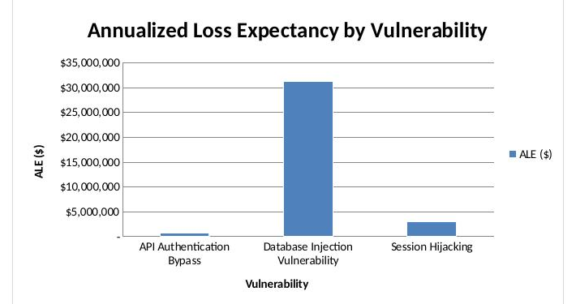
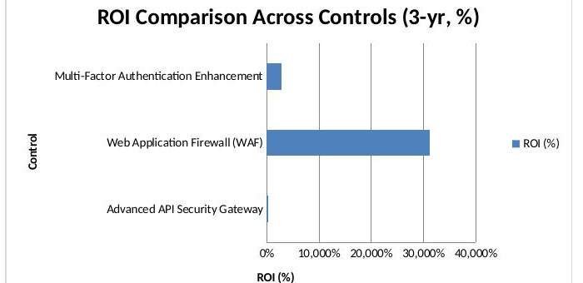
Financial Justification
Why Database Injection dominates current exposure, and why the WAF's ROI is so large
Note: Database Injection's ALE ($31.25M) and the WAF's resulting ROI (31,150% over 3 years) are both driven by a single stated assumption: the dataset models a full breach of all 500,000 customer records at $250/record. This is a documented modeling choice, not an error (see Assumptions #2-3 in the workbook) — a partial-breach scenario would reduce both figures substantially, but would not change which control to prioritize first.
SecureMobile Risk Quantification | SecureBank Financial | CONFIDENTIAL
3

Slide 4
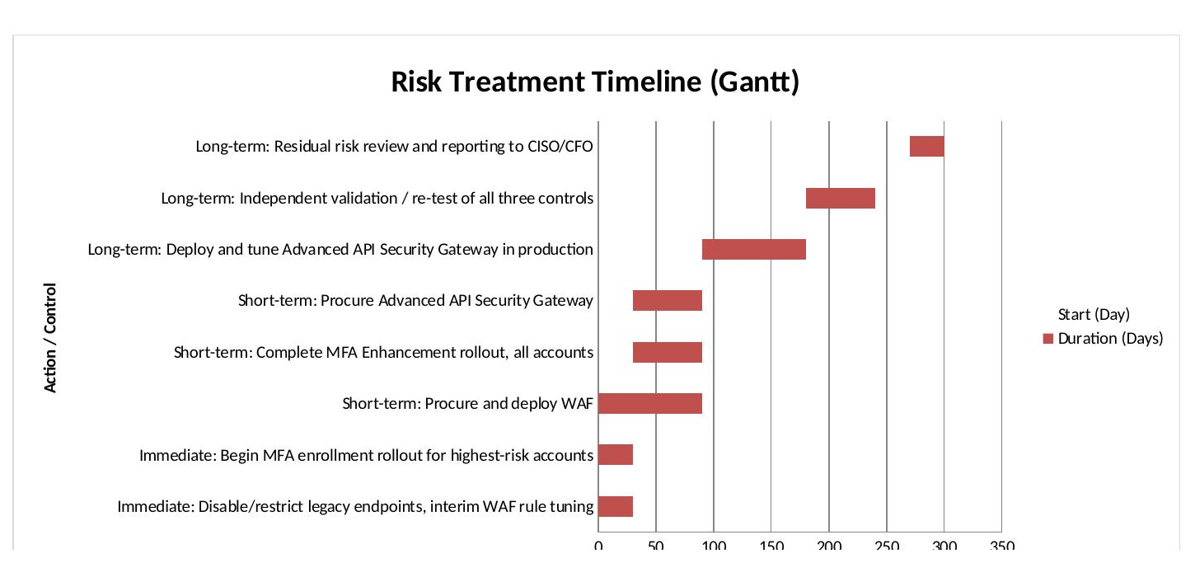
Risk Treatment Plan
Immediate (0-30 days), short-term (0-90 days) and long-term (90-365 days) actions, pursued in parallel
Planning assumption: no implementation start date, budget ceiling, or change in risk over time was supplied in the brief. This timeline assumes work begins Day 0 upon sign-off.
SecureMobile Risk Quantification | SecureBank Financial | CONFIDENTIAL
4

Slide 5
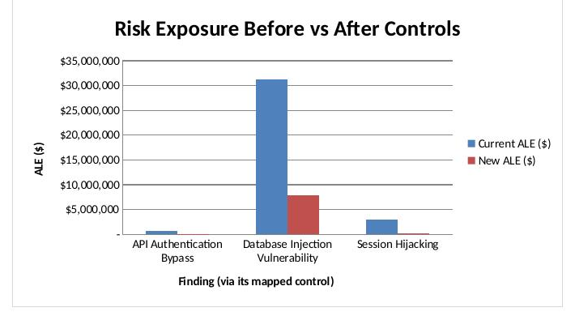
Residual Risk & Recommendation
Bottom line
Current annual exposure: $35,000,000
Total investment: $700,000 one-time + $105,000/yr
Residual exposure after controls: $8,037,500
Combined 3-yr ROI: 7,869%
The investment pays for itself inside the first year on every control individually (longest payback: 6.7 months, Advanced API Security Gateway). Residual risk after all three controls is still driven by Database Injection and should remain on the risk register for ongoing monitoring, not treated as closed.
Next step: CISO/CFO sign-off requested to release Year 1 funding ($700,000 initial + $105,000 maintenance) and begin the Immediate-phase actions on the treatment timeline.
SecureMobile Risk Quantification | SecureBank Financial | CONFIDENTIAL
5

