Slide 1


Data Mining to Improve
Student Outcomes
Team Six:
Nish Garg
Christopher Lucas
Aditi Sharma
Nelson Wang
Bill Wilson
Data Analysis and Visualization

Slide 2
Four Questions
What is the relationship between average teacher salary and student achievement?
What is the relationship between community type and student achievement?
What is the relationship between poverty and student achievement?
What conclusions can we draw from these relationships to improve student outcomes?
Data Analysis and Visualization

Slide 3
Data Source
Texas Education Agency
Texas Academic Performance Report
Snapshot: School District Profiles
Download of .dat files and imported as .csv files
School years
2012–2013
2013–2014
2014–2015
2015–2016
Data Analysis and Visualization

Slide 4
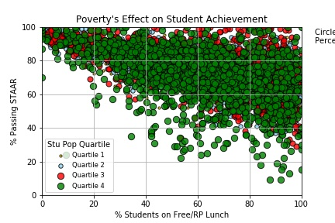
Relationship between poverty and student outcomes
Student population by quartile
Negative relationship
Varied dispersion by campus size
Data Analysis and Visualization

Slide 5
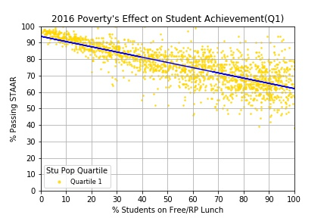
Relationship between poverty and student outcomes
First quartile of student population
Smallest schools have least variance from the regression line
Data Analysis and Visualization

Slide 6
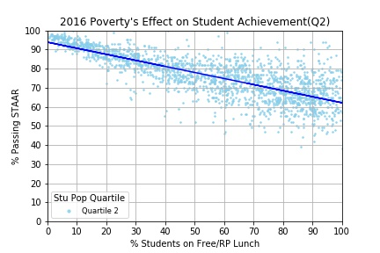
Relationship between poverty and student outcomes
Second quartile of student population
Lower variance from the regression line
Data Analysis and Visualization

Slide 7
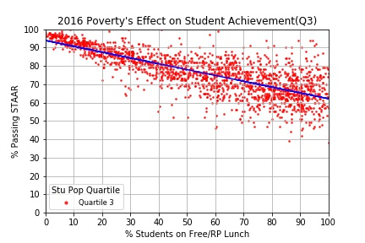
Relationship between poverty and student outcomes
Third quartile of student population
Lower variance from the regression line
Data Analysis and Visualization

Slide 8
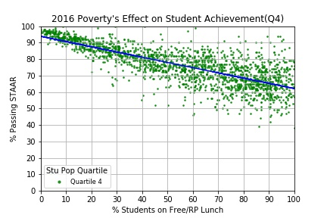
Relationship between poverty and student outcomes
Student population by quartile
x = percentage of economically disadvantaged students
y = percentage of student passing STAAR
Negative relationship
Dispersion varies by campus size
Data Analysis and Visualization

Slide 9
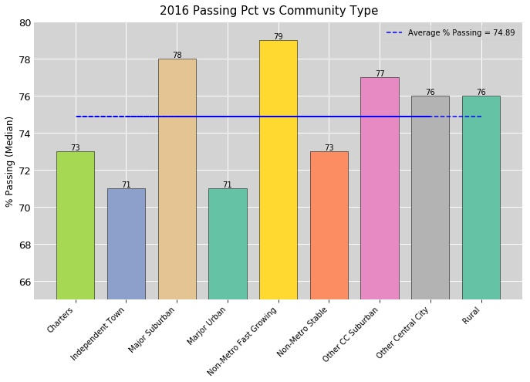
Relationship between community type and student outcomes
Highest passing rate- 78%.
Lowest passing rate – 71%
Average % Passing – 74.89%
Data Analysis and Visualization

Slide 10
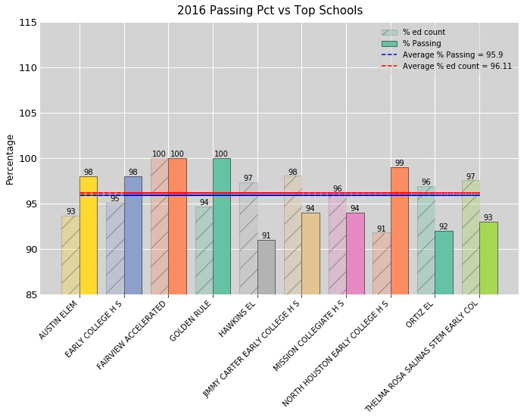
Relationship between top schools and student outcomes
Highest passing rate and count of schools
Lowest passing rate and count of schools
Average % Passing
Data Analysis and Visualization

Slide 11
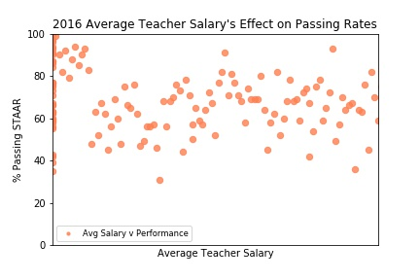
Relationship between teachers’ salaries and students’ performance
Student performance is not dependent on teacher’s average salary.
Further analysis can be done on the outliers.
Data Analysis and Visualization

Slide 12
Questions
?
Data Analysis and Visualization

