Slide 1

Passwords and protecting our internet Prescence
Nicole ely and Koribeth hansen
4-29-2021

Slide 2
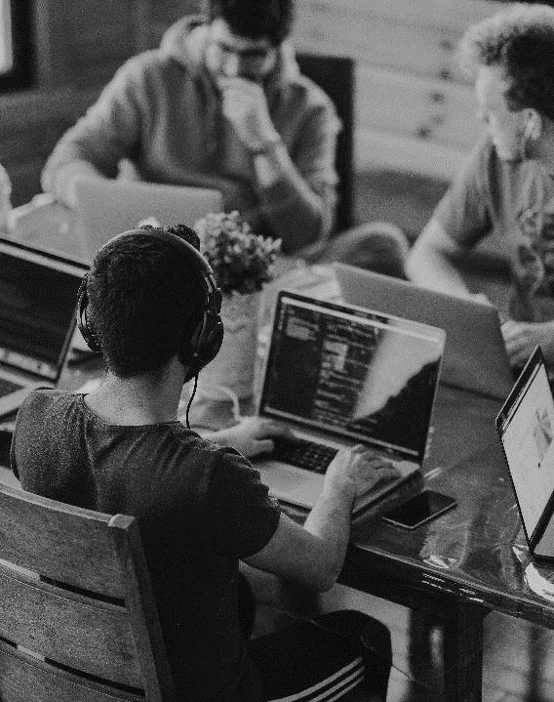
INTRODUCTION
Online Privacy
-Growing online privacy concerns
-Personal data under attack by theft, hacking, and unethical data collection
-Password strength criteria (i.e character length, upper and lowercase letters, numbers and special characters)
-Used data from Tidy Tuesdays

Slide 3

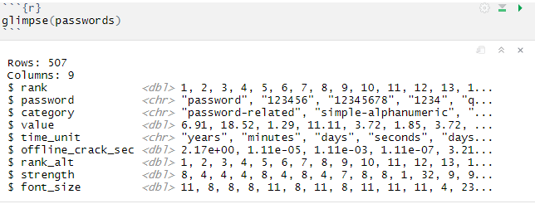
Glimpse into our data

Slide 4
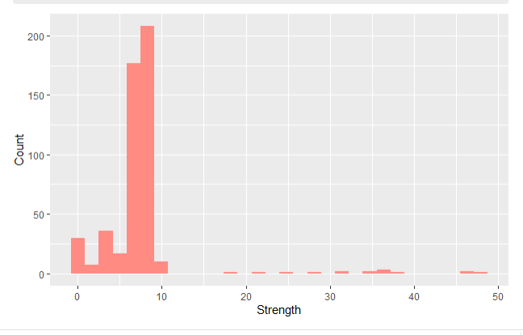
Count vs strength of passwords
-Histogram visualization of strength of each password vs the count
-Most are weak passwords

Slide 5
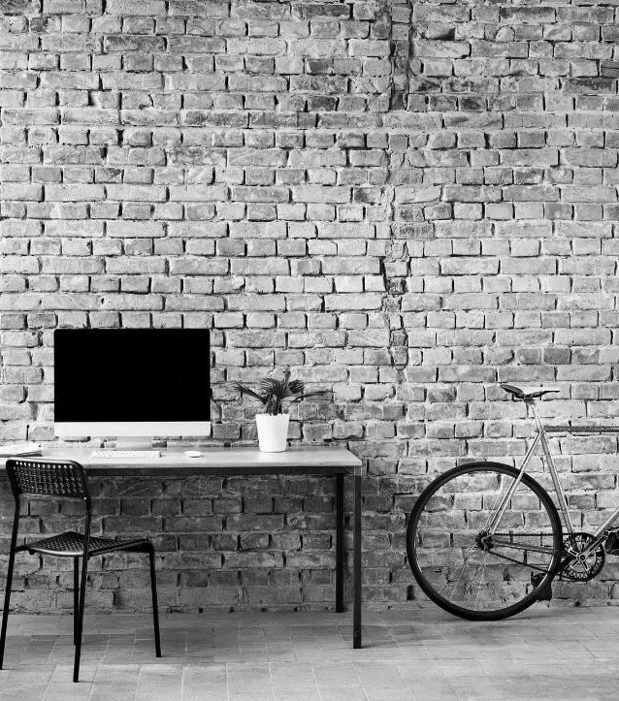
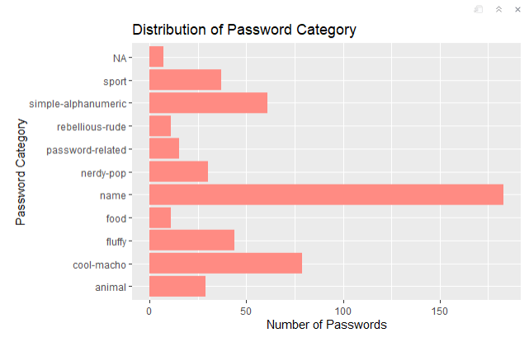
-Different password categories from the dataset
-Name category had most number of passwords
LOOKING AHEAD

Slide 6
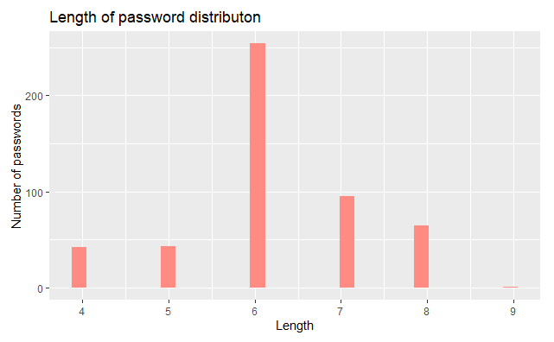
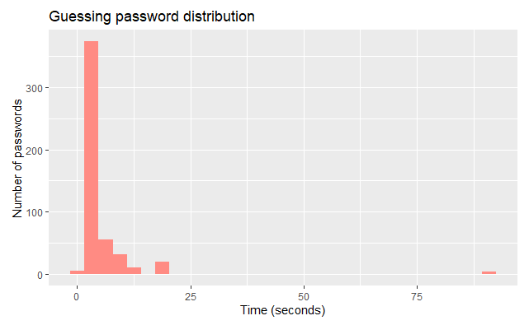
EMPLOYEE OPPORTUNITIES
Most common length of passwords was 6 characters
Time it took for hackers to guess passwords. Majority was within 25 seconds

Slide 7
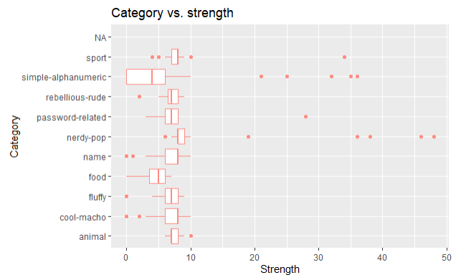
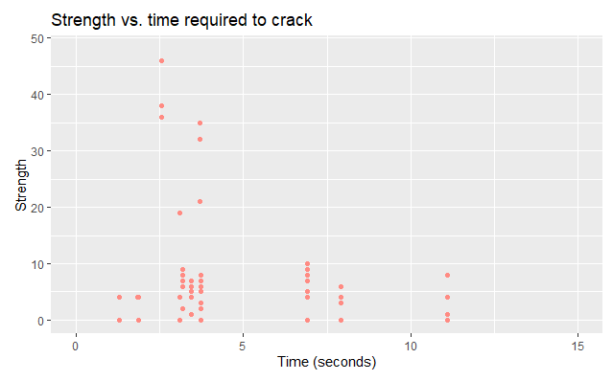
Simple-alphanumeric category had some of the weaker strengths
Weaker passwords were easiest to crack, most falling under 5 seconds

Slide 8
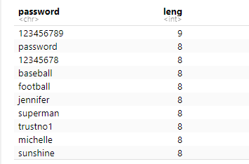
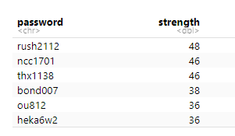
-These are the top longest and the top strongest passwords
-There is no overlap between the two

Slide 9
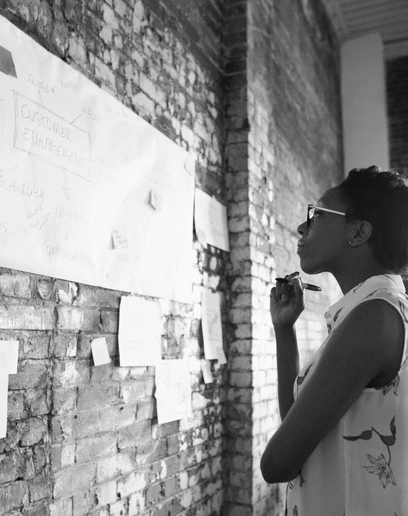
Conclusion
Long passwords aren’t necessarily the strongest
Simple alphanumeric passwords were the easiest for hackers to crack
Name-related passwords were the most common categories chosen

Slide 10
Future work
-Dataset contained primarily weak passwords
-Not completely representative of modern-day passwords
Thank you!

