Slide 1
GENPACT Problem: Pubmed Text Classification
Nelli Fedorova

Slide 2
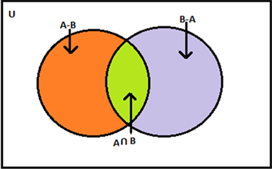
Pubmed Articles
class | n.of IDs | n.of abstracts | query
Class 0 | 10000 | 9981 | NOT drug NOT side NOT effects NOT congenital NOT anomalies
Class 1 | 10000 | 9995 | drug side effects NOT congenital NOT anomalies
Class 2 | 10000 | 9980 | congenital anomalies NOT drug NOT side NOT effects
Class 3 | 2082 | 2082 | drug side effects congenital anomalies
Multi-class
Multi-label

Slide 3

Word Cloud: original

Slide 4
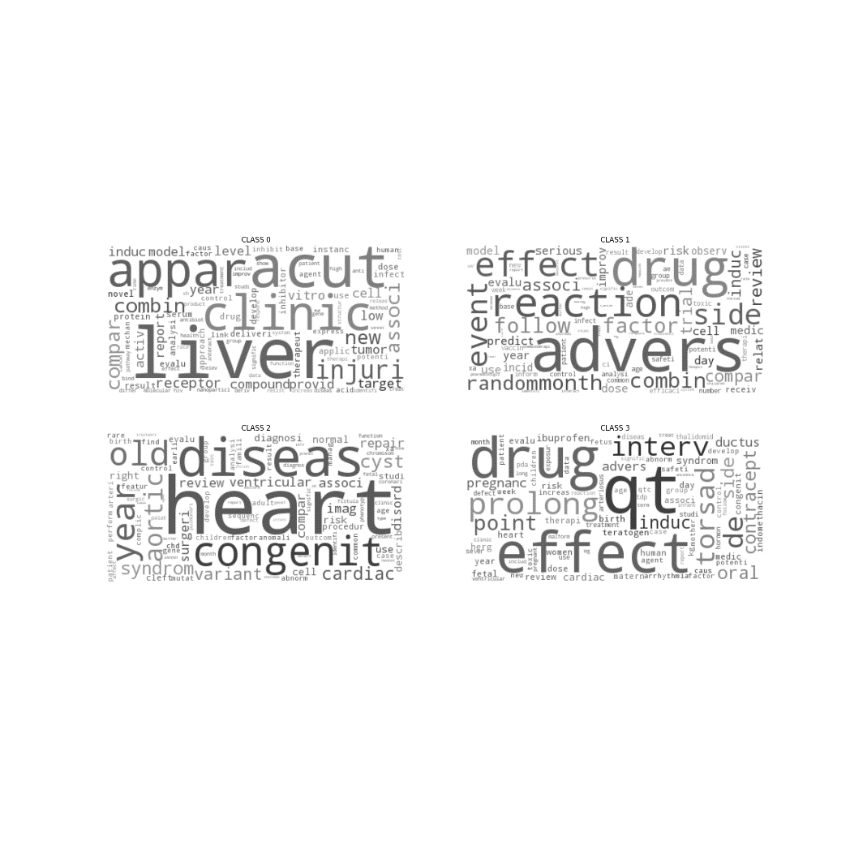
Word Cloud: 100 TF-IDF

Slide 5
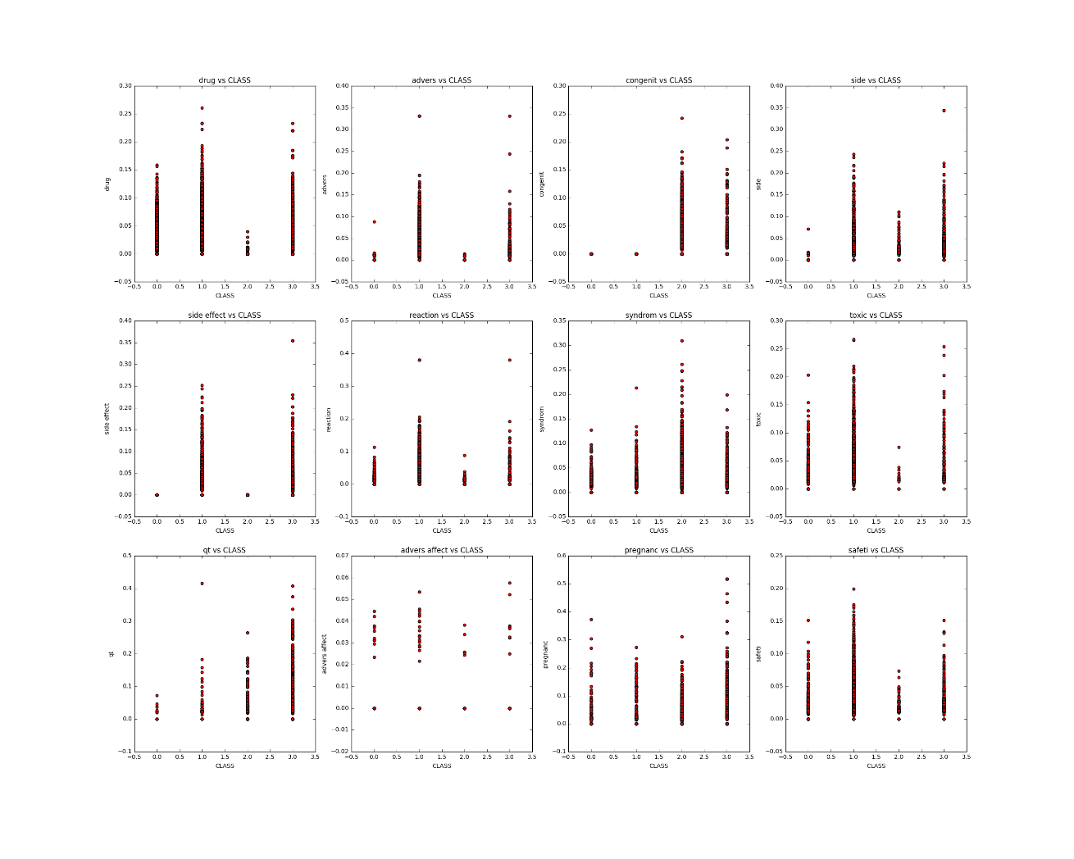
XGB importances: drug advers congenit side side effect reaction syndrom toxic qt advers affect pregnanc safeti

Slide 6
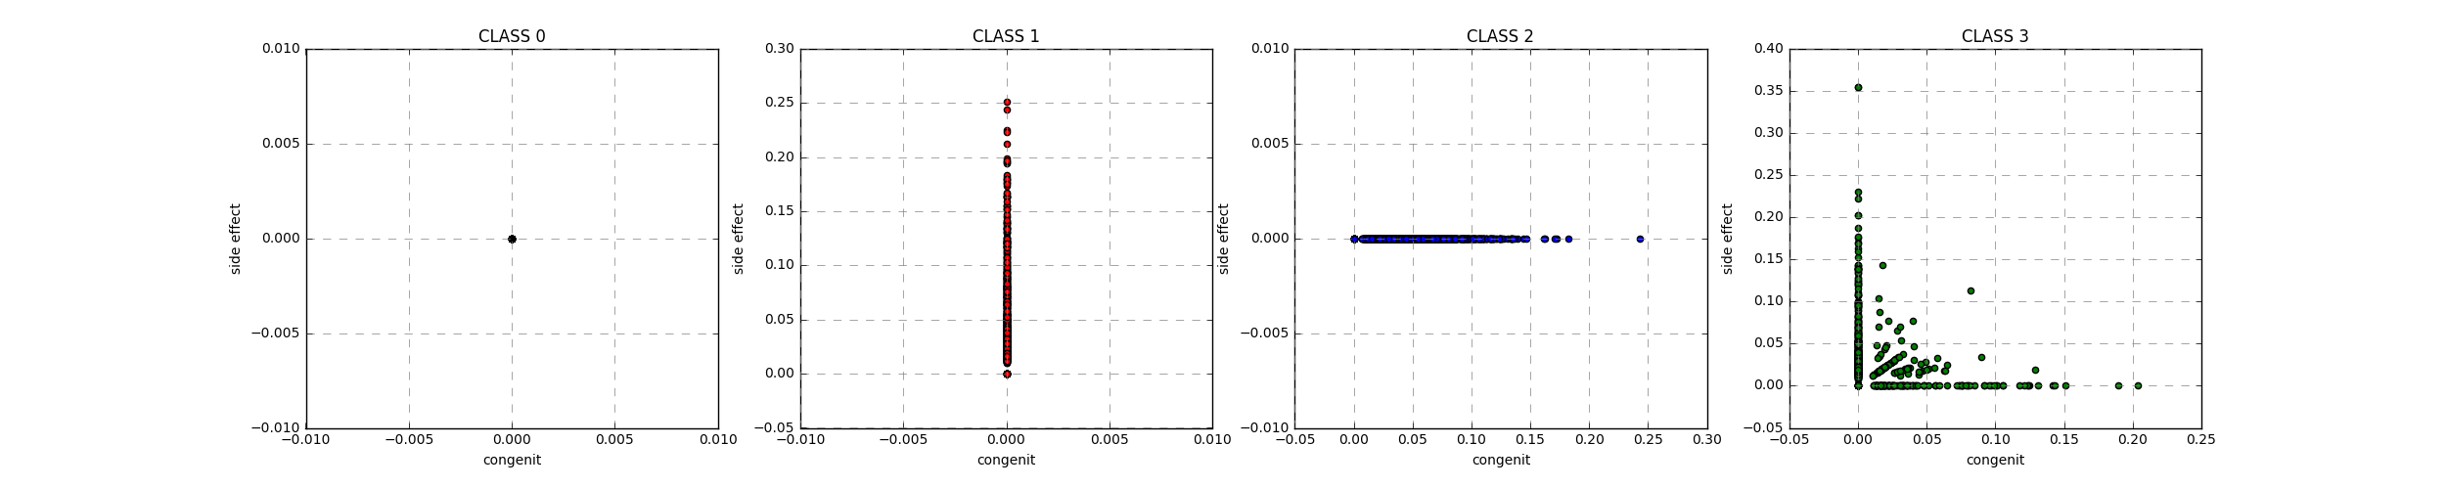
TF-IDF frequencies: congenit vs side effect

Slide 7
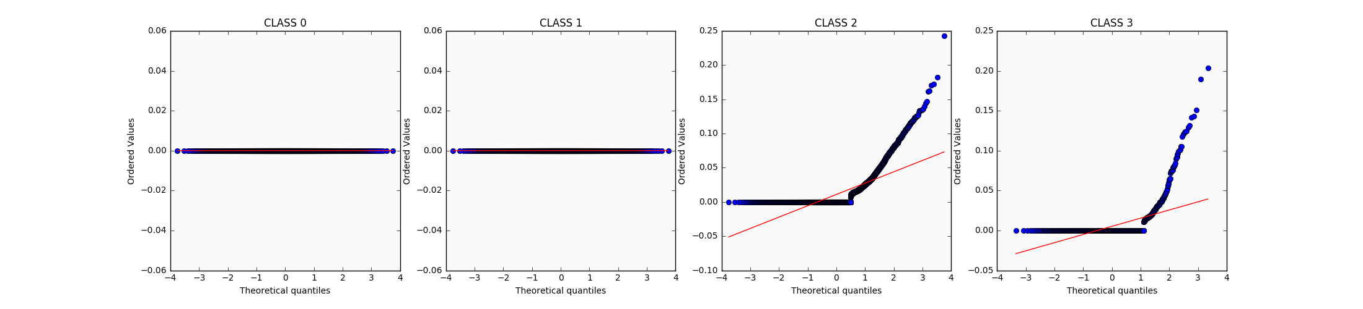
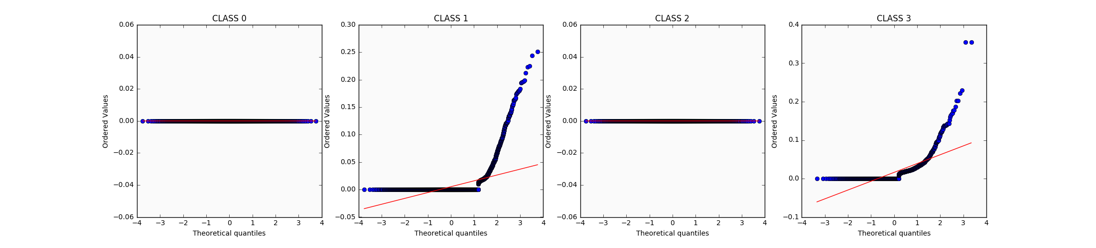
Q-Q plots: congenit, side effect
congenit
side effect

Slide 8
Multi-class and multi-label models

Slide 9
Leaderboard: ~4.7M BOW, ~45K BOW pruned, ~419 BOW best, 400 Doc2Vec

