Slide 1
Chamber schematics
Subcooled pool-boiling chamber with submerged tube-bundle condenser
Editable vector graphics (EMF). In PowerPoint, right-click a figure > Group > Ungroup to edit shapes, colours, and labels. SVG and PDF versions are in schematics/ for Inkscape.

Slide 2
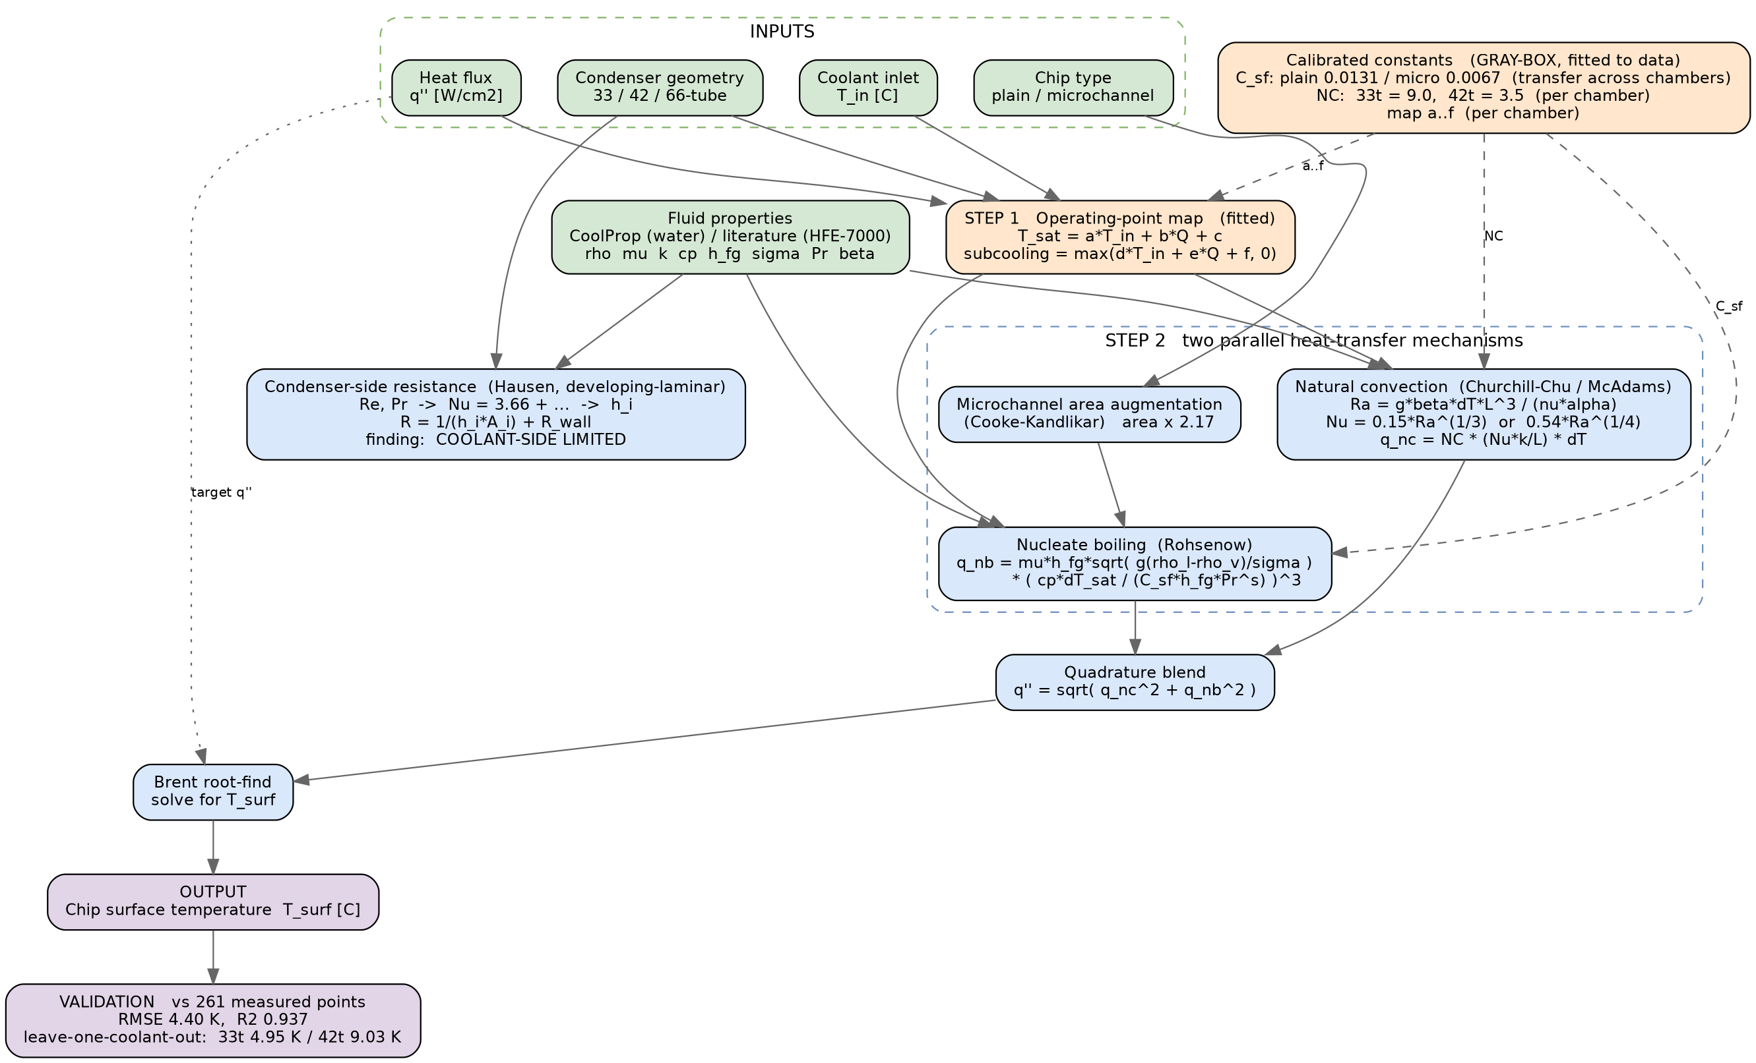
Gray-box reduced-order physics map
Part I model structure. Colour key: green = inputs, blue = established physics, amber = fitted gray-box constants, purple = output / validation.

Slide 3
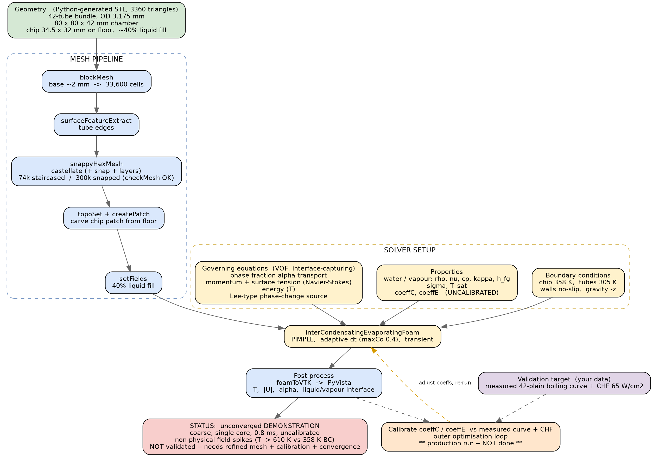
3D VOF numerical study map
Part II CFD framework. Colour key: green = geometry, blue = mesh pipeline, yellow = solver setup, amber = production-resolution step (not yet done), red = honest status.

Slide 4
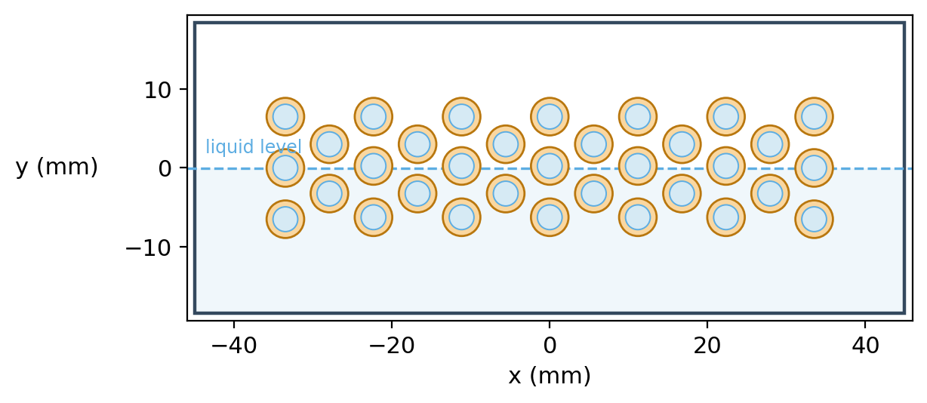
33-tube condenser bundle (cross-section)
Measured tube layout, OD 4.76 mm / ID 3.14 mm, open manifold. Liquid level shown for context.

Slide 5
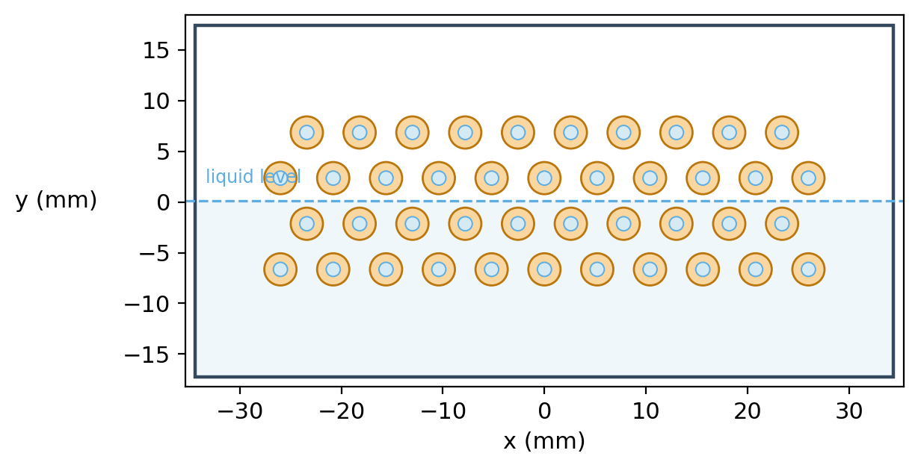
42-tube condenser bundle (cross-section)
Measured CAD tube layout, OD 3.175 mm / ID 1.39 mm, confined in-chamber manifold.

Slide 6
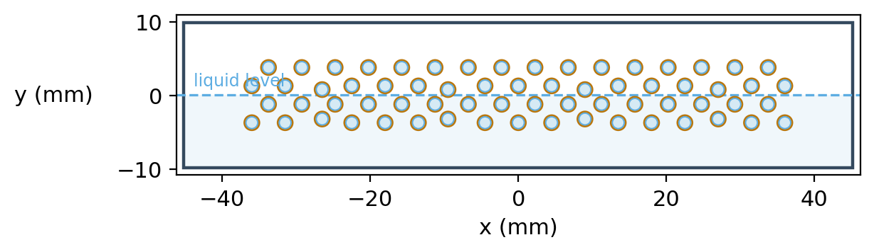
66-tube condenser bundle (cross-section)
Denser bundle, OD 2.0 mm / ID 1.8 mm (geometry table). Forecast geometry, no data yet.

Slide 7
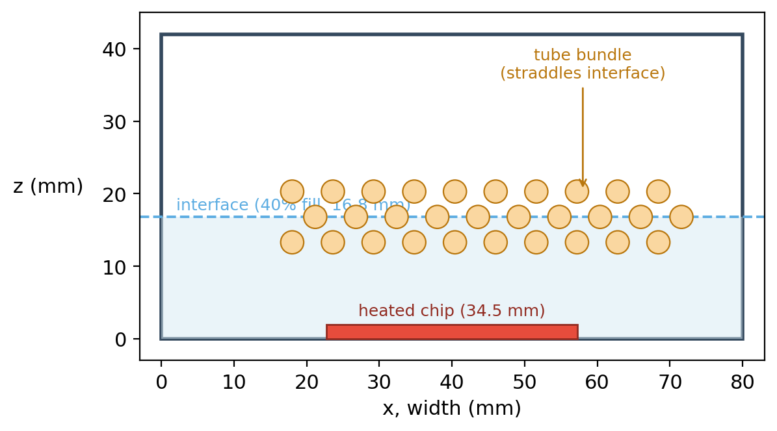
Computational domain (front x-z section)
Chamber 80 x 80 x 42 mm, 40% fill (16.8 mm), heated chip on the floor, bundle straddling the interface.

Slide 8
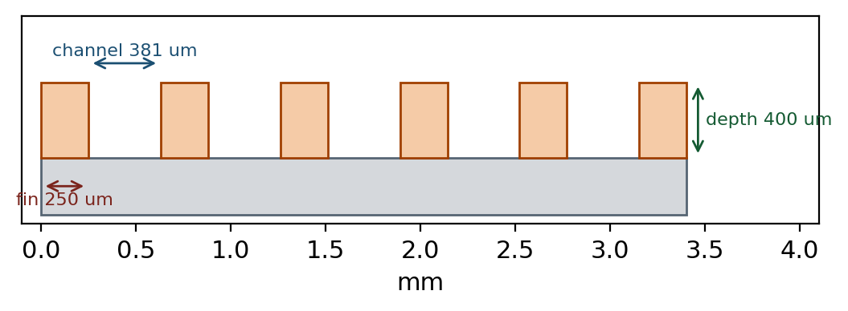
Open-microchannel evaporator surface
Cooke-Kandlikar geometry: 381 um wide channels, 400 um deep, 250 um fins; area augmentation A_r = 2.17.

