Slide 1

CAMPUS HOUSING SYSTEM
BY VIDHI POPAT PRATHAMESH NEMADE URVANG PATEL MILIND SHARMA

Slide 2
TEAM CONTRIBUTION
MEMBERS | CONTRIBUTION
MILIND SHARMA | MODULE – POLICE, INCIDENT DDL/DML – POLICE, POLICE INCIDENT MAPPING, INCIDENT POLICE REPORTS, TEST CASES
VIDHI POPAT | MODULE – UTILITY, STUDENT, DORM DDL/DML – UTILITY, UTILITY MASTER, STUDENT, DORM UTILITY REPORTS
PATHAMESH NEMADE | MODULE – RESIDENT, SWIPE LOGS, GUESTS DDL/DML - RESIDENT, SWIPE LOGS, GUESTS GUEST AND SWIPE LOG REPORTS, TEST CASES CREATE ACCESS ROLES - SECURITY
URVANG PATEL | MODULE – SUPERVISOR, PROCTOR, SHIFTS DDL/DML - SUPERVISOR, PROCTOR, SHIFTS PROCTOR, DORM OCCUPANCY, STUDENT REPORTS, TEST CASES, AUDITING

Slide 3
PROBLEM STATEMENT
The Campus Housing System wants to create a database to keep track of the Management system which consists of five major entities viz. Dorms, Residents, Management Admin, Proctors, and Police Department. The Campus Housing System helps schools to manage on-campus housing and regulates the management hierarchy in a properly aligned fashion.

Slide 4
PROPOSED SOLUTION
Since managing student housing is getting more difficult to manage in large universities, and it is considered a place that a decent percentage of students spend from 4 to 6 years of their lives inside it, Campus Housing System satisfies the need for developing a system that can manage most of the student housing operations from room registering to maintenance and security. In our system, Proctors will be working in the dorm according to their allocated shifts and can keep track of guests entering the dorm.

Slide 5
KEY FEATURES
Making student a residents
Schedule shifts for dorms
Restrict allocating a student to dorm if its capacity is full
Assigns shifts to proctors
Analyze most accessed utilities by residents
Keep track of guest entries in dorms
Police manages cases generated by dorm

Slide 6
IMPLEMENTED CONCEPTS
STORED PROCEDURES
FUNCTIONS AND FUNCTION OVERLOADING
PACKAGES
PRAGMA AUTONOMOUS TRANSACTIONS
VIEWS AND MAT VIEWS
TRIGGERS
SEQUENCE
CURSORS
EXCEPTION HANDLING
GRANTS
AUDIT

Slide 7
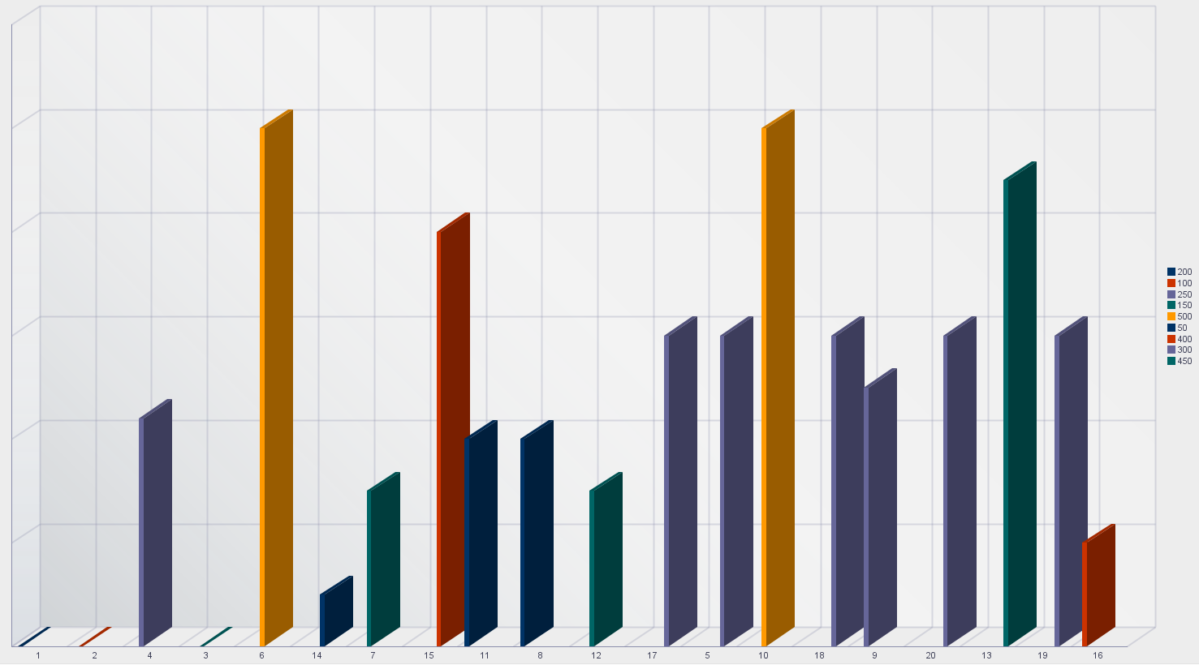
REPORTS
DORM OCCUPANCY
x axis -dorm capacity
y axis -dorm id
legend -capacity

Slide 8
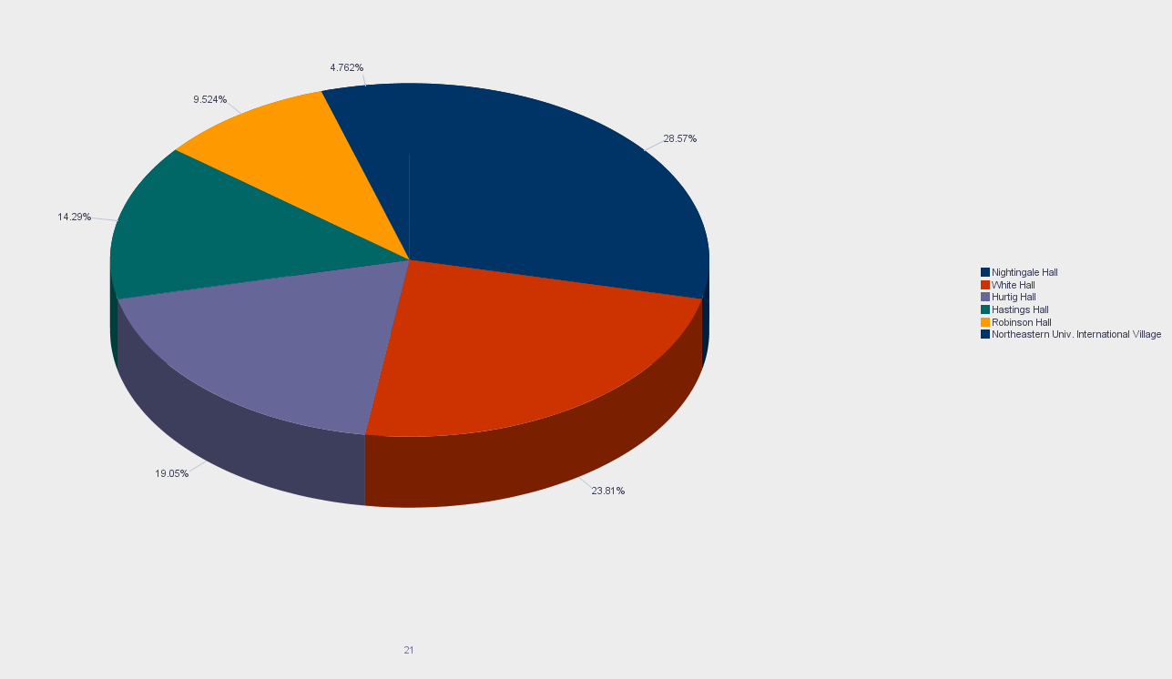
REPORTS
CASES PER DORM
x axis -case count
y axis -dorm id
legend -dorm name

Slide 9
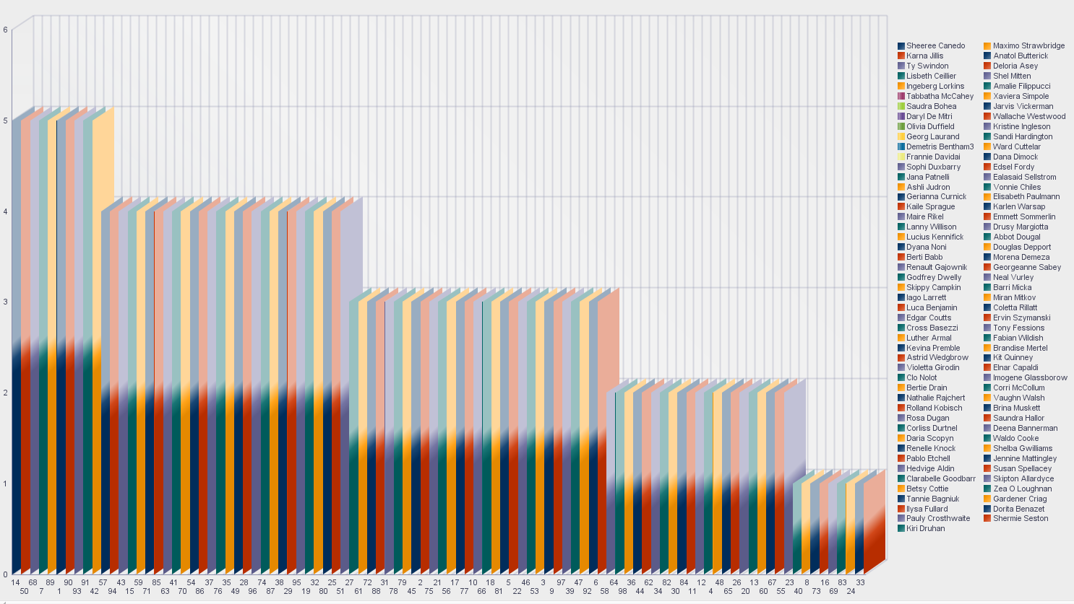
REPORTS
SHIFT DISTRIBUTION
x axis -proctor id
y axis -number of shifts
legend -proctor names

Slide 10
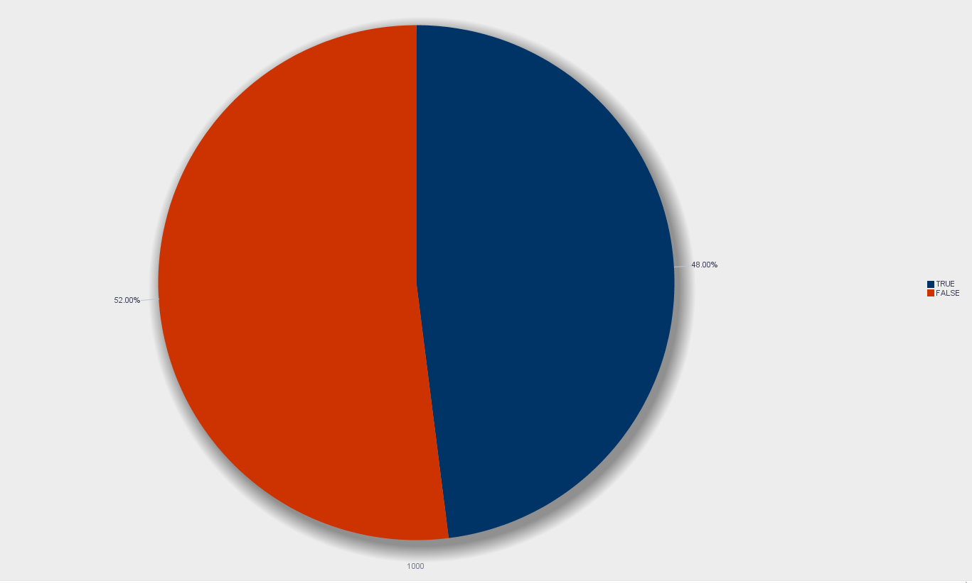
REPORTS
STUDENT OPTING FOR DORMS

Slide 11
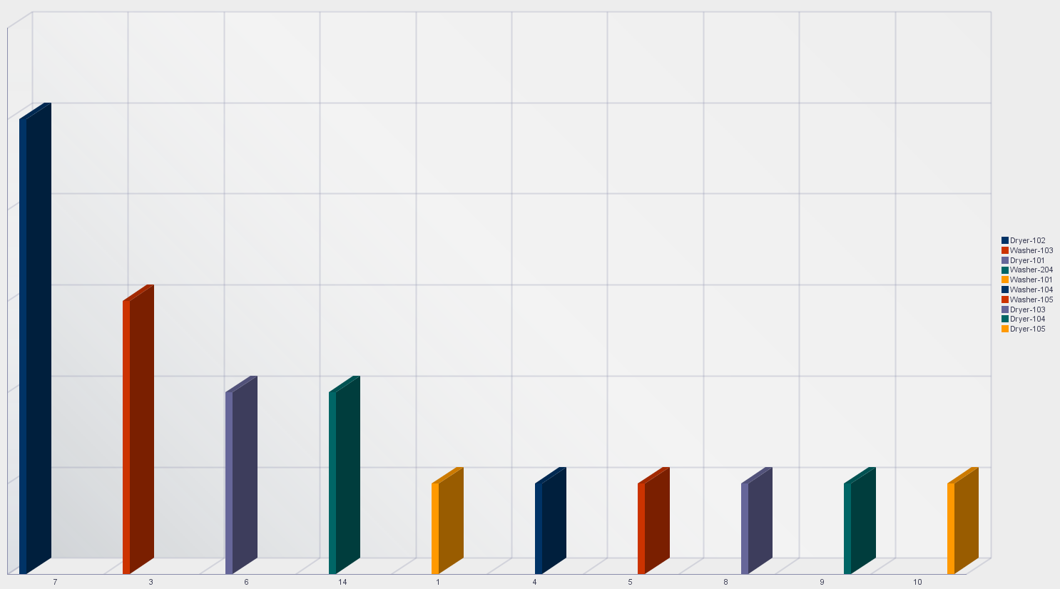
REPORTS
MOST ACCESSED UTILITIES
x axis -utility id
y axis -use count
legend -utility name

Slide 12
THANK YOU

