Slide 1
AWS VPN
ACCOUNTING SERVER
DATABASE
is SYBASE
AWS INSTANCE
VPN
VPN
MSSQL DATABESE
CRON SERVICES

Slide 2
DODATNA OPREMA
B2B WareHouse
B2B WareHouse
B2B WareHouse
JSON XML

Slide 3
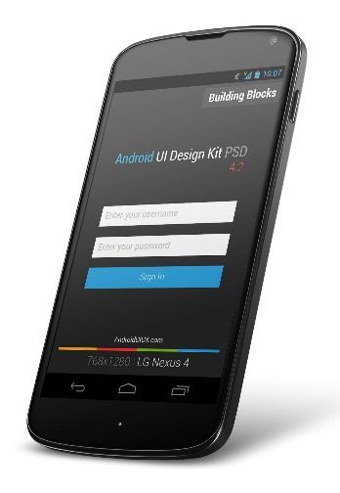
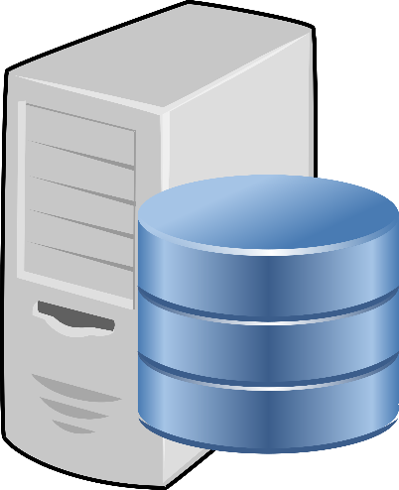
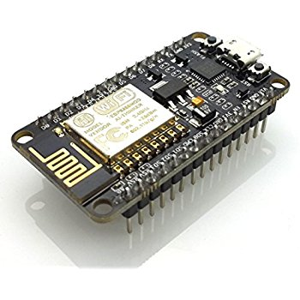
ANDROID APP
Android app send an receive information from server
AWS SERVER
Server receive information from SENSORS and collect them into Data Base
NODE MCU
Sensor collect information’s from Environment and sent to server
Collect Water and Environment Temperature, Humidity and Light
JAVA – Native Android APP
C++ Arduino
Linux Administration

