Slide 1
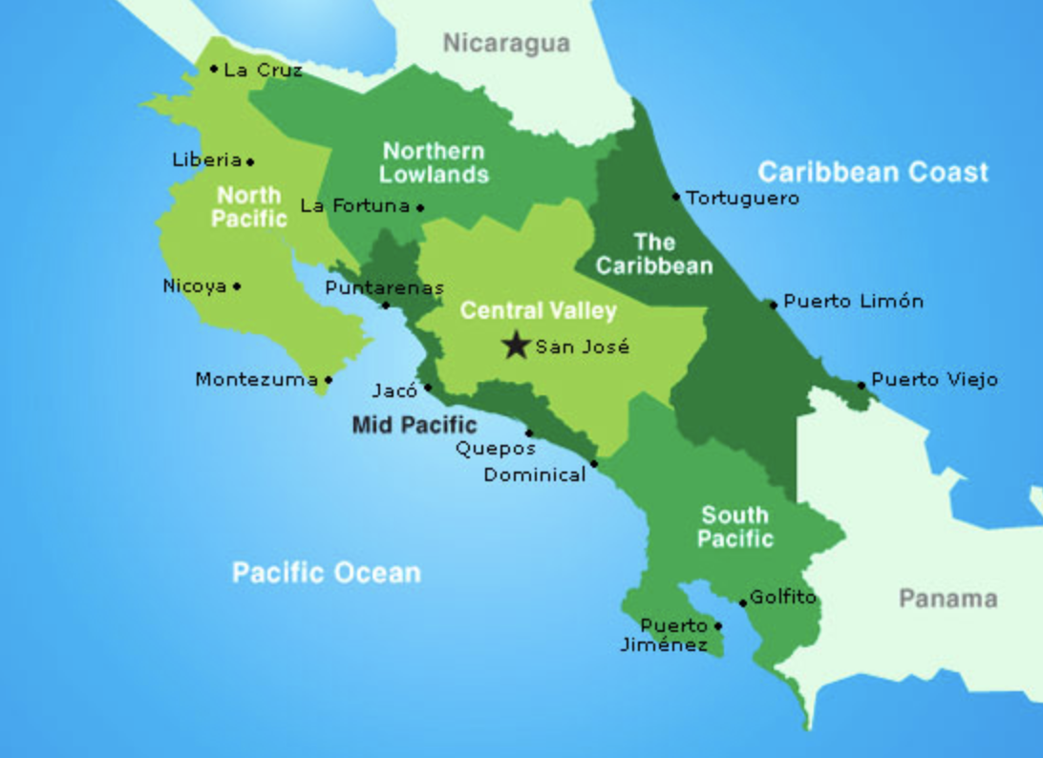
Costa Rican Household Poverty Level Prediction Project GitHub: github.com/nemasobhani/Kaggle-Costa-Rican-Poverty-Prediction Kaggle Competition: kaggle.com/c/costa-rican-household-poverty-prediction
Nema Sobhani
David LaCharite

Slide 2

Data Set and Motivation
Data Source:
Kaggle Competition sponsored by the Inter-American Development Bank
Motivation:
Organizations which distribute aid in Latin America use an algorithm called a Proxy Means Test, which is a model that uses observable household traits to predict vulnerability to poverty.

Slide 3
Research Question
Target Classes
Income Levels
1 = Extreme Poverty
2 = Moderate Poverty
3 = Vulnerable Households
4 = Non-Vulnerable Households
9,558 thousand individuals in Kaggle rovided Training Set
How well can our model predict an individual’s' vulnerability to poverty based on their household data?
What factors are most important in predicting an individual’s vulnerability to poverty?

Slide 4
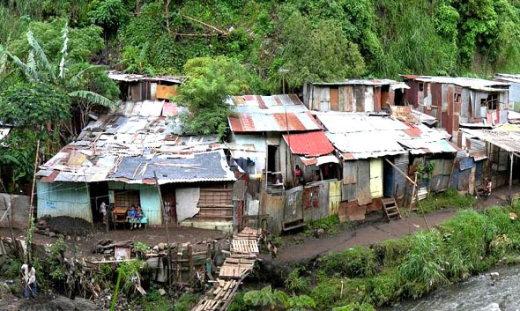
Dataset Explanatory Factors – Household Information
Access to Utilities
Access to Technology
Condition of Household Property
Monthly Rent
Age of Household residents
Sex and Education of Adults 18+

Slide 5
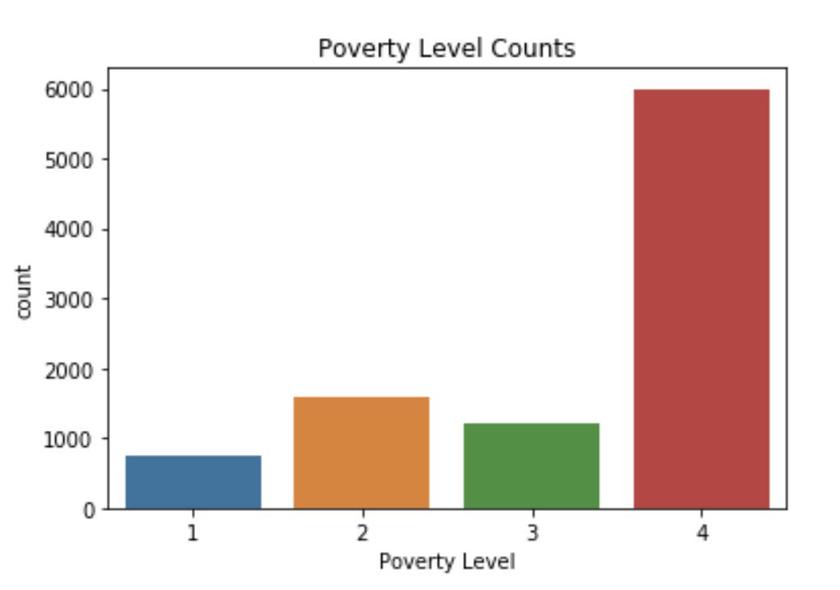
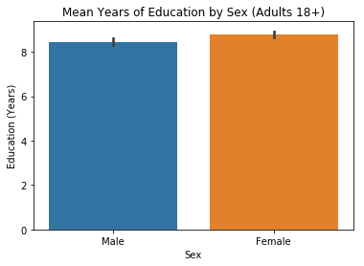
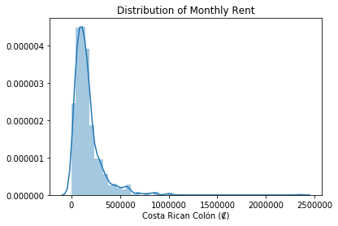
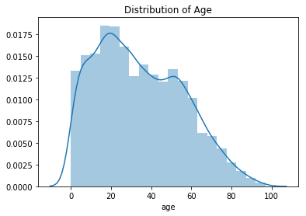
Data Exploration
Income Levels
1 = extreme poverty 2 = moderate poverty 3 = vulnerable households 4 = non vulnerable households

Slide 6
Dataset Summary Statistics
Utilities and Appliances
Resource | Sample Total
No water provision | 0.36%
No electricity provision | 0.22%
No toilet in dwelling | 0.39%
No kitchen | 0.19%
No refrigerator | 4.24%

Slide 7
Dataset Summary Statistics
Technology Access
Resource | Sample Total
Owns mobile phone | 97.5%
Owns tablet | 23.2%
Computer in household | 10.2%
Television in household | 28.5%

Slide 8
Dataset Summary Statistics
Property Condition
Structure in Bad Condition | Sample Total
Walls | 10.2%
Roof | 12.8%
Floors | 10.1%
Walls / Roof / Floors | 5.9%

Slide 9
Data Cleaning and Transformation
Missing Values
Feature | # Missing | % Missing
v2a1 (monthly rent) | 6860 | 71.8%
v18q1 (# tablets in house) | 7342 | 76.8%
rez_esc (years behind in school) | 7928 | 83.0%
meaneduc (avg yrs education for adults 18+) | 5 | 0.05%
SQBmeaned (square of meaneduc) | 5 | 0.05%

Slide 10
Data Cleaning and Feature Engineering
Missing Values
Feature | Approach
v2a1 (monthly rent) | Drop feature Find best classifier for rest of model Use classifier to predict rent and use
v18q1 (# tablets in house) | Values were missing by household Set to 0
rez_esc (years behind in school) | Without domain knowledge, dropped.
meaneduc (avg yrs education for adults 18+) | Grouped by household Mean education of adults applied
SQBmeaned (square of meaneduc) | Squared value found in “meaneduc”

Slide 11
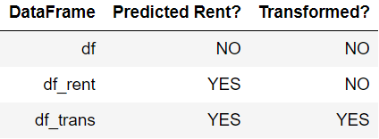
Data Transformation
Best Random Subsets
Took 8 most important features
Randomly selected subsets of varying sizes of:
Top 8 Features
Top 8 Features (Squares)
Top 8 Features (Logs)
Added to data and compared classification scores
Repeat ad infinitum…
Take best subset!

Slide 12
Modelling Activity
Model Type | Accuracy | Precision | Recall | f1 Score
Linear Regression (Round to nearest ordinal number) | 0.503 | 0.454 | 0.324 | 0.289
Multinomial Logistic Regression | 0.627 | 0.157 | 0.250 | 0.193
Support Vector Classifier(GridSearchSV) | 0.631 | 0.907 | 0.257 | 0.206
XGBoost | 0.870 | 0.873 | 0.756 | 0.800
Random Forest(GridSearchCV) | 0.952 | 0.952 | 0.902 | 0.925
Best Random Forest Model from Grid Search CV
(3-folds cross validation)
best_grid_search = RandomForestClassifier(bootstrap=False, class_weight=None,
criterion='gini’, max_depth=50, max_features='auto’,
max_leaf_nodes=None, min_impurity_decrease=0.0,
min_impurity_split=None, min_samples_leaf=1,
min_samples_split=2, min_weight_fraction_leaf=0.0,
n_estimators=300, n_jobs=None, oob_score=False,
random_state=None, verbose=0, warm_start=False)

Slide 13
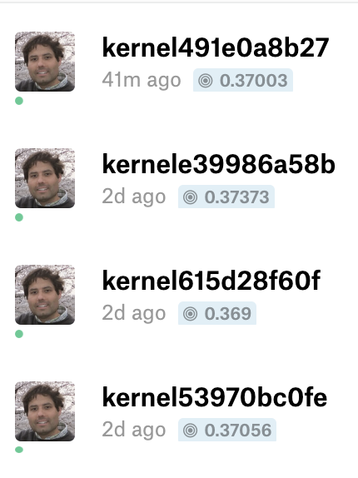
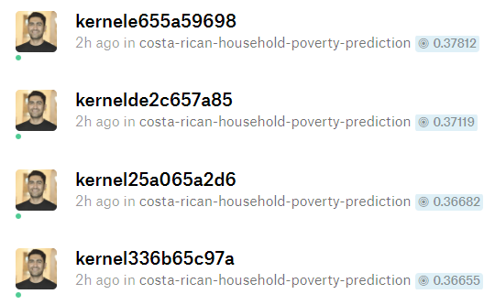
Kaggle Evaluation – Macro F1 Score
Winning Score | 0.44878
Our Best Score | 0.37812
Simple Random Forest Benchmark | 0.36604
David’s Macro F1 scores
Nema’s Macro F1 scores

Slide 14
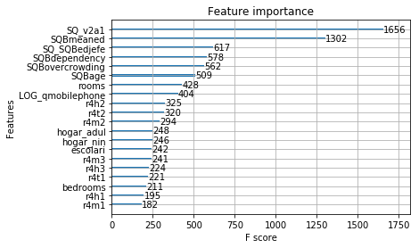
Feature Importance
Square of Monthly Rent Payment
Square of the mean years of education of adults in the household
Square of Dependency Rate
Square of # of persons per room
Square of Age
Number of Rooms
LOG Number of Mobile Phones
Males 12 years of age or older
Persons 12 years of age or older
Females 12 years of age or older

Slide 15
Conclusions
Comparing an array of classification methods, we found that Random Forest using GridSearchCV on the best-subset transformed data resulted in the our best Kaggle Macro F1 score of 0.37812 (374th place as of writing this) for determining Costa Rican poverty level.
Implications of feature importance:
Feature importance analysis could be used for poverty mitigation programs.
Focus future data collection on most important features.

Slide 16
Team Member Contributions
Nema
Data exploration, visualization, feature engineering, transformations, and classification. Assembled this final report.
David
Data exploration, visualization, classification, hyperparameter tuning, and Kaggle submission setup. Assembled final presentation.

