Slide 1
Public Grievance
Present to you by -
Room30
Subhojit Kundu
Subham Mohanty

Slide 2
Problem Statement
Crew has an imposter .They need to complete the task before imposter is successful in his motives.To help them complete the task efficiently crewmates need something that can efficiently speed up the process.Help them out!

Slide 3
Difficulties to the problem statement
All the staff dont able to see complaint assigned to others.
If custom complaint choose and payment failed
If any staff try to manipulate with complaint data of others staff
Review system

Slide 4
Approach to them problem statement
(1)We have made a CMS where user can register their complaint after completing registration if it is a custom complaint then user have to pay or otherwise he/she dont need pay.
(2)Admin user can any type of role he/she wants.And can assign specific permission to them list in permission group
(3)Admin add staff and assign them a complaint to resolve as soon as possible
(4)Once Staff assigned to he/she completed his task and closed the complaint user must have to give review and feedback or otherwise he/she will not be able to lodge complaint in future

Slide 5



Stack used
Frontend
HTML
Javascript
Bootstrap Framework
Font-awesome
1
Database
MySQL
an open-source
relational database management system
2
Codeigniter
Open-source software rapid development web framework, for use in building dynamic web sites with PHP
3

Slide 6
01
Staff inspect the problem ,take action n it and then closed the complaint
Complaint Lodge by User
Process cycle
03
02
Staff assigned by the staff to solve the complaint

Slide 7
Screenshot of some wow features

Slide 8

First we have the captcha validation and oauth login

Slide 9
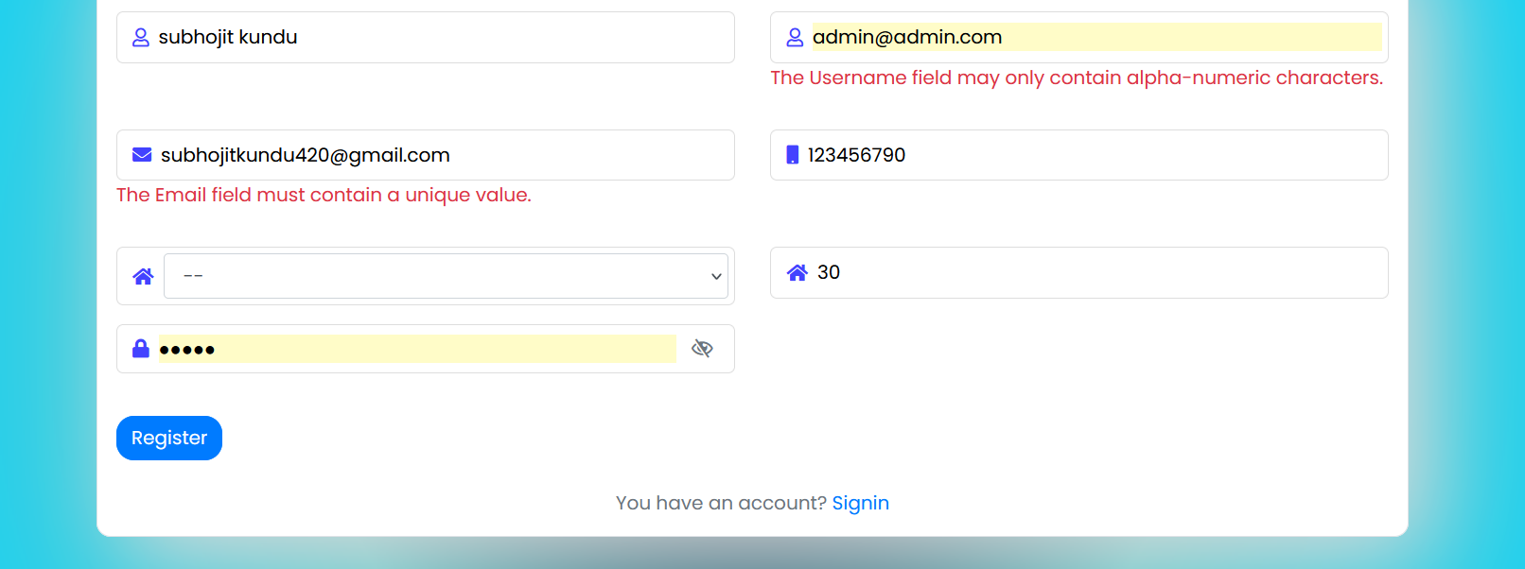
Form validation

Slide 10
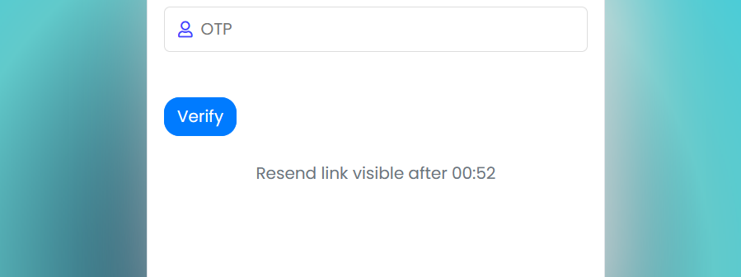
Email validation with resend link timer

Slide 11
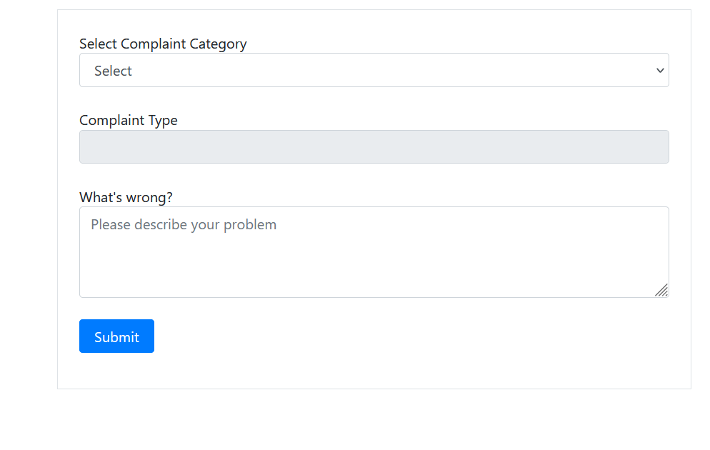
Complaint lodge form

Slide 12
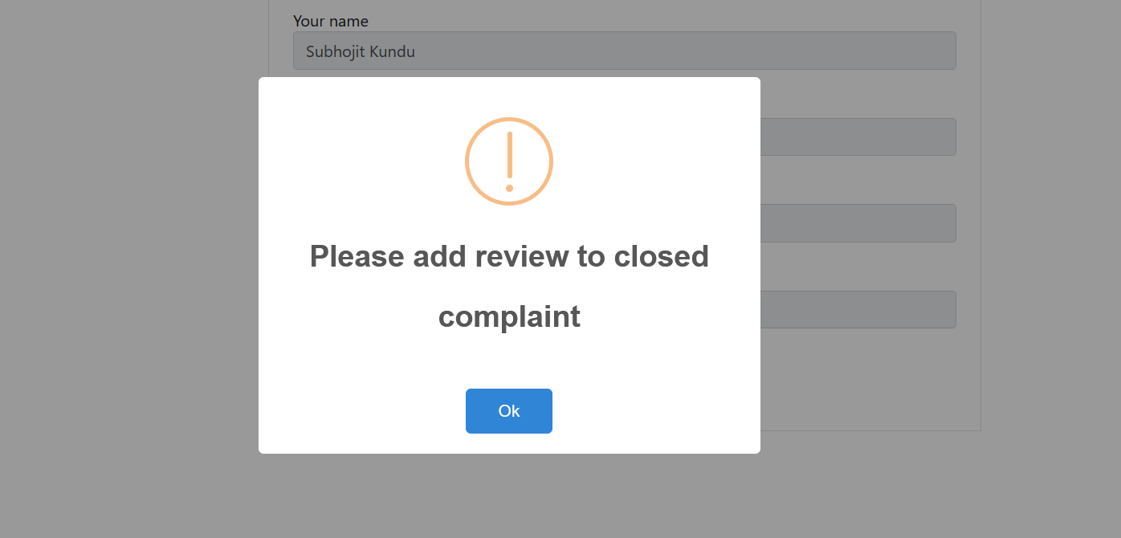
Complaint lodge failed if user not given rating to any previously closed application

Slide 13
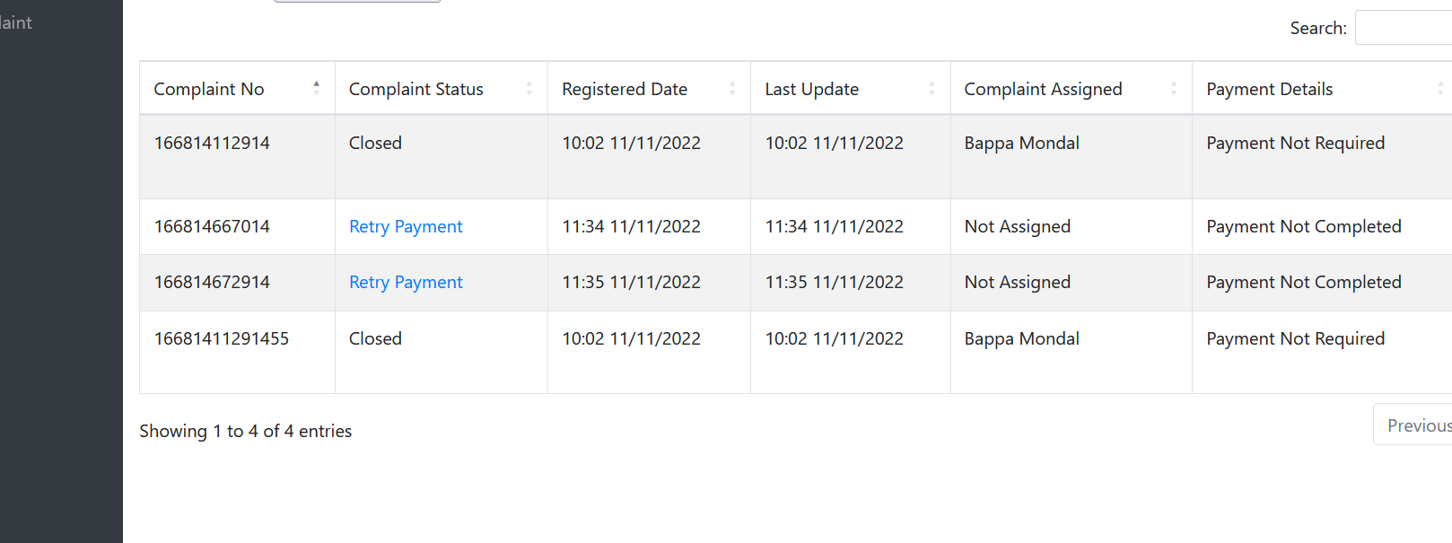
If payment failed then user will get this retry payment option in his portal

Slide 14
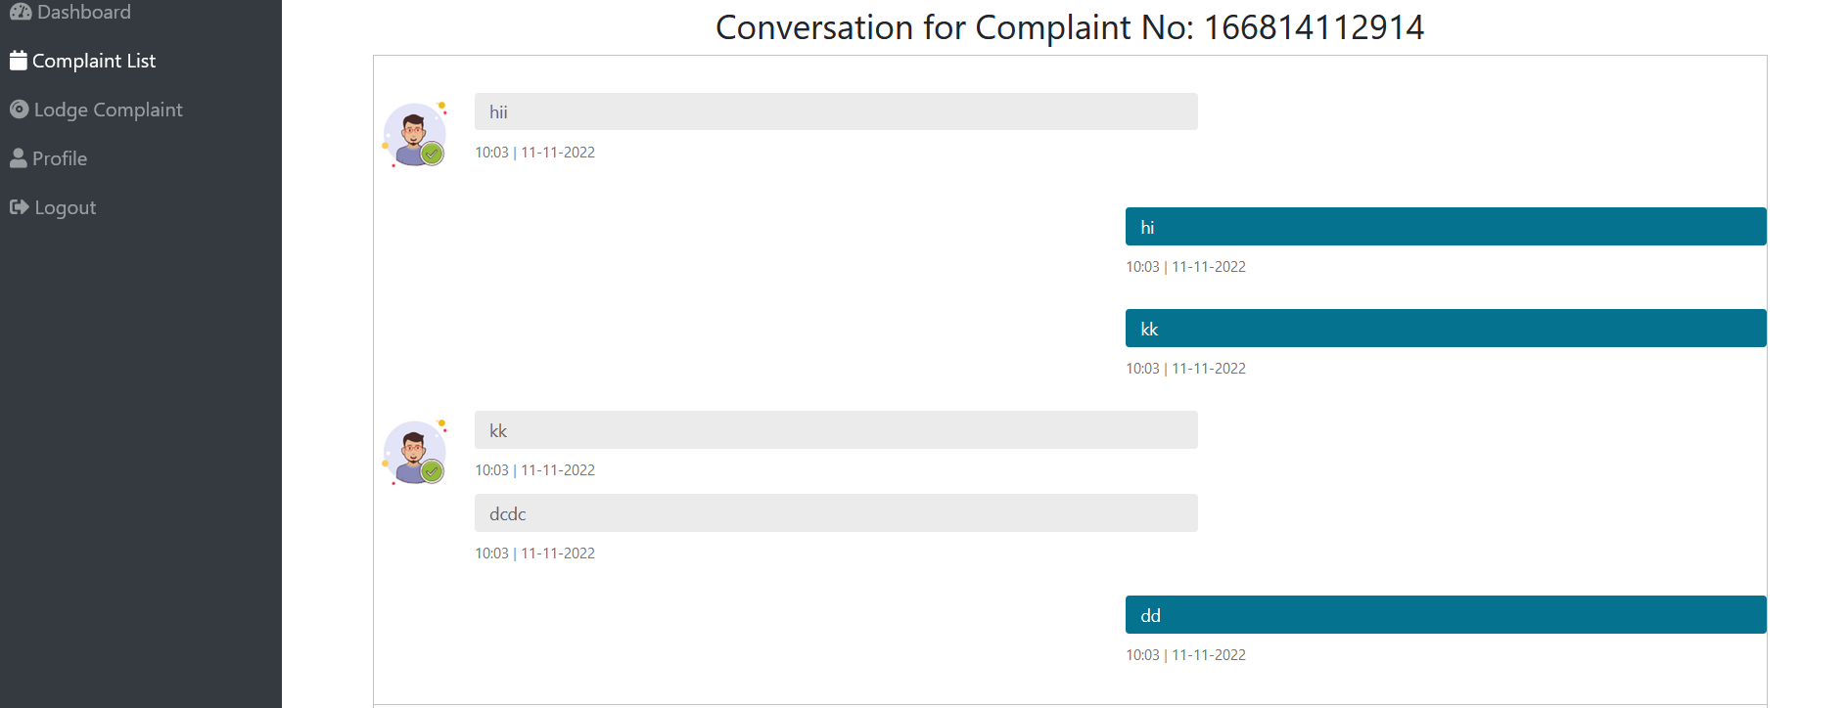
Chat between Staff and User and audio play automatically when user received message

Slide 15
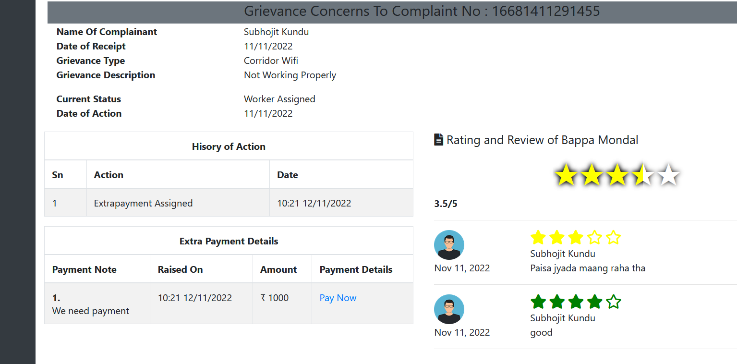
If extra payment added by staff then payment option...History of action

Slide 16
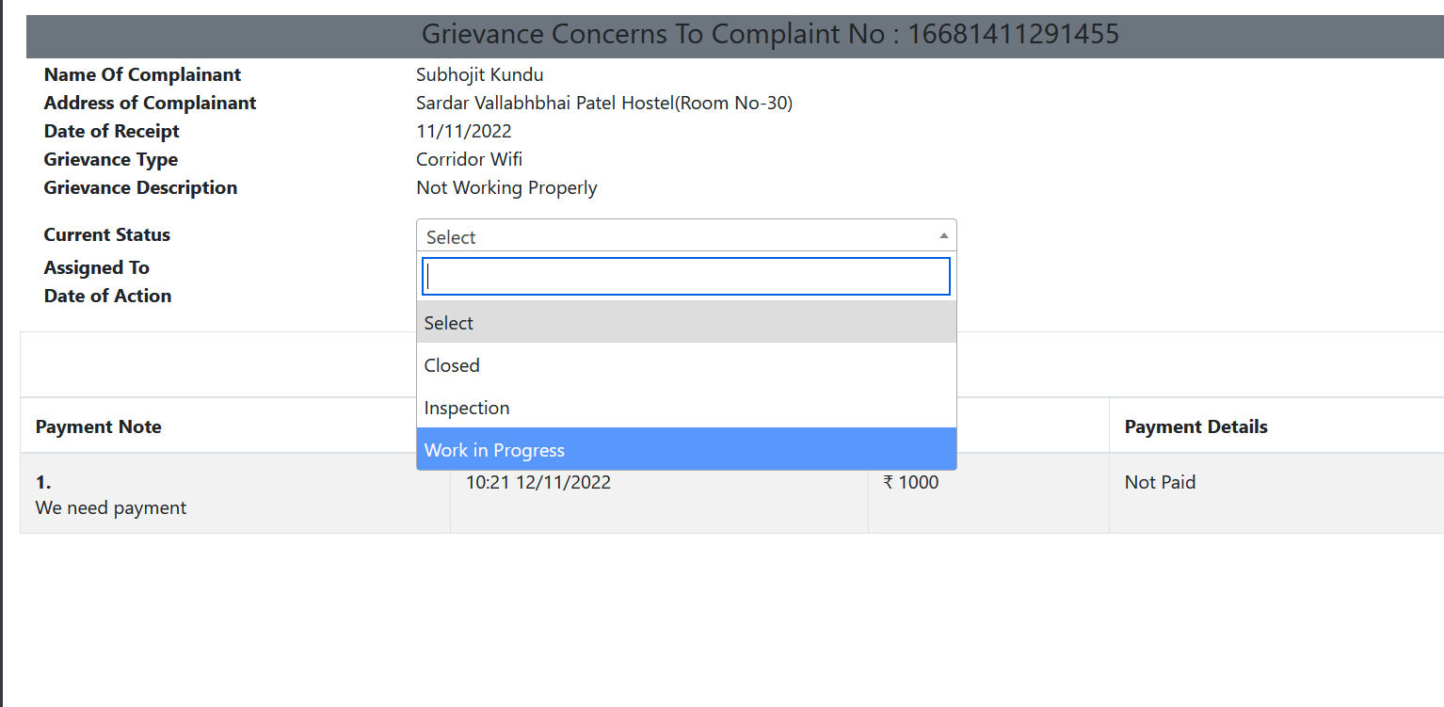
Worker can only change status to status assign to them

Slide 17
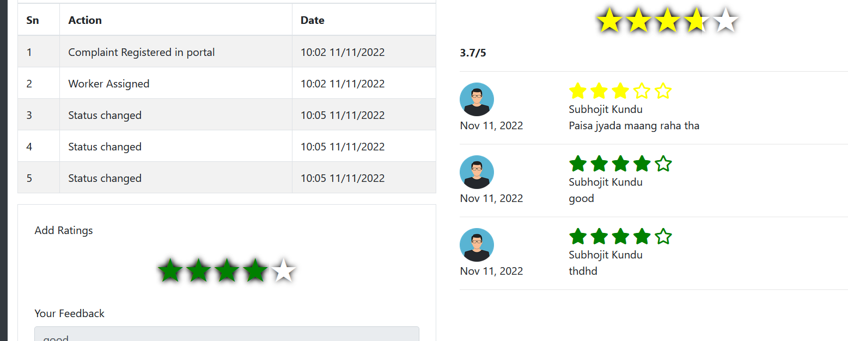
Rating by user…..and based on user average rating of the staff showing in right side

Slide 18
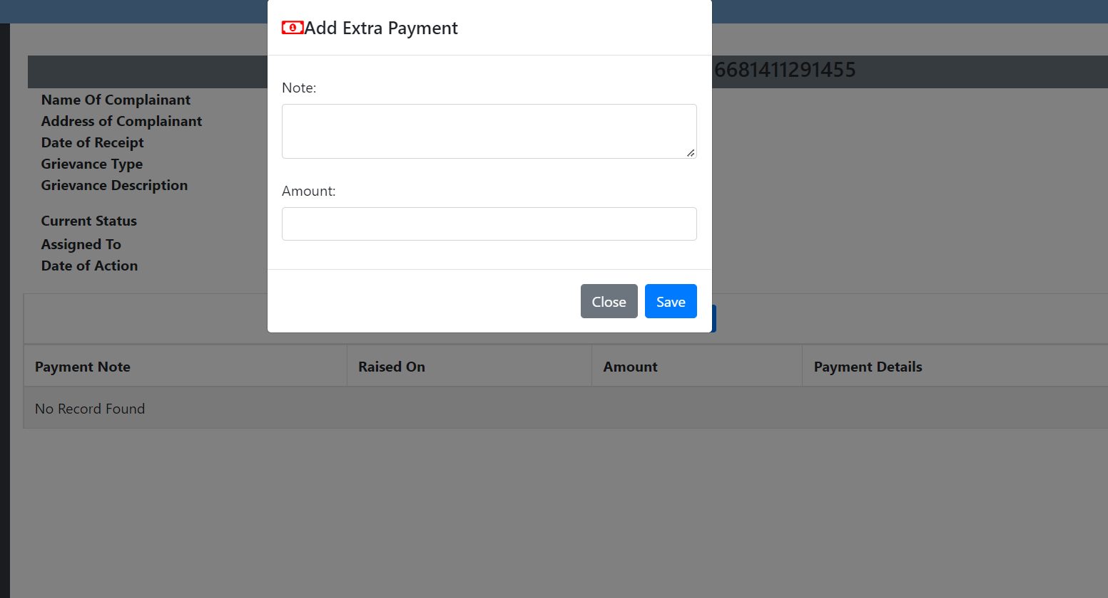
Extra payment add by user for any specific user

Slide 19
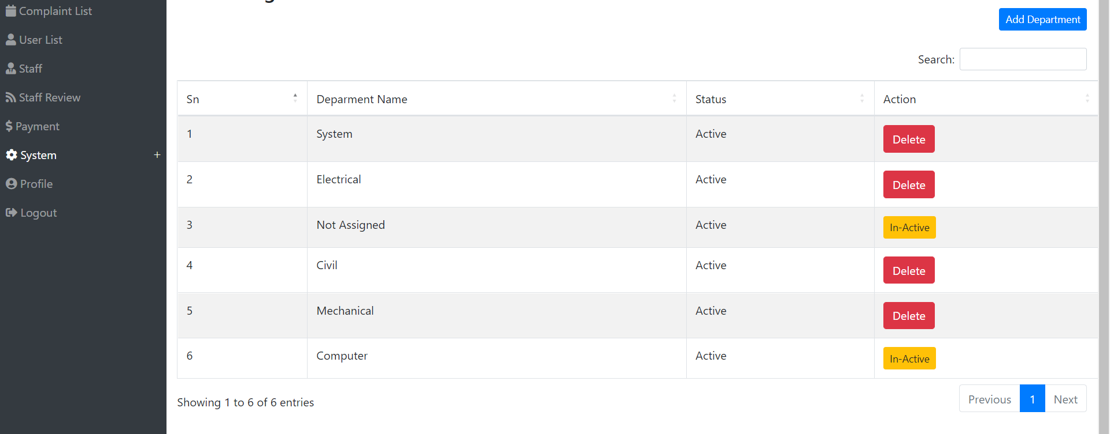
Custom department list.Admin/Staff can add new department in the system

Slide 20
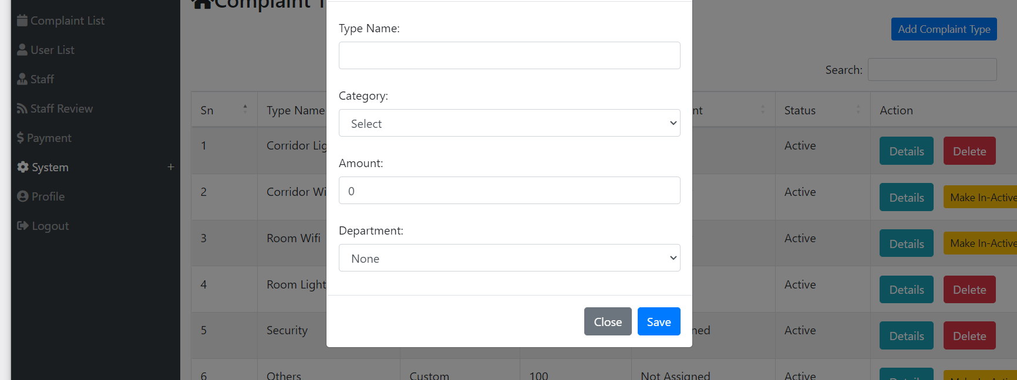
Here we have custom complaint type too..and staff can assign default department

Slide 21
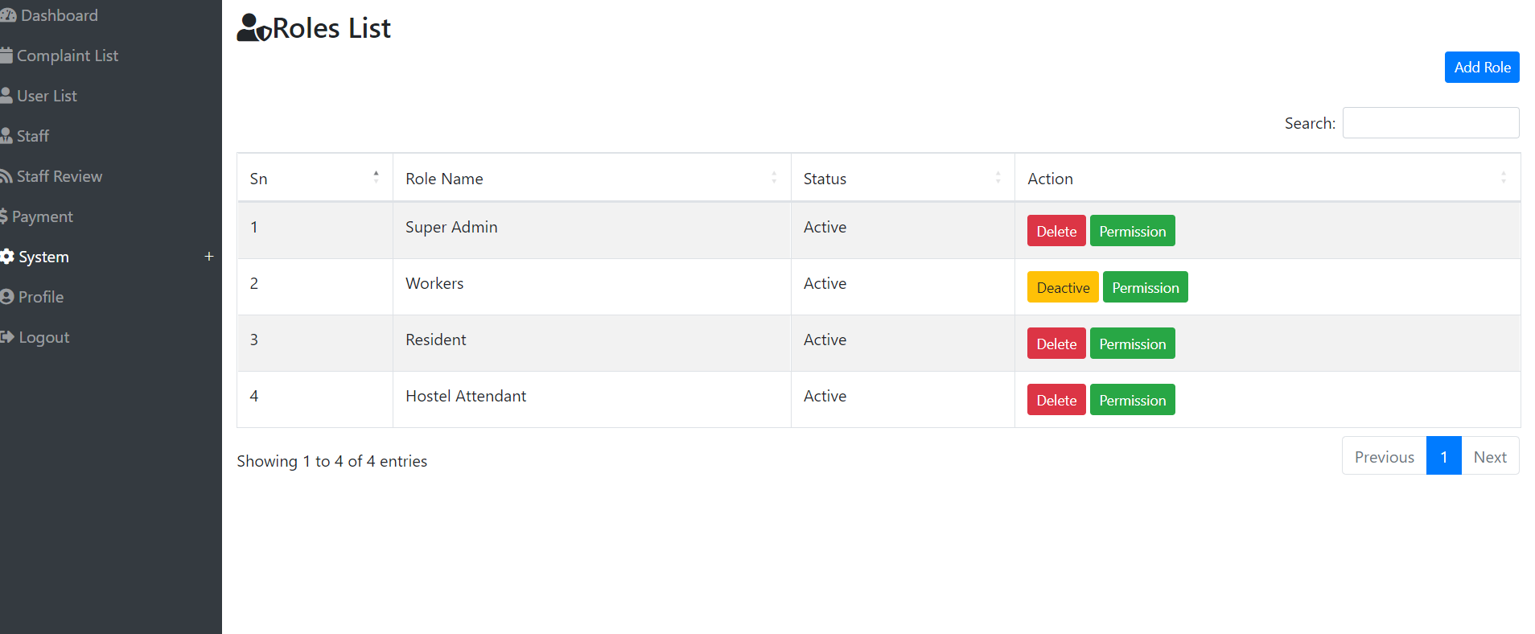
Custom role for the system and we can assign permissions to them

Slide 22
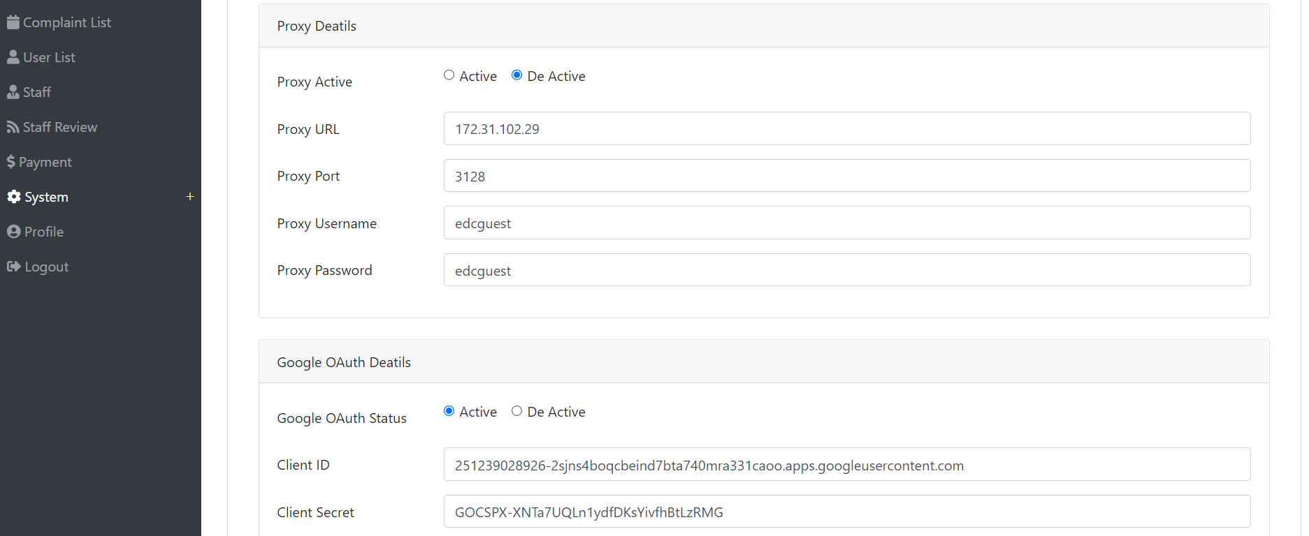
Proxy details if server is behind a proxy

Slide 23
Future possibilities

Slide 24
In system backend
(1)Staff based list of building and they can able to see complaint/user based on that particular building only
(2)More O-Auth system implementation .
(3)Dynamic commission(Percentage/Fixed) for admin in every payment made for complaint.
(4)Staff can request for payment release once user complete his review.
(5)Payment release api from the backend dont need to go the bank
(6)If refund raised payment release from the backend dont need to go to the bank
(7)Various types of reports generation from the backend

Slide 25
In staff panel
(1)Once user completed his review he/she can able ask for payment release.
(2)Can send image via chat box

Slide 26
In user panel
(1)If complaint status not updated for more than 15 days then he can claim refund of the amount he already paid
(2)Able to upload profile picture
(3)Can interact with other user in the system based on staff assigned to them
(4)Can send image in chat box
(5)Can raised concern against any staff assigned for their complaint to the admin
(6)Closed complaint reopen system if properly not solved by staff

Slide 27



