Slide 1
project Ideas
Volodymyr & William

Slide 2
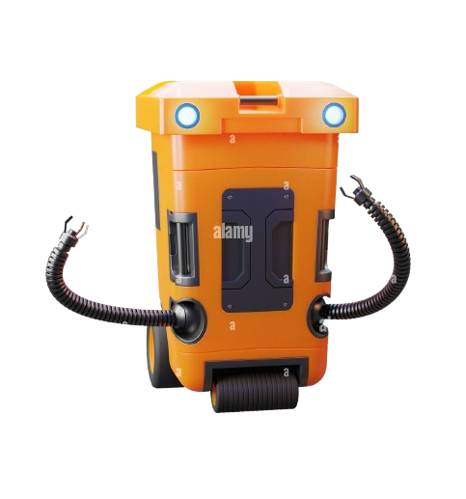
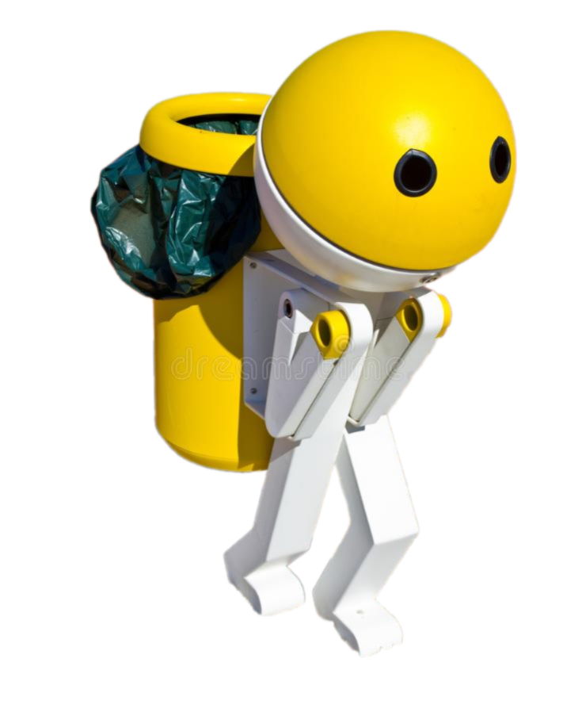
Smart Trash Bin

Slide 3
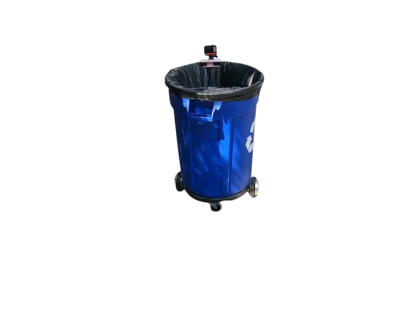
Smart Trash Bin
Objective: This project adds a smart trash bin functionality to
Tiago’s capabilities, making trash disposal more efficient and hands-free.
Key Features:
Users can summon Tiago through a mobile app to bring the trash bin to them.
Upon arrival, the trash bin’s lid opens automatically, allowing users to throw away their waste without touching anything.
A sensor inside the bin detects when the trash is thrown in, and the lid automatically closes afterward.
qrcode on the table,
Why This Project:
It provides a convenient and hygienic solution to trash disposal, minimizing direct contact and effort.
The project demonstrates how robotic platforms like Tiago can be enhanced with additional functionality for daily tasks.

Slide 4

Requirements
Hardware:
Motorized Lid: Controlled by a servo motor for opening and closing.
Proximity Sensor: To detect trash inside the bin.
Software:
Mobile Application: To send navigation commands to Tiago.
Extension for TiaGo software

Slide 5
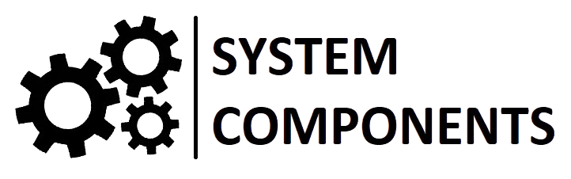
System Components
Mobile Application:
Allows the user to call Tiago to their location.
Trash Bin:
Installed on Tiago's platform.
Equipped with a motorized lid.
Sensors:
Proximity/Sonar Sensor: Detects when trash is inside the bin.
Actuator: Controls the opening/closing of the lid.
Control System:
Manages the lid based on sensor input and user commands.

Slide 6
Workflow
Step 1: User opens the mobile app and requests Tiago.
Step 2: Tiago navigates to the user’s location.
Step 3: Upon arrival, the trash bin lid automatically opens.
Step 4: The sensor detects trash inside the bin.
Step 5: Once trash is detected, the lid closes automatically.

Slide 7
Todo Reminder

Slide 8
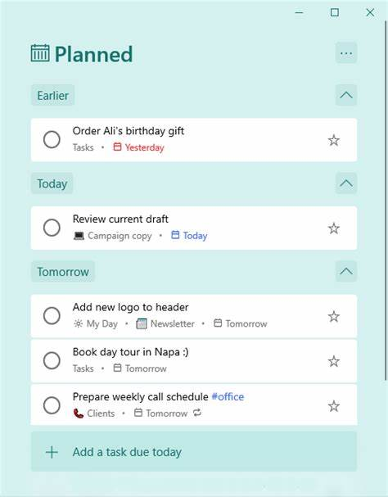
Todo Reminder
General purpose
Just using phone and making todo lists may satisfy most of the scenario.
But sometimes
we may not notice the reminder from our phone
we may need something to help us finish the task (eg. leave a form not filled somewhere but fail to find it afterward.)
we can send surprise to others, maybe a cup of coffee or a piece of music to refresh their minds.
You can make your todo lists on Todo Reminder and put your forms into its shelf. It will come back to you at the given time. Also, you can set the returning target to other people.

Slide 9
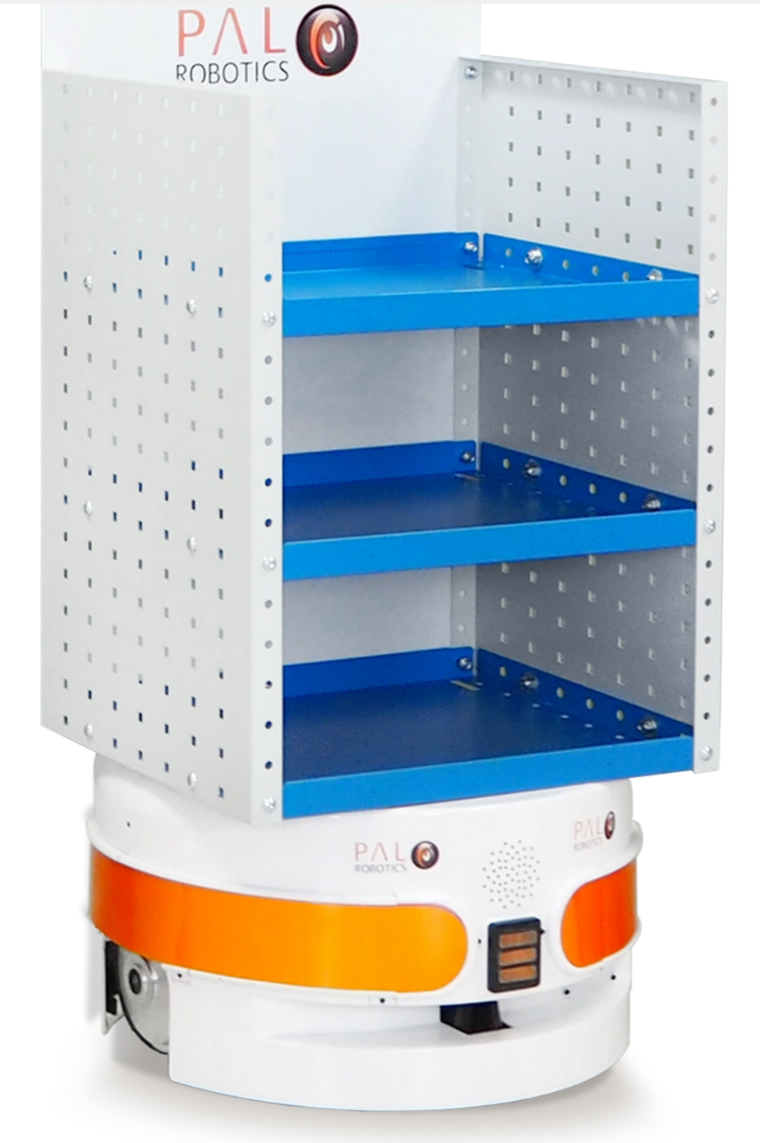
Todo Reminder
Interface
Users interact with Todo Reminder by App. We are still making todo lists on app like before. But after that, the messages are sent to Todo Reminder. Users need to provide time, place and content of Todo.
When time comes, Todo Reminder will communicate with the user by app to get their position. Then, it will come to the place and give reminder (make some noise).

Slide 10
Interface
Todo Reminder
Hardware:
Audio Output(Optional)
Shelf
Software:
Mobile Application: To send navigation commands to Tiago.
Extension for TiaGo software

Slide 11
Todo Reminder & Smart Trash Bin
Technical difficulties
Users send GPS positions to Todo Reminder. Maybe it cannot recognize them in the map and needs to localize them first. I don’t know whether there is any solutions to that.

