Slide 1




PROTOTYPING AND FABRICATION IN THE LEARNINGLAB · 2026
Personalized Robotic Training Assistant
Movement
Wearable
Combining robotics, movement monitoring and personalized feedback to understand individual training performance
Intermediate project presentation
Feedback

Slide 2





01 · THE CHALLENGE
Personalized Training Assistance
THE ROBOT SHOULD BE ABLE TO
THE NEED
Accessible, personalized training assistance for people with mobility impairments
Monitor movements
Acquire performance data
Observe the person during exercise
Capture how the training is going
Get a suitable camera view
Give feedback
People with mobility impairments can respond differently to exercise. The assistant should adapt to each user and to the needs of their trainer or therapist.
Adjust camera direction to locate the user
Useful corrections during training
Our proposal
combining four building blocks
Computer vision
Wearable sensors
Robotics
Intelligent training logic
Prototyping and Fabrication in the LearningLab (2026)
2

Slide 3
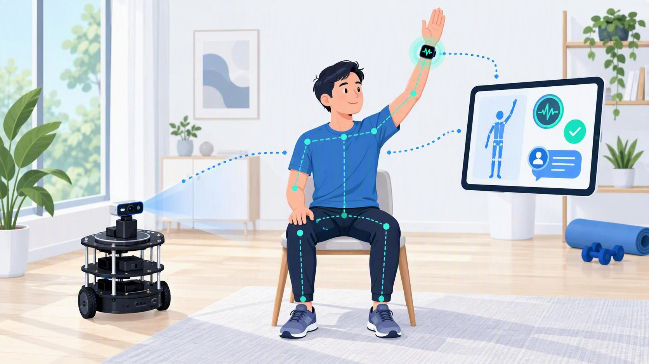

02 · GLOBAL CONCEPT
An Interactive Training Companion
A Personalized exercise plans
Adapted to mobility, abilities and goals
B Real-time exercise monitoring
Repetitions, pace and duration
C Physiological monitoring
Heart rate read against the user’s own reference
Flags unexpected responses, not only high values
Research: read with exercise and reported effort
Personalized monitoring asks not only how high the heart rate is, but whether the response fits the individual and the exercise.
All key training information will be accessible to the user through a simple interface.
D Feedback, Visual Statistics and Training History
Voice instructions and encouragement
Visual training statistics through a user interface
Training history and progress overview
Prototyping and Fabrication in the LearningLab (2026)
3

Slide 4





03 · USER INTERACTION SCENARIO
From Exercise to Feedback
1
2
3
4
User starts a personalized training session
Camera direction is adjusted to locate the user.
Camera captures the exercise
Computer vision processes the movements
8
7
6
5
Session results are displayed through the user interface.
Robot gives immediate, understandable feedback
Training logic combines data and reported effort
Wearable provides heart-rate data.
ILLUSTRATIVE FEEDBACK EXAMPLES
ILLUSTRATIVE EXAMPLES · NOT VALIDATED MEDICAL INSTRUCTIONS
“Great! You completed five repetitions.”
“Your movement pace has changed. Would you like to slow down?”
“Your heart-rate response differs from your configured reference. Let’s check how you feel.”
Prototyping and Fabrication in the LearningLab (2026)
4

Slide 5
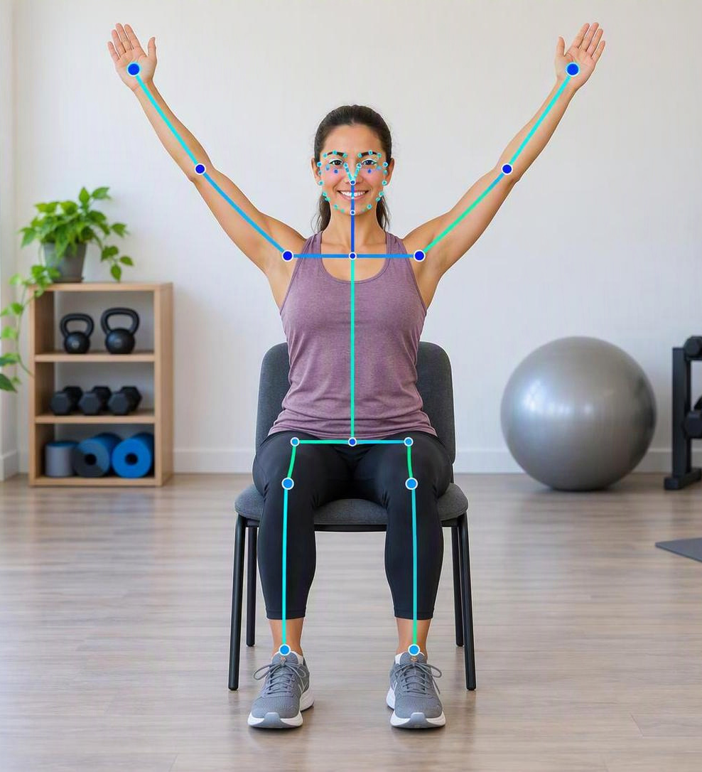
04 · PROTOTYPE SCOPE
From Vision to Proof of Concept
Hardware
TurtleBot3 Burger · USB camera · Raspberry Pi / robot computer · Servo motor (exclusively adjusts the camera direction to locate the user) · Audio output · Wearable heart-rate sensor
Pose estimation and exercise counter
MediaPipe Pose Landmarker extracts body landmarks. Custom exercise-counter logic interprets these landmarks to calculate repetitions, repetition duration and pace.
Physiological monitoring
Wearable heart-rate data. Research direction: interpret it relative to each user’s own reference, together with reported effort.
Training logic and feedback
ROS 2 training logic combines exercise measurements with user-specific parameters; voice feedback is delivered through the robot.
Training Dashboard / User Interface
Training statistics are visualized through a simple dashboard, helping both the user and the development team understand exercise performance.
MediaPipe Pose Landmarker: body landmarks (illustrative)
Prototyping and Fabrication in the LearningLab (2026)
5

Slide 6
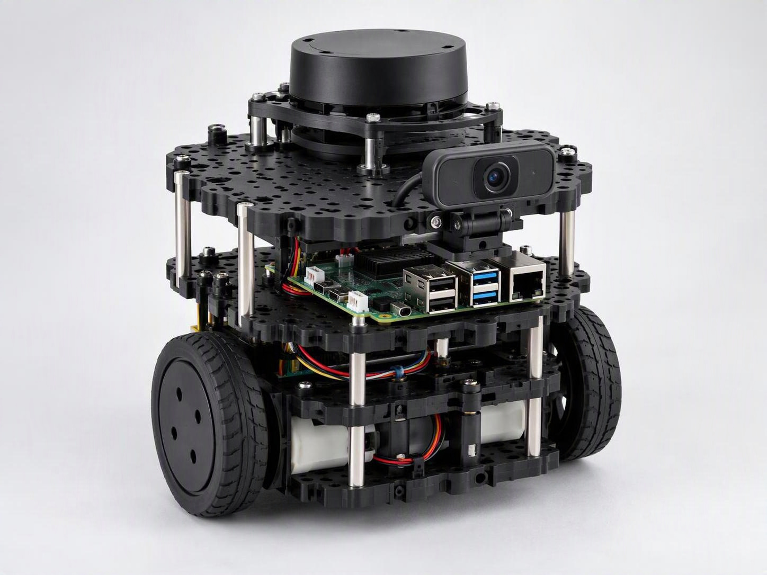
05 · HARDWARE ARCHITECTURE
Robotic Platform and Sensors
TURTLEBOT3 BURGER
Raspberry Pi / robot computer
ROS 2 Jazzy · Python
USB camera
connected to the TurtleBot
Audio output
voice feedback
Servo Motor – Camera positioning
Exclusive purpose: adjusting the camera direction to locate the user.
TurtleBot3 Burger with USB camera (illustrative)
Wearable heart-rate sensor
worn by the user
Prototyping and Fabrication in the LearningLab (2026)
6

Slide 7




06 · SOFTWARE ARCHITECTURE AND LOGIC
ROS 2 Architecture
Heart-rate Band
Worn by the user
Raspberry Pi –Heart-rate Receiver
/heart_rate/bpm
ROS 2 Training Logic
Decides the feedback
Bluetooth
TurtleBot3 Camera
Live video
MediaPipe / Exercise Detection
Pose and repetition counting
/image_raw
/exercise/stats
Repetition count · duration · pace
/training/feedback
/training/status
Speaker / Audio Feedback
Spoken messages
User Interface / Training Dashboard
Visualizes exercise data and training statistics.
Input
Detection
Logic
Output
Prototyping and Fabrication in the LearningLab (2026)
7

