Slide 1
Fabrication & Prototyping
LearningLab
Walking training monitoring prototype
Intermediary presentation · Week 8
Group 106 · Yann Gourraud · Romain Kern
Notes:
Timing: ~30 seconds.
We are developing a walking-training monitoring prototype. The idea combines an instrumented walker with a TurtleBot3 that observes the user while walking. Today we focus on the Week 8 requirements: the concept, the proof of concept we intend to build, the system architecture, and the technical elements.

Slide 2
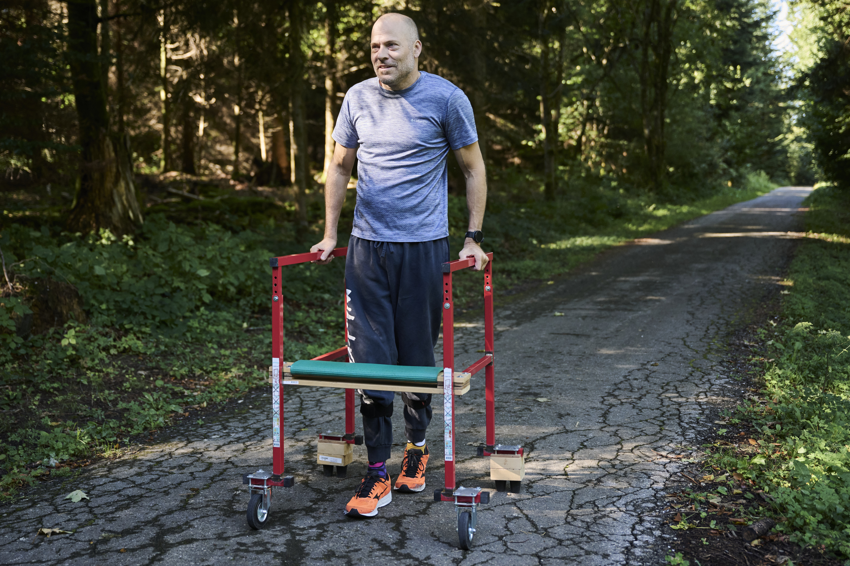
Concept
A training assistant that measures how much support the user needs while walking.
Hands
Measure left / right support on the walker.
Gait
Observe basic step regularity and lateral deviation.
Feedback
Display live values and compare training sessions.
Observe during exercise, compare after
.
Notes:
Timing: ~60 seconds.
The problem we want to address is that a walking exercise is often evaluated mainly by observation. We want to quantify two simple aspects. First, how much support is placed on the left and right hands. Second, basic gait characteristics observed from in front of the user. The system should give immediate feedback during a session and also make it possible to compare sessions over time. The aim is training monitoring, not medical diagnosis.

Slide 3

Proof of concept
For the POC, we only need to prove that the complete measurement chain works.
1 · Instrumented walker
2 · TurtleBot3 observer
3 · Live dashboard
Two load cells under the handles
→ left and right support
→ asymmetry over time
Robot stays in front of the user
LiDAR → maintain distance to the walker
Camera → gait observation
Combine both data sources
→ current values
→ simple alerts / trends
POC success = synchronized live hand-support + gait metrics while the user walks.
Notes:
Timing: ~70 seconds.
Our proof of concept is deliberately limited. We want to demonstrate three things. First, the walker can measure both hand forces separately. Second, the TurtleBot can remain at a useful observation distance and capture the user with a camera. Third, both data streams can be combined and displayed live. We do not need a complete clinical gait-analysis system. If these three blocks work together, the main feasibility of the concept is proven.

Slide 4
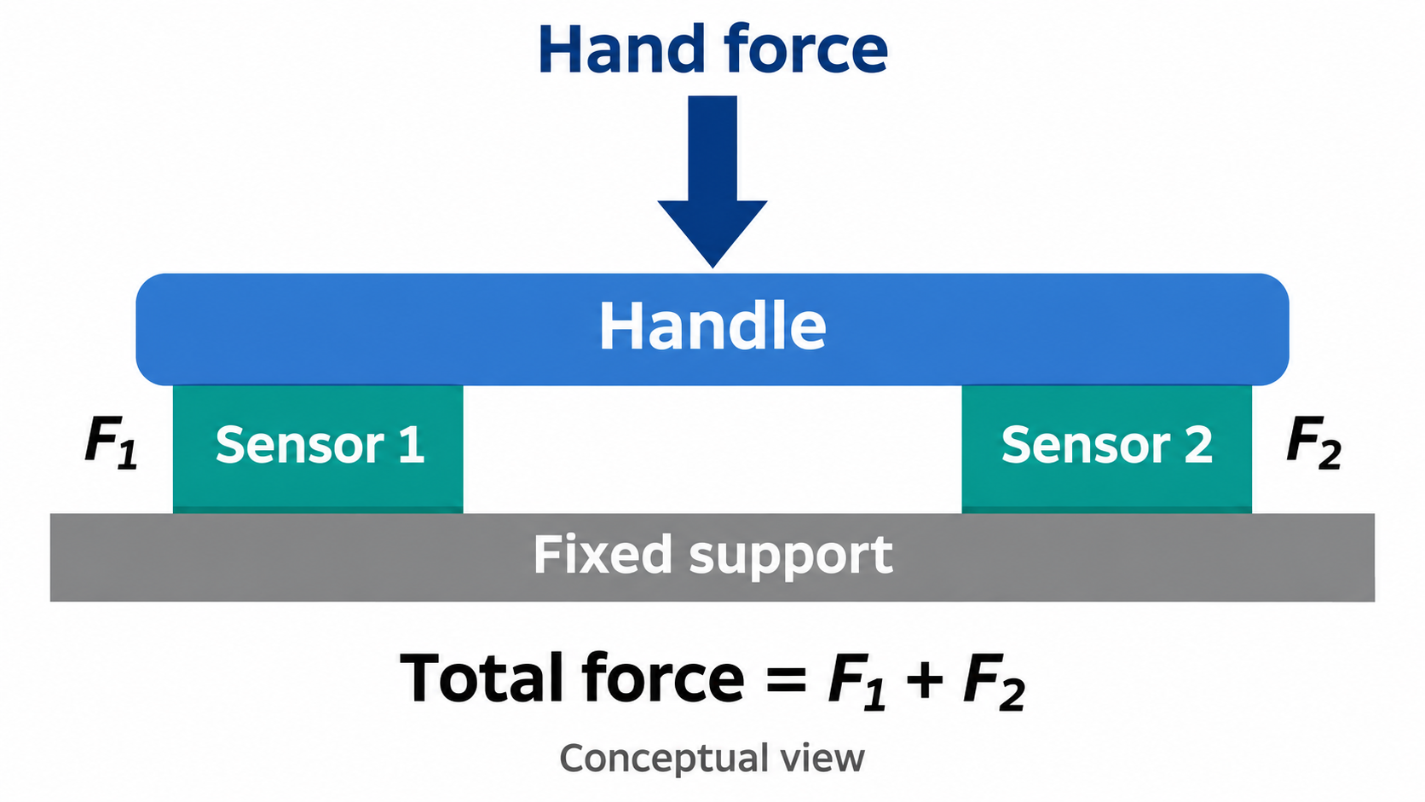
Hand support sensing
Left / right force
Left load cells
HX711
Live support on each handle
ESP32
Wi-Fi / MQTT
Asymmetry
Right load cells
HX711
Detect strong left-right difference
Progress
Compare values between sessions
.
Notes:
Timing: ~60 seconds.
The first subsystem is the instrumented walker. We plan to place one load cell under each handle and read them with HX711 amplifiers connected to an ESP32. The ESP32 can send the measurements wirelessly, for example with MQTT. From these two values we obtain the force on each hand, an asymmetry indicator, and a value that can be compared between sessions. A simple 3D-printed mount can be used to integrate the sensors mechanically.

Slide 5
Robot + gait observation
Separate the two robot functions: LiDAR for distance, camera for gait.
Distance control
LiDAR → ROS 2 controller → /cmd_vel
target distance
LiDAR
Camera analysis
Basic cadence, regularity and lateral deviation
TurtleBot3
camera
POC simplification
Use simple visual markers if needed
Notes:
Timing: ~70 seconds.
For the robot we separate two functions. The LiDAR is the robust sensor for maintaining a roughly constant distance to the user or walker. A simple ROS 2 controller can convert the distance error into a velocity command. The camera is then free to focus on gait observation. For the proof of concept we only need basic metrics such as cadence, regularity, and lateral deviation. If markerless detection is unreliable, simple visual markers on the shoes are an acceptable POC simplification.

Slide 6
System architecture
SENSING
PROCESSING / COMMUNICATION
OUTPUT
Walker
MQTT
4 × load cells
2 × HX711
ESP32
Hand-force data
Node-RED
Combine and display
all live metrics
Logic
force metrics
gait metrics
distance control
TurtleBot3
ROS 2
Dashboard
LiDAR
USB camera
/scan · /image
/cmd_vel
Phone / laptop
+ session comparison
Notes:
Timing: ~90 seconds.
This is the architecture we propose for the POC. On the walker side, the ESP32 reads the two load cells and sends their values through MQTT. On the robot side, ROS 2 handles the LiDAR, camera, and velocity commands. A processing layer computes force asymmetry, simple gait metrics, and the distance-control command. Node-RED acts as the integration and user-interface layer, so both data streams are visible in one dashboard. This architecture uses the technologies covered in the course without forcing everything into a single program.

Slide 7
Technical elements & demo target
Hardware
Software
• TurtleBot3 Burger
• ESP32 Feather
• 2 × load cells + HX711
• USB camera
• Raspberry Pi / ROS host
• External power source
• 3D-printed sensor & camera mounts
• ROS 2 Jazzy
• Python + OpenCV
• MQTT
• Node-RED dashboard
• Simple distance controller
• Data logging for session comparison
Demo target: live left/right forces + robot distance control + basic gait metric + dashboard.
Notes:
Timing: ~60 seconds.
The technical stack is intentionally based on course components: TurtleBot3 and ROS 2, an ESP32 with load cells, a USB camera, MQTT, Node-RED, and simple 3D-printed mounts. Our demo target is not every possible feature. We want one working end-to-end pipeline: live left and right hand forces, the robot maintaining observation distance, at least one useful gait metric from the camera, and all values visible on one dashboard. The next milestone after this presentation is to build the partial pipeline subsystem by subsystem.

