Slide 1
Isla Nublar
Explore the past. Embrace the future.

Slide 2
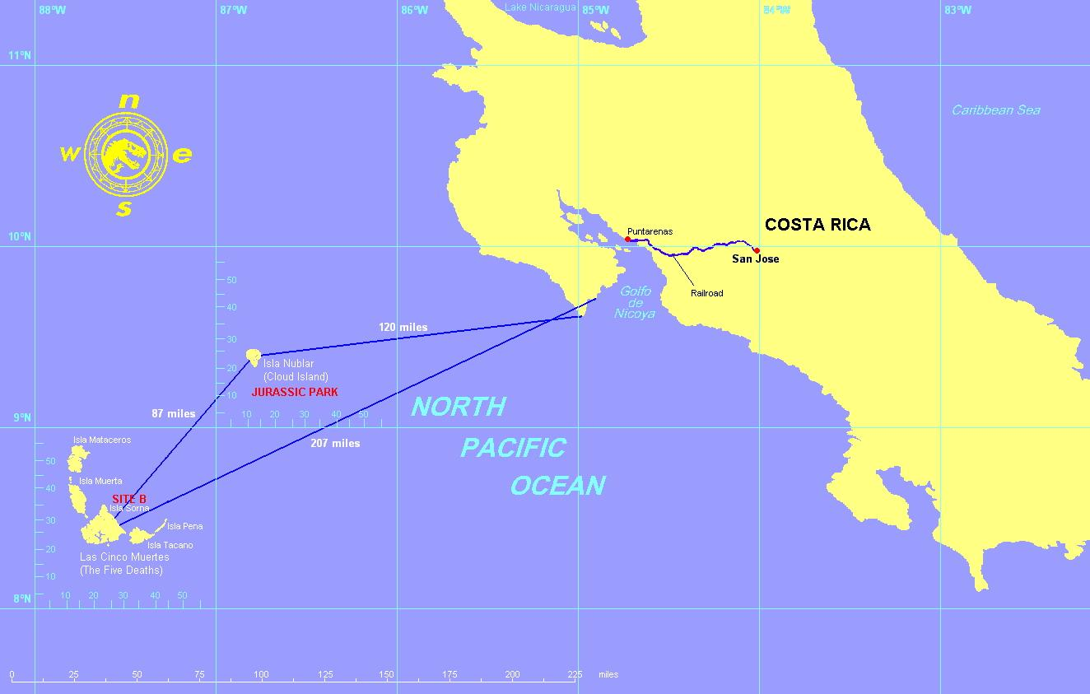
What is Isla Nublar?
Your new favourite vacation get away!
Offers full vacation packages on an island south of Costa Rica, full of beaches and jungle terrain.
Due to the history and negative press of the island, we are looking to rebrand as a inexpensive vacation spot.

Slide 3


Isla Nublar is NOT Jurassic Park

Slide 4
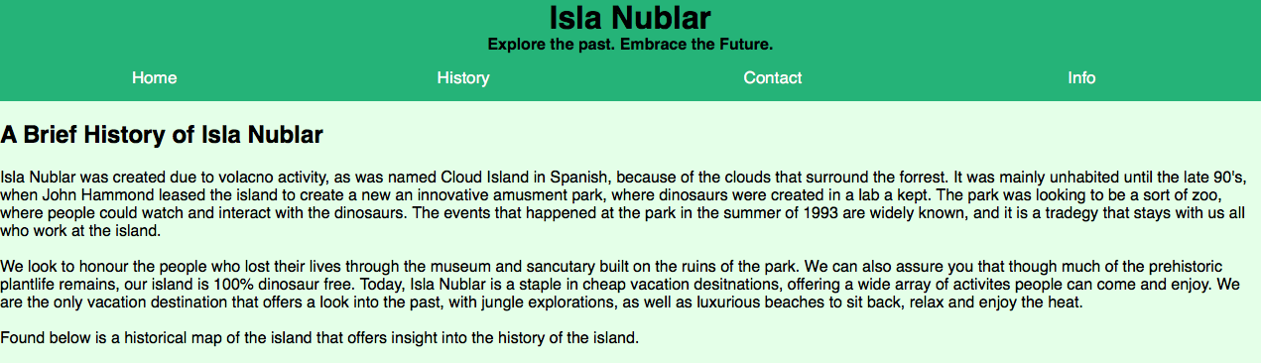
How to address the elephant (or T-Rex) in the room:
NOW 100% Dinosaur free!!

Slide 5
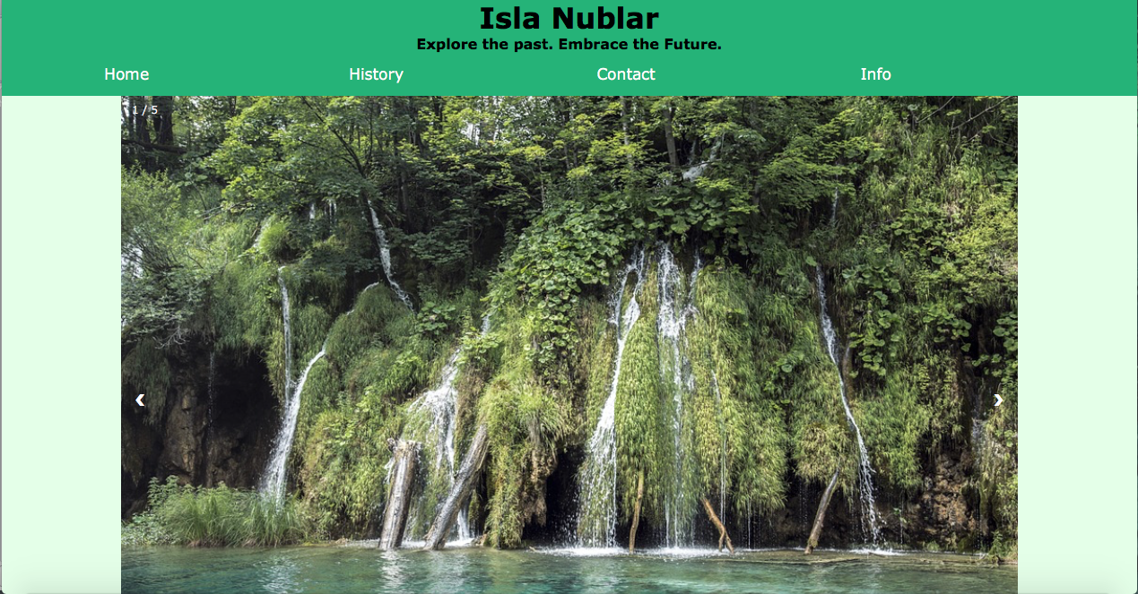
Simple design, people’s first contact with the island.
Green, natural colours.
Showing the natural beauty of the island.
Information and rebranding is the focal point of the website.

Slide 6
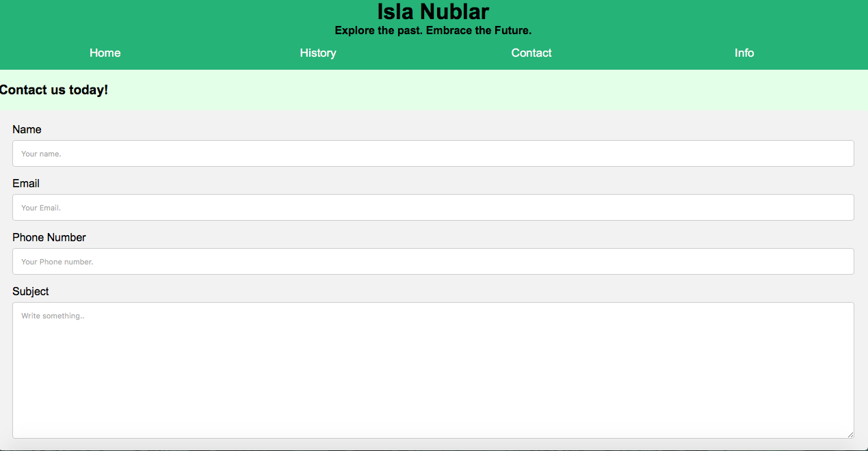
Inquiries about the island: we want people to learn more!

