Slide 1
Online Test Framework
Dan Nemesek

Slide 2
Problem Description
How to provide an online test framework that will allow the user to plug in different tests that can be taken online
Hypothetical customer was a teen youth suicide prevention organization so the test questions are geared toward their scenario
Questions/Answers/Tests are stored in database

Slide 3
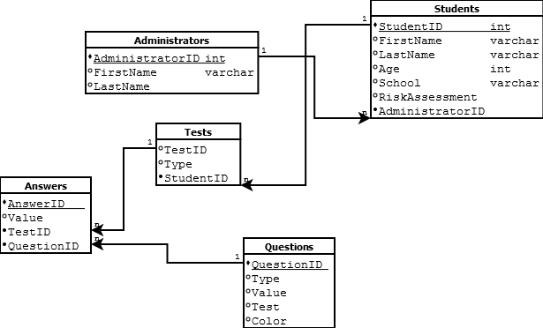
E-R Diagram

Slide 4
Table Descriptions
Refer to tabledescriptions.out

Slide 5
Scenarios supported
Start New Test – Update database via inserts into database with StudentID and TestID
Select question from database
Insert answer into database
Update Student risk assessment
Delete Administrator
View TestsID’s for a given UserID

Slide 6
Queries
Start New Test:
$TestQuery ="INSERT INTO Tests (Type, StudentID) Values ('SYSR'," .$StudentID .")";
$MaxQuery ="SELECT MAX(TestID) FROM Tests";
Select Question from Database:
$query="SELECT Value FROM Questions WHERE QuestionID=" .$QuestionID;
Insert Answer into Database:
$insert="INSERT INTO Answers (Value, TestID, QuestionID) VALUES (" .$answer ."," .$TestID ."," .$prevQuestion .")";
Update Student Risk Assessment:
$update="UPDATE Students SET RiskAssessment=" .$risk ." WHERE StudentID=" .$student;
Delete Administrator:
$update="DELETE FROM Administrators WHERE AdministratorID=" .$admin;
View TestIDs for a given UserID:
$query="SELECT * FROM Tests WHERE StudentID=" .$student;
Notes:
$TestQuery ="INSERT INTO Tests (Type, StudentID) Values ('SYSR'," .$StudentID .")";
$MaxQuery ="SELECT MAX(TestID) FROM Tests";

Slide 7
Design changes
Added EditUser and DeleteAdministrator to support required Update/Delete scenarios
Removed many to many relationship between Test and Questions and table TestQuestions as the Insert/Select required scenarios were already supported by the other scenarios
Originally was going to add business logic on the application side to have a way to dynamically choose next test question based off of previous answers. Decided not to support this as this had nothing to do with mySql only PHP. Eventually porting this to C# and didn’t want to spend too much time on PHP

