Slide 1
Introduction to giant planet retrievals in the visible/near-IR using NEMESIS
Session leaders:
Patrick Irwin, Daniel Toledo Carrasco, Ashwin Braude
Note 29.06.2018: Consult notes below each slide for further detail/context
Notes:
So this presentation was essentially intended to give a short introduction to performing scattering retrievals of giant planets in the visible/near-IR using NEMESIS, first of all highlighting the kind of things one can retrieve with Nemesis, and then towards the end going into more detail about some of the issues one might encounter when doing these kinds of retrievals. I will leave further details on how to actually perform these retrievals to a separate tutorial.

Slide 2
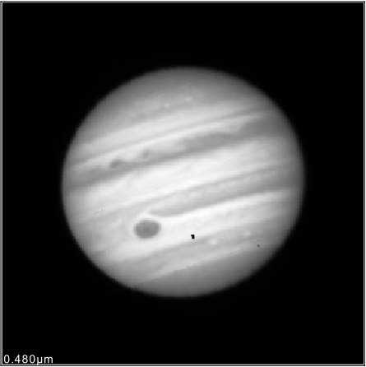
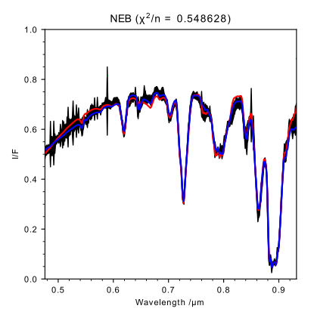
VLT/MUSE: 0.48-0.93μm
Can use NEMESIS to simultaneously retrieve:
Vertical aerosol abundance profiles
Aerosol optical constants
For Jupiter: Ammonia gas abundance at ~ 1 bar
Notes:
Here, for instance, we present data that I’m working on from the Multi-Unit Spectroscopic Explorer (MUSE), an integral-field spectrograph at the Very Large Telescope (VLT). The nice thing about this instrument is that the field of view is large enough to image an entire hemisphere of Jupiter in one go (an example image of which at 0.48μm is shown on the top left), with each spatial pixel containing a complete spectrum between 0.48-0.93μm, at 1.25A spectral resolution, of the giant planet in question, an example of which is shown in the bottom-left corner. Each of these spectra can be individually inverted by Nemesis to simultaneously retrieve the following parameters:
A complete vertical profile of aerosol between around 0.1-1.5 bar on Jupiter and around 0.01-0.8 bar on Saturn. This is done by measuring the relative sizes of each of the major methane bands, as indicated by the blue arrows (you might want to press the spacebar here to see them). Stronger methane bands (the strongest being at 0.889μm) are sensitive to aerosol at higher altitudes, while weaker methane bands (such as at 0.619μm) are sensitive to cloud at lower altitudes. The less deep an individual methane band appears, the greater the aerosol opacity at the altitude at which that methane band is sensitive. This is because aerosol particles reflect more of the incident solar radiation to the Earth and thereby prevent the optical path due to methane absorption from becoming too great.
-The aerosol optical constants of the aerosols in question. Using NEMESIS one can directly retrieve the particle size distribution and imaginary refractive index spectrum of aerosols, and then through Kramers-Kronig analysis derive real refractive index, extinction cross-section and single-scattering albedo spectra. This is very useful if one wants to solve the so-called ‘chromophore problem’, in order to identify the aerosol compound that is responsible for the blue-absorption gradient (shown by the horizontal blue arrow, you might want to press the spacebar again) below around 0.6μm that causes Jupiter and Saturn to appear different shades of colours from white to red.
- In the case of Jupiter, one can also retrieve gaseous abundances of NH3 at around 1 bar due to the presence of a number of ammonia absorption bands (shown with the blue arrows, press the space bar again) particularly at around 0.64μm and 0.79μm, although there is relatively little vertical sensitivity with respect to ammonia gas at these wavelengths. Saturn, however, is colder than Jupiter, and so ammonia condenses out of the atmosphere at relatively deep altitudes. This means that ammonia abundances within the altitude range that MUSE is sensitive to are too small on Saturn to be retrieved by NEMESIS.

Slide 3
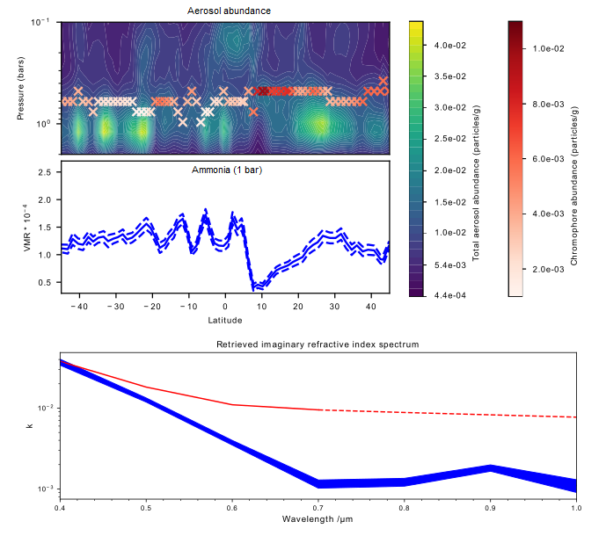
Notes:
This shows an example set of MUSE retrievals, taking a simple meridional cross-section through the centre of Jupiter. The top shows a contour plot of aerosol on Jupiter between 0.1-1.5 bar, while the overlaid red crosses show the likely altitude and the peak abundance of chromophore. Below that, you have a plot of the variation of ammonia volume mixing ratio over the same latitude range. In the bottom plot, you have a demonstration of the retrieval of the imaginary refractive index spectrum of chromophore, starting from a prior laboratory compound (in red) and finishing with a spectrum that fits radiance spectra of Jupiter (in blue, with errors).

Slide 4
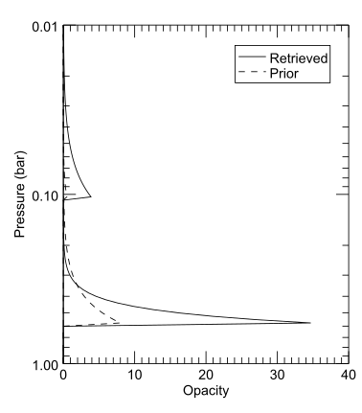
Discrete cloud layers – Model 9
Pros:
Simple to interpret
Quick
Easy to parametrise vertical variations in particle size
Cons:
Inflexible
Difficult to retrieve cloud base heights directly.
Notes:
So there are 2 main ways one can model a vertical aerosol profile using NEMESIS (we will ignore the so-called ‘Sromovsky’ layering schemes (NEMESIS varidents 222-227), which usually involve relatively constrained cloud layering schemes, and we would generally advise to avoid using these unless necessary). One can generally either model a set of discrete cloud layers, each characterised by their own particle properties, or one can use continuous cloud models as will be shown in the next slide. In this slide, we show an example of perhaps the most commonly-used discrete cloud model, here applied to Saturn: NEMESIS varident 9, in which each cloud layer is parametrised using just 3 variables: a base altitude, an aerosol opacity at the base altitude, and a fractional scale height of the decay of the aerosol opacity with altitude. Another alternative is NEMESIS varident 12, where a single cloud layer is modelled as a Gaussian at a given altitude, with the peak aerosol opacity and FWHM given as additional variables.
There are several advantages to such discrete cloud models:
They are parametrised using a limited set of variables, which means that fewer variables are to be retrieved by NEMESIS, and hence the retrieval converges to a solution relatively quickly (by the standards of a NEMESIS scattering retrieval).
It is also relatively easy to interpret how changing different parameters in the NEMESIS forward model affects the resulting fit to the spectrum, in a way that is more difficult to do using a continuous cloud model.
One can very easily model vertical variations in particle size, simply by making each cloud layer have a different associated particle size distribution.
However, they also have some disadvantages:
-To achieve a good fit to a spectrum, one does usually require some prior knowledge of the rough cloud structure in question. This also means that a single discrete cloud layering scheme that provides a good fit to a spectrum from a single area of a giant planet may be difficult to fit to other areas of the planet in question.
-The model is relatively inflexible: it doesn’t give NEMESIS a whole lot of freedom to retrieve whatever vertical aerosol profile it likes to provide the best fit to a spectrum.
-Some discrete cloud models involve very abrupt changes in aerosol with height in order to model a cloud base. This means that the altitudes of cloud bases are often very difficult to retrieve with such a model, due to how NEMESIS splits its reference atmosphere up into homogeneous layers.

Slide 5
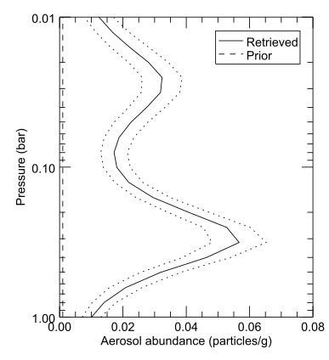
Continuous aerosol profiles – Models 0, 25
Pros:
Flexible, model has a lot of freedom
Provides best fit to spectra
Cons:
Slow
Difficult to parametrise vertical variations in particle size.
Notes:
The other way to parametrise an aerosol profile is by retrieving a continuous profile. This involves directly retrieving aerosol opacity at altitude points across the entire reference atmosphere. In the case of the most common continuous aerosol profile parametrisation, NEMESIS varident 0, aerosol opacity is retrieved at every single individual altitude specified in the .ref file.
The main advantage of this over a model of discrete layers of aerosol is that NEMESIS is given a lot of freedom to retrieve cloud layers wherever it likes in the reference atmosphere, in order to provide the best fit to the spectrum. This is great because (a) obviously, one can achieve a better fit to the spectrum than one can with a discrete cloud model parametrisation, (b) one can apply it to a planet where one knows little about the prior aerosol profile and (c) the same prior model can be applied to a wide range of different regions on a given planet without drastically changing the cloud model each time. For this reason, I personally prefer these over discrete cloud models if enough information is contained in my spectrum for a vertical cloud profile to be retrieved of substantial vertical resolution. However, they are not without their drawbacks, which one should be aware of:
Since aerosol is retrieved directly at a number of altitude points, that means there are also a lot of individual variables to retrieve, which means that the resulting NEMESIS retrieval can take a very long time to converge to a solution.
Unfortunately, for the moment, NEMESIS is designed in such a way that one continuous profile=one single particle size distribution over the entire altitude range. This makes it quite difficult to parametrise changes in particle size with altitude. I have attempted trying to program NEMESIS in such a way that it can quantify vertical changes in particle size with height using a single continuous cloud profile, but this requires it to calculate new scattering matrices for every single homogenous layer individually which makes the whole process PAINFULLY slow. A possible way to get round this is to retrieve two separate continuous profiles, each corresponding to a different associated particle size distribution. However, one can often find that this causes NEMESIS to retrieve high large-particle aerosol abundances across all altitudes at low viewing zenith angles, and high small-particle aerosol abundances across all altitudes at high viewing zenith angles.
Continuous aerosol profiles can also be deceptive, since they can result in retrieved profiles that are very easy to take completely at face value, when in fact they could have no bearing whatsoever with reality. One should therefore conduct very careful sensitivity analyses on continuous aerosol profiles in order to confirm that what NEMESIS retrieves is completely legit.

Slide 6
Parametrising aerosol properties in Nemesis
Makephase: Stand-alone program
Model 444: Direct retrievals of aerosol properties.
Model 445: Retrievals using coated spheres (Toon and Ackerman, 1981) – in development.
Notes:
So there are 2 main ways in which one can quantify the properties of the aerosol particles in question. The traditional method of doing this was using the Makephase program, which generated extinction cross-sections and single-scattering albedoes in an output .xsc file from a set of reference optical constants (or from user input), which would then serve as an input for a NEMESIS retrieval in which they would remain invariant throughout. However, we prefer now to directly retrieve aerosol properties using NEMESIS varident 444, which will be elaborated on in greater detail in Patrick Irwin’s presentation.
In the case of 444, the aerosol particles are parametrised as ‘homogeneous spheres’, that is to say that they are each composed of one single substance with a single set of optical constants. However, there is also the option in NEMESIS of using a ‘coated sphere’ model, where each aerosol particle is divided into an inner ‘core’ surrounded by an outer ‘shell’ of a different substance and of different optical constants. This is, however, still very much in the Beta stage, and so we encourage people to test it themselves and point out any bugs/deficiencies that may still linger.

Slide 7
Common issues
Notes:
So now we move on to the most common issues that one might face when doing scattering retrievals of giant planets in the visible/near-IR, ranging from minor niggles relating to how NEMESIS is set up, to major issues relating to deficiencies in the spectra themselves.

Slide 8
1) Scattering is slow!
Profile number 25: fewer elements in state vector than profile number 0.
Reduced wavelength scheme (runname.rdw): Run first few iterations of NEMESIS using a limited number of wavelengths.
Notes:
One major issue is that retrievals that require scattering take far, far longer to converge to a solution than simple thermal emission calculations, and so it starts to become important to find ways of making retrievals more efficient while losing as little information as possible. The retrieval can be speeded up in one of two ways: either reduce the number of variables to retrieve in the model, or reduce the number of wavelengths in the spectrum to fit.
The former can be done by making the model as simple as possible, perhaps by using a discrete cloud model instead of a continuous aerosol profile. A more efficient continuous aerosol profile (varident 25) has also recently been set up for NEMESIS, where aerosol is only retrieved at a sample set of representative altitudes and then interpolated over the entire reference atmosphere using a cubic spline, as opposed to varident 0 where aerosol was retrieved at each of the individual altitudes specified in the .ref file. This allows the user to concentrate retrievals within altitudes of greatest sensitivity to aerosol opacity, while performing fewer retrievals at altitudes where there is little sensitivity. Hence, an enormous saving in state vector variables can be made.
With regard to the latter, Nemesis can now make use of what I’ve referred to as a ‘reduced wavelength scheme’ (dunno what the technical term is?). This basically allows Nemesis to reduce the number of wavelengths to retrieve in the first few iterations when there is basically zero chance of convergence being achieved. Each wavelength in the spectrum is given a ‘ranking’ (see Nemesis manual for explanation of the .rdw file format), so that the higher the wavelength ranking, the later it is included in the Nemesis retrieval. Depending on how efficiently one ranks each wavelength (which I usually do manually), one can usually save at least half the time in a retrieval while having a very negligible difference in the resulting fit. I usually include four different ranks: the first two just getting the rough shape of the spectrum right and including the most important wavelengths, the third rank where every two or three wavelengths is included, and the final rank which includes the full wavelength grid. However, one does have to be careful in how one ranks each wavelength, so that one doesn’t bias certain wavelengths and cause NEMESIS to converge to a bad solution. One can also occasionally find spectra from an anomalous region of a giant planet where the .rdw file one has applied successfully to every other region of a single planet doesn’t work well.

Slide 9
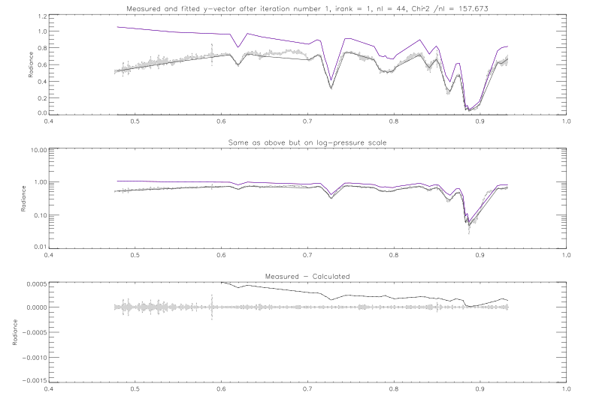
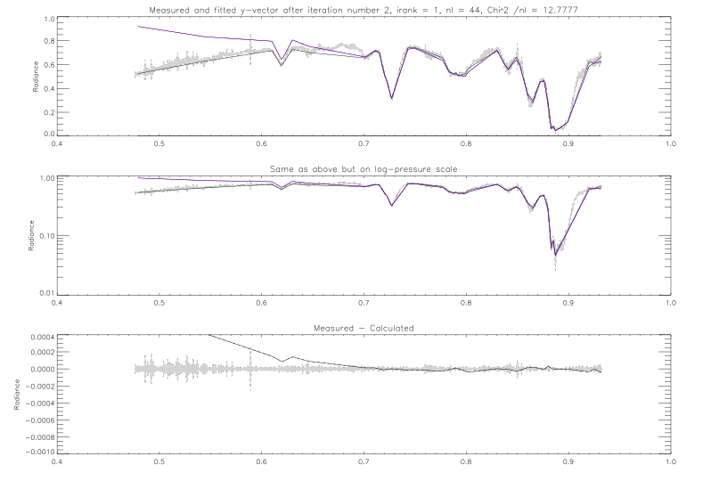
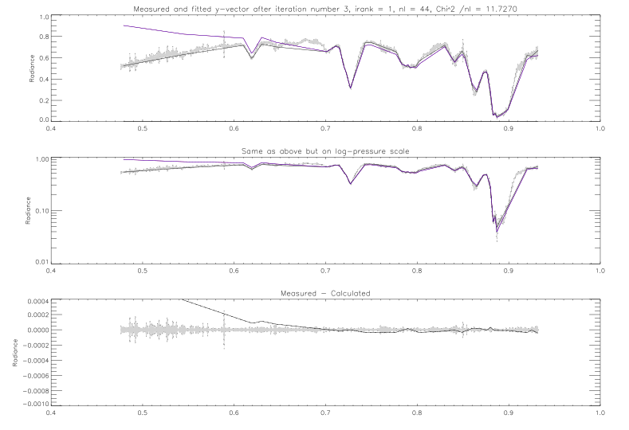

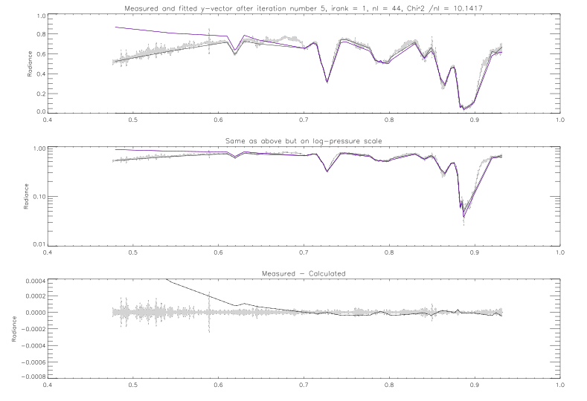
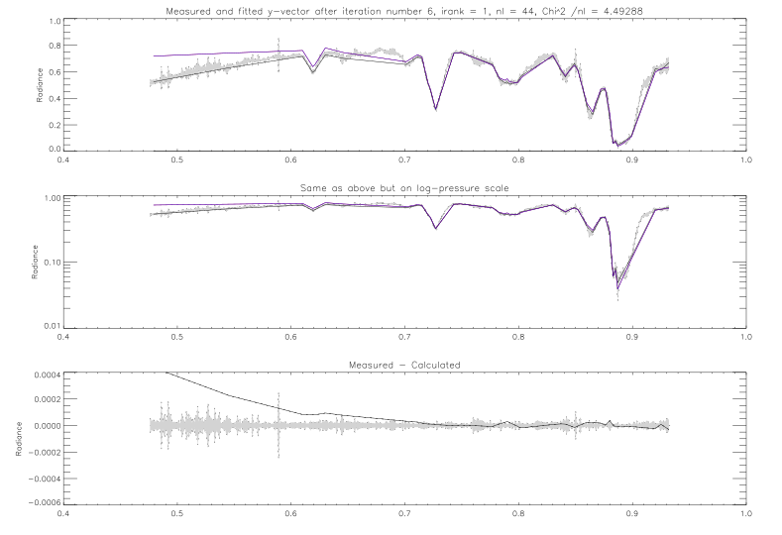
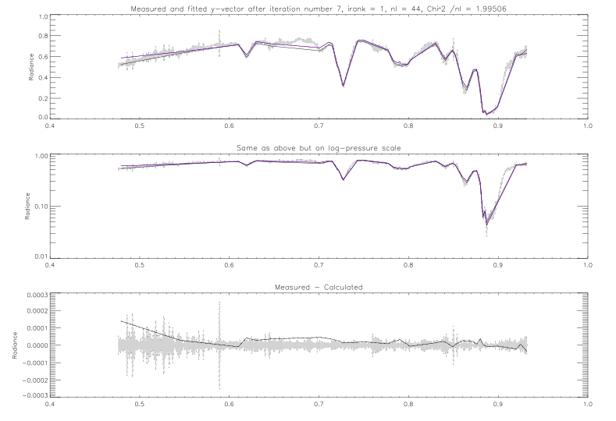

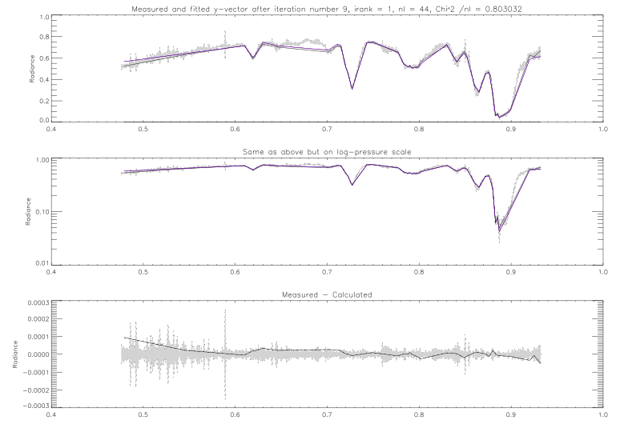
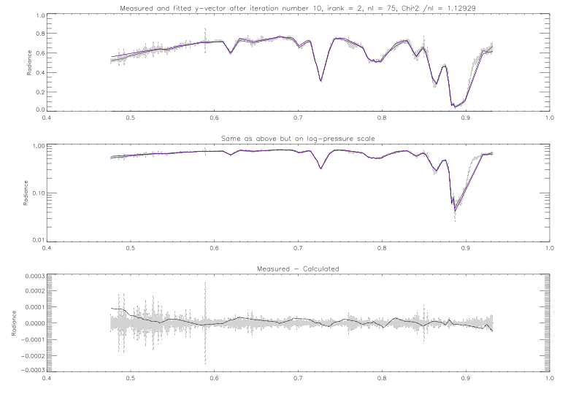


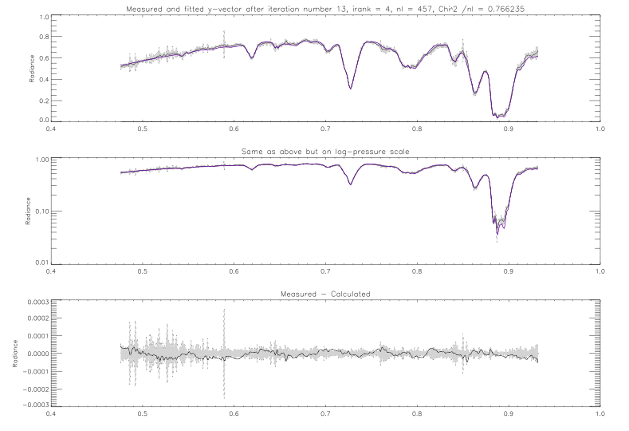

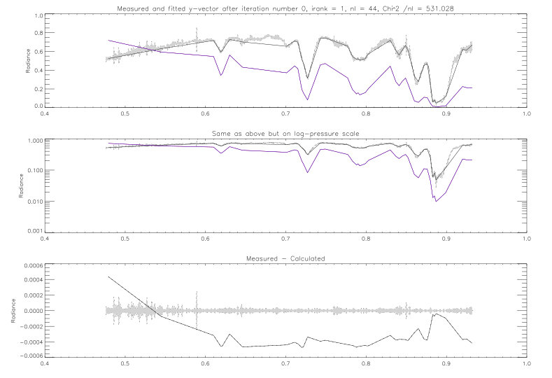
Notes:
This is a short demonstration of the reduced wavelength scheme in action (you might want to actually start the slide show here to see this). In black, you have the observed spectrum, while the spectrum fit by NEMESIS is in blue. For the first rank, I have decided to only include 44 out of the total 457 wavelengths in the spectrum. The motive behind selecting these wavelengths in particular was a combination of modelling the rough shape of the spectrum (with all the major methane peaks) as accurately as possible and getting the wavelengths with the highest information content. A channel-selection algorithm, such as that described by Ventress and Dudhia (2013) (“Improving the selection of IASI channels for use in numerical weather prediction”), can be used as a guide to see which wavelengths are the most important and which wavelengths can be discarded in the first few iterations of the retrieval.
(Press the spacebar here) So, using just the 44 1st-ranked wavelengths, NEMESIS takes 9 iterations to converge to a solution under the standard NEMESIS criteria. At this point, NEMESIS adds on the rank 2 wavelengths onto the original rank 1 wavelengths, giving 75 wavelengths in total, and performs further iterations.
(Press the spacebar here) However, if the spectrum still hasn’t converged to a solution with a reduced number of wavelengths after a given number of iterations, NEMESIS will automatically jump to the highest-ranked wavelengths (in this case, the full wavelength grid) for the final two or three iterations.

Slide 10
2) Particle size distributions very difficult to retrieve directly
Leave effective particle radii and variances fixed where possible.
Use Χ² analysis to find best-fit solutions (eg. Sato et al, 2013)
Notes:
The second issue one will encounter doing retrievals of aerosol is that, while aerosol opacity is highly degenerate with particle size, particle size is very difficult to retrieve directly at this wavelength range, particularly if a given spectrum has only been observed at one single viewing geometry. Leaving the particle radius and variance to vary in varident 444 will either cause NEMESIS to barely vary the particle size distribution at all from the prior, or it will make it oscillate wildly between several degenerate and most likely unphysical solutions. One should therefore leave the particle radius and variance completely fixed in the retrieval. To determine the best prior value for the particle size distribution, one could perform a Χ² analysis (see Sato et al, 2013. " Retrieval of Jovian Cloud Structure from the Cassini ISS Limb-Darkening Data: I. Continuum Scattering Phase Functions for Cloud and Haze in the South Tropical Zone"), performing several different limb darkening retrievals (see Daniel Toledo Carrasco’s presentation) using a range of possible particle sizes, and then choosing the particle size that produced the best Χ² /n value.

Slide 11
3) Units of aerosol opacity inconsistent
Continuous profiles: Particles/g or particles/cm³
Discrete profiles: Normalised opacity in particles/cm²
Notes:
This is a minor but annoying bugbear of mine, which one should be aware of when doing a retrieval of aerosol. So in NEMESIS, the units of aerosol abundance will be different depending on which aerosol profile parametrisation you will use. Most (but not all!) discrete cloud models will be expressed in units of aerosol opacity in particles/cm² (normalised to a wavelength specified in varident 444), while almost all continuous cloud models are expressed in terms of aerosol specific density in particles/g, bar varident -1, which is expressed in terms of aerosol density in particles/cm³. I am currently trying to change this so that one can specify the units of a cloud profile using a separate flag. Note that, while aerosol density is a more physical and intuitive measurement than aerosol specific density, sometimes the density of the atmosphere itself can go down so sharply with height that it is easier to spot distinct cloud layers (particularly at higher altitudes) when they are retrieved in terms of particles/g than in terms of particles/cm³.

