Slide 1
VB
Solving the
Procurement Crisis
VendorBridge
AI-Powered Procurement
& Vendor Management ERP
A modern AI-powered platform that replaces
spreadsheets, emails, and disconnected tools
with one unified procurement command center.
8
AI
100%
Core Modules
Decision Engine
Automated
Odoo Hackathon 2026
Team: Code Crafters

Slide 2
The Procurement Problem
How procurement looks in most organizations today
📊 Spreadsheet Chaos
📧 Email RFQ Process
🔄 No Approval Workflow
Vendor data scattered across
multiple Excel files with no
single source of truth
RFQs sent manually, quotations
received in inconsistent formats,
hard to compare
Unstructured approvals via email
create bottlenecks and compliance
risks
📉 Zero Visibility
⚠️ Manual PO & Invoicing
❌ Poor Vendor Tracking
No real-time procurement data,
spending reports take days to
prepare
Purchase orders and invoices
are manually created, error-prone
and time-consuming
No vendor performance history
or rating system to inform
better decisions
2

Slide 3
Introducing VendorBridge
One platform. Complete procurement visibility.
Vendor
Management
Approval
Workflow
VendorBridge
ERP Platform
RFQ &
Sourcing
Purchase
Orders
Quotation
Comparison
Invoice
Management
🤖 AI Copilot & Recommendations
📊 Analytics & Reporting
3

Slide 4
8-Step Procurement Lifecycle
From vendor onboarding to invoice — fully automated
1
2
3
4
Vendor Registration
RFQ Creation
Vendor Quotation
Quotation Compare
Onboard vendors with GST, categories & ratings
Create structured Requests for Quotation
Vendors submit bids via self-service portal
AI-powered side-by-side vendor comparison
5
6
7
8
Approval Workflow
Purchase Order
Invoice Generation
Analytics
Structured multi-level approval routing
Auto-generate POs upon approval
Auto-create GST-compliant invoices from POs
Real-time spend & vendor performance reports
4

Slide 5
AI-Powered Intelligence
Smart procurement decisions backed by data
🤖 AI Procurement Copilot
⭐ AI Vendor Recommendation
🚨 AI Risk Detection
"Show pending approvals"
Vendor rating analysis
High-risk vendor flagging
"Recommend best vendor"
Historical delivery success
Spending anomaly alerts
"Generate monthly report"
Approval pass rates
Approval bottleneck detection
"Show procurement spend"
Response time benchmarks
Vendor dependency risks
Natural language to procurement insights
Explains why a vendor was recommended
Continuous real-time monitoring
5

Slide 6
Why VendorBridge?
Key differentiators over traditional procurement ERPs
✨ Modern UX
🤖 AI Decision Support
📊 Executive Dashboards
Inspired by Linear, Ramp, Brex & Stripe. Clean, intuitive interface that teams actually want to use.
Not just data storage — intelligent recommendations, risk detection, and procurement copilot.
Real-time procurement intelligence with spend analytics, vendor scorecards, and trend reports.
⚡ Full Automation
🔒 Enterprise Compliance
🏢 Built on Odoo
From RFQ to invoice — automated PO generation, approval routing, and document creation.
GST-compliant invoicing, full audit trails, role-based access control, and approval logging.
Leverages the full power of Odoo ERP ecosystem with seamless integration to existing modules.
6

Slide 7
Who Uses VendorBridge?
Four key roles with distinct workflows and benefits
🧑‍💼
🏭
👔
⚙️
Procurement Officer
Vendors / Suppliers
Managers / Approvers
Administrators
Pain Point:
Pain Point:
Pain Point:
Pain Point:
Too much manual work, difficult comparison
Slow communication, no visibility
Delayed approvals, no visibility
No central control
✓ Benefit:
✓ Benefit:
✓ Benefit:
✓ Benefit:
Faster sourcing, automated comparison, better vendor selection
Self-service portal, real-time status tracking, faster decisions
Centralized approval center, timeline tracking, spend analytics
Full platform visibility, audit logging, compliance monitoring
7

Slide 8
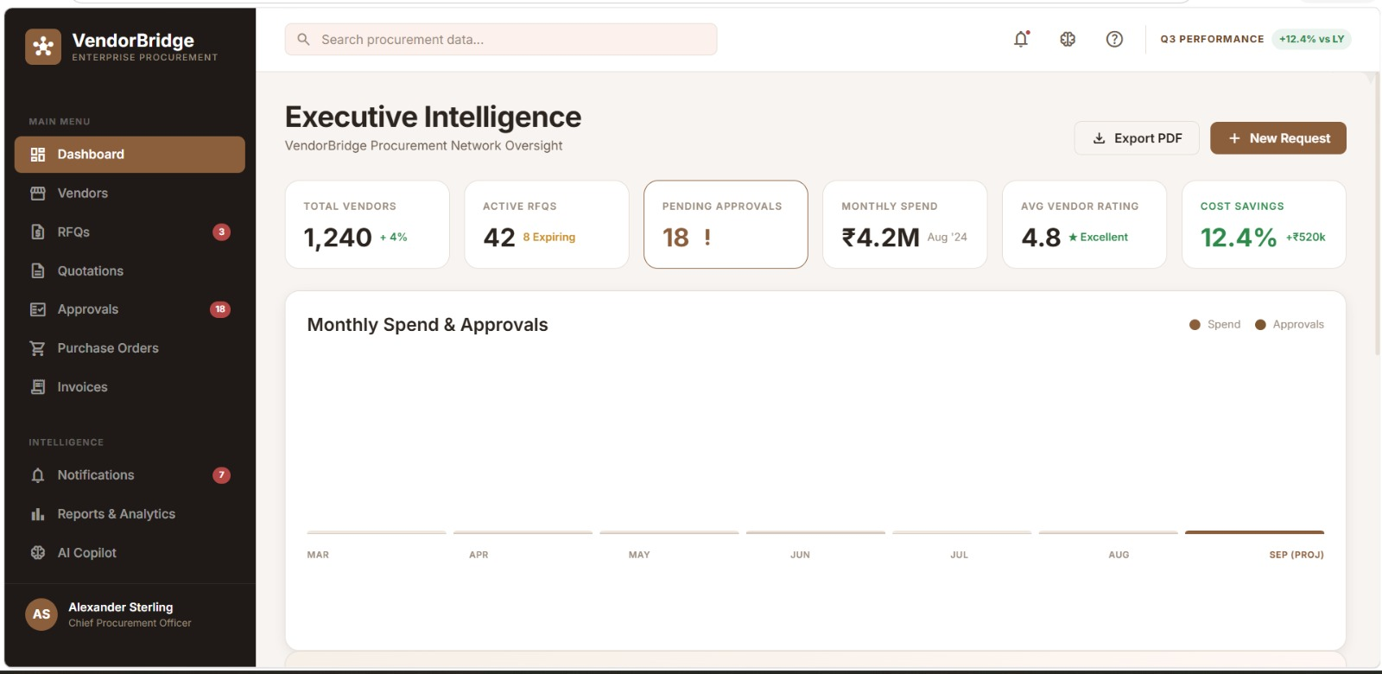
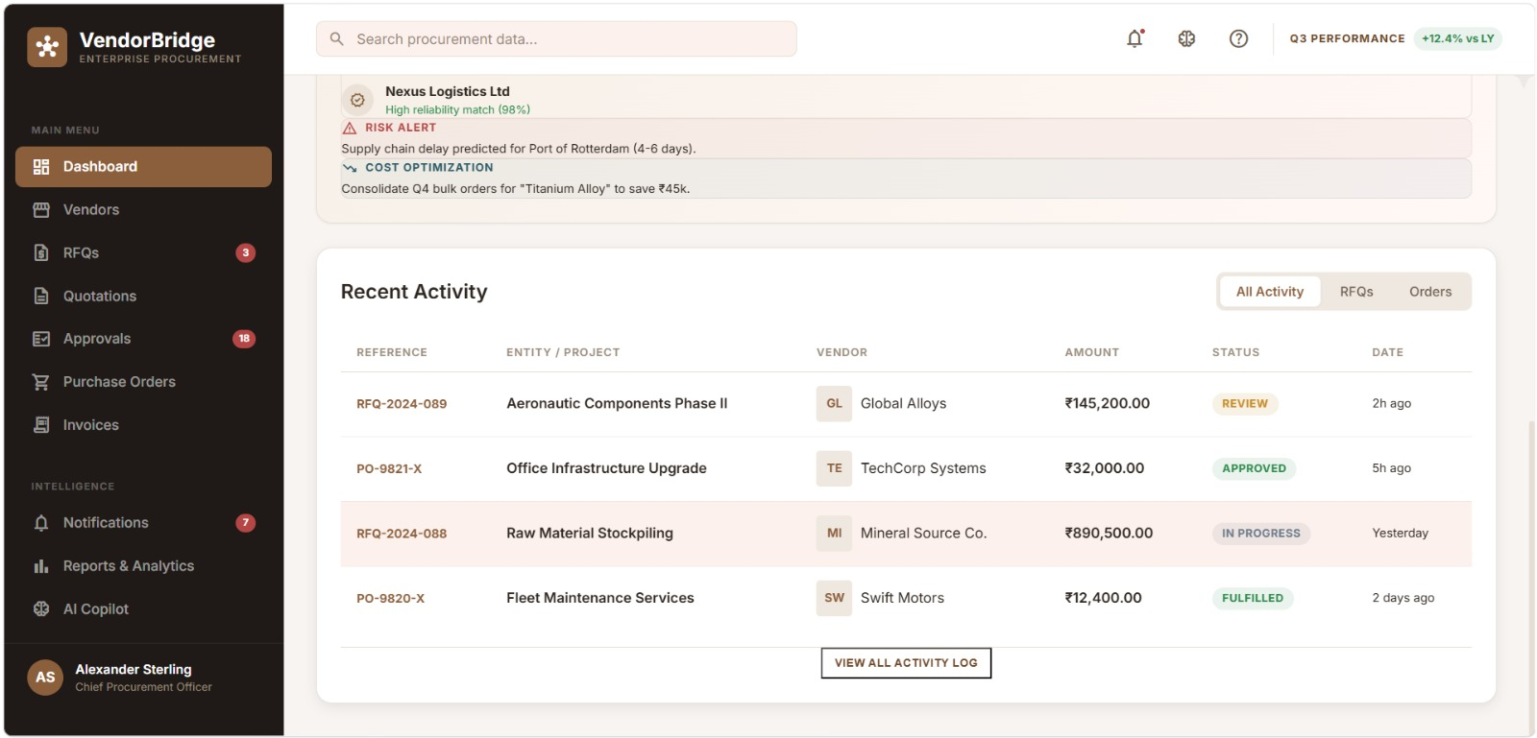
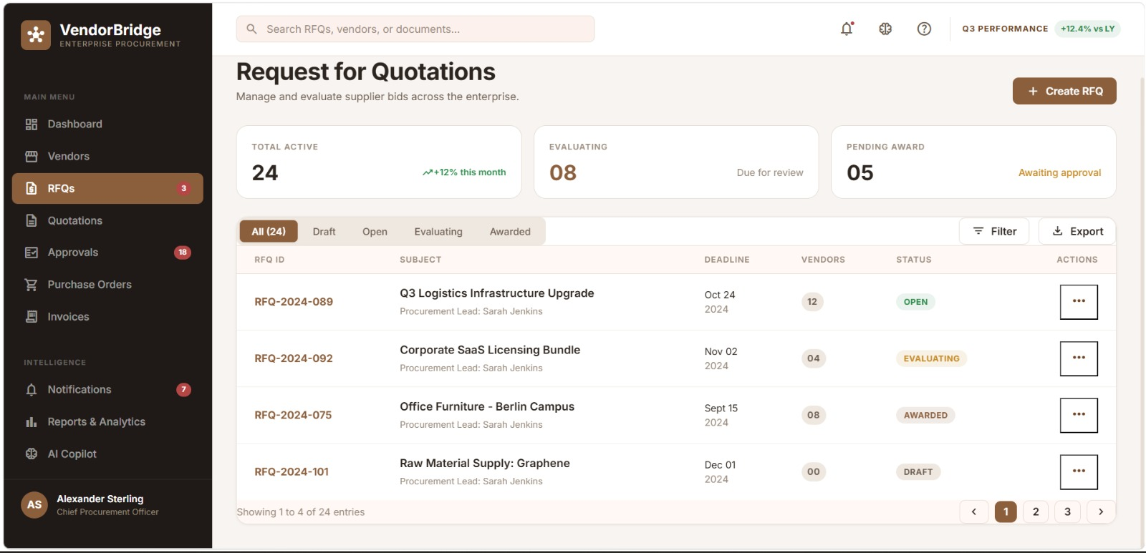
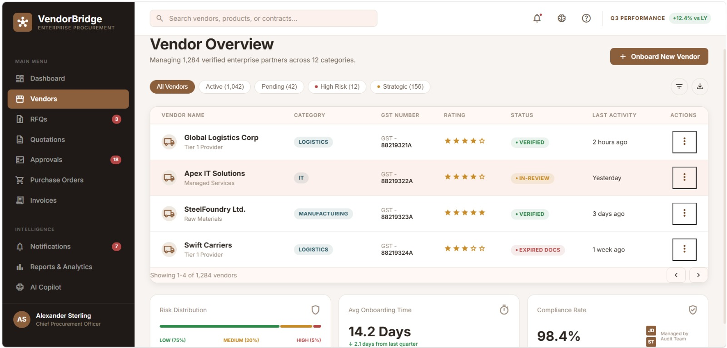
Screenshots — Dashboard & Vendor Management
Add actual application screenshots above
8

Slide 9
Technology Stack
Built on Odoo ERP with modern AI integrations
Frontend
Odoo QWeb Templates • XML Views • JavaScript OWL Framework
Backend
Python 3 • Odoo ORM • Custom Odoo Modules • REST API
AI Layer
Anthropic Claude API • AI Copilot • Vendor Recommendation Engine • Risk Detection
Database
PostgreSQL • Odoo Data Models • Audit Log Tables
🏆 Built for Odoo Hackathon 2025 • Code Crafters Team • VendorBridge v1.0
11

Slide 10
Thank You
VendorBridge — Reimagining Procurement for Modern Organizations
✅ Complete 8-step procurement lifecycle automation
✅ AI Copilot, Vendor Recommendation & Risk Detection
✅ GST-compliant invoicing & purchase order generation
✅ Role-based workflows for all stakeholders
✅ Real-time analytics & executive dashboards
🏆 Code Crafters | Odoo Hackathon 2026
Built with ❤️ using Odoo ERP + Claude AI

