Slide 1
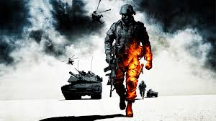
IKON WARS
Made by Wishy,Nemil,Ruchit,David

Slide 2

Project Over View and Description
War game between 2 teams; each with 5 avatars.
During play, player upgrades his avatar and gathers useful artifacts skillfully to attack the enemy.
Account Creation, Select Avatar, Select Map.
MOBA
Entertainment Value + Critical thinking + Social Interaction

Slide 3
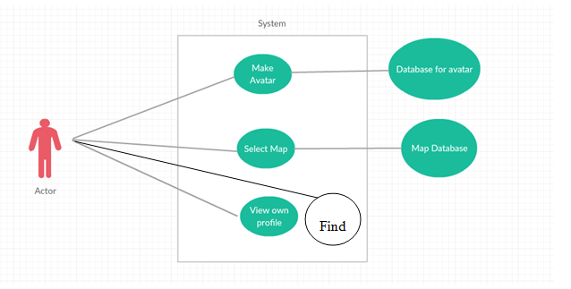
USE CASE DIAGRAM

Slide 4
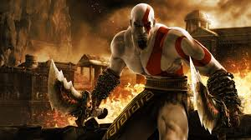
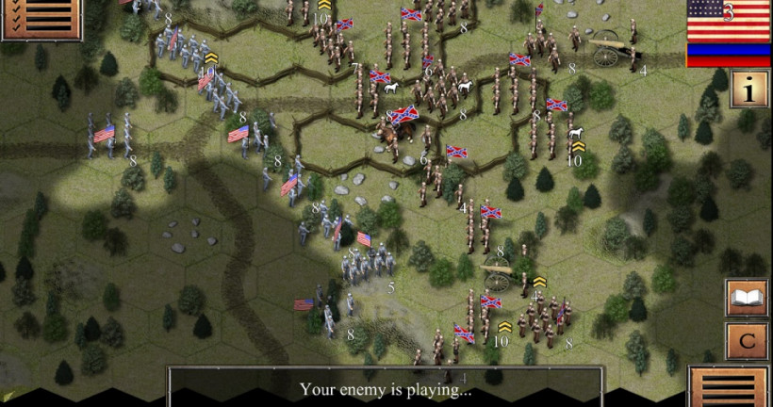
USE CASE LIST
Make Avatar, Select Map
Select Match
View Profile
Find:
Normal Match:
a) Single Player b) Party Player
Ranked match:
a) Single Player b) Party Player
Bots

Slide 5
Requirements: Product Use Cases
Use Case Name: Make Avatar
Actors: User
Sequence of Events User can select the Heroes tab from the top of menu User can select what map he wants to play on.
Use Case Name: View User
Actors: User
Sequence of Events: User can go on the top tabs to view Profile. User can view his stats. User can view his rank. User can view most played heroes and their stats on selected hero.
Use Case Name: Find Match
Actors: User
Sequence of Events User can select Normal Match, Ranked Match, Bots. User has 2 options in normal and ranked matches. In Normal games User is matched with players in region regardless of rank. In ranked games User is matched with the similar ranked players. In Bot games User just plays with the Pre defined lineup.

Slide 6
Functional Requirements
Event/Use case#: 3 Description: The system shall allow the user to create an account Rationale: This allows the user to gain access the product’s services and online capabilities while letting the user personalize their profile Fit Criterion: The option will be available on product start-up
Event/Use case#: 1 Description: The System should allow to select Heroes from the database Rationale: The user needs to access database to select available heroes. Fit Criterion: The option will be available on product start-up
Event/Use case#: 4 Description: The system shall allow user to find the match in their region Rationale: The user needs to access to the server to find the match Fit Criterion: The option will be available on product start-up
Event/Use case#: 4 Description: The system shall allow the user to find match according to rank Rationale: The user needs to get the match according to his rank Fit Criterion: The option will be available on product start-up

Slide 7
Other Requirements
Performance Requirements
Speed Requirements: Game load quickly; Database for Avatars and map load quickly
Capacity Requirements: Database hold large records; Server handle large players
Security Requirements
Access Requirements: User access their own account
Integrity Requirements: Prevent internal abuse, hacking etc
Usability Requirements
Personalization and Internalization: Available globally, language preference,
Learning: Tutorials, Trainings
Appearance and Style: High graphics, Themes, Creative Avatars and Map.
Privacy Requirements: Ask permission to user; hide user’s data.

Slide 8
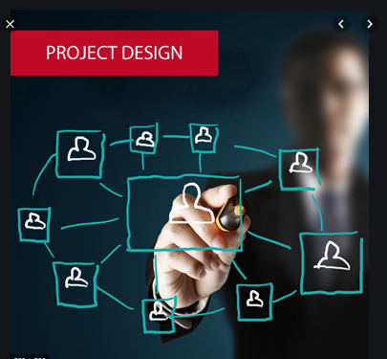
Design Goals
Try to have 24/7 server uptime.
Simulations must be as realistic as possible.
Try to provide updates to avatars regularly.
Be open to user’s feedback by opening a blog.
Try to have the product be compatible with any OS.
Make the product as accessible as possible in terms of cost and usability

Slide 9

User Interface
Product available should be used by mouse and keyboard.
Product should have option have right hand user or left hand user.
Selection of Avatar also change color theme and background sounds.

Slide 10
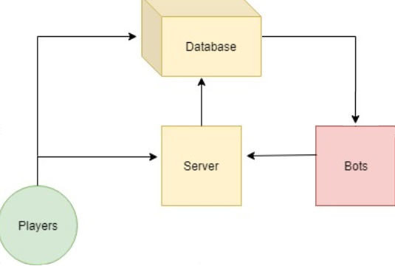
UML DIAGRAM

Slide 11

THANK YOU

