Slide 1


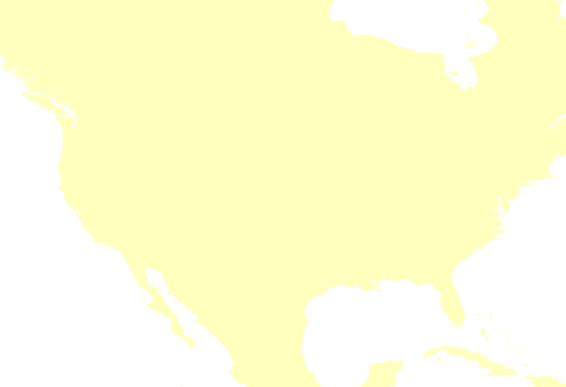
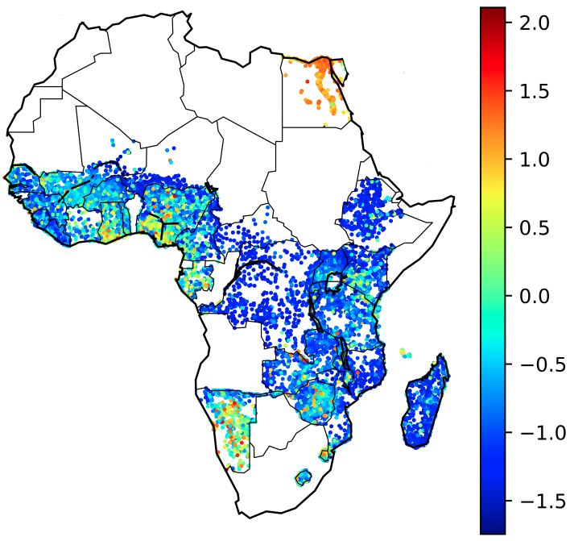


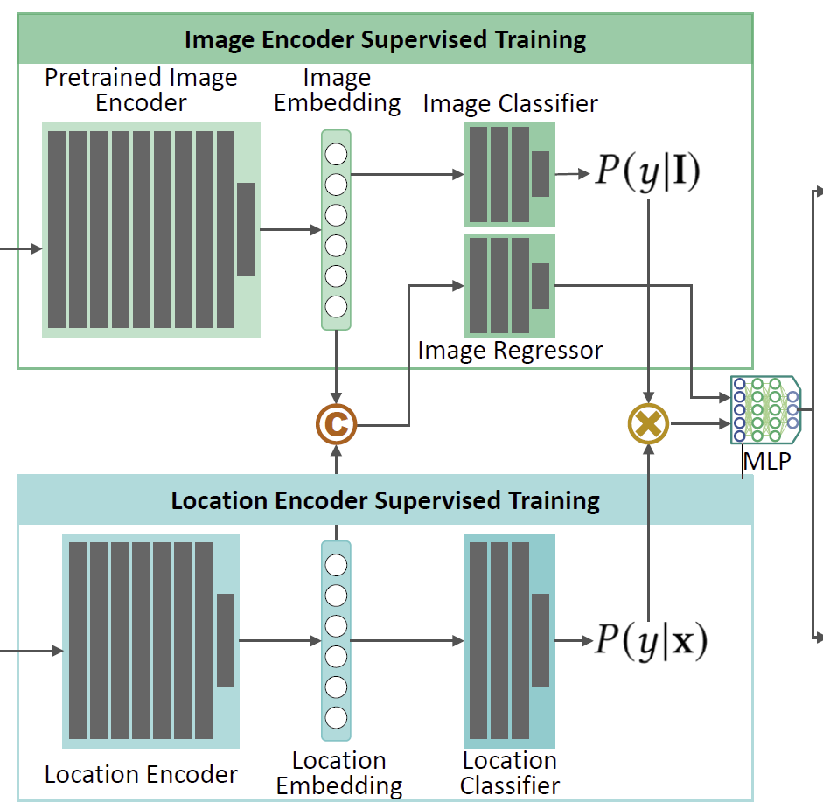




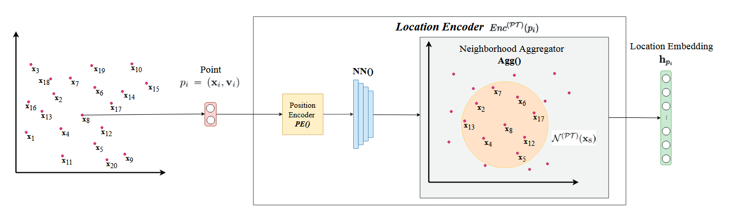
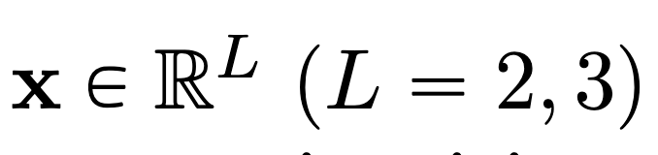
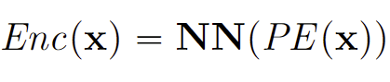




TorchSpatial: A Location Encoding Framework and Benchmark for Spatial Representation Learning
Nemin Wu*, Qian Cao*, Zhangyu Wang, Zeping Liu, Yanlin Qi, Jielu Zhang,
Joshua Ni, X. Angela Yao, Hongxu Ma, Lan Mu, Stefano Ermon, Tanuja Ganu, Akshay Nambi, Ni Lao, Gengchen Mai†
¹ Department of Geography
University of Georgia, Athens, GA, US
TorchSpatial
TorchSpatial
Background
Geo-Bias Score
Spatial representation learning (SRL):
A set of technique learning neural spatial representations from spatial data in their native formats while avoiding manual feature engineering or data conversion.
Application:
Urban planning, environmental monitoring, autonomous navigation, and precision agriculture to analyze spatial patterns, optimize resource allocation, etc.
e.g.,
We employ the spatial self-information (SSI), using a Gaussian distribution to approximate the probability of observing certain types of spatial patterns.
The lower the SSI, the more likely the current spatial patterns arise randomly, namely less geo-baised.
r
TorchSpatial
California
Pelican
Brown
Pelican
Sample Point
Extract a low-performance
observation’s neighborhood by radius r.
Base Geo-Bias Score
The SSI of low-performance
observations if they are completely randomly distributed
Relative Geo-Bias Score
Difference between the SSI of the low-performance observations (red crosses)
and the SSI of completely random low-performance observations (cyan-blue crosses)
Sustainability
Wealth Index Prediction
(Sheehan et al., KDD 2019;
Manvi et al., ICLR 2024)
Species Distribution Modeling
iNat2017
(Mac Aoda et al, ICCV 2019; Mai et al., ICLR 2020; Mai et al., Wu et al. NeurIPS 2024)
Contribution
A location encoder framework that consolidates 15 location encoders and necessary model building blocks for future location encoders.
A benchmark which contains 7 geo-aware image classification and 10 image regression datasets.
A set of evaluation metrics to quantify location encoders’ overall model performance and their geographic bias.
All evaluation result details please refer to the paper.
The dataset and code are available on our GitHub and website.
A Python package with the same name has been released.
Motivation
Current challenges:
Lack of a community-shared framework for SRL model development
Lack of benchmarks to systematically evaluate the location encoders’ impact on model performance
Lack of evaluations on the geographic bias of geo-aware AI approaches
Model Inference Architecture
Location Encoder Framework
Classification Task
image and location data are processed separately and combined via element-wise multiplication.
Images
Paper
Python Lib
GitHub
Website
Selected References
Input Location:
Mac Aodha, Oisin, et al. (2019). "Presence-only geographical priors for fine-grained image classification." Proceedings of the IEEE/CVF International Conference on Computer Vision. 2019.
Position Encoder:
Regression Task
Image and location embeddings are concatenated and fed into a neural network to predict a continuous value.
Mai, Gengchen, et al. (2022). "A review of location encoding for GeoAI: methods and applications." International Journal of Geographical Information Science 36.4 (2022)
Wang, Zhangyu et al. (2024). “Probing the Information Theoretical Roots of Spatial Dependence Measures.” Proceedings of the 16th Conference on Spatial Information Theory (COSIT)
Learnable Neural Nets:
Geolocations
A unified, flexible framework that supports the development of location encoders, ensuring scalability and reproducibility.
Notes:
Western Chickadee vs. Black-capped Chickadee: These two bird species are very similar in appearance, making it challenging to differentiate them based on physical characteristics alone. However, the Western Chickadee is primarily found in the forests of western North America, while the Black-capped Chickadee has a broader range, primarily distributed in central and eastern North America. Therefore, having precise geographic location data can significantly aid in distinguishing between these two species.
California Pelican vs. Brown Pelican: Although these two pelican species look alike, the California Pelican is mainly distributed along the western coast of the United States, while the Brown Pelican has a wider distribution, including the Gulf of Mexico and the Atlantic coast. Geographic distribution information is crucial for differentiating between these species as well.

