Slide 1
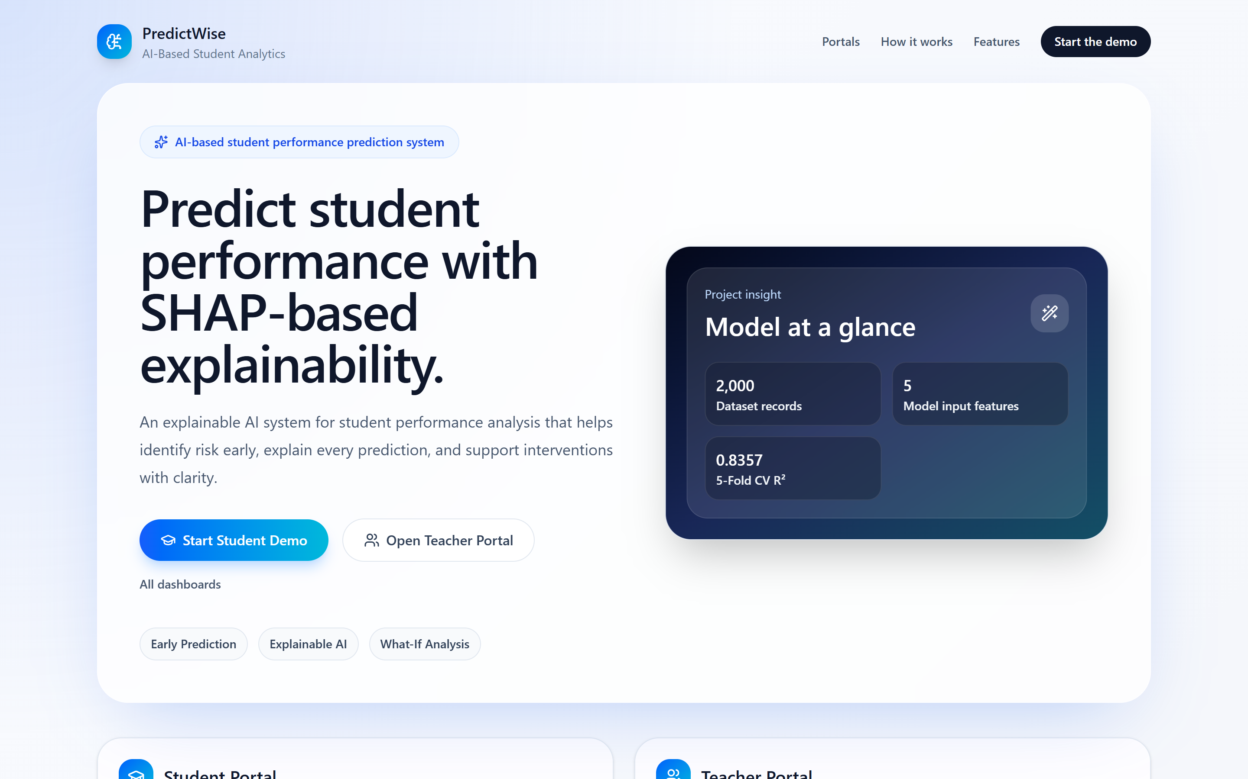
PBL · SEMESTER 5
AI-Based Student Performance Prediction and Decision Support System with Explainable AI
Explainable AI Techniques for Early Identification of At-Risk Students
The working application — landing page (actual screenshot)
Team
Nemmi Tangha · Oyindrela Das Oitri
Working prototype: React + Flask + scikit-learn + SHAP. The live demo uses five predefined demonstration student profiles — not real student data.
Notes:
Good morning. Our project is an AI-based student performance prediction and decision support system with explainable AI.
The theme is explainable AI for early identification of at-risk students.
In one sentence: the system predicts a student's final-exam marks, flags an early-warning level, explains the prediction with SHAP, suggests actions, and shows how a teacher could assign and track those actions.
Everything I show today is a working prototype that I will demonstrate live. The model is trained on our 2,000-record dataset, but the app itself demonstrates the workflow with five predefined demo student profiles — they are not real students.
Transition: let me start with the problem we are addressing.

Slide 2
PROBLEM STATEMENT
Struggling students are often identified late
Late identification
Predictions without reasons
Insight not linked to action
Academic difficulty often becomes visible only after final results, when there is little time left to help.
A predicted score alone does not tell a teacher which factors are behind it or what to look at.
Even when a risk is noticed, there is no simple path from the warning to a concrete, trackable support action.
Our question
Can a machine-learning prediction, combined with an explanation of that prediction, support earlier identification of students who may need help — and connect that warning to a teacher action?
AI-Based Student Performance Prediction · Explainable AI · PBL Semester 5
2 / 21
Notes:
The problem is simple: struggling students are often noticed late, typically after results are out.
Second, even if we have a model that predicts a score, a number by itself does not tell the teacher why.
Third, there is usually no clear path from "this student may be at risk" to "here is what we will do about it".
So our question is whether prediction plus explanation can support earlier identification and connect it to action.
I am careful not to claim this solves the problem — it is a prototype that explores the idea.
Transition: that leads to our objectives.

Slide 3
PROJECT OBJECTIVES
What the system sets out to do
1
Predict
Predict final-exam marks from five academic inputs using a validated regression model.
2
Warn early
Apply early-warning rules to the prediction: High Concern, Borderline, Lower Concern.
3
Explain
Explain every individual prediction with SHAP feature contributions, in marks.
4
Recommend
Generate feature-level recommendations guided by the SHAP explanation.
5
Act
Demonstrate a teacher workflow: assign an intervention, track assigned / completed, and report.
AI-Based Student Performance Prediction · Explainable AI · PBL Semester 5
3 / 21
Notes:
We had five objectives.
One, predict final-exam marks from five academic inputs.
Two, turn that prediction into an early warning with three levels.
Three, explain each individual prediction using SHAP, so it is not a black box.
Four, generate recommendations based on that explanation.
Five, demonstrate how a teacher would act on it: assign an intervention, see it marked completed, and view a report.
Transition: here is how these pieces fit together as one system.

Slide 4
PROPOSED SYSTEM
From prediction to explanation to action
MODEL + API (Flask: /predict, /explain, /recommend)
1
2
3
4
Student data
ML prediction
Early warning
SHAP explanation
5 academic inputs
Final-exam marks
3 project-defined bands
Contribution of each input
DECISION SUPPORT (Student Portal + Teacher Portal, session state)
5
6
7
8
Recommendation
Teacher intervention
Intervention status
Demo report
Model-based, per feature
Assign a HIGH/MEDIUM item
Assigned → Completed
Student · Prediction · Intervention
Steps 1–5 are computed by the real model and API for every prediction. Steps 6–8 are the demonstration workflow, kept in browser session state (no database).
AI-Based Student Performance Prediction · Explainable AI · PBL Semester 5
4 / 21
Notes:
This is the most important slide, because it is also the structure of my live demo.
The top row is the machine-learning part. We take five academic inputs, the model predicts final-exam marks, early-warning rules turn that into a level, and SHAP explains which inputs pushed the prediction up or down.
The bottom row is decision support. The explanation drives recommendations, a teacher can assign one as an intervention, the student marks it completed, and a report brings it all together.
Everything in the top row plus the recommendations comes from the real Flask API. The teacher workflow runs in the browser session — there is no database — which I will be open about throughout.
Transition: before the data, a quick look at how the application is built.

Slide 5
SYSTEM ARCHITECTURE
How the application is built
User
React + Vite frontend
Flask REST API
Model and rules
Student or teacher
in a web browser
Student Portal
Prediction · What-If · Tasks
Teacher Portal
Analytics · Reports
Session state (React context): selected demo student, latest results, assignments
GET / (status)
POST /predict
POST /explain
POST /recommend
Validates the five input ranges
scikit-learn pipeline: StandardScaler → LinearRegression (.pkl)
SHAP explainer
Early-warning rules
Recommendation rules
uses
HTTP/JSON
calls
Prediction
SHAP contributions
Recommendation rules
Teacher intervention / report
No database in the current implementation. Prediction results and intervention assignments for the five demo students are held in browser session state for the demonstration.
AI-Based Student Performance Prediction · Explainable AI · PBL Semester 5
5 / 21
Notes:
Here is how the application is built.
The user works in a React and Vite frontend, which has the Student Portal and the Teacher Portal.
The frontend talks to a Flask REST API over HTTP and JSON. There are three main endpoints: /predict returns the predicted marks and the early-warning band, /explain returns the SHAP contributions, and /recommend returns the recommendations. The API also checks that every input is inside the range the model was trained on.
Behind the API is the saved scikit-learn pipeline — StandardScaler plus Linear Regression — together with a SHAP explainer and the two sets of rules.
The bottom row is the logical chain: prediction, then SHAP, then recommendation rules, then the teacher's intervention and report.
There is no database. The results and interventions for the five demo students live in the browser session, which is enough for a demonstration.
Transition: now let's look at the data behind the model.

Slide 6
DATASET AND FEATURES
Model training and evaluation data
TRAINING / EVALUATION DATA — not the demo students
2,000
Feature | Meaning | Range in data
Attendance (%) | Share of classes attended | 52 – 100
Internal Test 1 | First internal test, out of 40 | 18 – 40
Internal Test 2 | Second internal test, out of 40 | 16 – 40
Assignment Score | Assignment marks, out of 10 | 4 – 10
Daily Study Hours | Self-reported daily study time | 1 – 5
Target: Final Exam Marks | Final-exam result, out of 100 (25–100 in data) | predicted
student records
5
input features
1
target: Final Exam Marks (/100)
The web application does not use these records. Its live demo uses five predefined demonstration profiles, whose inputs stay inside the same ranges (the API rejects values outside them).
AI-Based Student Performance Prediction · Explainable AI · PBL Semester 5
6 / 21
Notes:
This is the data the model was trained and evaluated on: 2,000 student records, five input features and one target.
The inputs are attendance, two internal tests out of 40, an assignment score out of 10, and daily study hours. The target is the final-exam mark out of 100.
The ranges in the right column are the ranges present in the data, and the app's API only accepts inputs inside them — so we never ask the model to extrapolate.
One important distinction: this is training data. The application you will see does not show these records. It uses five predefined demo students to demonstrate the workflow.
Transition: next, how we built and validated the model.

Slide 7
MACHINE-LEARNING METHODOLOGY
How the model was built and validated
1
2
3
4
5
6
Data preparation
Train/test split
Model comparison
5-fold cross-validation
Final model
Prediction
Load CSV, 5 features + target, no missing values
80/20 (1,600 / 400) in the per-model experiments
Five regression models on identical folds
KFold, shuffle, random_state = 42
Lowest error on every metric
Served by Flask for new inputs
Final pipeline (saved as final_student_performance_model.pkl)
Five inputs
StandardScaler
Linear Regression
Predicted marks
Scaling happens inside the pipeline, so in cross-validation it is fitted on the training folds only (no leakage). Each of the 2,000 students is predicted exactly once, out-of-fold.
AI-Based Student Performance Prediction · Explainable AI · PBL Semester 5
7 / 21
Notes:
Our method had six steps. We prepared the data — five features and the target, with no missing values.
In the individual model experiments we used an 80/20 split, 1,600 rows for training and 400 for testing.
For the final comparison we used five-fold cross-validation: the data is split into five parts, each part is held out once, and we average the results. That gives a more reliable estimate than a single split.
The final model is a pipeline of a StandardScaler followed by Linear Regression. The scaler is inside the pipeline, so during cross-validation it only learns from training rows — no data leakage.
Transition: here is how the five models compared.

Slide 8
MODEL COMPARISON
Five regression models, same 5-fold cross-validation
Model | MAE (marks) | RMSE (marks) | R²
Linear Regression ✓ final | 3.62 ± 0.07 | 4.59 ± 0.09 | 0.8357 ± 0.0084
Random Forest (tuned) | 3.85 ± 0.08 | 4.88 ± 0.09 | 0.8145 ± 0.0053
SVR | 3.91 ± 0.11 | 4.94 ± 0.11 | 0.8099 ± 0.0069
Random Forest | 3.99 ± 0.11 | 5.05 ± 0.10 | 0.8008 ± 0.0063
Decision Tree | 4.85 ± 0.17 | 6.07 ± 0.17 | 0.7123 ± 0.0158
How to read this. Mean ± standard deviation over the same five folds (evaluate_models.py → results/evaluation.md). Linear Regression has the lowest error on every metric, so it is the final model.
XGBoost: experiment scripts exist, but the xgboost package is not installed or listed in requirements.txt, so it could not be re-evaluated and is not part of this verified comparison.
AI-Based Student Performance Prediction · Explainable AI · PBL Semester 5
8 / 21
Notes:
This table compares five regression models on exactly the same five folds, so the comparison is fair.
Linear Regression has the lowest MAE and RMSE and the highest R squared, so we chose it. The bar chart shows the MAE: lower is better.
It is a nice result because the simplest model won — which also makes SHAP explanations very clean for a linear model.
If asked about XGBoost: we have experiment scripts for it, but the xgboost package is not installed or in our requirements, so we could not reproduce it. Rather than quote an unverified number, we left it out of the comparison.
Transition: now the final model's numbers in detail.

Slide 9
FINAL MODEL PERFORMANCE
Linear Regression · 5-fold cross-validation
MAE
RMSE
R²
3.62 ± 0.07
4.59 ± 0.09
0.8357 ± 0.0084
marks
marks
no unit
Mean absolute error: on average, a prediction is about 3.6 final-exam marks away from the actual mark.
Root mean squared error: like MAE, but larger mistakes count more. Also in marks.
Coefficient of determination: the model explains about 84% of the variation in final-exam marks.
These are regression errors, not "accuracy". The model predicts a number (marks), so there is no single percentage of correct answers. R² is the share of variance explained, not the share of correct predictions. The model gives no probability or confidence score.
AI-Based Student Performance Prediction · Explainable AI · PBL Semester 5
9 / 21
Notes:
Here is the final model performance, from five-fold cross-validation.
MAE is 3.62 marks: on average our prediction is about three and a half marks away from the real final-exam mark. The plus-minus is the variation across the five folds, and it is small, so the result is stable.
RMSE is 4.59 marks. It is similar to MAE but penalises big mistakes more.
R squared is 0.8357: the model explains roughly 84 percent of the variation in final marks.
Please note I do not call this accuracy. This is a regression model — it predicts a number — so accuracy does not apply, and the model does not give a confidence score either.
Transition: but a teacher needs more than a number, which brings us to the early warning.

Slide 10
EARLY-WARNING CLASSIFICATION
Project-defined rules applied to the predicted marks
High Concern
predicted < 40
Student inputs
Regression prediction
(final-exam marks)
Borderline
predicted 40 – 44
Lower Concern
predicted > 44
How it works
Honest evaluation (out-of-fold)
The ML model is a regressor — it is not a three-class classifier.
The three bands are fixed, project-defined decision rules applied to each predicted mark (HIGH_CONCERN_BELOW = 40, BORDERLINE_UP_TO = 44 in app.py).
The app shows the band with its basis and a note that it is not an official pass/fail decision.
Only 25 of 2,000 students actually scored below 40 (1.25%).
High Concern flagged 13 of those 25 (recall 0.52, precision 0.77). High Concern or Borderline flagged 21 of 25.
Low scores are predicted slightly high (about +3 marks), so thresholds were kept, not tuned, and this limitation is reported.
AI-Based Student Performance Prediction · Explainable AI · PBL Semester 5
10 / 21
Notes:
The model predicts marks. To turn that into an early warning we apply three project-defined rules: below 40 is High Concern, 40 to 44 is Borderline, above 44 is Lower Concern.
I want to be clear: the ML model is not a three-class classifier. It is a regressor, and these bands are decision rules on top of its prediction.
We also evaluated the bands honestly using out-of-fold predictions. Only 25 of the 2,000 students actually scored below 40. High Concern caught 13 of them; if you count High Concern or Borderline together, 21 of 25 were flagged.
Regression tends to pull low scores towards the average, so some low scorers are predicted a bit too high. We kept the thresholds fixed rather than tuning them on the same data, and we report this limitation.
Transition: the band tells us "how worried"; SHAP tells us "why".

Slide 11
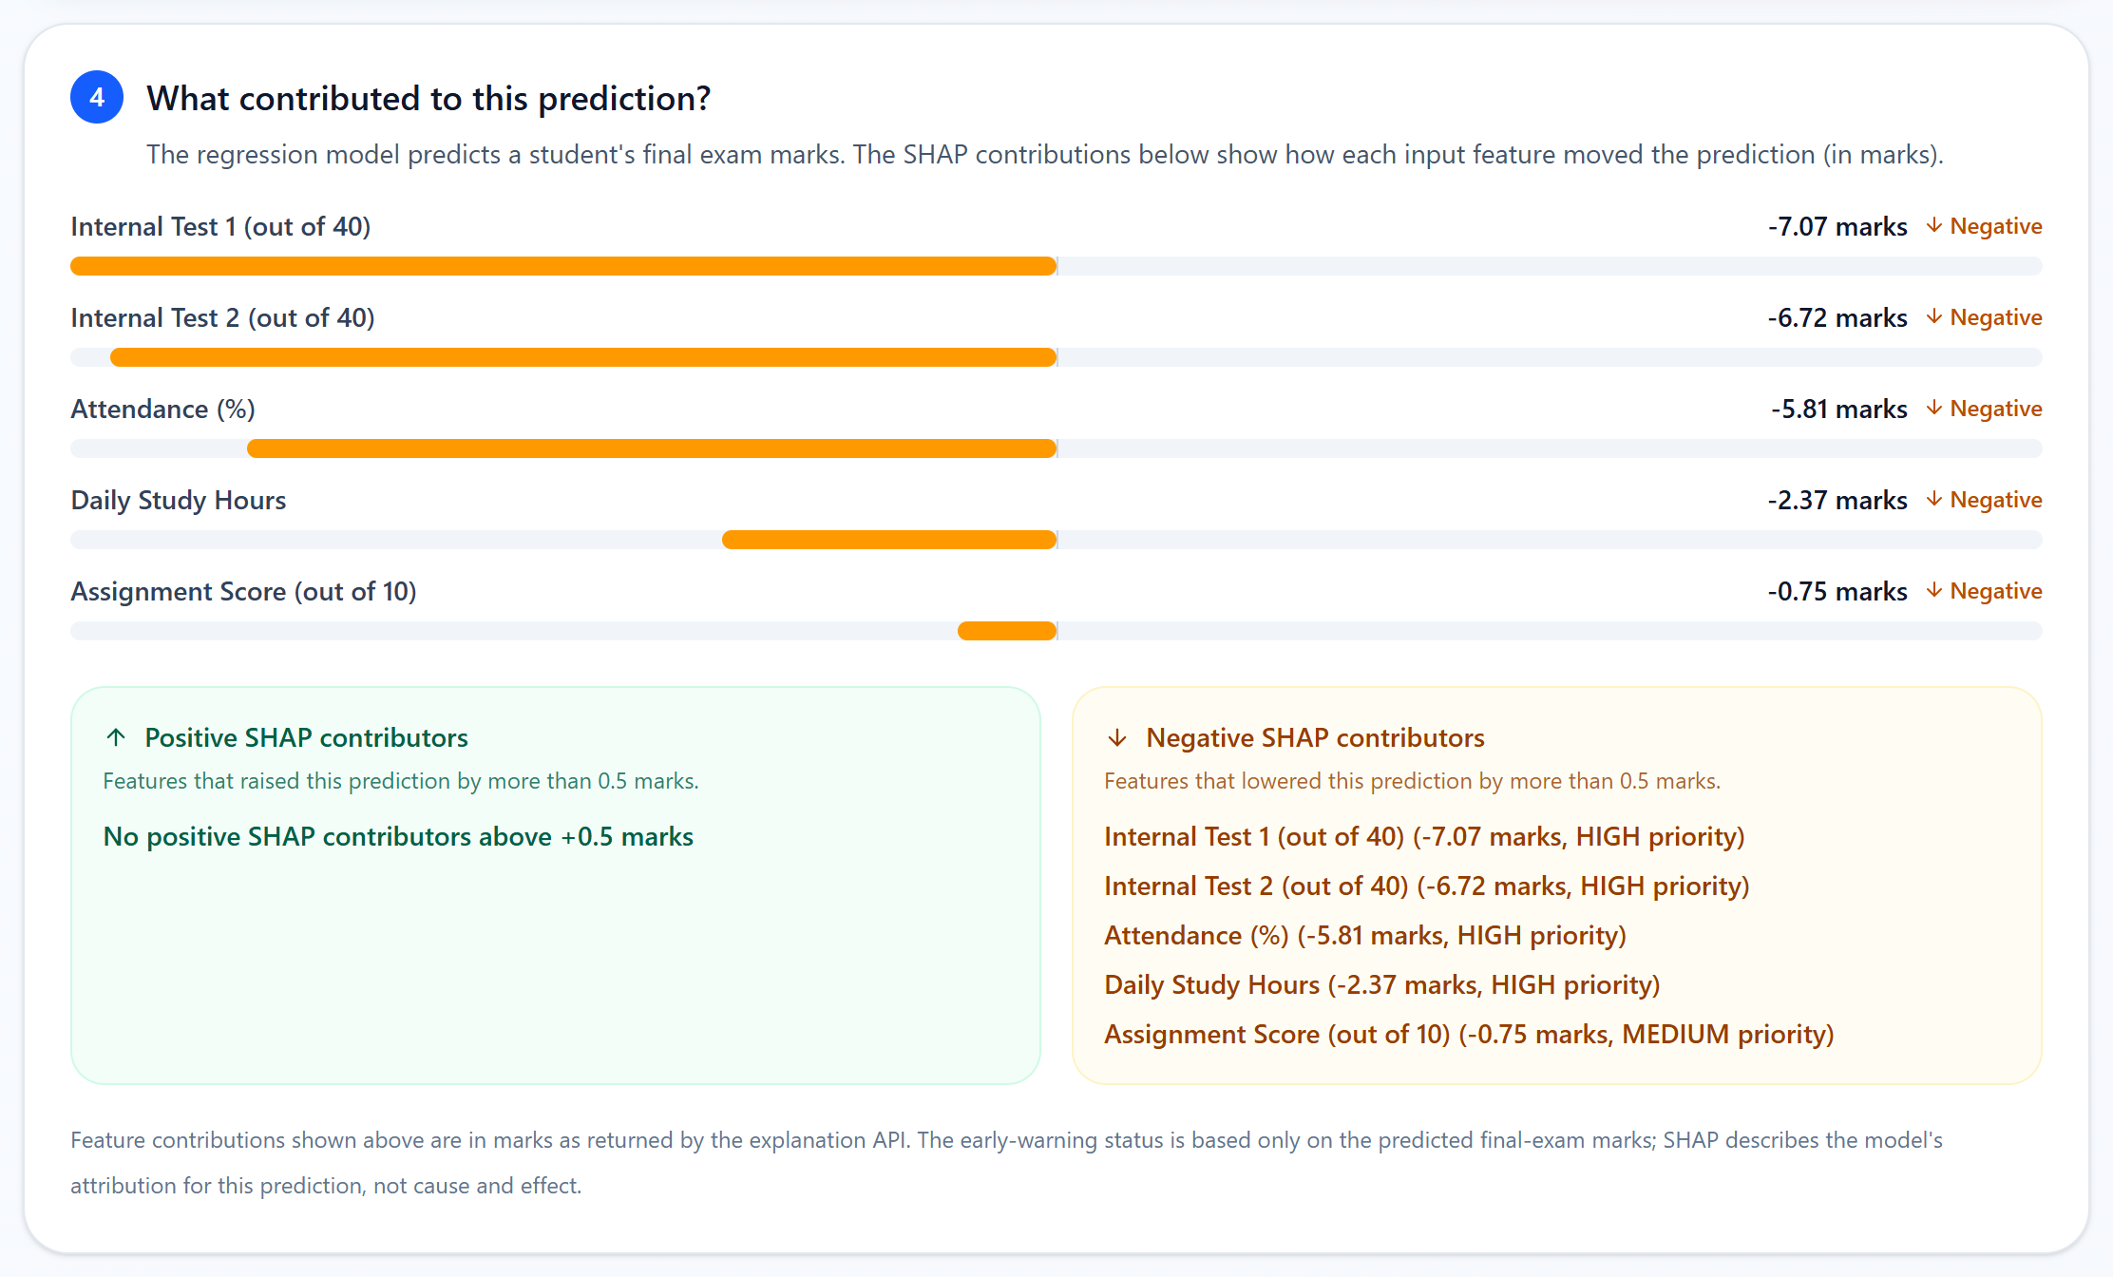
EXPLAINABLE AI WITH SHAP
Which inputs contributed to this prediction?
Prediction alone
"What did the model predict?" → 42.12 marks
With SHAP
"Which inputs pushed it up or down — and by how much?"
Verified in the API for all five demo students:
base value + Σ SHAP = prediction
Demo Student 3: 64.855 + (−22.73) = 42.12
▲ Positive — pushes the predicted marks up
▼ Negative — pushes the predicted marks down
Feature contribution to the model prediction — not proof of cause and effect.
Actual /explain output in the app — Demo Student 3 (inputs 70 / 24 / 25 / 7 / 2)
AI-Based Student Performance Prediction · Explainable AI · PBL Semester 5
11 / 21
Notes:
A prediction alone answers "what". SHAP answers "why": how much each input moved this particular prediction, in marks.
SHAP starts from a base value — the model's average prediction, 64.855 marks — and adds one contribution per feature. The contributions add up exactly to the prediction. We checked this in our API for all five demo students. For Demo Student 3, 64.855 plus minus 22.73 gives 42.12.
In the screenshot, Internal Test 1 pulled the prediction down by about 7 marks, Internal Test 2 by about 6.7, attendance by about 5.8.
Positive means it pushed the prediction up, negative means down.
A key point for questions: SHAP explains the model, not the real world. It shows contribution to the prediction, not that attendance caused a low score.
Transition: we then use those contributions to generate recommendations.

Slide 12
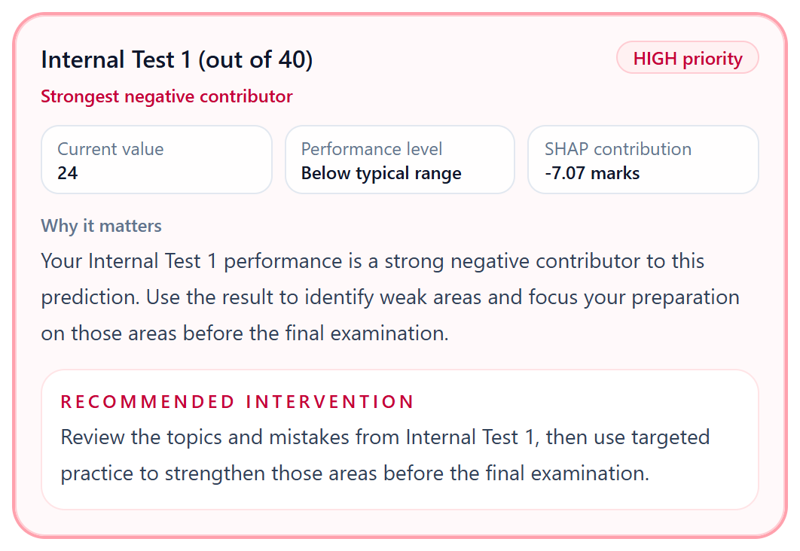
RECOMMENDATION ENGINE
SHAP contributions → prioritised, feature-level guidance
SHAP contribution
Priority rule
Recommend
Teacher / student
per feature, in marks
fixed thresholds
message + action
assign · act
SHAP contribution | Result
below −1.0 marks | HIGH priority
−1.0 to −0.5 marks | MEDIUM priority
−0.5 to +0.5 marks | no recommendation
above +0.5 marks | POSITIVE (maintenance guidance)
Rules live in app.py (classify_shap_priority). Negative contributors come first, strongest first. Recommendations are academic guidance — they are not guaranteed to raise marks and are not causal claims.
Actual /recommend output — Demo Student 3, strongest negative contributor
AI-Based Student Performance Prediction · Explainable AI · PBL Semester 5
12 / 21
Notes:
The recommendation engine is rule-based and driven by SHAP.
For each feature we look at its SHAP contribution. Below minus one mark it becomes a HIGH priority recommendation; between minus one and minus half a mark it is MEDIUM; near zero we say nothing; above plus half a mark it is a POSITIVE maintenance message.
The card on the right is real output for Demo Student 3. Internal Test 1 was 24 out of 40, it contributed minus 7.07 marks, so it is HIGH priority and the strongest negative contributor, with a concrete recommended action.
I want to be careful: these are guidance, not guarantees. We do not claim that following them will raise the marks.
Transition: to explore "what if", we built a scenario simulator.

Slide 13
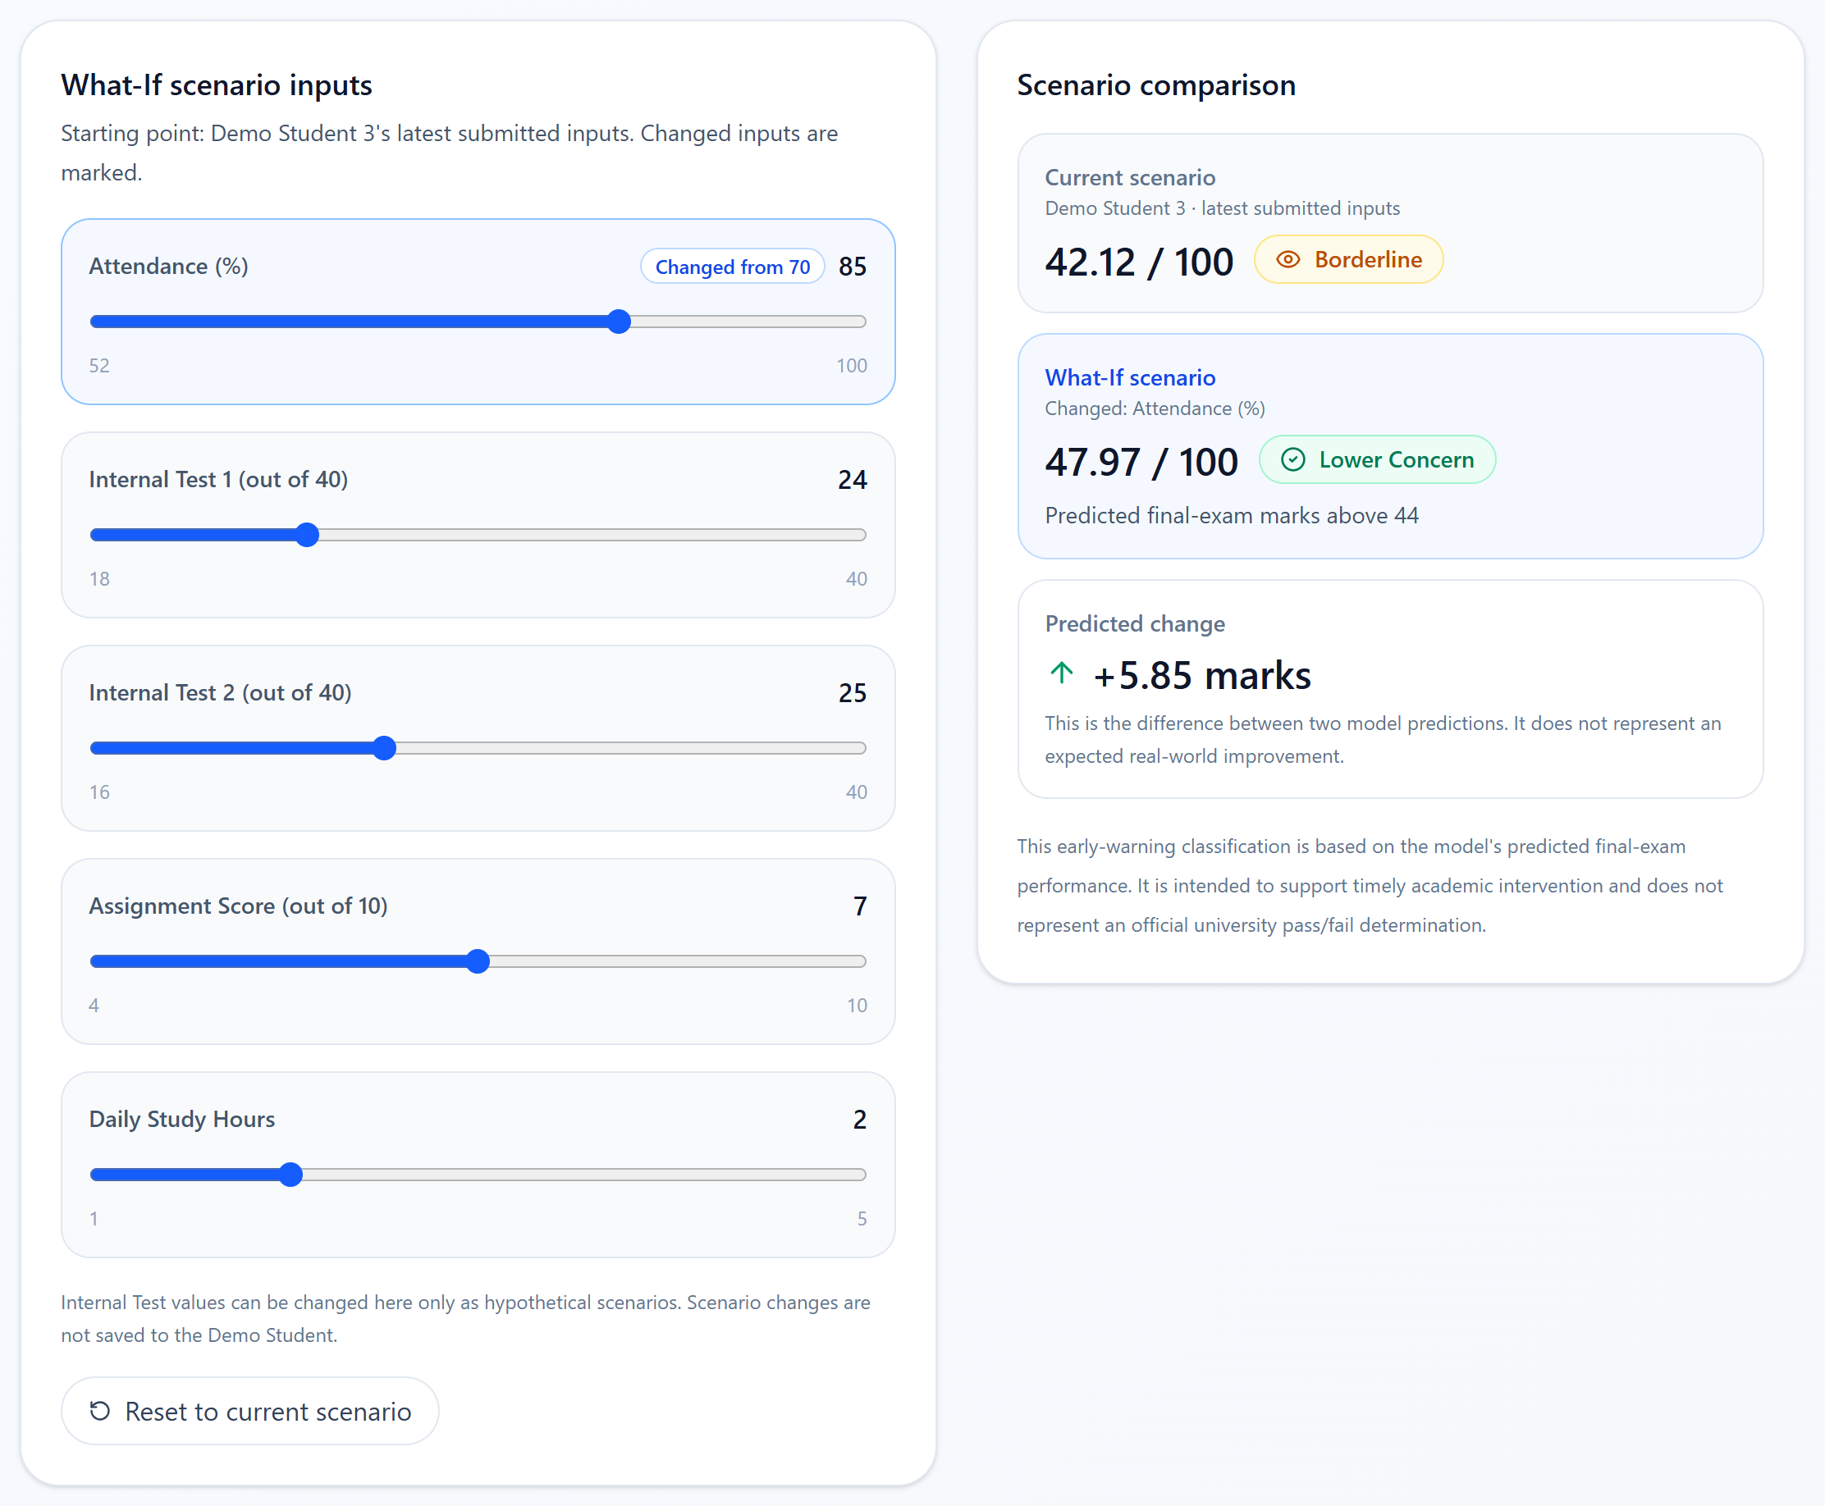
WHAT-IF SCENARIO SIMULATOR
How does the model's prediction change for a different scenario?
1
Start from the selected demo student's current inputs.
2
Move one or more sliders — changed inputs are marked.
3
The app calls the real /predict endpoint for the scenario.
4
It shows current vs What-If prediction and the difference.
Model scenario comparison, not a causal guarantee.
Example on screen: attendance 70 → 85 changes the model's prediction from 42.12 to 47.97 (+5.85 marks). It does not mean the student will gain 5.85 marks.
Actual What-If page — Demo Student 3, attendance changed from 70 to 85
AI-Based Student Performance Prediction · Explainable AI · PBL Semester 5
13 / 21
Notes:
The What-If simulator lets us ask: how would the model's prediction change for a different scenario?
It starts from the selected demo student's current inputs. When I move a slider, the app calls the same /predict endpoint and shows the current prediction, the What-If prediction and the difference.
In the screenshot I raised attendance from 70 to 85, and the model's prediction went from 42.12 to 47.97 — it even crosses from Borderline to Lower Concern.
But this is a comparison between two model predictions, not a causal simulation. It does not promise that the student would really gain 5.85 marks.
Transition: now let me show how this looks in the Student Portal.

Slide 14
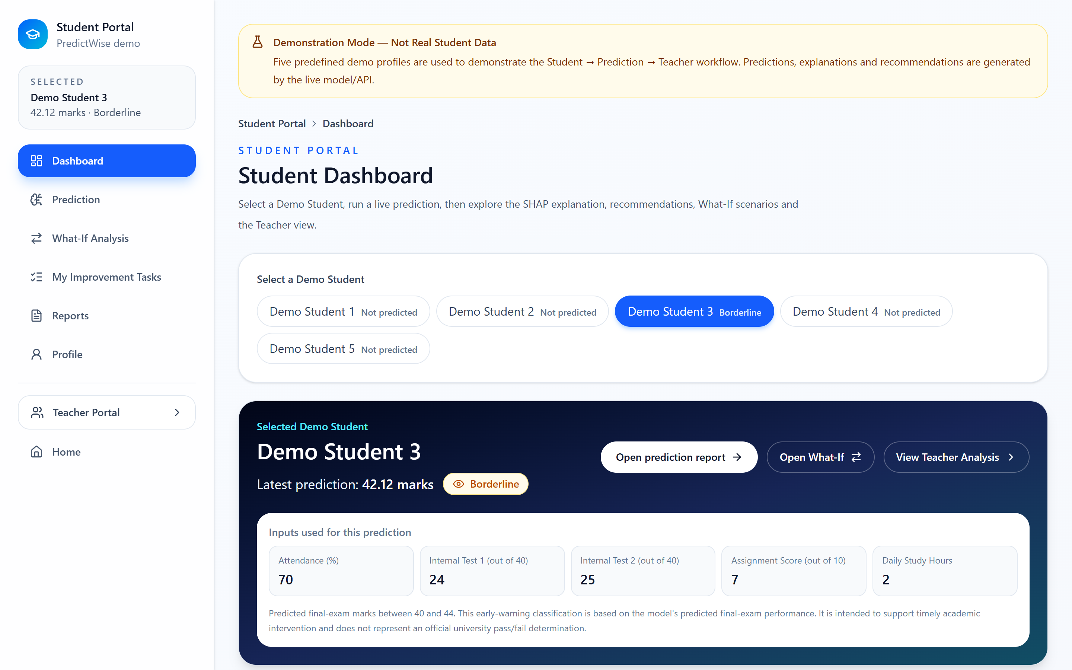
STUDENT PORTAL
LIVE DEMO · predefined demo students
One demo student, from inputs to explanation
1
Demo student selector
five predefined profiles
2
Predicted final marks
from /predict
3
Early-warning status
6
1
band + basis
4
Academic inputs
as submitted
5
2
3
5
What-If simulator
4
scenario comparison
6
Navigation
Prediction · SHAP · Tasks · Reports
The Prediction page adds the full SHAP explanation and recommendation cards (slides 11–12).
Actual Student Dashboard after predicting Demo Student 3
AI-Based Student Performance Prediction · Explainable AI · PBL Semester 5
14 / 21
Notes:
This is the Student Portal, and it is the first thing I will open in the demo.
One: I pick one of the five predefined demo students — the yellow banner says clearly this is not real student data.
Two and three: after predicting, the dashboard shows the predicted marks and the early-warning status.
Four: the inputs that were actually used for that prediction.
Five: from here I can open the What-If simulator.
Six: the sidebar takes me to the full prediction report with SHAP and recommendations, and to the student's improvement tasks.
Transition: now the same result from the teacher's side.

Slide 15
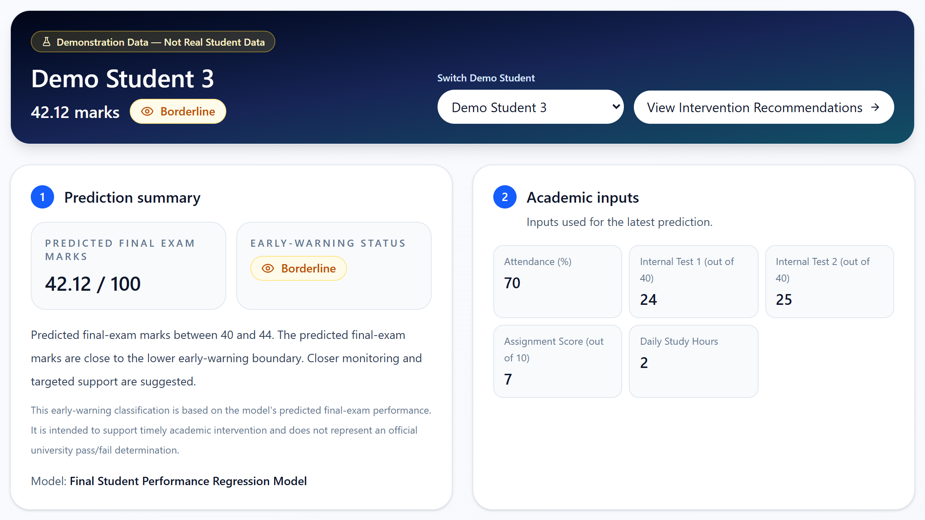
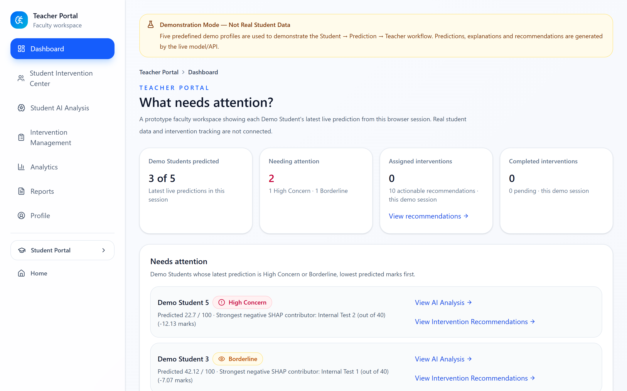
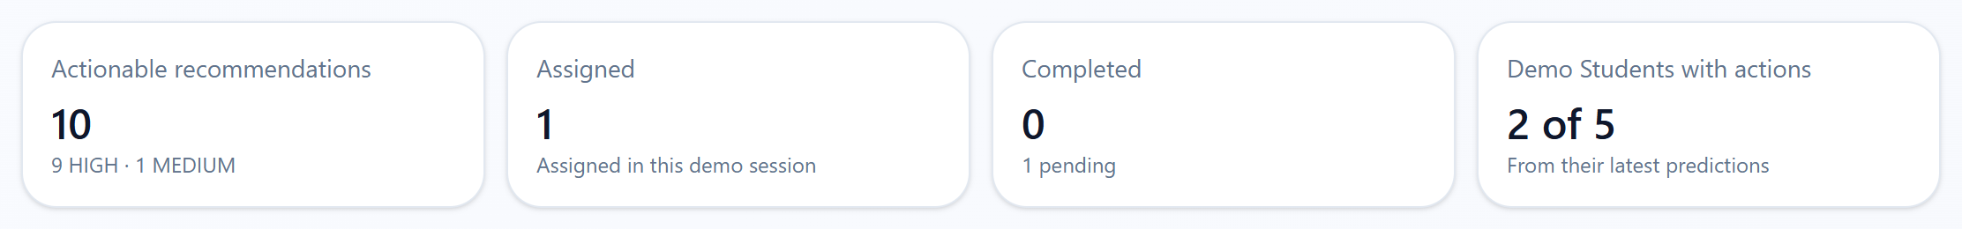
TEACHER PORTAL
LIVE DEMO · predefined demo students
The same live results, seen by a teacher
Student AI Analysis — Demo Student 3
Dashboard — "What needs attention?"
Intervention Management — session summary
Views: Dashboard · Student Intervention Center · Student AI Analysis · Intervention Management · Analytics · Reports · Profile — a demonstration teacher workflow over the five demo students.
AI-Based Student Performance Prediction · Explainable AI · PBL Semester 5
15 / 21
Notes:
The Teacher Portal shows the same live results from the faculty side.
The dashboard answers "what needs attention?": which demo students are High Concern or Borderline, sorted by predicted marks, and how many interventions are assigned or completed.
Student AI Analysis shows one student in depth: the prediction summary, the inputs, the SHAP contributions and the recommendations.
Intervention Management lists the actionable recommendations and lets the teacher assign them.
This is a demonstration teacher workflow. There are no real faculty accounts and no real student records behind it.
Transition: let me zoom into the intervention workflow.

Slide 16
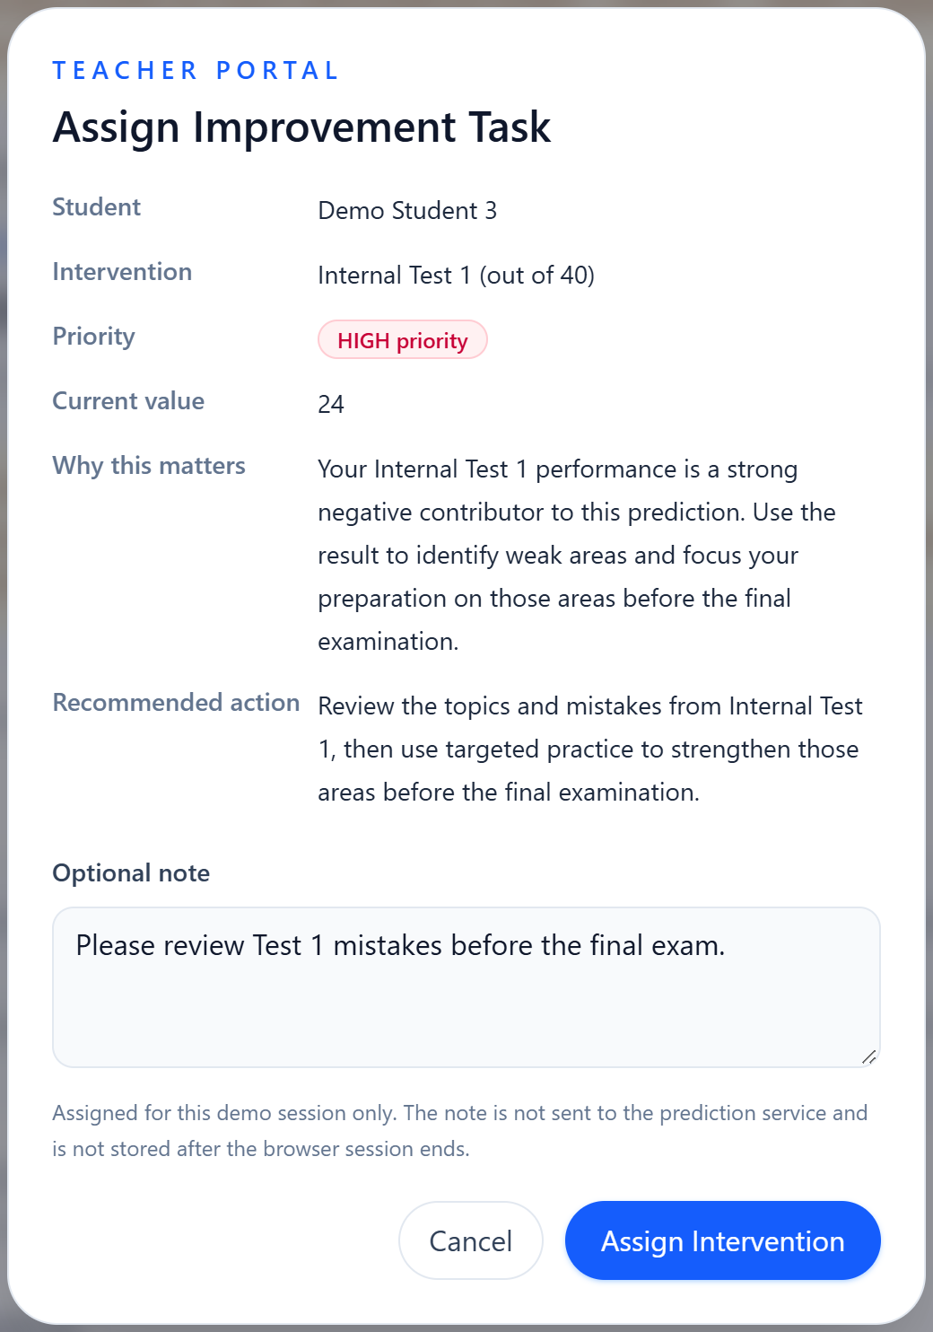
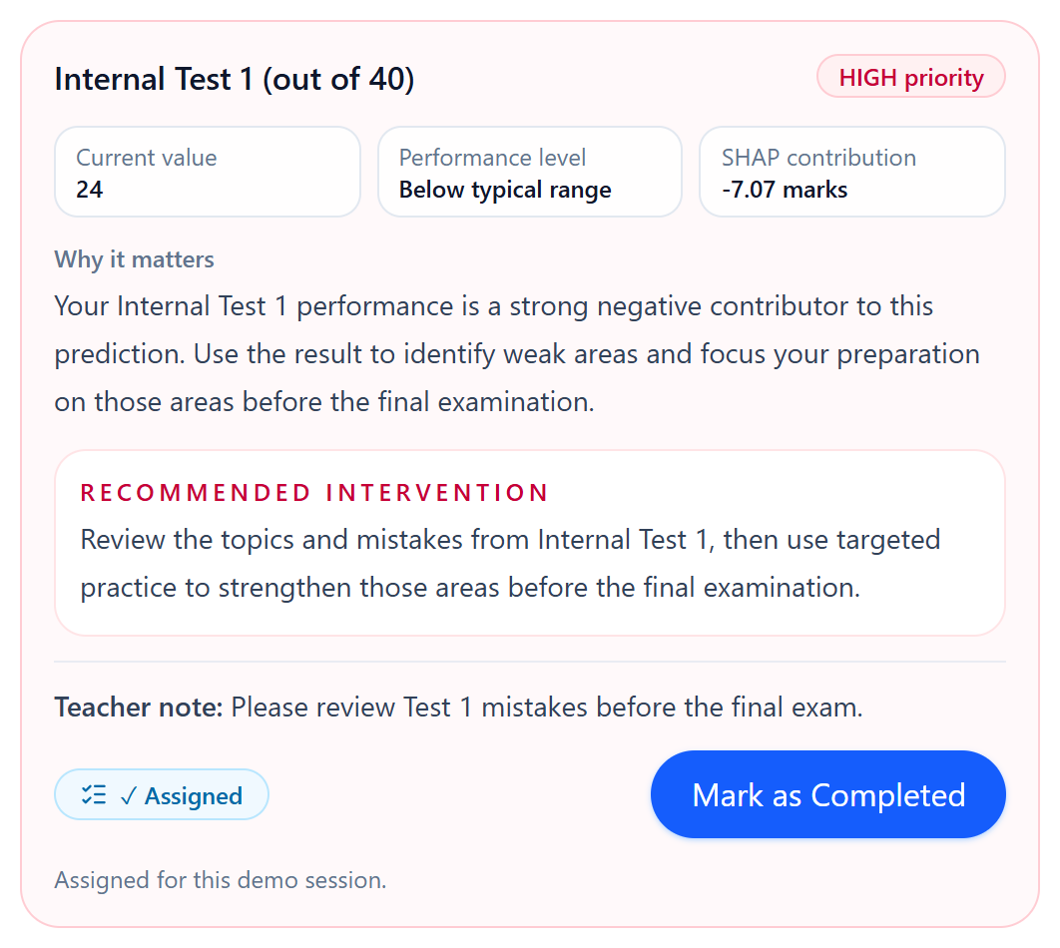
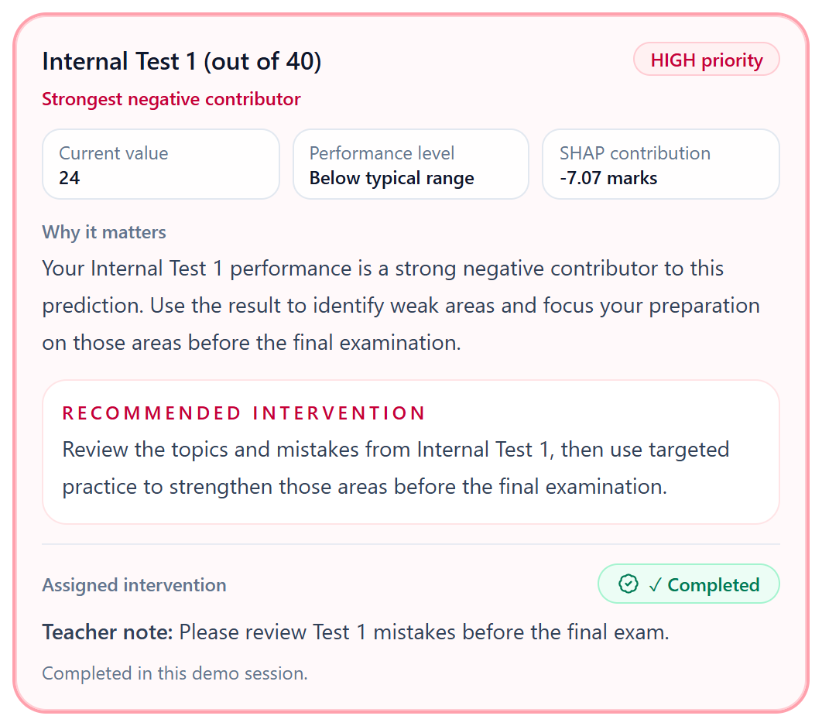
INTERVENTION WORKFLOW
LIVE DEMO · predefined demo students
From a recommendation to a completed task
Risk identified
Recommendation
Teacher assigns
Student sees task
Assigned → Completed
HIGH / MEDIUM item
from /recommend
optional note
My Improvement Tasks
visible to teacher
1 · Teacher assigns
2 · Student marks it completed
3 · Teacher sees ✓ Completed
Session-only state (no database). Intervention effectiveness is not measured — no outcome data is stored.
AI-Based Student Performance Prediction · Explainable AI · PBL Semester 5
16 / 21
Notes:
This is the intervention workflow, which connects the explanation to an action.
A HIGH or MEDIUM recommendation is a risk area. The teacher clicks Assign to Student, sees exactly the recommendation from the API, can add a note, and assigns it.
The student then sees it under My Improvement Tasks and marks it completed, and the teacher immediately sees Completed.
Two honest points. First, this state lives in the browser session only — refreshing the page clears it, there is no database.
Second, we do not measure whether the intervention worked, because we do not store any outcome data. So there is no effectiveness percentage anywhere in the app.
Transition: everything then comes together in Reports.

Slide 17
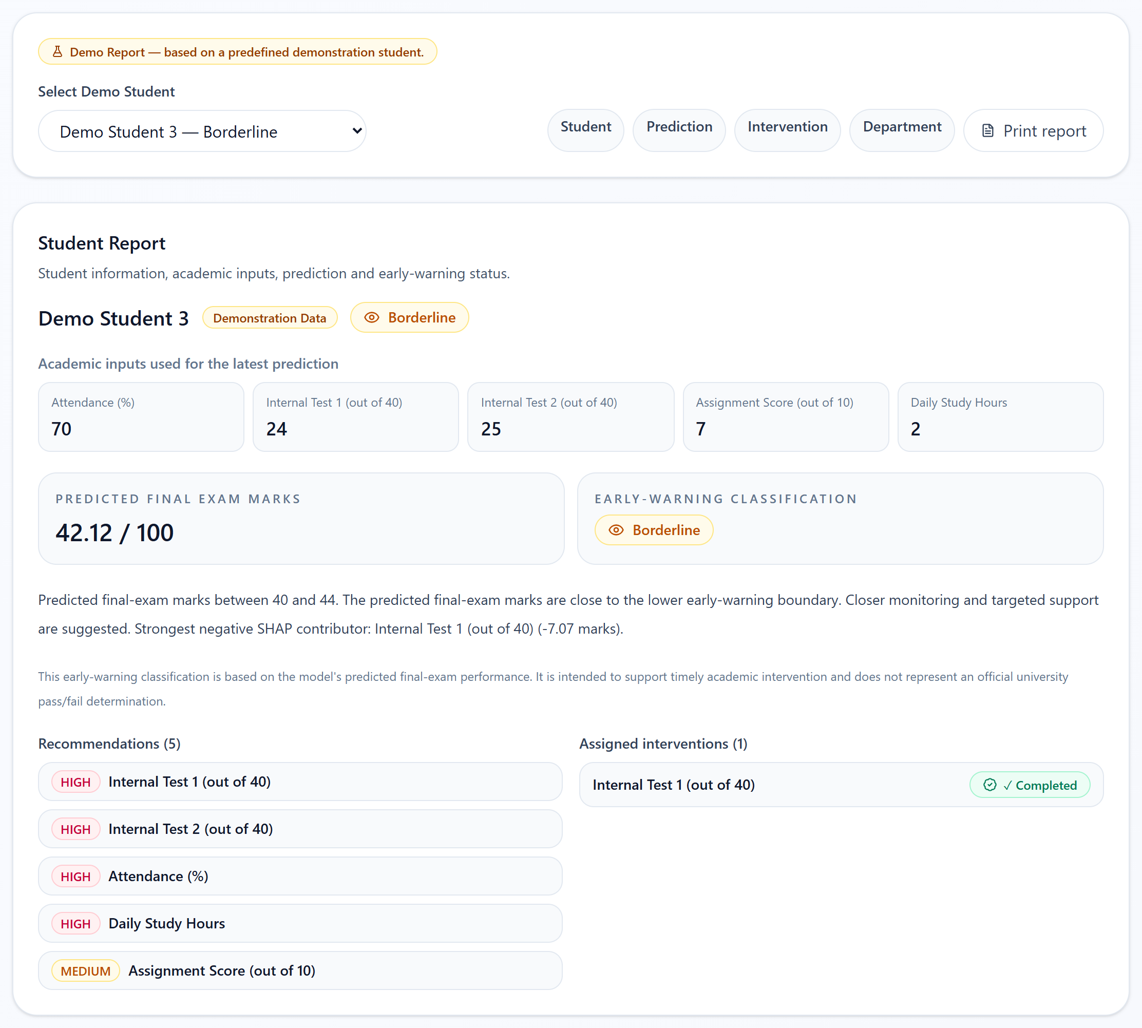
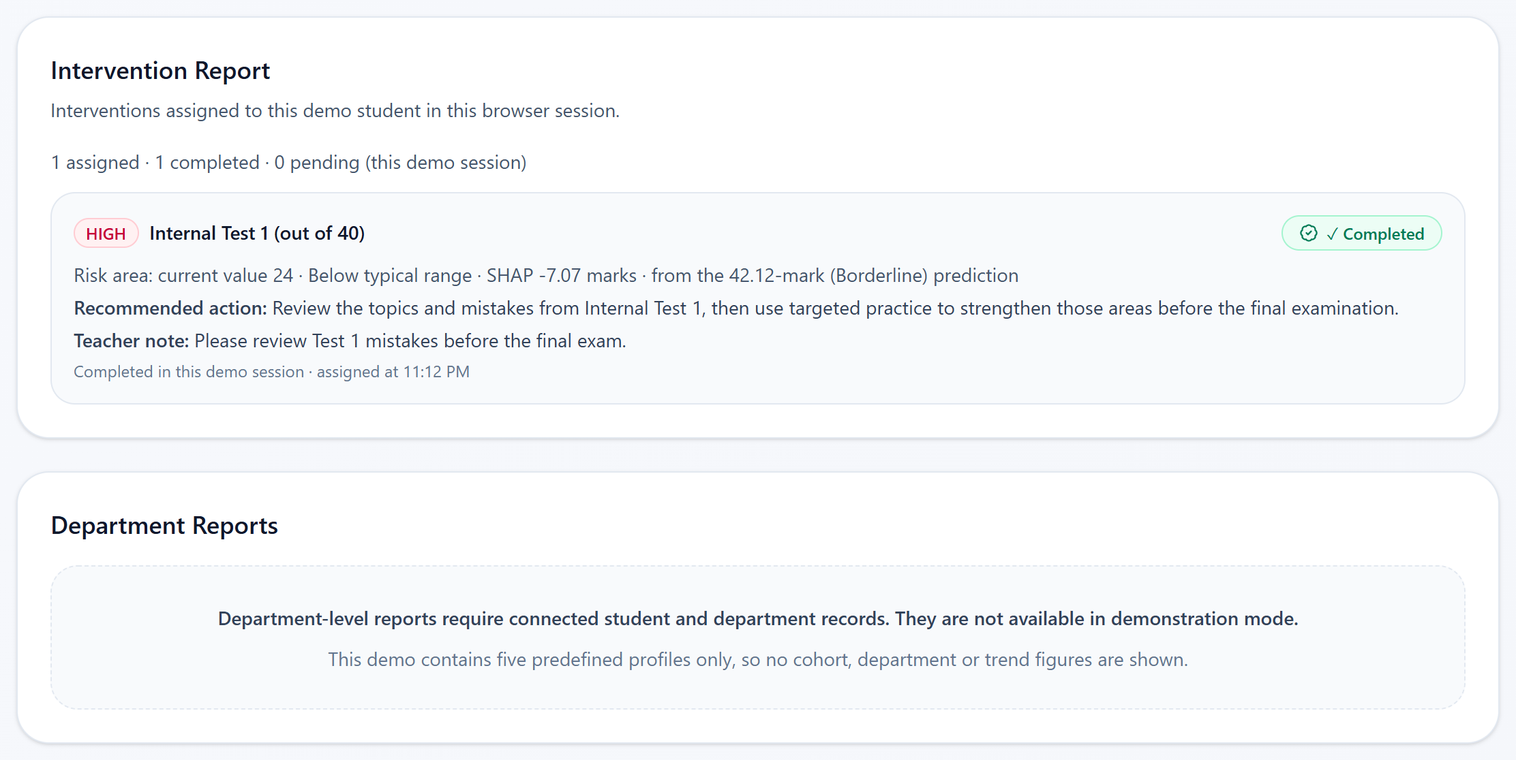
REPORTS
LIVE DEMO · predefined demo students
Consolidated demo reports from live results and session state
Intervention Report + Department Reports (unavailable by design)
Student Report
inputs, predicted marks, band, explanation, recommendations, interventions
Prediction Report
SHAP contributions, positive / risk contributors, recommendations
Intervention Report
priority, risk area, action, teacher note, status, assignment time
Department Report
unavailable — needs connected student and department records
Student Report — Demo Student 3
AI-Based Student Performance Prediction · Explainable AI · PBL Semester 5
17 / 21
Notes:
Reports bring the whole flow together for one demo student.
The Student Report shows the inputs, the predicted marks, the band and its explanation, the recommendations and any assigned interventions.
The Prediction Report shows the five SHAP contributions and the model's recommendations.
The Intervention Report shows what was assigned, why, its status and when it was assigned.
Everything here comes from the same live model results and the same session state — nothing is typed in or invented. If a student has not been predicted yet, the teacher can generate the report, which calls the same API.
The Department Report is deliberately unavailable, because we do not have department or cohort data, and I did not want to show fake charts.
Transition: here is exactly how I will demonstrate all of this live.

Slide 18
END-TO-END DEMONSTRATION
LIVE DEMO · predefined demo students
Live demo script
1
Select Demo Student 3
6
View recommendations
Student Portal → Dashboard
HIGH / MEDIUM / POSITIVE cards
2
View academic inputs
7
Assign intervention
70 · 24 · 25 · 7 · 2
Teacher Portal → Intervention Management
3
Generate prediction
8
Mark intervention completed
Prediction → Predict Performance
Student Portal → My Improvement Tasks
4
View early-warning status
9
Open Reports
42.12 marks → Borderline
Teacher Portal → Reports
5
Inspect SHAP explanation
10
View consolidated report
What contributed to this prediction?
Student · Prediction · Intervention
Optional: What-If (attendance 70 → 85) between steps 6 and 7. Before class: start the Flask backend and the frontend.
AI-Based Student Performance Prediction · Explainable AI · PBL Semester 5
18 / 21
Notes:
This slide is my live demo script. I will switch to the browser now.
One: in the Student Portal I select Demo Student 3. Two: these are the academic inputs — 70 attendance, 24 and 25 in the tests, 7 in assignments, 2 hours of study.
Three: I run the prediction. Four: the model predicts 42.12, which is Borderline.
Five: SHAP shows the two internal tests and attendance pulled the prediction down the most. Six: here are the recommendations those contributions produce.
If there is time, I open What-If and raise attendance to 85 to show the prediction change.
Seven: I switch to the Teacher Portal, Intervention Management, and assign the Internal Test 1 recommendation. Eight: back in the Student Portal, under My Improvement Tasks, I mark it completed.
Nine and ten: in Teacher Reports, the consolidated report shows the prediction, the explanation and the completed intervention.
Backup plan: if the backend is not running, the app shows "Prediction service unavailable" with a Retry button instead of fake numbers.

Slide 19
LIMITATIONS
The scope of the current prototype
Five predefined demo students
No persistent database
Session-based workflow
The live demo uses demonstration profiles, not real students.
Predictions and interventions live in browser session state.
A page refresh resets the demo.
No real university records
No department analytics
No historical trends
Training data is a project dataset of 2,000 records.
No department or cohort data exists, so none is shown.
No attendance or performance history over time.
No measured effectiveness
No institutional login
Early-warning recall
Intervention outcomes are not recorded.
No authentication or faculty accounts.
High Concern found 13 of 25 low scorers; thresholds not tuned.
AI-Based Student Performance Prediction · Explainable AI · PBL Semester 5
19 / 21
Notes:
I want to be open about the limitations, because they define the scope of this prototype.
The live demo uses five predefined demo students, and there is no database — everything is in the browser session, so a refresh resets it.
The model is trained on our project dataset, not on real university records.
Because there is no department or historical data, we do not show department analytics or trends — and we chose empty states instead of fake charts.
We do not measure intervention effectiveness, and there is no real login.
Finally, the early-warning bands are not perfect: High Concern found 13 of the 25 students who actually scored below 40. We report that rather than hide it.
Transition: these limitations also point directly to future work.

Slide 20
FUTURE SCOPE
NOT CURRENTLY IMPLEMENTED
Possible next steps
Database integration
Real student records
Persist predictions, interventions and reports.
With consent and proper data governance.
Institutional authentication
Historical tracking
Separate student, faculty and admin roles.
Performance and attendance over time.
Department-level analytics
Intervention outcomes
Cohort and department views once data exists.
Record results to study effectiveness.
Longitudinal evaluation
Institutional deployment
Re-validate the model and thresholds on new cohorts.
Hosting, monitoring and security review.
AI-Based Student Performance Prediction · Explainable AI · PBL Semester 5
20 / 21
Notes:
These are possible next steps, and I want to stress that none of them exist today.
The first is a database, so predictions and interventions persist. With consent and governance, the system could then use real student records, with proper login for students and faculty.
With history over time we could add trends and department analytics, and by recording intervention outcomes we could finally study whether interventions help.
We would also re-validate the model and the thresholds on new cohorts before any institutional deployment.
Transition: to conclude.

Slide 21
CONCLUSION
From prediction to explanation to action
Machine Learning
+
Early-Warning Rules
+
SHAP Explainability
+
Recommendations
+
Teacher Intervention Workflow
A validated regression model (MAE 3.62 marks, R² 0.8357) predicts final-exam marks; rules flag early-warning levels; SHAP explains each prediction; the explanation drives recommendations and a teacher workflow that ends in a report.
"From prediction to explanation to action."
Current system: demonstration prototype using predefined demo students
Tool references: Lundberg, S. M., & Lee, S.-I. (2017). A unified approach to interpreting model predictions. NeurIPS 30. · Pedregosa, F., et al. (2011). Scikit-learn: Machine learning in Python. JMLR 12, 2825–2830.
AI-Based Student Performance Prediction · Explainable AI · PBL Semester 5
21 / 21
Notes:
To conclude: our system combines machine learning, early-warning rules, SHAP explainability, recommendations and a teacher intervention workflow.
The regression model is validated with five-fold cross-validation — MAE 3.62 marks and R squared 0.8357. The rules turn predictions into early-warning levels, SHAP explains each prediction, and those explanations drive recommendations and a simple teacher workflow that ends in a report.
In short: from prediction, to explanation, to action.
And to be clear once more, this is a demonstration prototype using five predefined demo students.
The two references at the bottom are the SHAP paper and scikit-learn. Thank you — I am happy to take questions.

