Slide 1
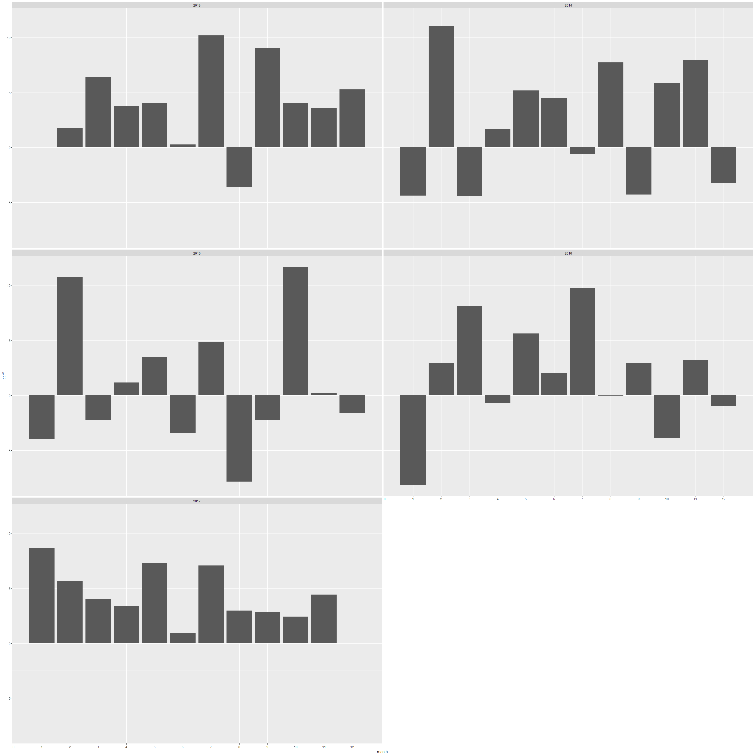
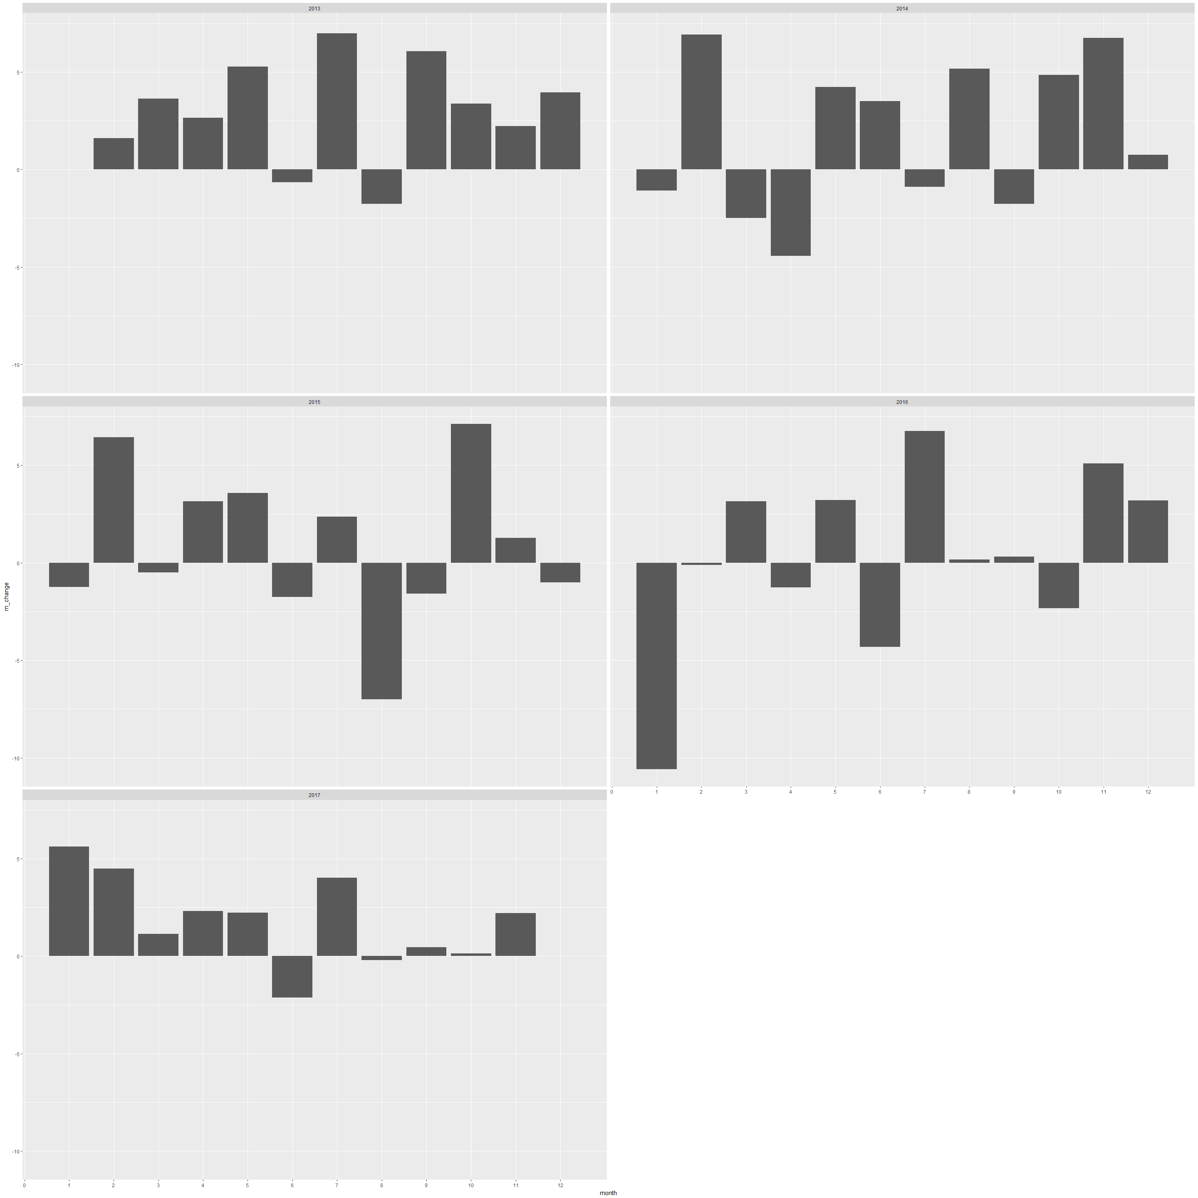
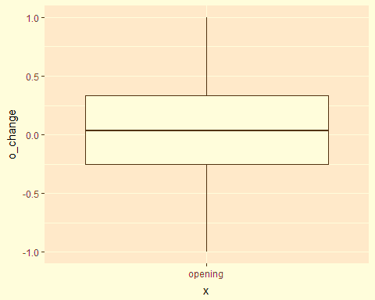
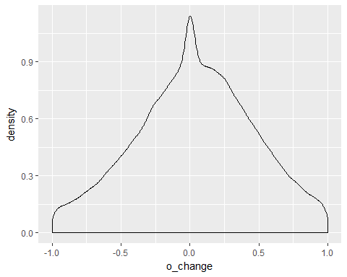
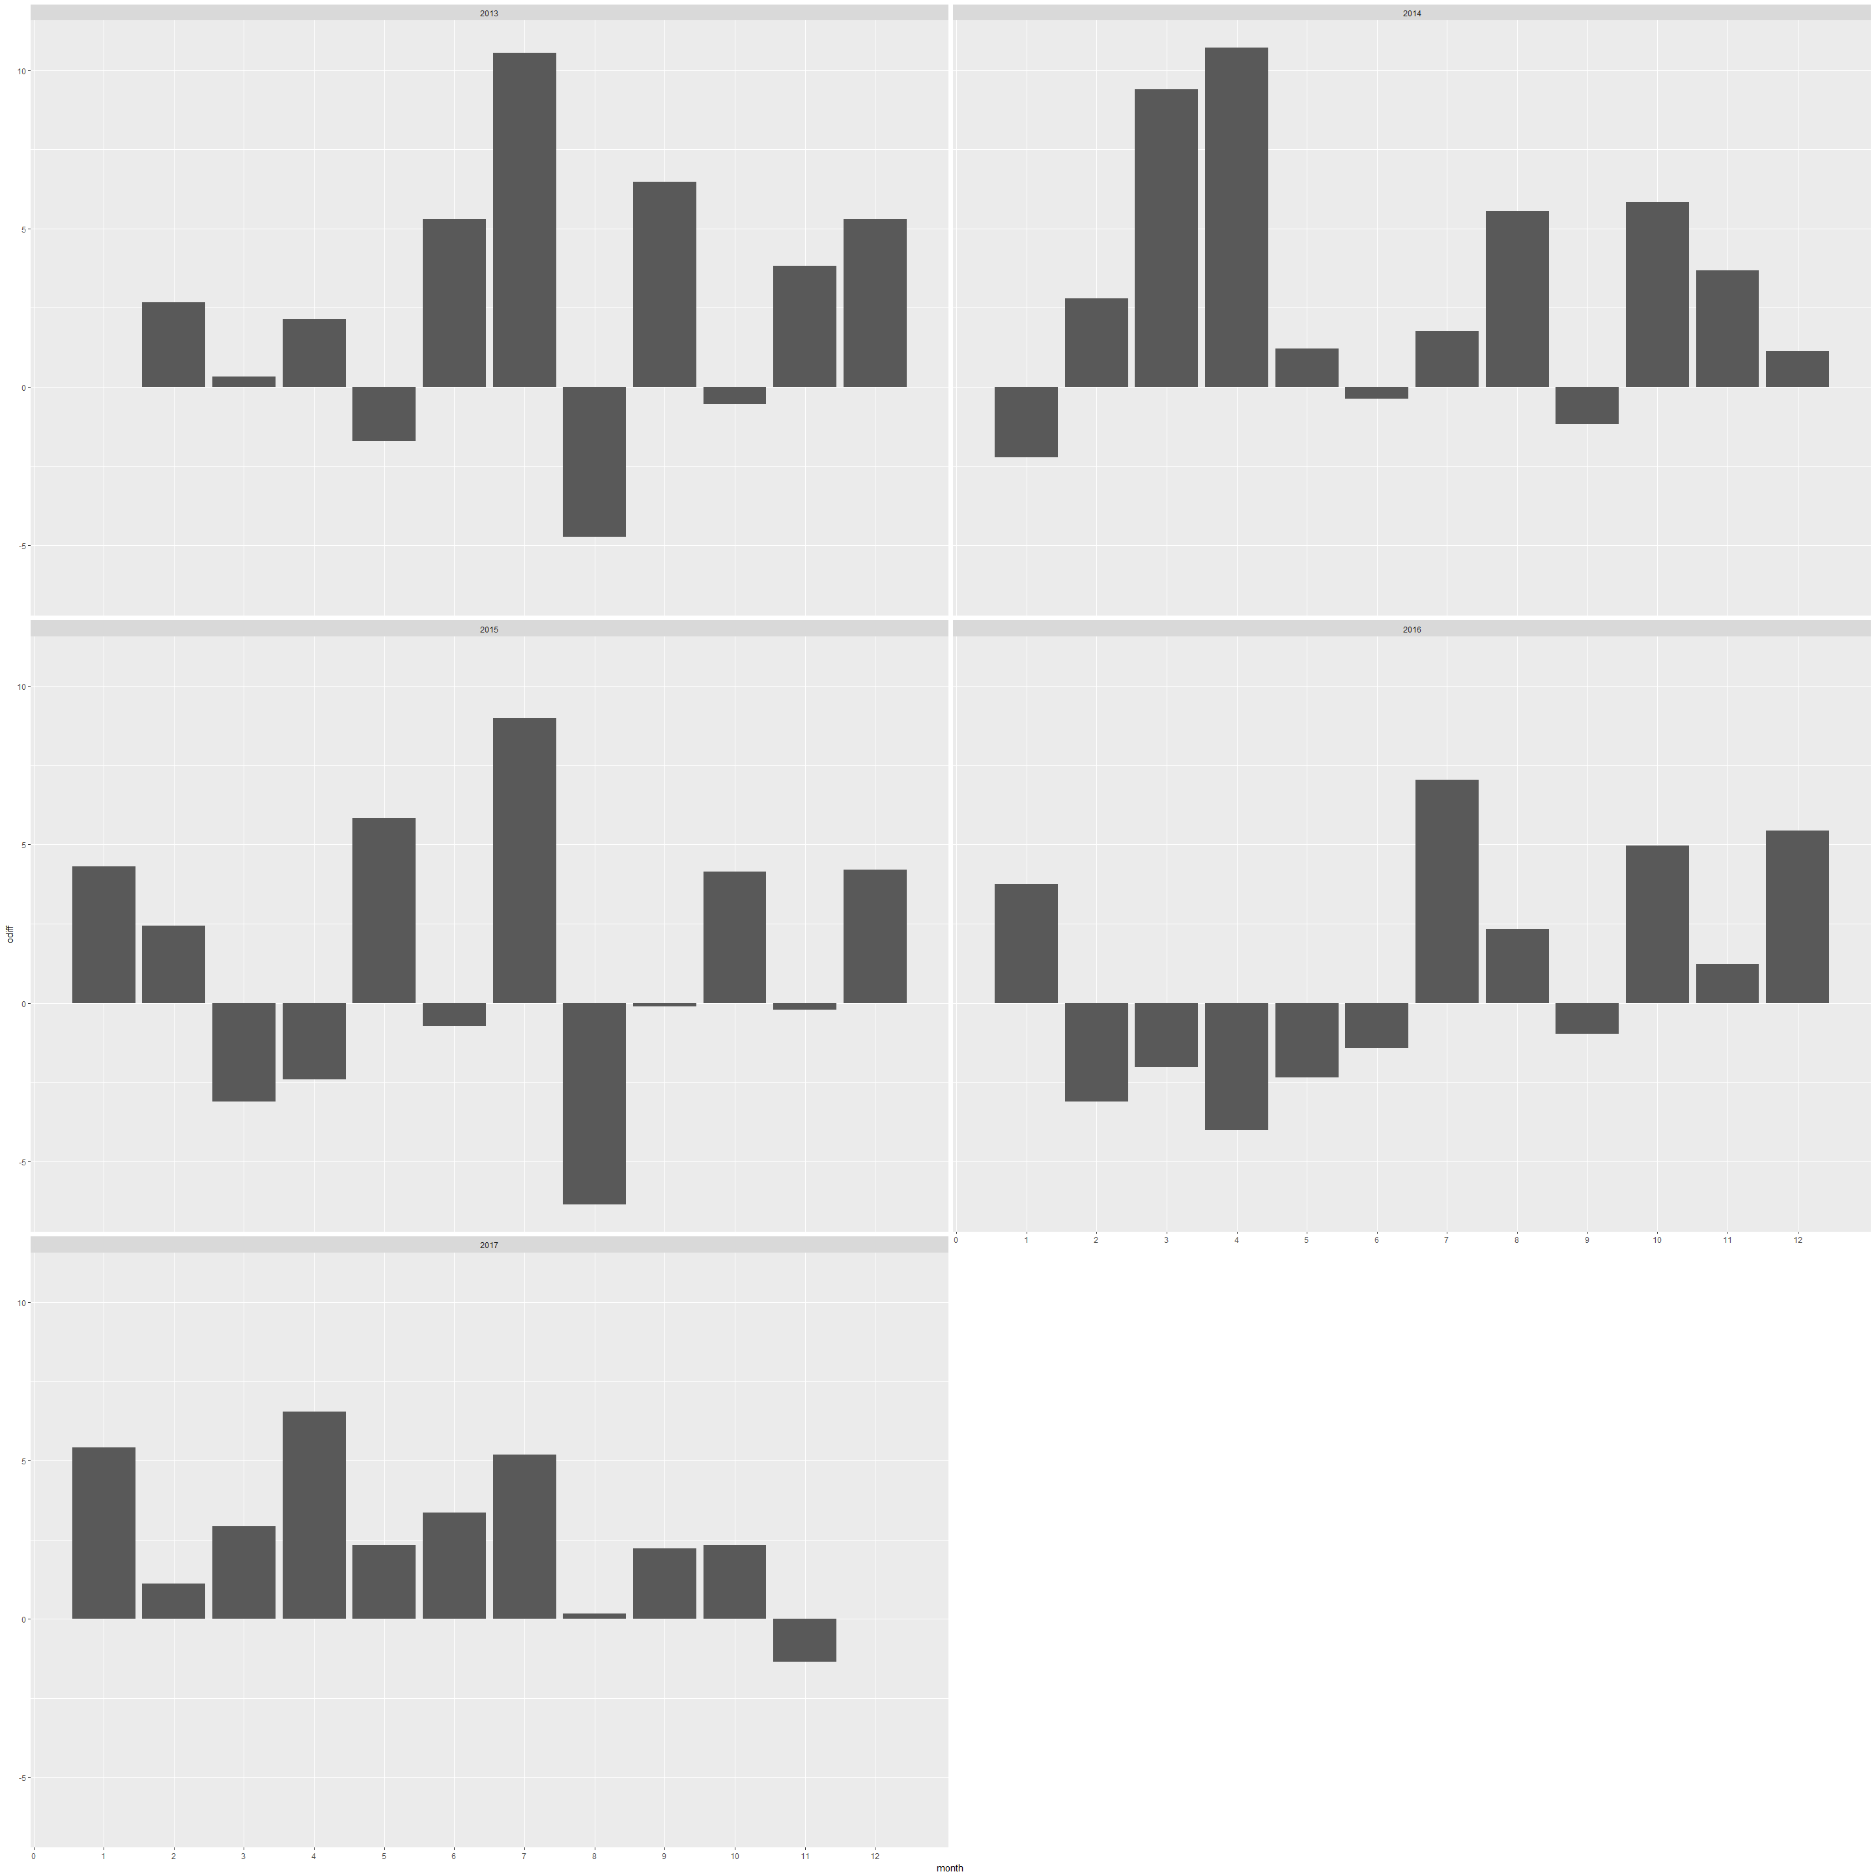
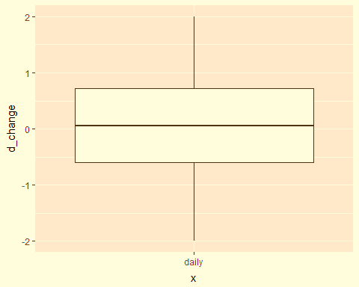
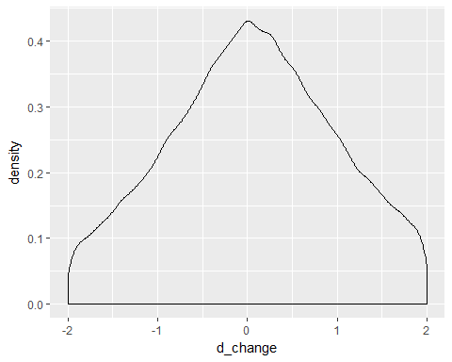
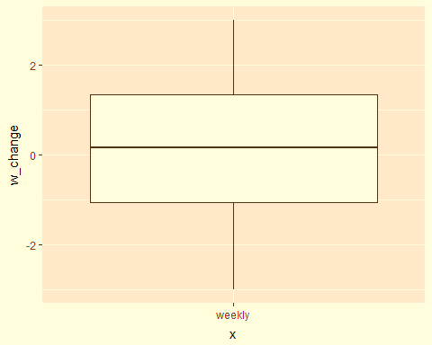
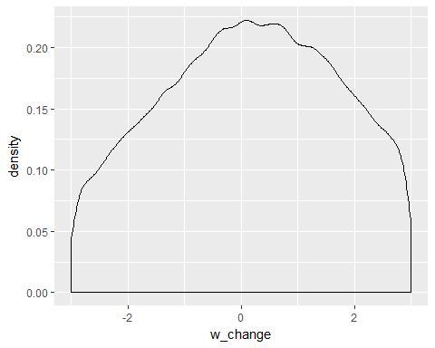
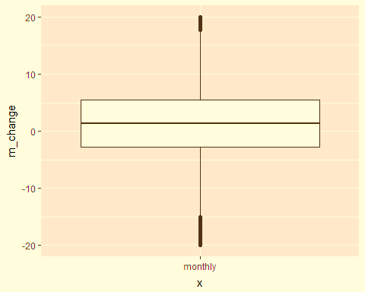
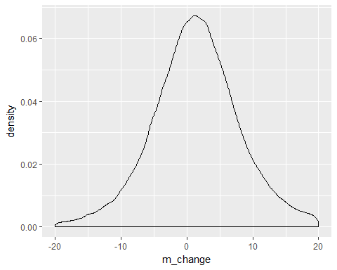


MONEYTALKS
Make Students Rich Again
Adriano Augusto and Grace Achenyo Okolo
MOTIVATION AND OBJECTIVES
PATTERNS IN THE STOCK PRICE MOVEMENT ACROSS 5 YEARS
DATA ANALYSIS
Identify patterns in the price movements of the stocks composing the NASDAQ-100 index.
Draw general advices for investors according to the patterns identified.
Analyse the relation between opening price and closing price in terms of % change.
Train and evaluate a classifier able to provide BUY or SELL advices for investors.
We made use of 107 Datasets (each of ~80KB, ~1300 entries, 7 features):
each dataset captures the historical price movement (on a 5 years basis) of one of the 107 stocks composing the NASDAQ-100 index.
Successively, we decided to analyse what is the average monthly return for the NASDAQ100. First, we considered the monthly return of each month per year per each listed company in the NASDAQ100, and we evaluated the average. Then, we plot such average and we analysed the results, as well the summary of the values.
This first series of plots show how many days the stock price closed in positive (>0.5) for a specific month, w.r.t. the number of days the stock price closed in negative (<-0.5).
A positive value X means that, for that month, there were X-days positive more than the negative days.
Overall, there are more positive days than negative.
Months having many positive days, are eventually followed by month with more negative days, and vice-versa.
This entails that the stock prices movements follow a cycle that repeats itself.
The summary shows that the average return over the last 5 years has been 1.5% monthly.
Despite some outliers (e.g. January 2016), we can say that across the last 5 years the NASDAQ100 had positive returns for majority of the month.
Also, positive returns are often followed by negative returns.
DATA EXPLORATION
We focus on the most important features: the opening change, the daily change, the weekly change and the monthly change. For each of these features we report their ranges below:
Stock Price Closed In Positive For Each Month
This is similar to the analysis of the previous, but we are focusing on the opening price change now. Indeed, the number of positive days reduce overall. A clear example is the year 2016, first semester. Considering the opening price, there were more negative days than positive. This means that most of the times for those months a stock price opening with a negative change, turned the negative change into positive over the day. This is a first step toward the analysis of the relation between the opening price change and the closing price change.
Average monthly return for the NASDAQ100
ADVICES FOR INVESTORS
Should I invest? Yes, NASDAQ100 showed to have positive returns across the 5 years, with an average of 1.5% monthly.
Short or long time investments? Buy and hold strategies are the most valuable.
When to buy? the best moment to buy is within negative periods.
When to sell? The later the better.
THE RESULTS OBTAINED FROM CLASSIFIER
Classifier gives advices of the type Buy, Hold or Sell at the beginning of the day, based on weekly return, monthly return and the change at the opening.
We train a tree and a random forest using the default parameters. Then perform the predictions on the test set, and we show the accuracy of both classifiers.
The accuracy for the tree classifier is 0.64, which is not enough for our requirements. However, the accuracy for the random forest is instead 0.97, which is very high and outperform the minimum requirement that we set at the beginning of the project, which was 0.75.
We designed for this project a Prediction Tool. Based on Opening, Weekly and Monthly Change of a stock in percentage as parameters, it gives advices of the type Buy, Hold or Sell .
Opening Change
Daily Change
Stock Price Opened In Positive For Each Month
Weekly Change
RELATION BETWEEN OPENING AND CLOSING PRICE CHANGE (%)
We first select the features opening change and closing change in terms of percentage, and we evaluate the correlation:
The correlation between the two features is 0.66.
The average distance between the two value is 1.06.
Monthly Change
https://github.com/nemo-91/moneytalks

