Slide 1
Database Management Systems
Unsorted and Sorted Sequential Files

Slide 2
Recap
Data should be stored on secondary storage devices such as hard disks or SSDs because
RAM is volatile
RAM has limited capacity compared to disks
Disks are slow compared to RAM
By changing the organization of data, we can speed up data access

Slide 3
Topics
Unsorted sequential files
Timing
Fetch
Delete
Update
Exhaustive read
Sorted sequential files
Timing
Fetch
Delete
Update
Exhaustive read

Slide 4
Sequential Files
Part one: Unsorted Sequential Files

Slide 5
Basic Definitions
Entity: Anything that we store some data about
Attribute: Any property that helps to identify an entity. Ex. Name, height, age
Data: Any value given to an attribute, Ex. ‘John’ for attribute Name
Record: A group of attribute values which uniquely identifies an entity.
Ex. For entity ‘student’, the record is
Student <Student ID, name, surname, major, year started, address, phone>
<201511777, John, Lewis , Computer Eng. , 2015, Dallas, 1234567 >

Slide 6
Basic Definitions
File: A set of related records.
Ex. Student file (Set of student records)
Hospital file (Set of patient records)
Exceptions: Text files and binary files

Slide 7
Sequential Files
Definition: A file which is read from beginning to end.
Types:
Unsorted sequential files (Pile files): A set of records with no order
Sorted sequential files : The records are sorted in the order of an attribute

Slide 8
File Header
Header is part of the file which includes data like:
Record size
Block size
Number and type of indexes
Address of the last block
Header is read into memory when the file is opened

Slide 9
Sequential File Operations and Timings
Fetch one record T_{F}
Fetch next record T_{N}
Insert a record T_{I}
Update a record T_{U}
Delete a record T_{D}
Exhaustive reading of the file T_{X}
Re-Organize a file T_{Y}

Slide 10
Fetch One Record
Find and read a record given an attribute value.
Ex. Find student record with Student ID=201612345
In a pile file on average half of the blocks are read
T_{F} = s + r + b/2*ebt
b: number of blocks in the file

Slide 11
Example
Find T_{F} given:
Total number of records = 100,000
Number of blocks (b) = 16667 (Bfr = 6)
ebt = 0.84 msec
s=16msec
r=8.3msec

Slide 12
Fetch Next Record
Find and read the next record in order of an attribute value.
If the file is not sorted T_{N} = T_{F} (Each fetch is independent)

Slide 13
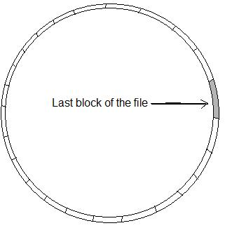
Insert a New Record
Insert is always done at the last block
Time to read the last block = s + r + btt
Time to write back the block = 2r
T_{I} = s + r + btt + 2r

Slide 14
Update a Record
To update, first the block is read, then the record is updated and the block is written back
Time to read the block = s + r + b/2*ebt = T_{F}
Time to write back the block = 2r
T_{U} = T_{F} + 2r

Slide 15
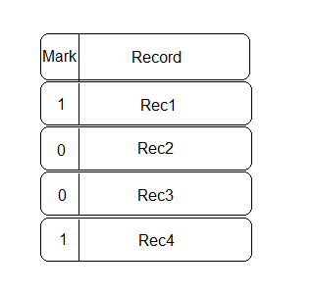
Delete a Record
To delete a record, we mark it as deleted
First read the block (s + r + b/2*ebt )
Update the mark and write the block (2r)
T_{D} = T_{F} + 2r

Slide 16
Exhaustive Reading of a File
Case 1: Read records without any attribute order
T_{X} (Beginning to End) = b*ebt + s + r
Ex:
b = 16667
ebt = 0.84 msec
s=16 msec
r=8.3 msec

Slide 17
Example
Assume a hospital file records include illness, and duration of stay in hospital too. To find the average duration of stay in hospital for each illness, an exhaustive reading of the file without any attribute order is used

Slide 18
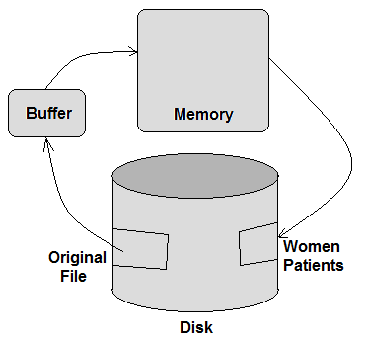
Example
Write records of the hospital file which show a female patient in a new file. An exhaustive reading without any attribute order is used here too.

Slide 19
Exhaustive Reading of a File
Case 2: with the order of an attribute value
Tx = Number of records * T_{F}

Slide 20
Example
Find the time needed to read the hospital file with 100,000 records.
Assume
Bfr = 10
ebt = 0.84 msec
s=16 msec
r=8.3 msec

Slide 21
Solution
Case 1: Without any attribute order
Tx = b*ebt + s + r
b = 100,000 /10 = 10,000 (number of blocks, Bfr is 10)
Tx = 10,000 * 0.84 + 16 + 8.3 = 8.424 s

Slide 22
Solution
Case 2: with the order of an attribute
Tx = 100,000 * T_{F}
Assume T_{F} = 7000 ms
About 8 days

Slide 23
Re-Organizing a File
In delete operation records are not physically deleted from the file.
Operations in a file with many marked records are slow
In re-organizing a file, marked records are deleted physically by copying active records to a new file.
Old file is deleted

Slide 24
Re-organizing files
Time to read the file= s + r + b*ebt
Time to write active records=s+r+(n/Bfr)*ebt
(n is the number of active records)
T_{Y} = s+r+b*ebt + s+r+(n/Bfr)*ebt
If two disks are available then
Read from disk one and write to disk two at the same time
T_{Y} = s+r+b*ebt

Slide 25
Sorted Sequential Files

Slide 26
Definitions
Sorted Sequential Files: A sequential file which is sorted according to the value of an attribute. (This attribute is also called key)
Ex. The student file is sorted by “student ID” attribute.
The main operation in a sorted sequential file is exhaustive read (same as pile files)

Slide 27
Why Sorting?
Remembering from pile files, exhaustive reading of a sequential file in order of an attribute needs
n*T_{F} Seconds. (Several days in hospital file example)
If we sort the file, the exhaustive read will need only a few seconds (14 seconds in hospital file example)
In a sorted file (or list) search is much faster.

Slide 28
Advantage of Sorted Sequential Files
Instead of exhaustive (sequential) search, much faster search algorithms such as:
Binary search
Interpolation search
Can be used

Slide 29
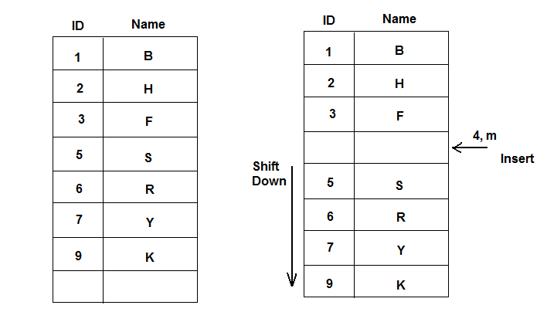
Disadvantage of Sorting (1)
New insertions are expensive

Slide 30
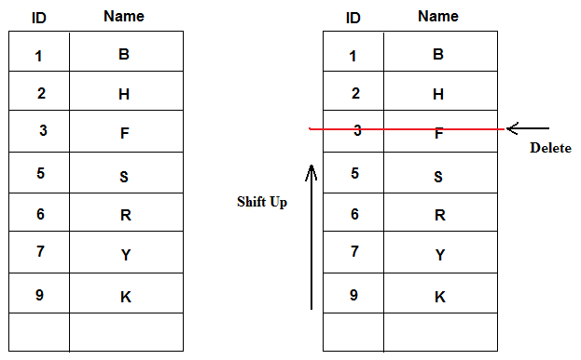
Disadvantage of Sorting (2)
Delete operation is expensive

Slide 31
Search Algorithms
Sequential Search
Start from the first record
Read until either the record is found or end of the file is reached
On average half of the records are read

Slide 32
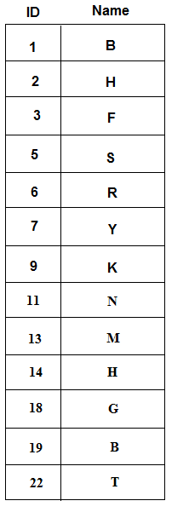
Sequential Search Example
Query 1: Find record with ID=3
3 comparisons
Query 2: Find record with ID=18
11 comparisons
Query 3: Find record with ID=9
7 comparisons
On average for each query N/2 comparisons are needed (N is the number of records)

Slide 33
Search Algorithms
Binary search
Define two boundaries (up and Down) for the search area
Find the middle of the search area: mid=(Up+Down)/2
If the record at position “mid” has an attribute greater than key then search in the first half
(Down = mid)
Else search the second half (Up=mid)
Repeat until the record is found or Up==Down
With Log₂n read, the record is found (worst case)

Slide 34
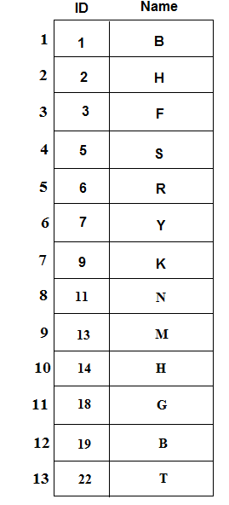
Binary Search Example
Find record with ID = 5
Up = 1, Down = 13, Mid=(1+13)/2 = 7
Record[7].ID = 9 > 5 Then
Down = Mid = 7
Mid = (1+7)/2 =4
Record[4].ID = 5 (found)

Slide 35
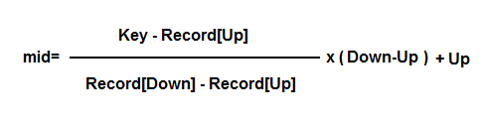
Interpolation Search
If the key value is closer to the record value at Up(or Down) then mid is selected closer to Up(or Down)
Record[Up] means the attribute value at position Up, Up and Down are index or position at the data file

Slide 36
Example
Find record with ID = 2
Interpolation Search
Up = 1, Down = 13
Record[Up].ID = 1
Record[Down].ID=22
Mid = (2-1)/(22-1)*(13-1)+1
Mid = 1.57 (rounded to 2)
Record found
Binary Search
Up=1, Down = 13
Mid = 7
Record[Mid] =9> 2 Then
Down = Mid = 7
Mid = (1+7)/2 = 4
Record[Mid] = 5> 2 Then
Down = Mid = 5
Mid = (1+5)/2 = 3
Record[Mid] = 3>2 Then
Down = Mid = 3
Mid = (3+1)/2 = 2
Record[Mid] = 2
Found

Slide 37
Sorted sequential file operations

Slide 38
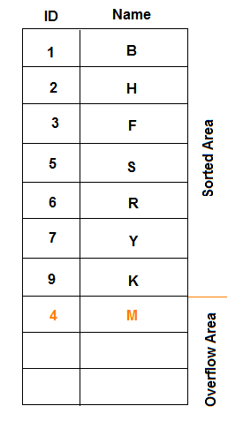
Insertion in Sorted Sequential Files
An overflow area is defined at the end of the file with unsorted records.

Slide 39
Sequential File Operations and Timings
Fetch one record T_{F}
Fetch next record T_{N}
Insert a record T_{I}
Update a record T_{U}
Delete a record T_{D}
Exhaustive reading of the file T_{X}
Re-Organize a file T_{Y}

Slide 40
Fetch One Record
Find and read a record given an attribute value. Ex. File student record with Student ID=200612345
In a sorted sequential file, using binary search Log₂n blocks are read
If overflow area is empty then
T_{F} = (s + r + btt ) * Log₂n
n: number of records in the file

Slide 41
Example
Find T_{F} given:
Total number of records (n) = 100,000
btt = 0.8 msec
s=16msec
r=8.3msec

Slide 42
Fetch One Record
If y blocks are in sorted area and x blocks in overflow area then
(y/b) * (Log₂y * (s+r+btt)) + (x/b) * (x/2*ebt+s+r)
y/b : probability of having the record in sorted area
x/b: probability of having the record in overflow area

Slide 43
Example
Find T_{F} given:
Total number of blocks (b) = 16,667
15,000 blocks in sorted area
1,667 blocks in overflow area
btt = 0.8 msec
s=16msec
r=8.3msec
ebt=0.84

Slide 44
Insert a Record
Insert is always done at the overflow area
Read the last block of the overflow area (s+r+btt)
Add the new record and write back the block (2r)
T_{I} = s+r+btt+2r

Slide 45
Update a Record
To update, first the block is read, then the record is updated and the block is written back
Time to read the block = T_{F}
Time to write back the block = 2r
T_{U} = T_{F} + 2r

Slide 46
Delete a Record
To delete a record, we mark it as deleted
First read the block T_{F}
Update the mark and write the block (2r)
T_{D} = T_{F} + 2r

Slide 47
Questions?

