Slide 1
Database Management Systems
Queries and Relational Algebra

Slide 2
Topics
Definitions
Queries and Query Types
Query Languages
Relational Algebra
Relational Algebra Procedures
Union, Intersection, Difference
Renaming
Selection
Projection
Join (natural join, outer join, equi join)

Slide 3
Operations on Databases
Operations on databases:
Read queries: read data from the database
Update queries: change the content of the database
Mathematical foundations of these operations can be studied with “Relational Algebra”

Slide 4
Queries and Query Languages
Query is a set of operations that take one or some relations (database) as input and return one or some relations (database) as output.
Query languages are used for writing queries for databases

Slide 5
Relational Algebra
A collection of operators that
are defined on relations
produce relations as results
and therefore can be combined to form complex expressions
Operators
union, intersection, difference
renaming
selection
projection
join (natural join, outer join, equi join)

Slide 6
Union, Intersection, and Difference
Relations are sets, so we can apply set operators
However, we want the results to be relations
Therefore: it is meaningful to apply union, intersection, difference only to relations defined over the same attributes (relations that have the same schema)

Slide 7
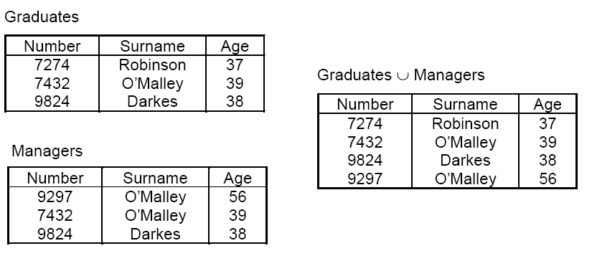
Union

Slide 8
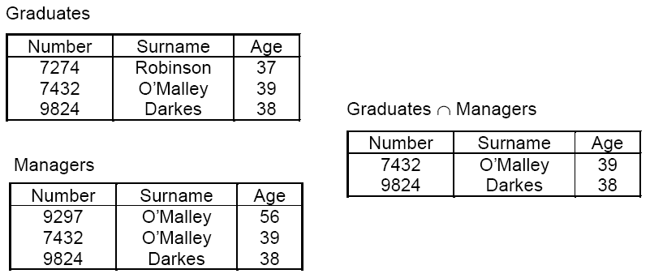
Intersection

Slide 9
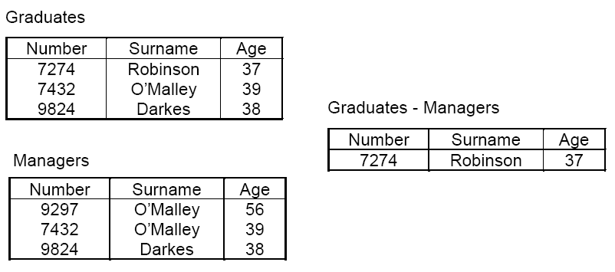
Difference

Slide 10
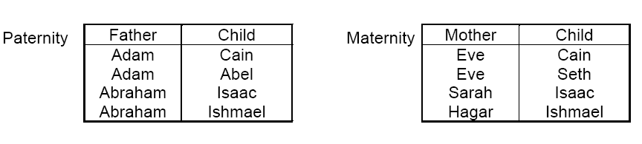
A meaningful but Impossible Union
Paternity Maternity = ??
the problem: Father and Mother are different attribute names, but both represent a "Parent"
the solution: rename the attributes

Slide 11
Renaming
unary operator
changes attribute names without changing values
notation: ρ _{y← x} (r)
Example: : ρ _{parent← father} (Paternity)
Two or more attributes can be renamed with one expression
Example: ρ _{Location, Pay← Branch, Salary} (Employee)

Slide 12
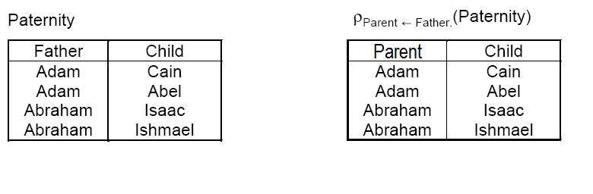
Renaming Example

Slide 13
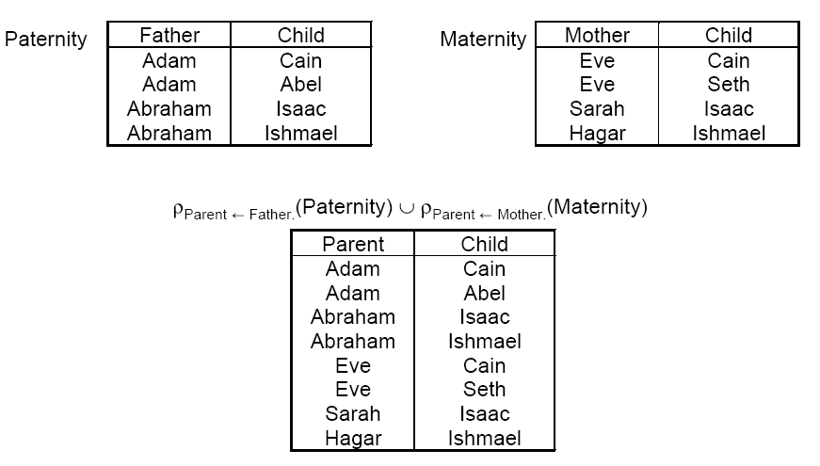
Renaming and Union

Slide 14
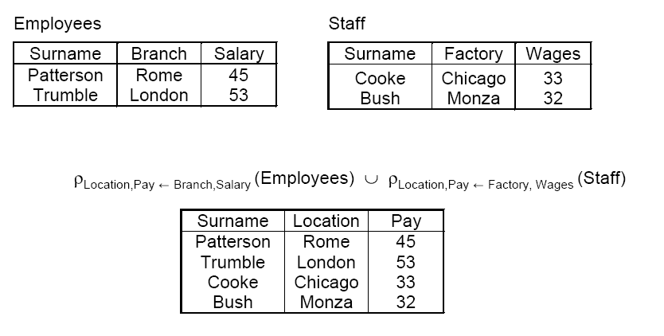
Renaming and Union with More Attributes

Slide 15
Selection
Selection operation produces a relation with the same schema as its operand.
The resulted (output) relation is a subset of the operand (input) relation.
Notation: σ_{F} (r)
r is the relation
F is the condition

Slide 16
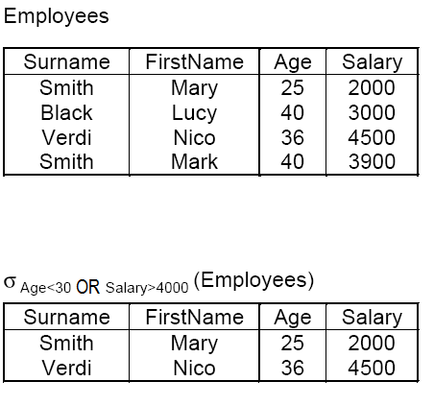
Selection Example 1

Slide 17
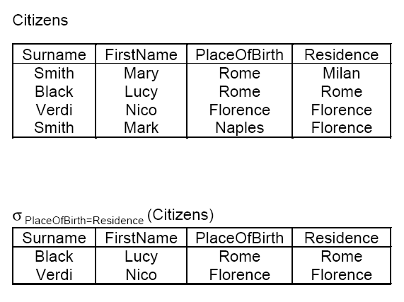
Selection Example 2

Slide 18
Projection
Projection operation produces a relation with a sub-set of the attributes of its operand
All tuples from the operand will be in the resulted relation
Notation: π_{Y}(r)
r is a relation
Y is the list of selected attributes

Slide 19
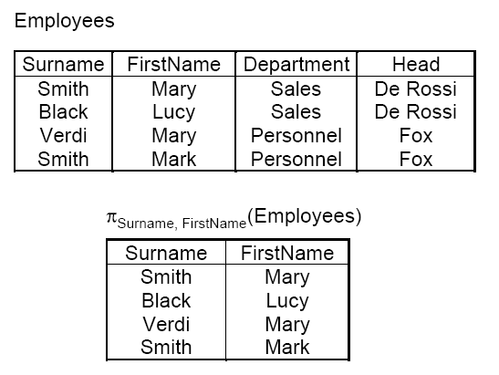
Projection Example 1

Slide 20
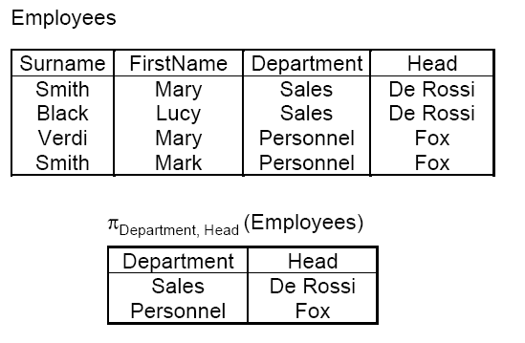
Projection Example 2

Slide 21
Cardinality of Projection
The result of a projection contains at most as many tuples as the operand
It can contain fewer tuples, if some tuples are the same.
π_{Y}(r) contains as many tuples as r if and only if Y is a key for r

Slide 22
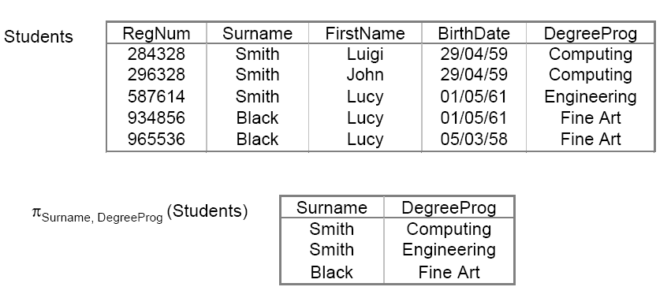
Cardinality of Projection: Example

Slide 23

Join
Join operation uses the connection between the relations to combine (join) them.
Notation

Slide 24
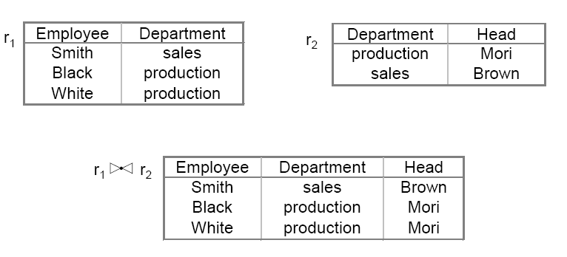
Natural Join
Joins two tuples of relations r1 and r2 if the values of attributes with the same name are equal.

Slide 25
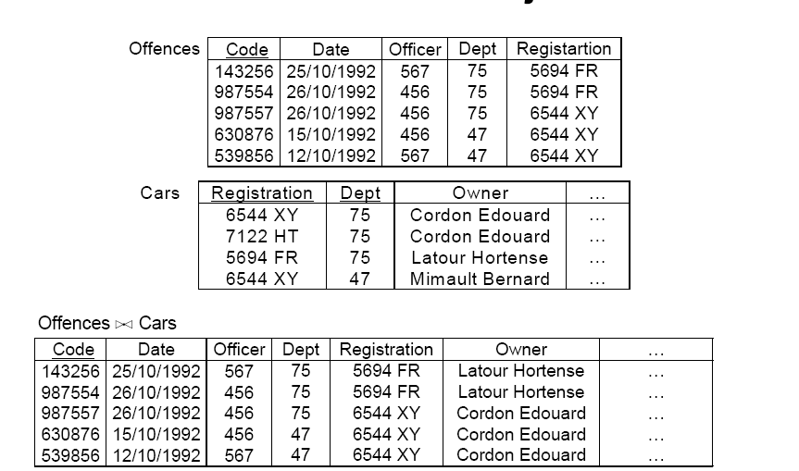
Natural Join Example 1

Slide 26
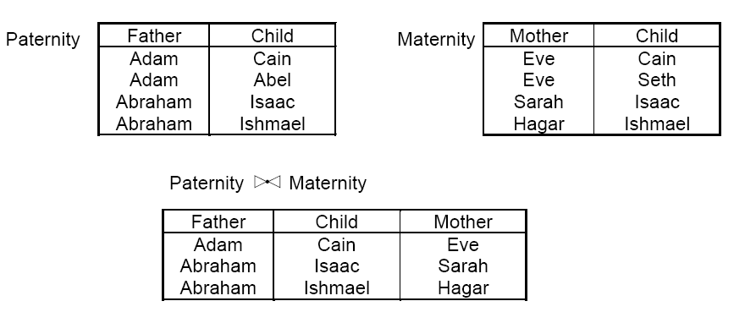
Natural Join Example 2

Slide 27
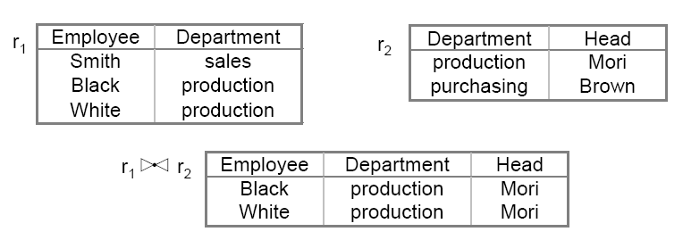
Incomplete Natural Join
Some tuples from the first relation may have no match in the second relation. Natural join will be incomplete in this case.

Slide 28
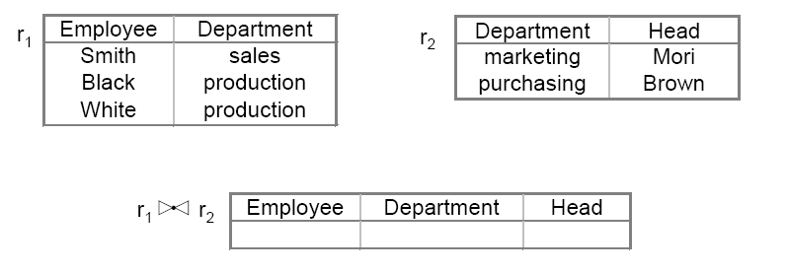
Empty Natural Join
If no tuple of the first relation matches a tuple from the second relation, the natural join will be empty.

Slide 29
Outer Join
If no match is found for a tuple, we can join it with a null tuple. This is called outer join.
Left outer join: the null tuple is from the second relation
Right outer join: the null tuple is from the first relation
Full outer join: the null tuple can be from either the first or the second relation

Slide 30
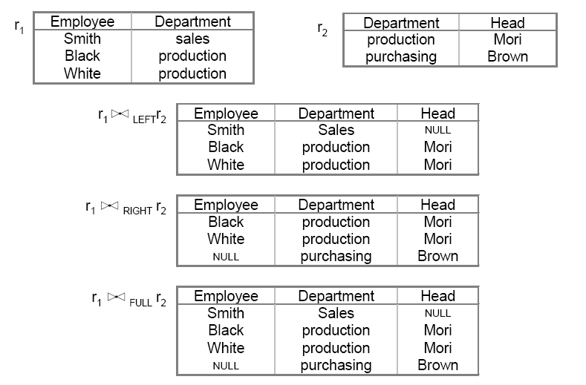
Outer Join Example

Slide 31
Equi Join
Equi join, combines tuples using attributes with different names if they have equal values
Notation: r1 _{x=y} r2
(x is an attribute from r1 and y an attribute from r2)

Slide 32
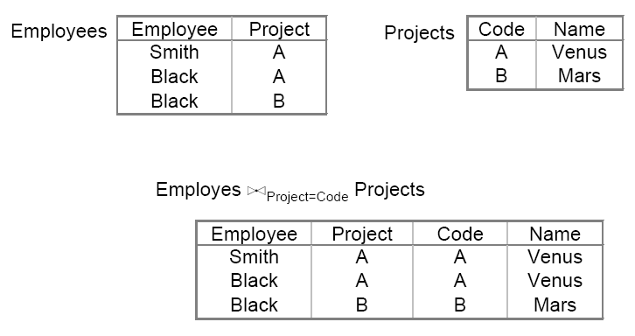
Equi Join Example

Slide 33
Queries using Relational Algebra
Queries can be written using relational algebra operations
Example: Find the numbers, names and ages of employees earning more than 40 thousand

Slide 34
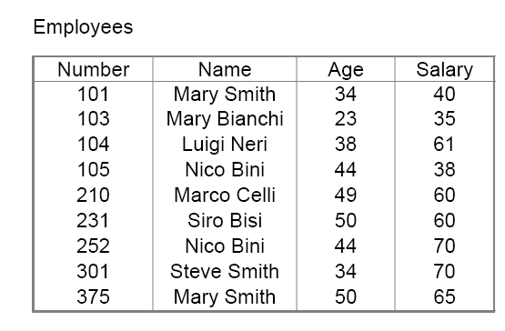
Query Example 1
Data Table:

Slide 35
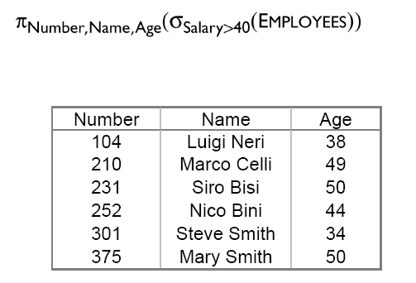
Query Example

Slide 36
Summary
Queries are used to read or update data in a database
Queries can be expressed using Relational Algebra Procedures
The most important operations in relational algebra are
Union, Intersection, Difference, Renaming
Selection, Projection, Join (natural join, outer join, equi join)

Slide 37
Questions?

