Slide 1
Database Management Systems
SQL Query Language (1)

Slide 2
Topics
Introduction
SQL History
Domain Definition
Elementary Domains
User-defined Domains
Creating Tables
Constraint Definition
INSERT Query
SELECT Query
Attribute Expressions
Logical Expressions in Queries

Slide 3
SQL
SQL stands for Structured Query Language
First proposed by IBM Research 1974
First implementation SQL/DS, IBM 1981
Most DBMS systems support base functionality but add some new properties

Slide 4
Domains
Domains specify the content type of attributes
e.g. Attribute “Employee name” gets its value from the domain of strings (Each name is a string)
Two categories of domains are:
Elementary (predefined by the standard)
User-defined

Slide 5
Elementary Domains - Character
Character domain is used with single character or string attributes
Strings may have variable length
Syntax:
character or char to define single character attributes
character (n) or char (n) defines a fixed length string
character varying or varchar defines a variable length string

Slide 6
Elementary Domains – Exact Values
Exact numeric domains are used with exact values, integer, or numbers with a fractional part
Four types are:
numeric [ ( Precision [, Scale ] ) ] where precision is the total number of digits and scale is the number of digits after decimal point
e.g. numeric (5,2) shows numbers like 455.12
decimal [ ( Precision [, Scale ] ) ] (same as numeric)
integer
smallint

Slide 7
Elementary Domains – Real Values
Real Value Domains are used for non-exact numeric values
Real value domains are based on a floating point representation
Three types available
float [ ( Precision ) ] e.g. float(6) (total number of digits is 6)
double precision (two times the precision of float)
real

Slide 8
Elementary Domains – Date, Time, and Intervals
Date and Time are used for temporal instant attributes
e.g. Date (stores day, month and year values)
A date value is given as
MM/DD/YY or MM/DD/YYYY in USA
YY.MM.DD or YYYY.MM.DD in ANSI (and more..)
Time ( stores hour, minute, and second values)
Time value is given as hh:mm:ss

Slide 9
Intervals
Temporal Interval domains are defined by
Interval First To Last
e.g. Interval 1990 To 1999 (year)
Interval 1985.1 To 2009.10 (year and month)
Interval 11:20:10 To 12:25:40 (hour, minute and second)

Slide 10
User-defined Domains
A user-defined domain is given by
name
elementary domain
default value
Syntax:
create domain DomainName as elementaryDomain
[ default DefaultValue ]
e.g. create domain StudentName as char(30)
e.g. create domain money as numeric(19,2) default 0

Slide 11
Table Definition
An SQL table consists of
an ordered set of attributes
an optional set of constraints
create table statement
defines a relation schema
creates an empty table

Slide 12
Create Table
Syntax:
create table TableName
(
AttributeName₁ Domain [ DefaultValue ] [ Constraints ],
AttributeName₂ Domain [ DefaultValue ] [ Constraints ] ,
…
AttributeName_{n} Domain [ DefaultValue ] [ Constraints ]
[ Other Constraints ]
)

Slide 13
Example
create table Employee
(
RegNo character(6) primary key,
FirstName character(20) not null,
Surname character(20) not null,
Dept character (15)
)

Slide 14
Primary Key Constraint
Primary key constraint is defined by primary key keyword as
After defining the attribute in the table (as a constraint)
At the end of create table statement. This method is used when primary key has more than one attribute in it.

Slide 15
Example 1
CREATE TABLE Persons ( P_Id integer PRIMARY KEY, LastName varchar NOT NULL, FirstName varchar, Address varchar, City varchar )

Slide 16
Example 2
CREATE TABLE Persons ( P_Id integer NOT NULL, LastName varchar(255) NOT NULL, FirstName varchar(255), Address varchar(255), City varchar(255), PRIMARY KEY (P_Id,LastName) )

Slide 17
Uniqueness Constraint
We may define an attribute or a group of attributes as unique. This constraint will not allow repeated values for that attribute(s)
Syntax
Use unique after defining the attribute
Use unique( attribute_name ) at the end of table definition.

Slide 18
Example
create table Employee
(
RegNo character(6) primary key,
FirstName character(20) not null,
Surname character(20) not null,
Dept character (15)
Salary numeric(9) default 0,
City character(15),
unique(Surname, FirstName)
)

Slide 19
Foreign Key Constraint
Foreign keys are defined using references keyword
Syntax references External_Table( Attribute)

Slide 20
Example
create table Employee
(
RegNo character(6) primary key,
FirstName character(20) not null,
Surname character(20) not null,
Dept character (15)
references Department(DeptName),
Salary numeric(9) default 0,
City character(15),
unique(Surname,FirstName)
)

Slide 21
NULL Constraint
An attribute can be defined to always have a value using not null constraint
e.g.
FirstName character(20) not null,
Surname character(20) not null unique,

Slide 22
INSERT Query
INSERT is used to add a record ( tuple ) to the table.
Syntax
Insert Into table_name [( Attributes) ]
values (list of values )
e.g.
insert into Department(DeptName, City)
values(‘Production’,’Atlanta’)

Slide 23
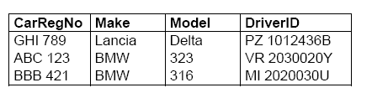
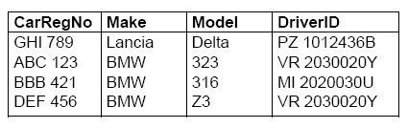
Example
Car:
Insert into Car (CarRegNo, Make, Model, DriverID)
Values ( ‘DEF 456’, ‘BMW’, ‘Z3’, ‘VR 2030020Y’ )
Car:

Slide 24
INSERT Query Properties
The ordering of the attributes (if present) and of values is important (first value with the first attribute, and so on)
If AttributeList is omitted, all the relation attributes are considered, in the order in which they appear in the table definition
If AttributeList does not contain all the relation attributes, to the remaining attributes it is assigned the default value (if defined) or the null value

Slide 25
SELECT Query
Select is used for retrieving records from tables
The simplest form of Select query is:
SELECT attribute_list
FROM Table_name
WHERE Condition
Condition eliminates some of the records from the list.

Slide 26
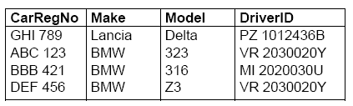
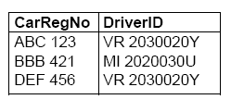
Example
SELECT CarRegNo, DriverID
FROM Car
WHERE Make = ‘BMW’

Slide 27
Selecting All Attributes
To select all attributes we can use * in place of the attribute list
SELECT *
FROM table_name
WHERE condition
SELECT * is the same as select operation defined in relational algebra

Slide 28
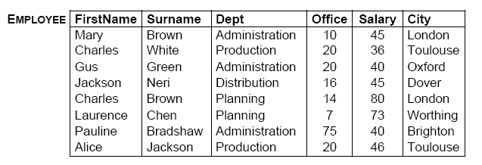
Example

Slide 29
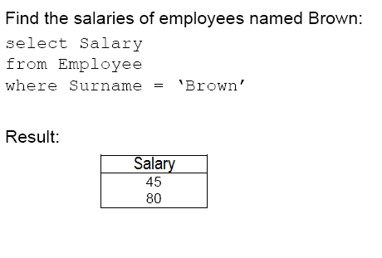
Example (Cont.)

Slide 30
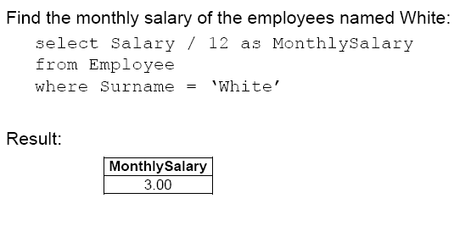
Attribute Expressions
Attributes can be written as expressions. In this case a name can be assigned to the resulted table attribute using as new_name.

Slide 31
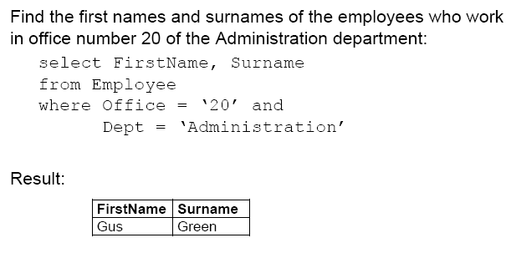
Logical Expressions in SELECT Query
The condition part of a select query can be written using logical expressions with AND, OR and NOT

Slide 32
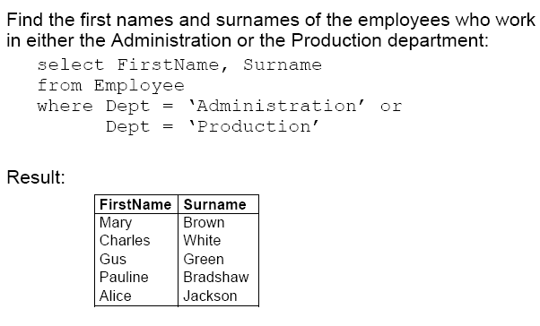
Example

Slide 33
Example
Find the names and surnames of all employees working in Administration department in London and earning more than 45, or working in Production department in Oxford and earning less than 30.

Slide 34
Solution
SELECT Name, Surname
FROM Employee
WHERE (Dept=‘Administration’ AND City =‘London’
AND Salary > 45 )
OR
(Dept=‘Production’ AND City =‘Oxford’
AND Salary < 30 )

Slide 35
Summary
SQL query language is designed to write queries in relational databases
Each attribute is defined by using a domain
CREATE TABLE is used to create a new table
INSERT is used to add records to a table
SELECT is used to retrieve data from a table

Slide 36
Questions?

