Slide 1
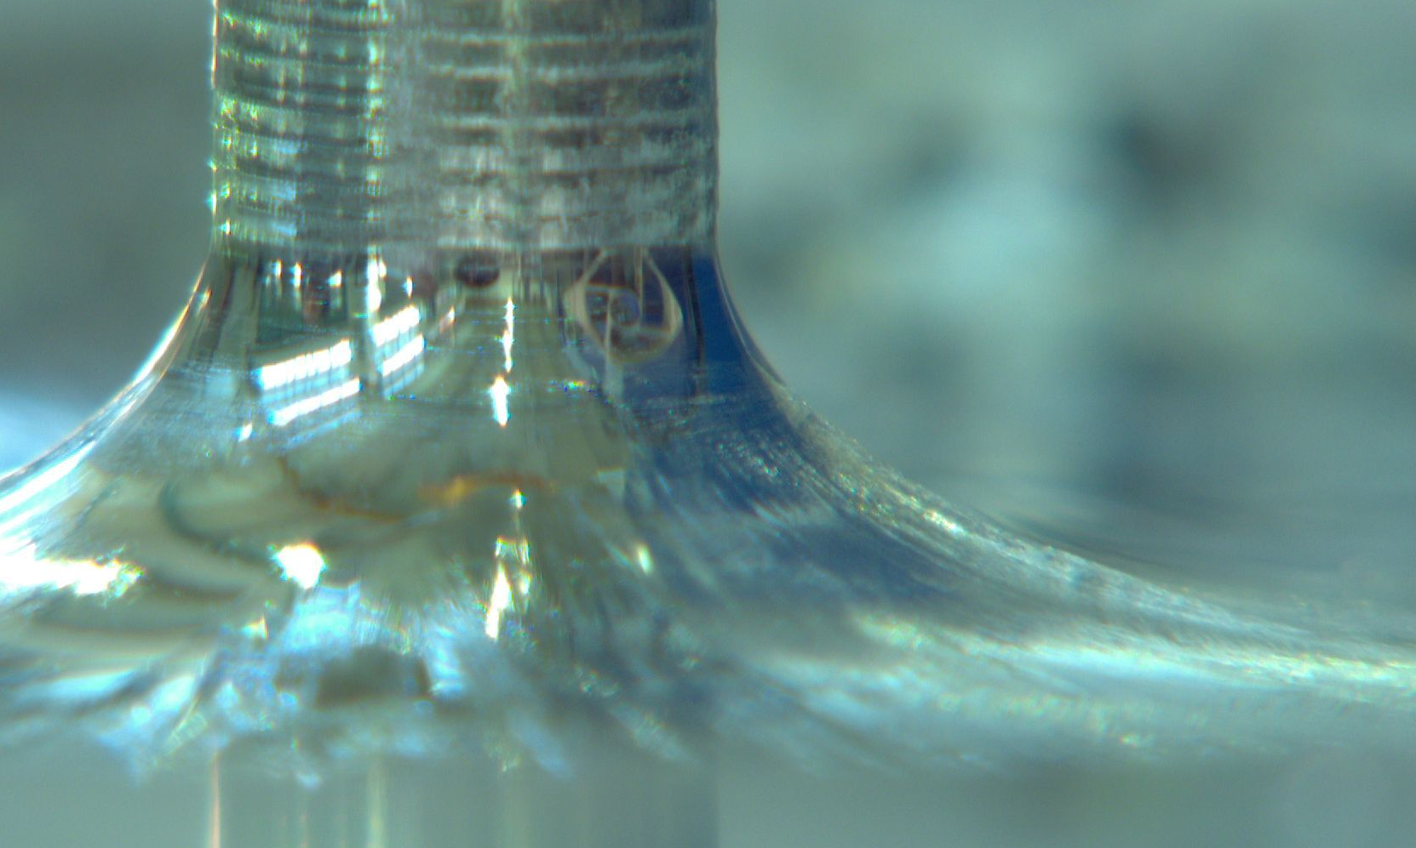
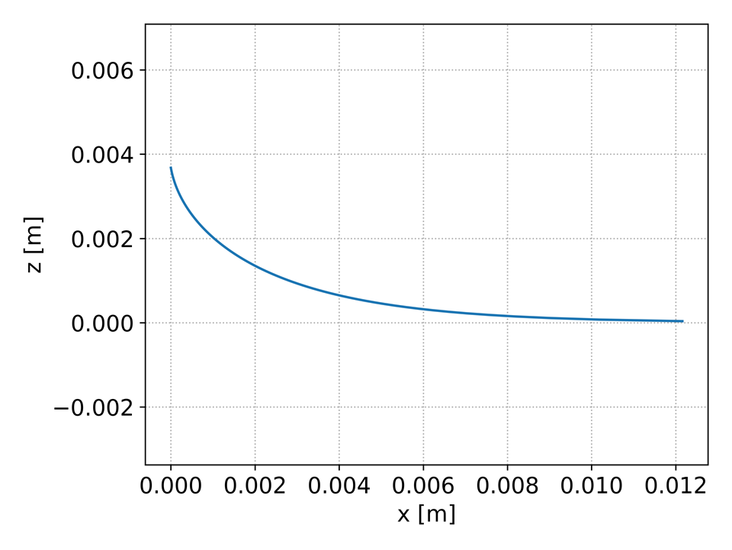
r₂
β = 10°
h
z
x
r₁

Slide 2
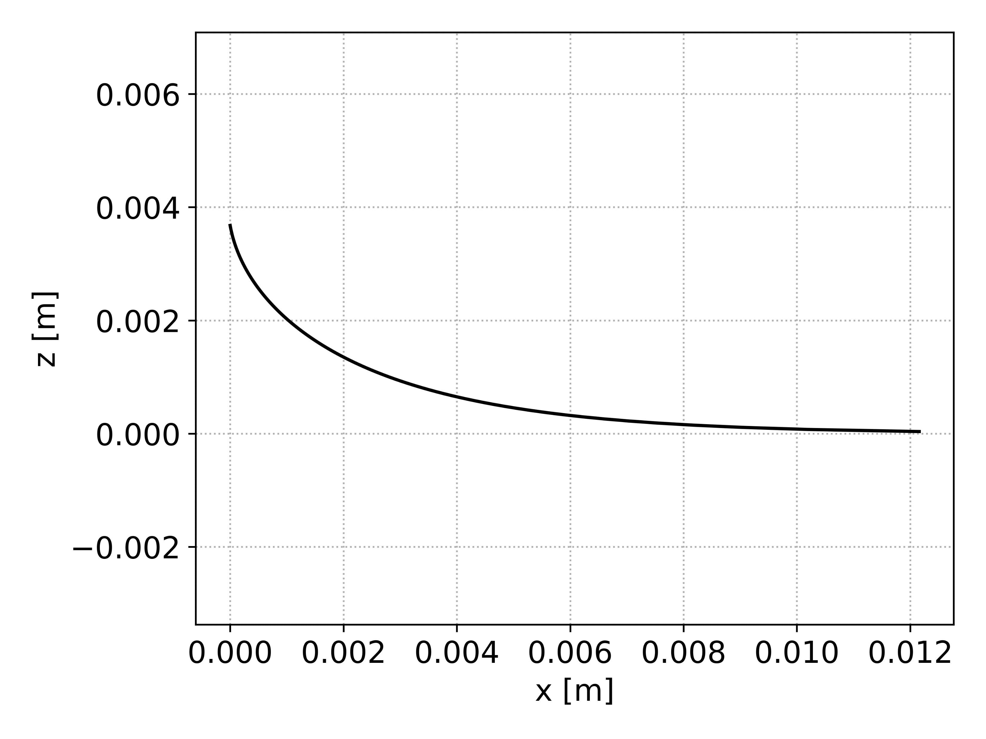
r₂
β = 10°
h
z
x
r₁

Slide 3
r₂
β = 10°
h
z
x
r₁

Slide 4
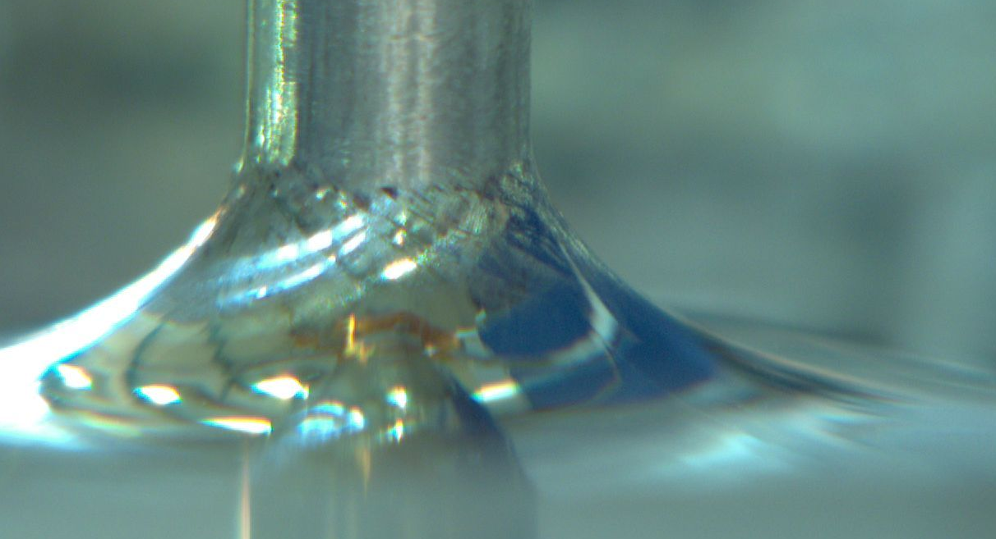
10°

